Slide 1
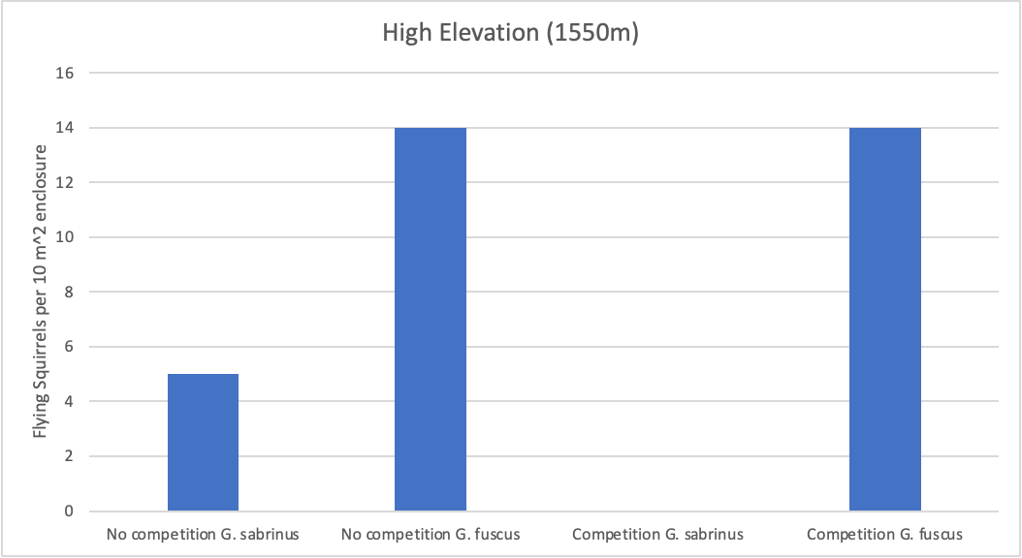
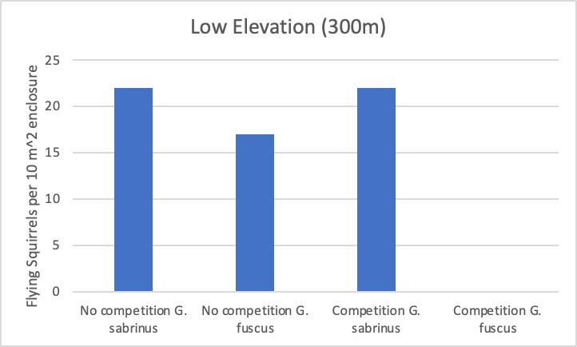
Does competition affect flying squirrel abundances at different elevations?
Competition experiments were done in high elevation zones (G. fuscus) and low elevation zones (G. sabrinus)
G. Sabrinus did not grow abundantly in the G. Fuscus zone with or without competition, while G. Fuscus grew well in both zones but not with competition G. Sabrinus zone.
The lower end of G. fuscus distribution appears to be limited by competition with G. sabrinus.
The higher end of the G. sabrinus distribution is not limited by competition with G. fuscus, but abiotic factors.
Morgan Zimmerman and Leila Melvin

