Slide 1
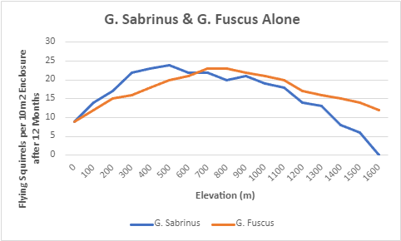
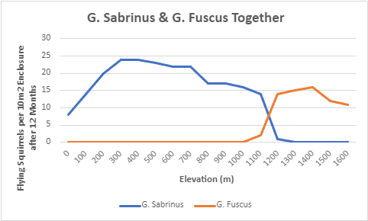
Competition between G. Sabrinus and G. Fuscus
John Zambito
Brandon Vargas-Torres
Isabella Interlicchio
Figure 1 :
Figure 1 demonstrates the Fundamental niche of each species alone (initial density of 10 squirrels per enclosure), while Figure 2 demonstrates the Realized niche of each species together (initial densities of 10 squirrels each) across elevations in 100m increments.
The fundamental and realized niches of each species are proven to be different, thus Competition is present between G. Sabrinus and G. Fuscus.
As seen in Figure 2, G. Sabrinus “wins” between 0m and 1000m (when G. Fuscus is driven to extinction), while G. Fuscus “wins” between 1300m and 1600m (when G. Sabrinus is driven to extinction).
As also seen in Figure 2, the two species Coexist between 1100m and 1200m, when neither species are driven to extinction.
Figure 2 :

