Slide 1
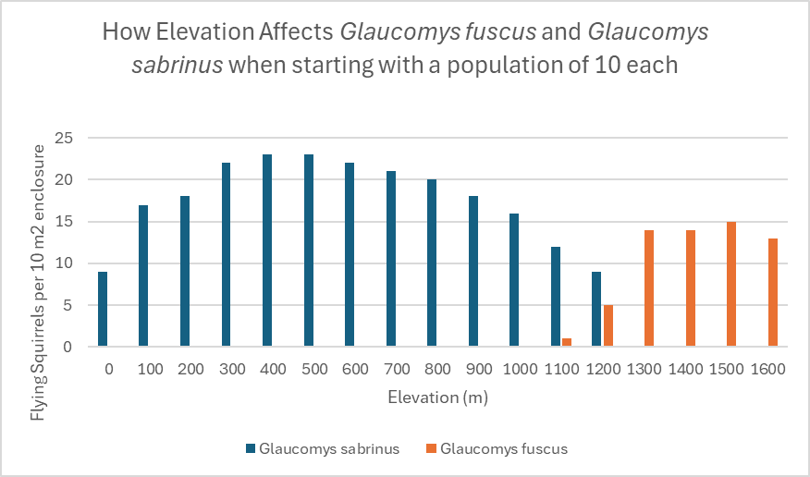
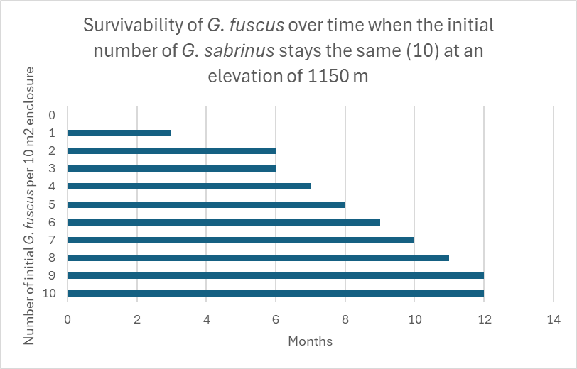
Competition Experiment Results:
Through our experiment the northern species, Glaucomys sabrinus, decreased due to the introduction of the southern species, Glaucomys fuscus, at elevations higher than 1200 meters and increased or remained stable at elevations lower than 1100 meters. See figure 1
Competition can be seen at all elevations, however at elevations lower than 1100 meters Glaucomys fuscus goes extinct throughout the course of a year (G. sabrinus “wins” in competition) while at elevations higher than 1200 meters Glaucomys sabrinus goes extinct throughout the course of a year (G. fuscus “wins” in competition). See figure 1
The two species seem to be able to coexist at an initial population size of 10 at elevations between 1100 and 1200 meters. See figure 1
When the Glaucomys fuscus population size is low compared to the population size of Glaucomys sabrinus the population is more likely to go extinct or close to extinction due to out-competition even in an elevation that previously showed stability of both populations; however, when the population size is high the Glaucomys fuscus population seems to have more individual survivability over longer periods of time than Glaucomys sabrinus. We found this by adjusting the initial densities of the Glaucomys fuscus populations (the immigrating species) at an elevation of 1150 meters (the center point between the fluctuation of overall species mortality) while leaving the Glaucomys sabrinus population at a stable size of 10. See figure 2
Figure 1
Group Members:
Sarah Ware, Kennedie Bollinger, Grace Carrion
Figure 2

