Slide 1
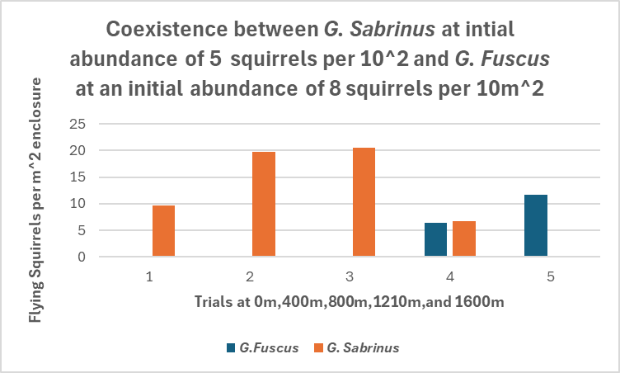
How does competition affect G. fuscus and G. sabrinus abundances at varying altitudes?
Joenah Tyler
Matthew Taylor
At the abundances presented, Coexistence only occurs at 1210m, which indicates that G. fuscus’s niche is higher elevation than G. sabrinus’, but coexistence is possible at the intersection. (Table 1)
Competition does occur between the species which is why at the niche overlap (1210m) squirrel densities are diminished except for when one wins competition (trials 4 & 5, table 2)
Coexistence at 1210m appears to be unstable, since it can be driven to either species’ extinction by stochasticity, so in the long run coexistence may be impossible.
G. Sabrinus is a better competitor at most elevations

