Slide 1
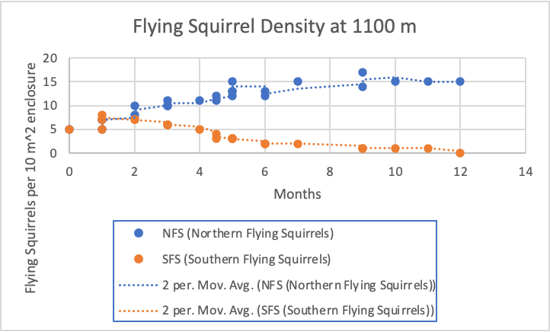
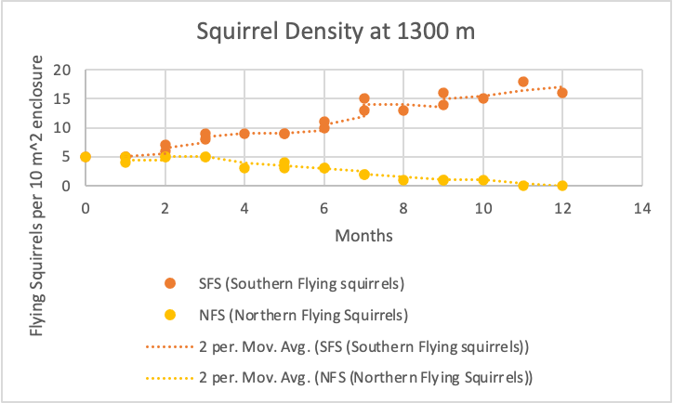
Elijah Trevino
Kevin Tran
3/19/2024
At an elevation of 1300 meters or more the southern flying squirrels do not experience much competition when compared to the results at 1200 meters due to the environment suiting them instead of the northern squirrels.
At an elevation of 1200 meters the northern and southern squirrels experience competition while coexisting throughout the entire 12 months of the study.
At an elevation of 1100 meters or less the northern squirrels experience less competition than at 1200 meters due to the environment suiting them instead of the southern squirrels.
Even though there is competition at each altitude the intensity of the competition between both species vary depending on the altitude.

