Slide 1
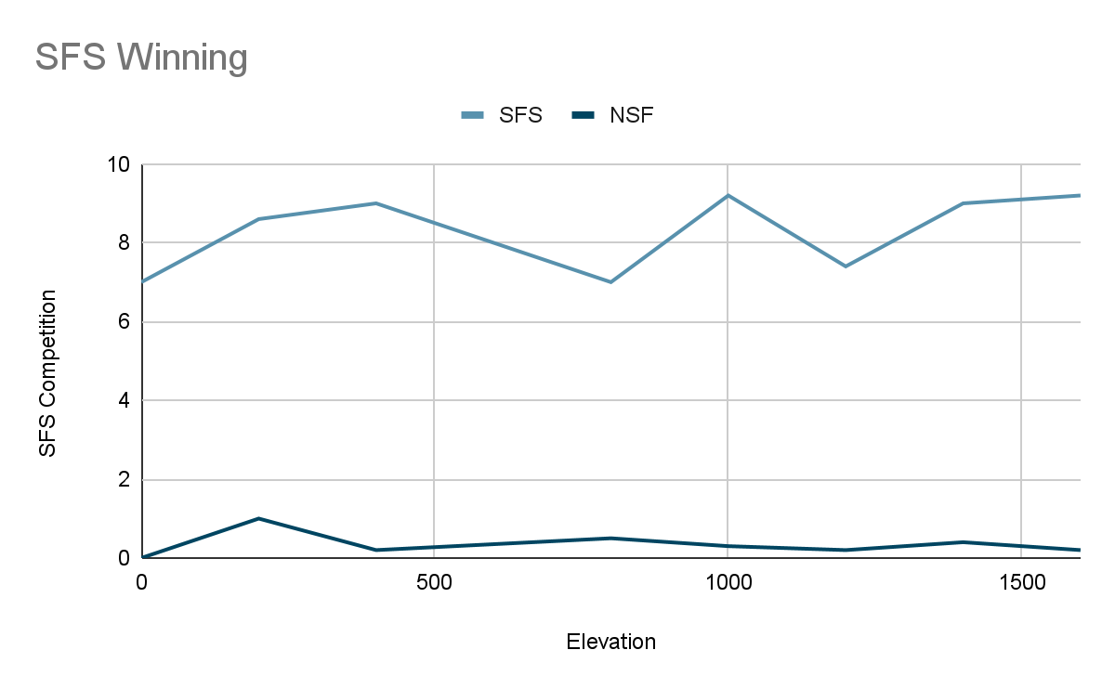
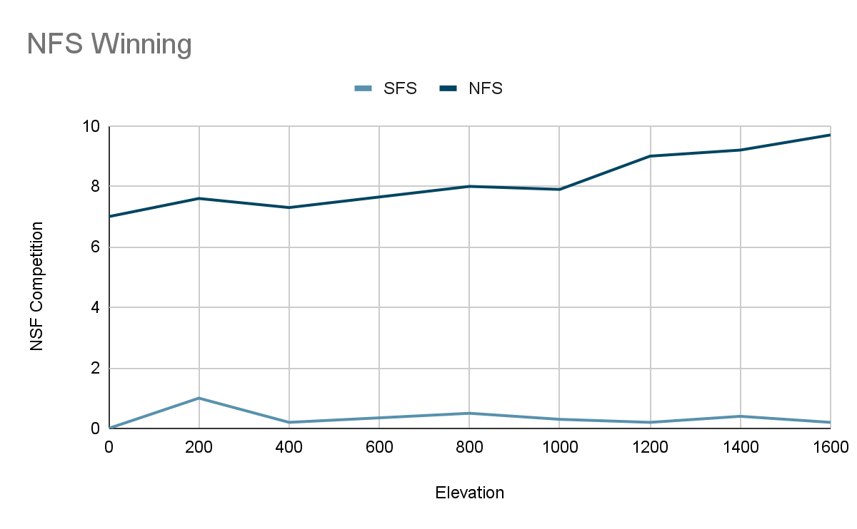
Bria Toussaint & Tequanda Jackson
Yes there is competition, we know this because when we change the elevation and set either the SFS or NFS to zero, we can see that one species will dominate the other.
The NFS wins at higher elevations because of adaptations to the cooler temperatures and they lose at lower elevations because it is too warm
The SFS wins at lower elevations due to preference of warmer temperatures and they lose at higher elevations because it is too cold and limits on resources
The species coexist in areas that are suitable for both temperature preferences and where there is reduced competition

