Slide 1
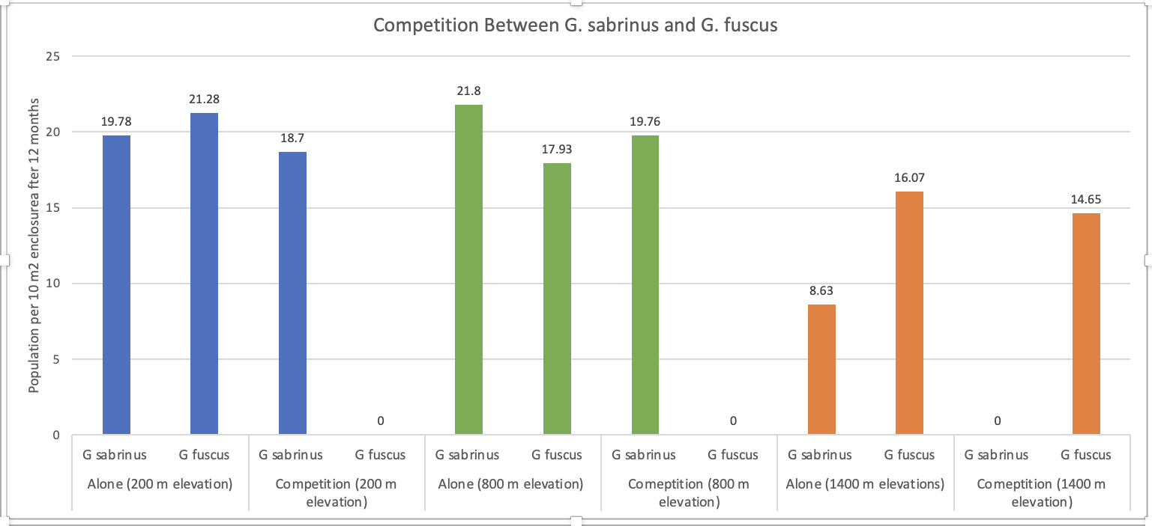
Lauren Scott, Jake Pursell, Tyler Olby, Freddy Raftis
After 12 months, G. fuscus grows to the highest population when grown alone and at low elevations (200 m) whereas G. sabrinus grows to the highest population when grown alone and at an intermediate elevation (800 m).
When the two species are grown together with the same initial poulation, G. sabrinus does better in low (200 m) and intermediate (800 m) elevations, whereas G. fuscus at high elevations (1400 m) after a 12 month period.
The two above bullet points indicate there is competition between the two species at all elevations, and there is unstable coexistence.
In a 12 month time period, G. sabrinus “wins” competition at low (200 m) and intermediate (800 m) elevations, and G. fuscus “wins” competition at high (1400 m) elevations.

