Slide 1
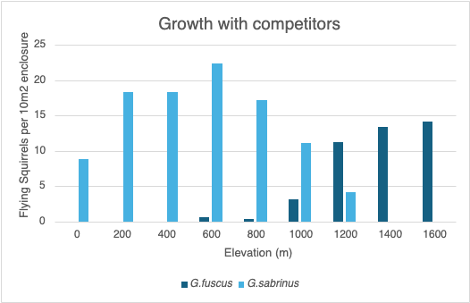
Ecology Assignment 3- Species Interactions
Conditions:
G. sabrinus= 5
G. fuscus= 5
Elevation (m)= 1600
Without competition G. fuscus and G. sabrinus both grew well throughout the elevation zones, G. sabrinus preferring slightly lower elevation compared to G. fuscus who seemed to thrive better in the higher elevation.
The species display competition showing no co-existing of the two species in the competitor graph, always having one species succeeding over the other.
The lower elevation of the competitor graph G. fuscus distribution appears to be limited by competition with G. sabrinus, G. fusucs loses to G. sabrinus around elevation (0-1000m).
The higher elevation of the competitor graph G. sabrinus distribution appears to be limited by competition with G. fuscus, G. sabrinus loses to G. fuscus around elevation (1200-1600), this can perhaps be due to abiotic factors shown in the no competitor graph where G. fusucs had a higher tolerance for higher elevation.
Valery Sastoque, Melanie Gimenez

