Slide 1
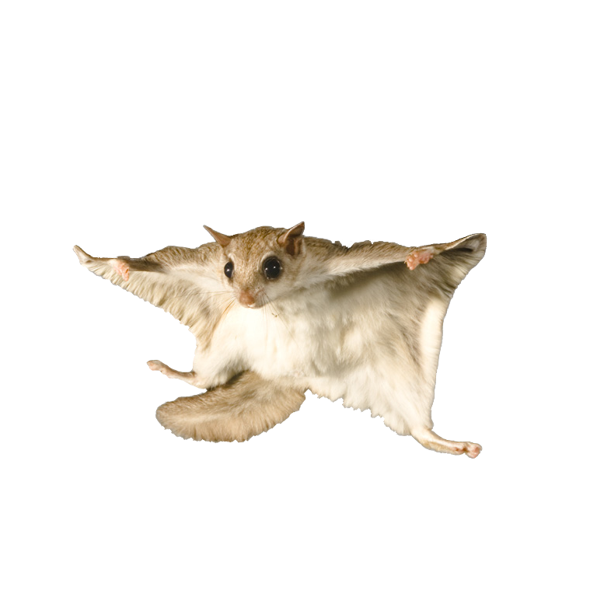
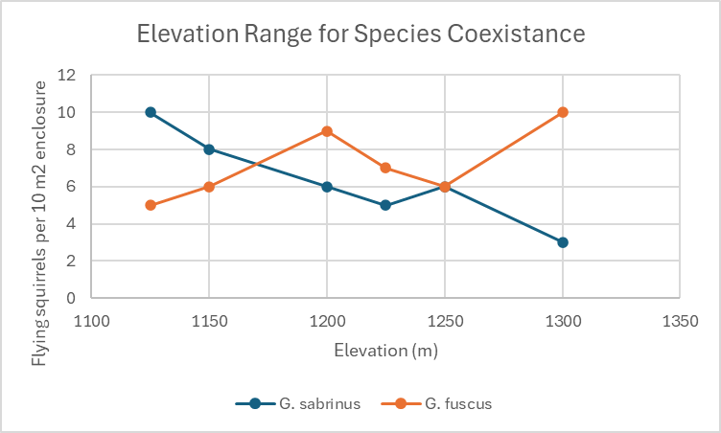
Yes there is competition between the two species and the range of coexistence is from 1125 m to 1300 m.
We manipulated the program to examine competition at different elevation and population number.
At lower elevation both survive when alone but G. sabrinus was found to compete better at lower elevation (Left graph at 500(m)).
At higher elevation both survive when alone but G. fuscus was found to compete better at higher elevation (Right graph at 1450(m)).
Alissa Roland, Riley Massey, Collin Carlson, Lydia Arrieta

