Slide 1
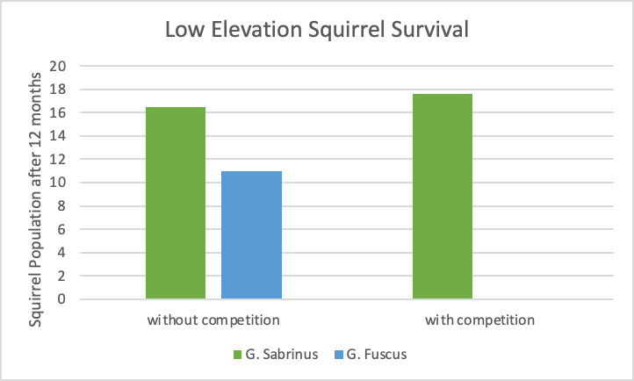
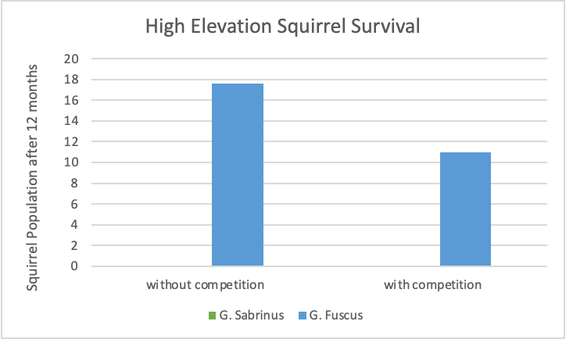
There is competition because at low elevation, both species of squirrels will survive if the other is not present however, if both species are present at low elevation, then only G. sabrinus will survive.
G. sabrinus dominates the lower elevation from around 0-1000m when both species are present.
A coexistence can be seen when at a medium to high elevation (around 1100-1200m), where both species are able to survive with each other.
G. fuscus dominates the higher elevation from around 1300-1600m when both species are present.
Andrew Pike, Sheev Govind, Kaipo Puahala, Joelle Lanoue, Sammie Hadley

