Slide 1
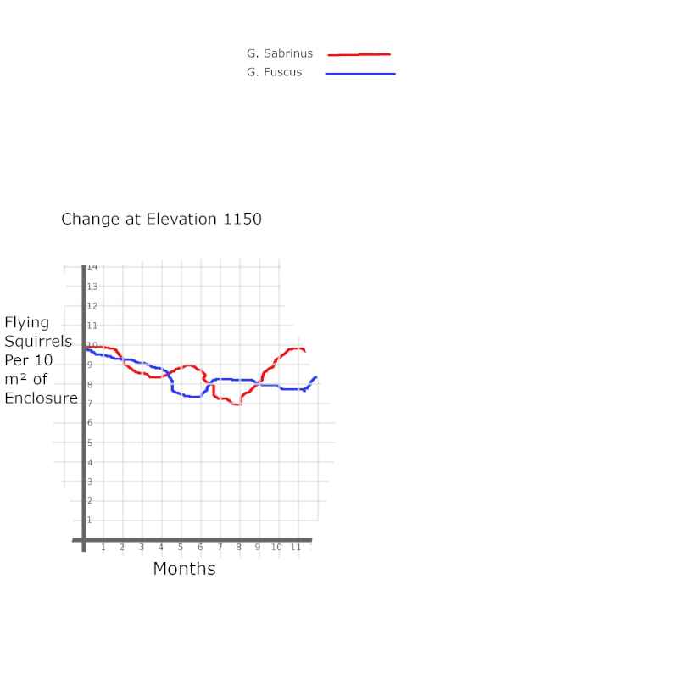
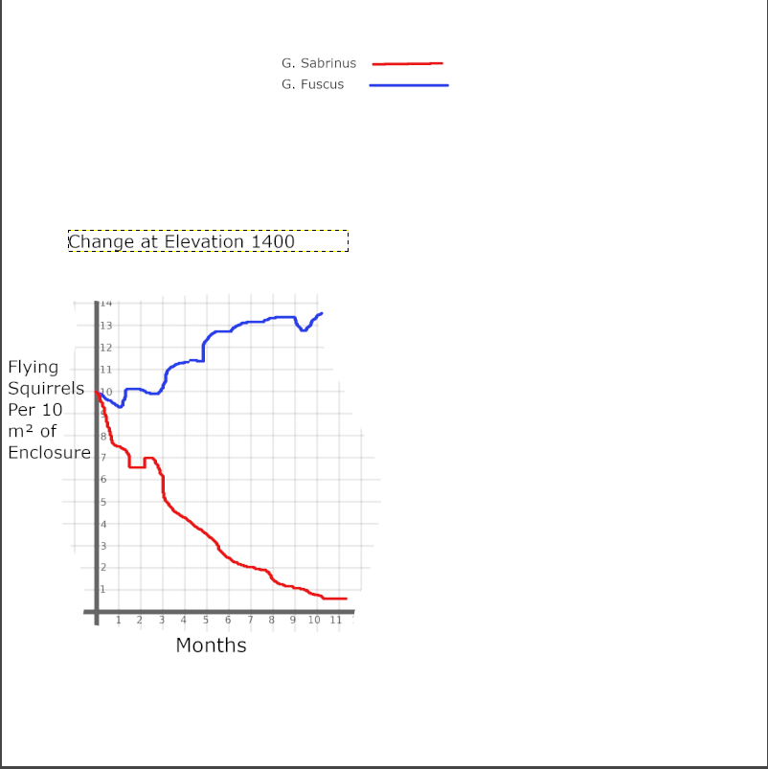
Assignment 3 (Rocky Pierrepont)
Fig. 2
At higher elevations G. Fuscus is more successful (fig. 1)
At lower elevations G. Sabrinus is more successful.
At an elevation of roughly 1140 there is a higher amount of competition between these two; however, G. Fuscus shows more success over time.
Overall, there is competition observed that is highly tied to the elevation of the enclosures
Fig. 1

