Slide 1
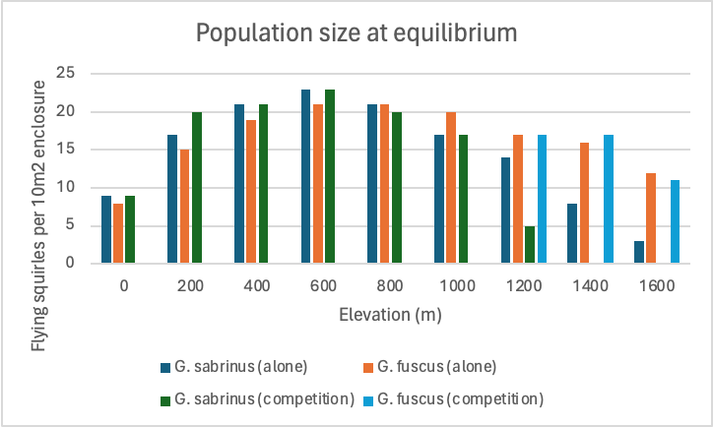
Group Members: Amayas Overstreet, Lauren Kim, Nicholas Franca, and Samantha Ortega​
Oscillations in species' population before the 12th month and stablizing population densities for each species at the 12th month suggest that there is interspecific competition between the two species, indicating indirect evidence of competition.
Competitive advantage shifts along the elevation gradient, with Glaucomys fuscus outcompeting Glaucomys sabrinus at higher elevations, possibly due to environmental factors favoring G. fuscus, while G. sabrinus dominates at lower elevations, reflecting habitat preferences or resource availability that benefit G. sabrinus in those areas.
The two species coexist within an elevational range of approximately 1100 meters, exhibiting stable population dynamics and niche overlap, indicating sympatric distribution and shared resource utilization within their ecological niche.
In this experiment the independent variable is the elevation, while the dependent variable is the population of the flying squirrels per 10 m2.
G. sabrinus = 4​
G. fuscus = 4​
Elevation (m) = 1100​
The G.sabrinas and G. fuscus were found to coexist at an altitude of 1100 m.
The carrying capacity was at 23 for both species at an elevation of 600m.

