Slide 1
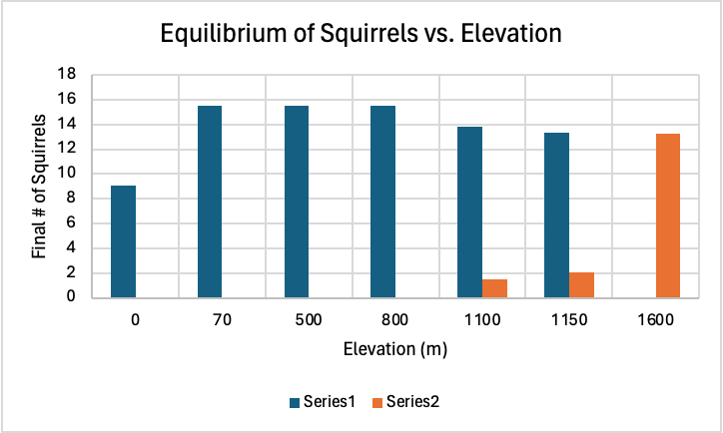
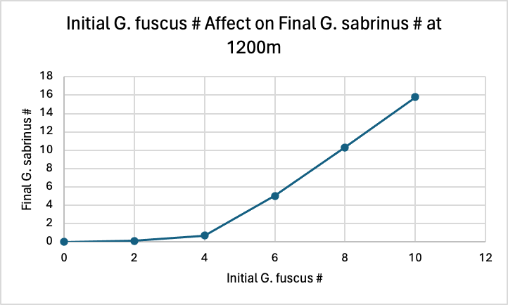
Competition Amongst Flying Squirrel Species
By: Briana Orbegoso, Grace Casper, and Lauren Dumas
We set up our competition experiment to find our fundamental niche of each species, by growing each species in allopatry, and also to find our realized niche, by growing the species together in sympatry.
We know that there is competition between the G. fuscus and G. sabrinus squirrel species because when each species exists without interaction from its competitor species they both thrive alone however, when they exist together, one species survives better than the other depending on the elevation.
When both species are kept at equal densities the region of coexistence exists most closely from 1100m - 1200m, meaning that both populations densities are relatively the same, while at 1100m alone, the species are coexisting and increasing.
The G. fuscus species wins in competition at lower elevations ranging from 0 to 1150 m, while the G. sabrinus species wins in competition at higher elevations ranging from 1300 m to 1600 m.

