Slide 1
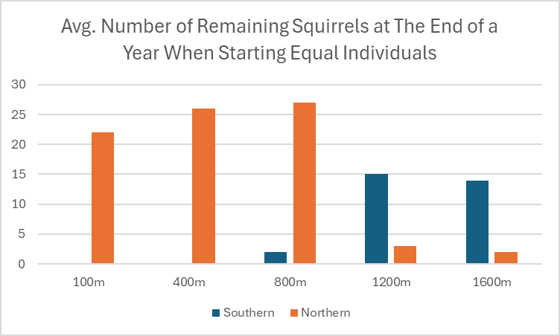
Northern vs Southern Flying Squirrels
by : Matthew Burns and Rhys Noda
There is competition between the northern and southern groups as the populations do not stabilize with one group always increasing and one either nearly or completely dying out when they begin with the same number of individuals.
The northern squirrels out compete the southern squirrels at lower elevations while the southern squirrels outcompete the northern squirrels at higher elevations when starting with the same amount of individuals.
Depending on elevation the two species can coexist when the initial size of the more suitable population is less than their counterparts.
When initial population for southern squirrels is double that of northern squirrels at 800m, the northern squirrels become outcompeted around 10 months.

