Slide 1
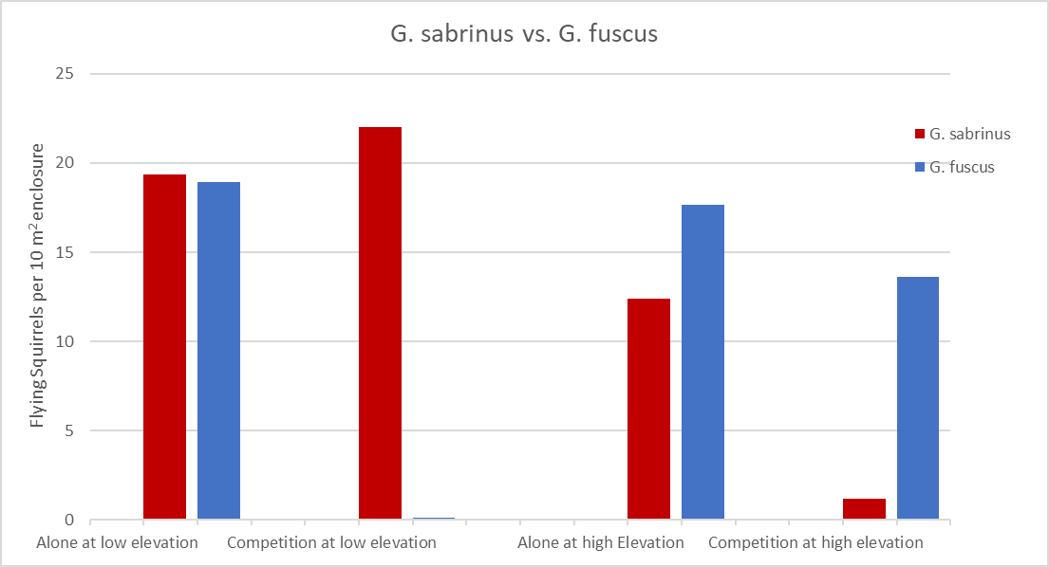
Does Competition Affect Flying Squirrel Abundancies at High and Low Elevations?
Yes, competition was demonstrated amongst flying squirrels as the G. fuscus moved North due to abiotic factors causing a decline of the G. sabrinus. Competition experiments were done using the standard elevations we set, a low elevation of 400 meters and high elevation of 1200 meters, with varying flying squirrel abundancies.
When in competition for territory with G. fuscus, G. sabrinus demonstrated a "win" with high numbers at the low elevation (400 m), while “losing” at the high elevation (1200 m).
When in competition for territory with G. Sabrinus, G. fuscus demonstrated a "win" with high numbers at the high elevation (1200 m), while “losing” by coming to complete extinction at a low elevation (400 m).
Both G. sabrinus and G. fuscus coexisted at an elevation of 1180 meters as both, G. sabrinus and G. fuscus, had equal densities.
Nelly Meza and Ava DuBois PCB3043 Assignment 3

