Slide 1
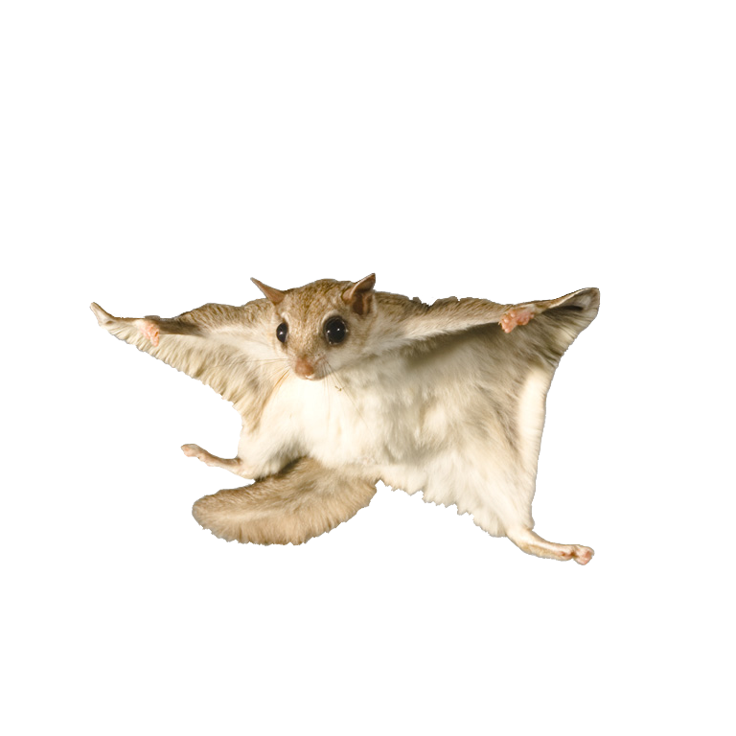
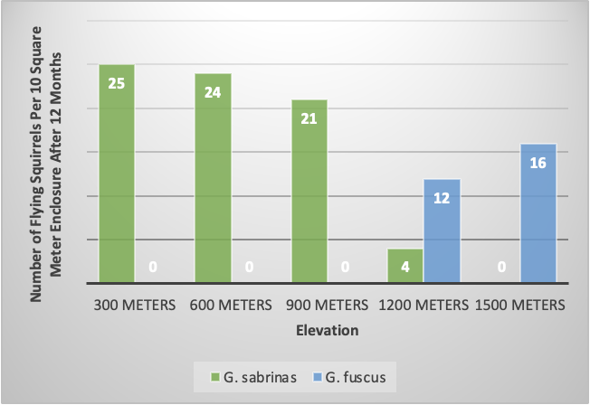
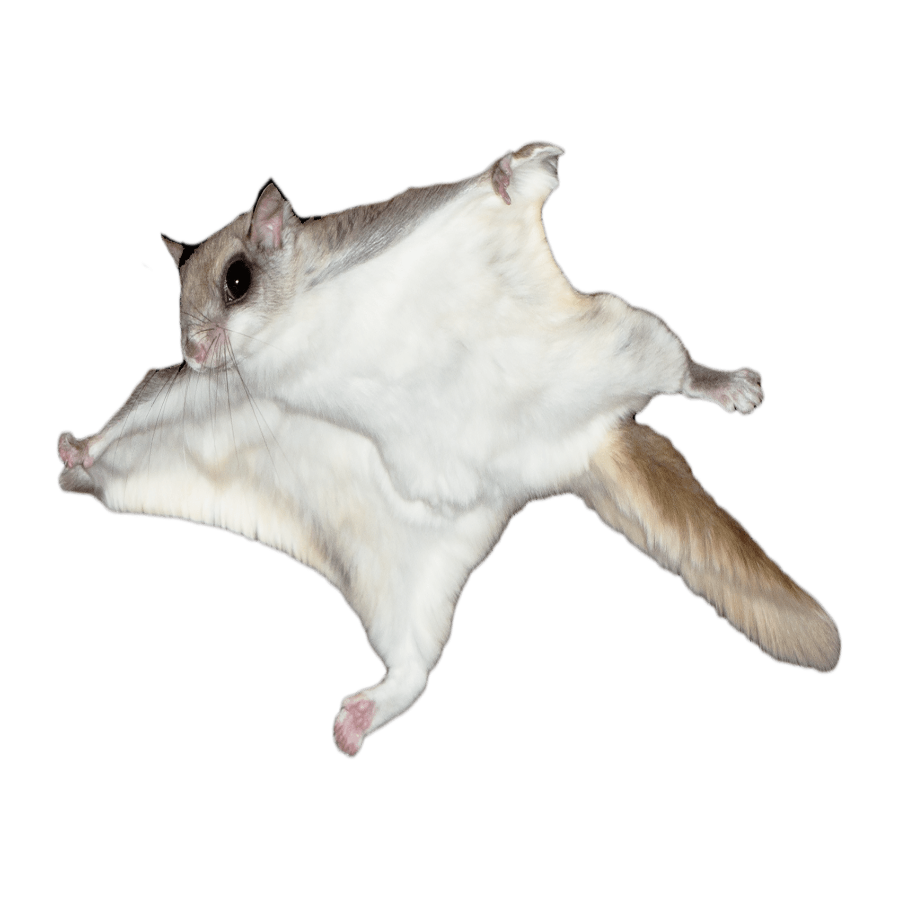
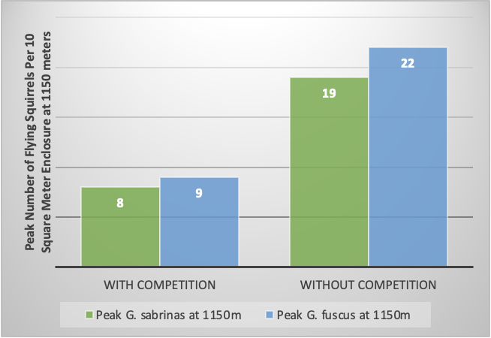
PCB 3043 Assignment III: Flying Squirrels - Joseph McLeod
There is competition between these two flying squirrel species because at any given elevation—assuming each of the flying squirrel enclosures contain the same initial number of Glaucomys fuscus and Glaucomys sabrinas—one species of flying squirrel will always out-survive the other.
With 10 of each flying squirrel species per 10m² enclosure at elevations of 1,100 meters and below, G. sabrinas outcompetes G. fuscus, and at elevations of 1,200 meters above sea level or more, G. fuscus outcompetes G. sabrinas, but at an elevation of 1,100-1,200 meters, the two species coexist.
Both species survive better without competition, but G. fuscus seems to outcompete G. sabrinas in overlapping territory—which is an elevation of 1,150 meters.
Both flying squirrel populations seem to have increasingly poor survival as they venture outside of their ideal elevation, implying they won’t often encounter each other in the wild unless they travel to a more extreme elevation (respective to the species’ ideal range) where both species have only an okay chance of survival.

