Slide 1
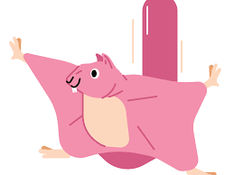
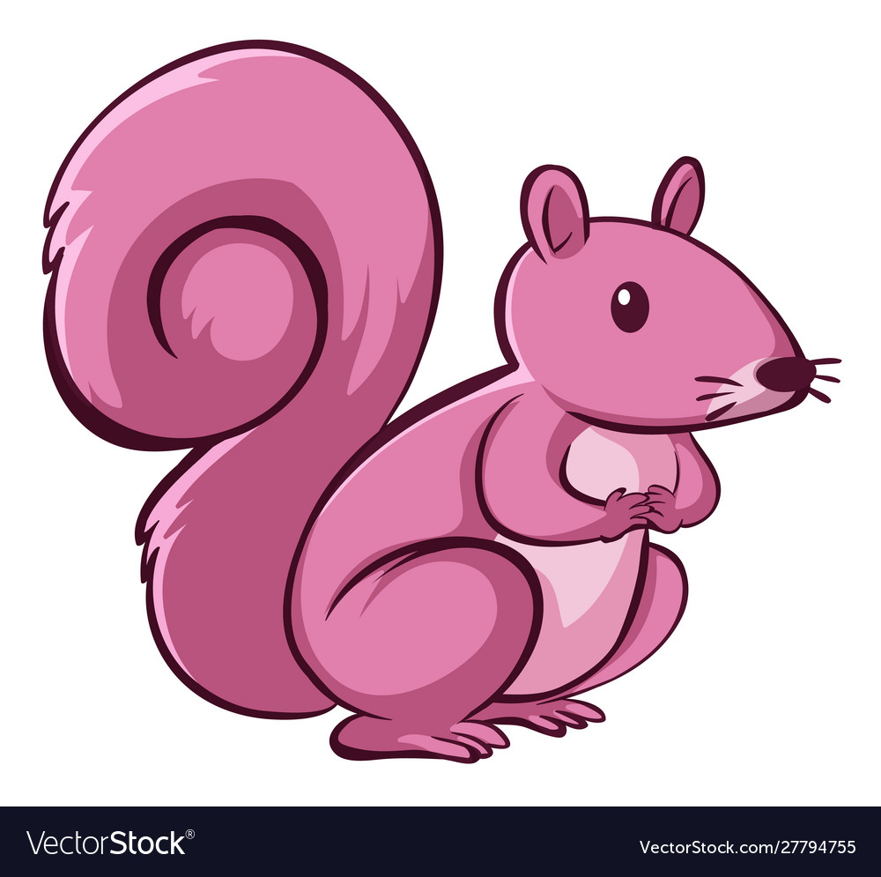
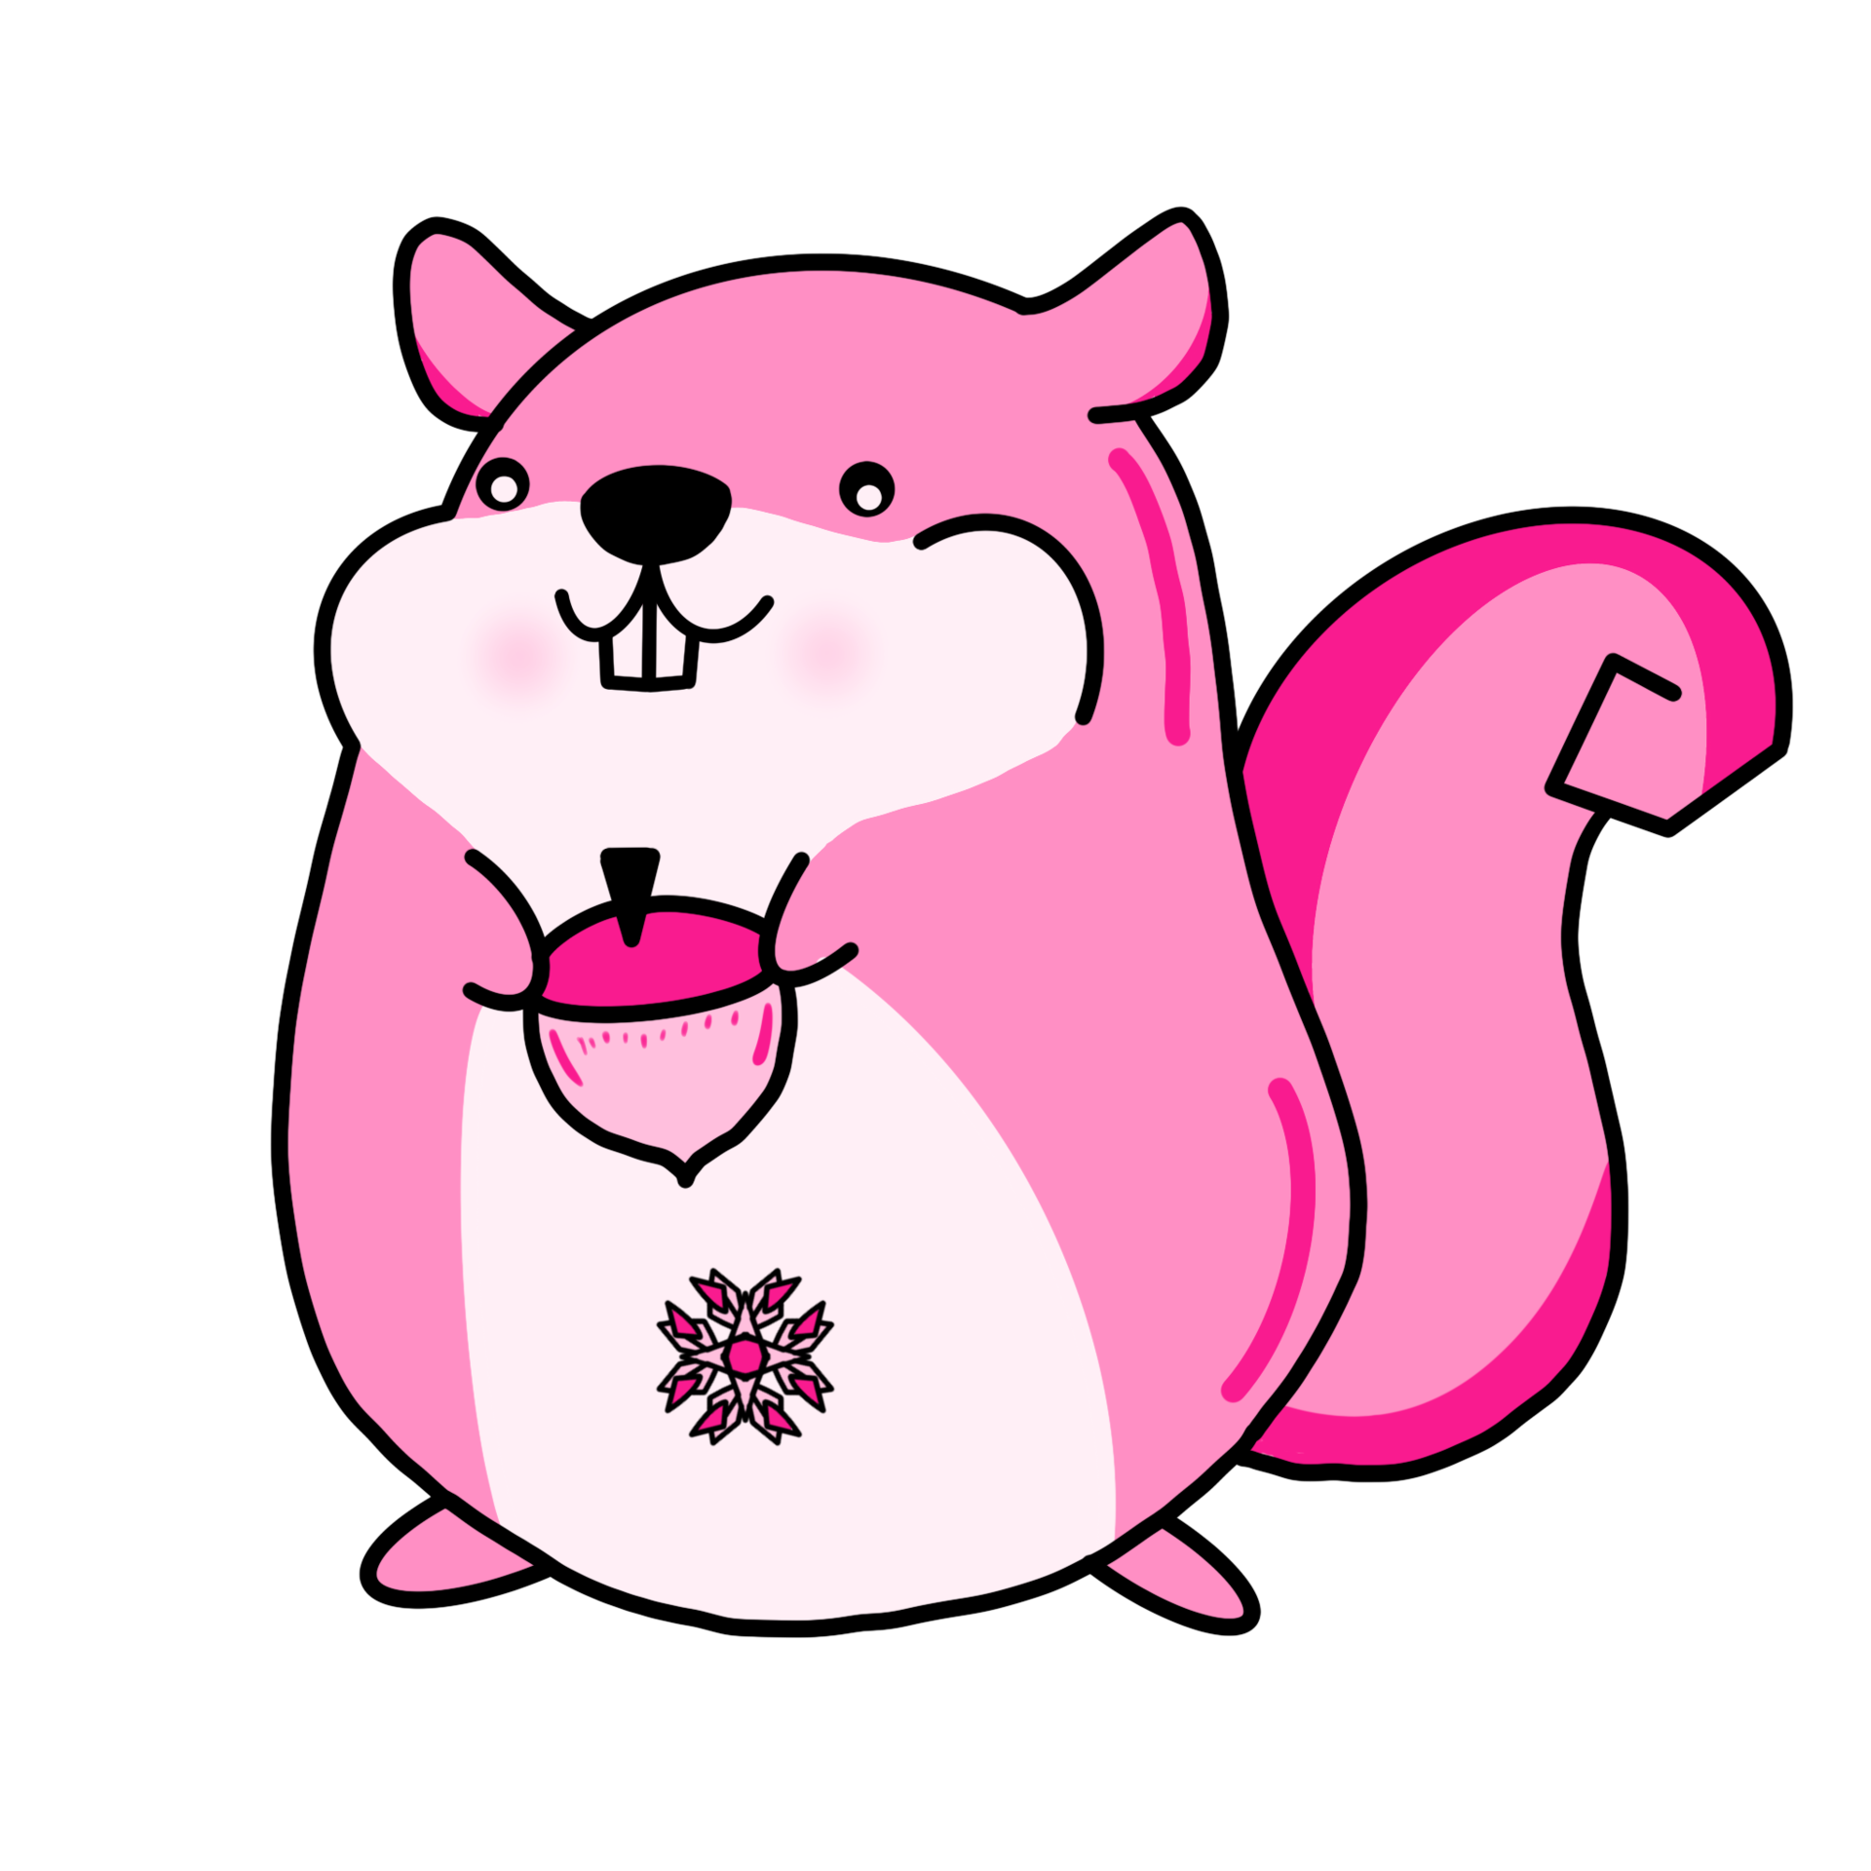
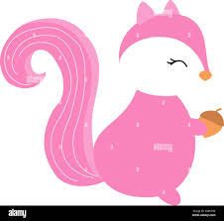
The data from the excel program indicates that there is competition between G. Fuscus and G. Sabrinus.
We know this because the two species can exist at all elevations, but, when the two are "grown together" they only coexist at 1100 and 1200 meters.
At, and below, 1100 meters G. Sabrinus outcompetes G. Fuscus
Above 1100 meters G. Fuscus outcompetes G. Sabrinus
Aaron Lawson
Rileigh Skinner

