Slide 1
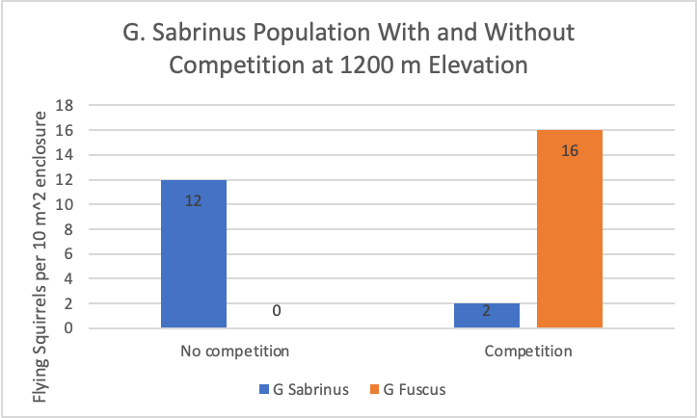
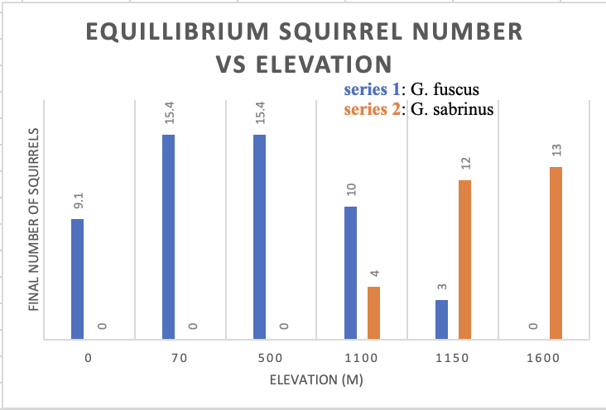
Species Interactions
There is competition between these two species of flying squirrels: Due to the presence of another species, both squirrel populations face reductions in their resource acquisition rates.
Using the first graph, when the G. Sabrinus population exists without G. Fuscus, we see that their population grows, but when G. Fuscus is added the G. Sabrinus population decreases significantly which demonstrates competition.
The species compete at an elevation of 1,100 m and 1,200 m, as seen in the graph below it is where the two species coexist, before G. Fuscus dies off.
G. Fuscus thrives at lower elevations, while G. Sabrinus thrives at higher elevations, and the closest they are to coexisting is between 1,100 and 1,200.
Abigail Lakich, McKinley Dvorak, Abigail Veitkus, Emma Abel

