Slide 1
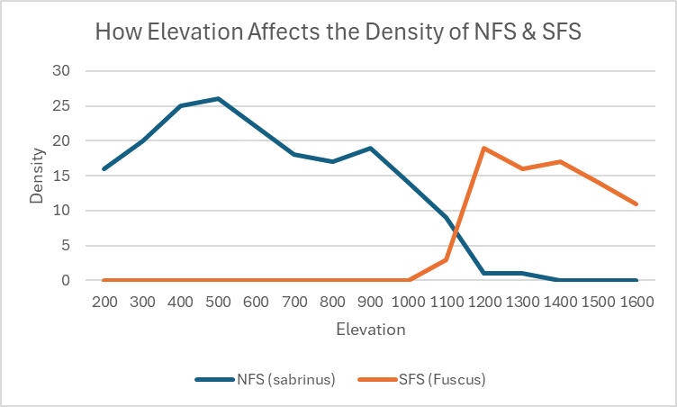
Jada Llerena Tadd Sembler
When the Southern Flying Squirrel (SFS) and Northern Flying Squirrel (NFS) have no competition, they will both be abundant at all elevations.
When SFS and NFS are both competing at elevations below 1000, the NFS species will be the better competitor.
When SFS and NFS are both competing at elevations higher than 1200, the SFS species will be the better competitor.
Both the SFS and NFS species can coexist at elevations from 1000-1200.

