Slide 1
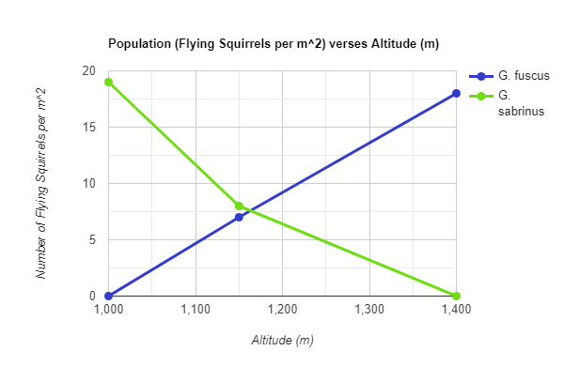
Ecology Assignment 3
Kallie Gutierrez
Arianna Coons
Questions:
When at an altitude of around 1400 m and a population ratio of 10 G. sabrinus to 0 G. fuscus, the G. sabrinus stays stable at a population of around 9 flying squirrels per 10 m², however, at a population ratio of 0 to 10 G. fuscus maintains an increasing population stretching into 18 flying squirrels per 10 m².
When at an altitude of around 1400 m and a population ratio of 10 G. sabrinus to 10 G. fuscus, all G. sabrinus die, thus, G. fuscus wins at a higher altitude and G. sabrinus loses.
When at an altitude of around 1000 m and a population ratio of 10 G. sabrinus to 10 G. fuscus, all G. fuscus die, thus, G. sabrinus wins at a lower altitude and G. fuscus loses.
When at an altitude of around 1150 m and a population ratio of 10 G. sabrinus to 10 G. fuscus, both species maintain stable populations at around 8 to 7 squirrels per 10 m² respectively, showing coexistence at that altitude.
Figure 1:

