Slide 1
Assignment 3
Flying Squirrel Analysis
Group members: Guadalupe Guerra, Ethan Simovitch

Slide 2
Experimental Design
For this experiment, we are observing how the migration of Southern Flying Squirrels (G. fuscus) into the northern hemisphere affects native Northern Flying Squirrel (G. sabrinus) populations. In doing so, we are observing for evidence of competition, possible displacement, and possible symbiosis between the two species at varying altitudes. In doing so, we would be able to analyze trends in population growth/decline by observing first the populations of the 2 species in absence of one another at varying altitudes as a control. Then, comparing these results with data from both species being present simultaneously at the same for the control altitudes tested.

Slide 3
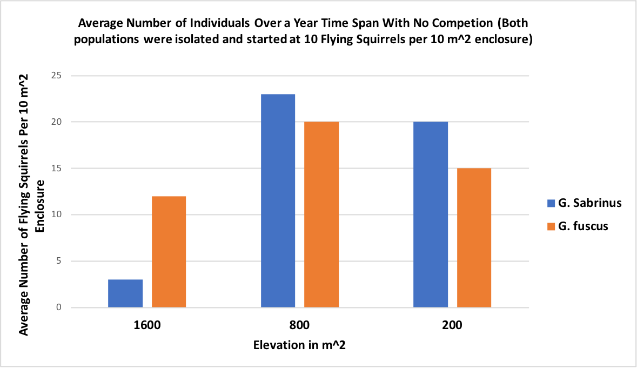
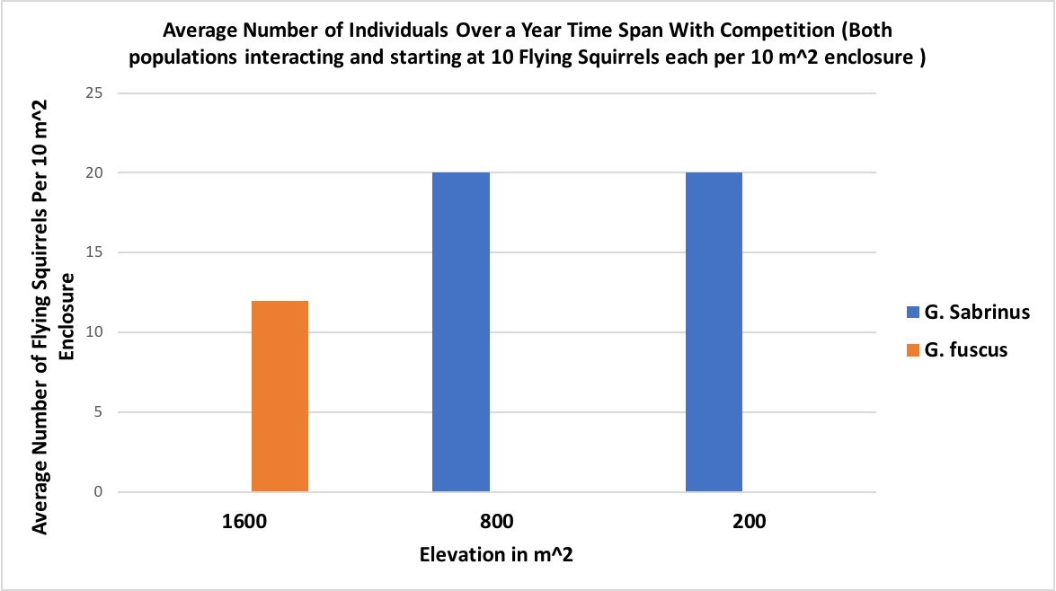
Competition Analysis Conclusions
By: Guadalupe Guerra and Ethan Simovitch
In isolated populations, Southern G. fuscus flying squirrels thrive in all elevations, but thrive the most in median elevations.
In isolated populations, Northern G. sabrinus thrives in only median/lower elevations showing positive population growth there only.
When both species are present, median/lower elevations are dominated in competition for resources by Northern G. sabrinus flying squirrels where higher elevations are dominated for resources by Southern G. fuscus.
Overall, with both species present, there is competition for resources at each elevation as one species population tends to drop to 0 over a 1 year period depending on the elevation, showing no coexistence.

