Slide 1
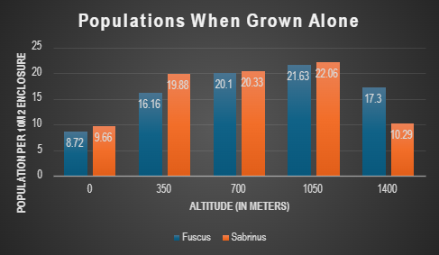
Joseph Gerretz and Maia Goldstone
Competition is observed at 1400 meters of elevation as each species survived when grown individually at that elevation, yet when grown together, G. fuscus outcompetes G. sabrinus, leading to the latter dying off by the end of a 12 month period.
Similarly, competition occurs for the rest of the observed elevations (0m, 350m, 700m, and 1050m), yet at these elevations G. Sabrinus outcompetes G. fuscus, leading to the latter species dying off by the end of a 12 month period.
Initial population density when grown alone as well as when grown together was 10 (i.e. 10 fuscus and 0 sabrinus; 10 sabrinus and 0 fuscus; and 10 fuscus and 10 sabrinus).
When observing the populations grown together at the various aforementioned altitudes, coexistence is not observed after a 12 month period, where the populations have reached equilibrium, rather one species in each altitude dies off.

