Slide 1
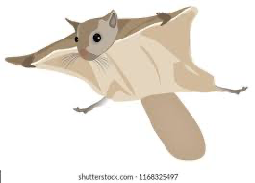
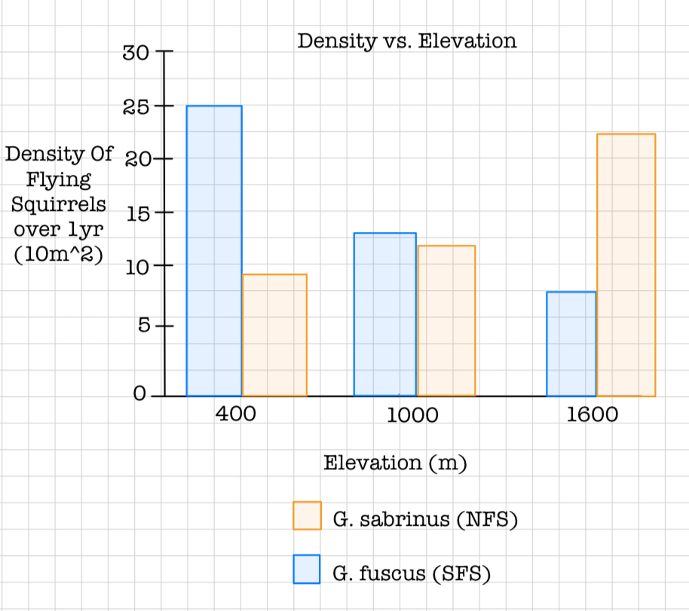
Probable Competition Between Glaucomys fuscus & Glaucomys sabrinus
Jade Garcia & Paola Melendez
There is competition between G. fuscus and G. sabrinus due to factors such as temperature, elevation, and resource availability.
Each enclosure had an initial density of 5 for both species furthermore, when elevation fluctuated there was a change in the densities of both species.
At an elevation of 1000 meters, competition was observed between the two species as density levels of the G.fucus began to decline and G.sabrinus rose.
The Glaucomys fuscus “won” at lower elevations and ”lost” at higher elevations, while the Glaucomys sabrinus “won” at higher elevations and “lost” at lower elevations, and they reached coexist in moderate elevations.
Fig1. Densities of G.fucus and G.sabrinus over a span of 1 year at varying altitudes.

