Slide 1
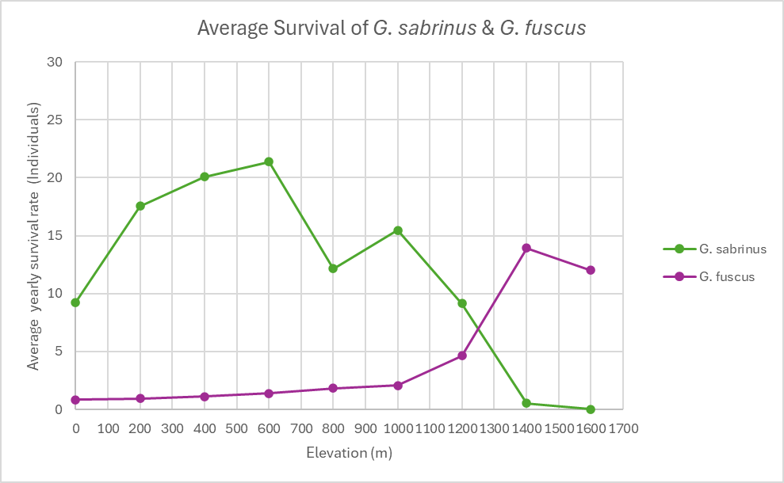
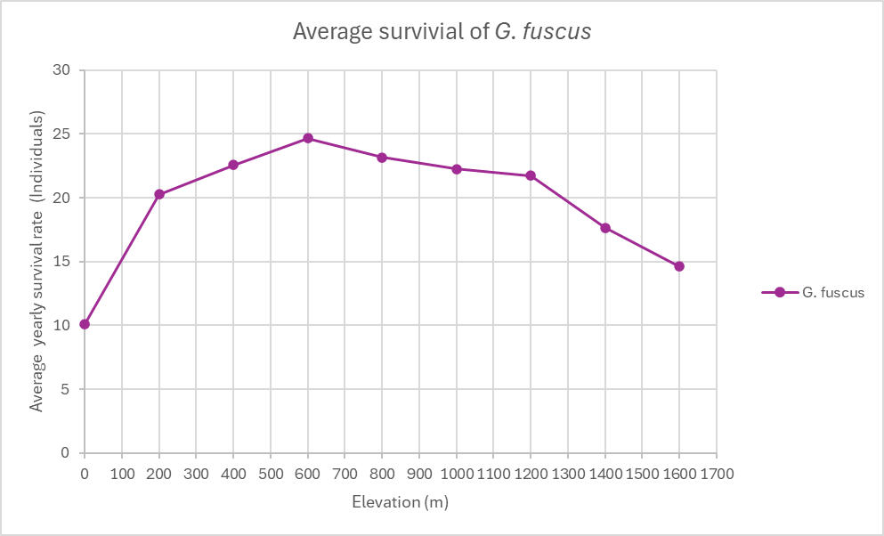
PCB3043 Assignment Three
Emily Fisher, Esa Petersen, Ganae Norman
Fig. 1: For both G. sabrinus and G. fuscus the initial population was maintained at 10 individuals. Averages were cal`culated by examining the number of individuals present at each month interval for each elevation.
G. sabrinus can not survive at elevations past 1475m and G. fuscus can not survive below 25m.
At elevation 1250m we can see where the two species are coexisting because this is where the graph is overlapping.
From elevation 0m to 1250m G. sabrinus is winning, and from elevation 1250m to 1600m G. fuscus species is winning.
We know that the two species are competing because when G. fuscus experiences incremental increases in elevation as the only species present it has a higher rate of survival than when the G. sabrinus is present under the same conditions.
Fig. 2: For G. fuscus the initial population was maintained at 10 individuals and G. Sabrinus set to 0. Averages were calculated by examining the number of individuals present at each month interval for each elevation.

