Slide 1
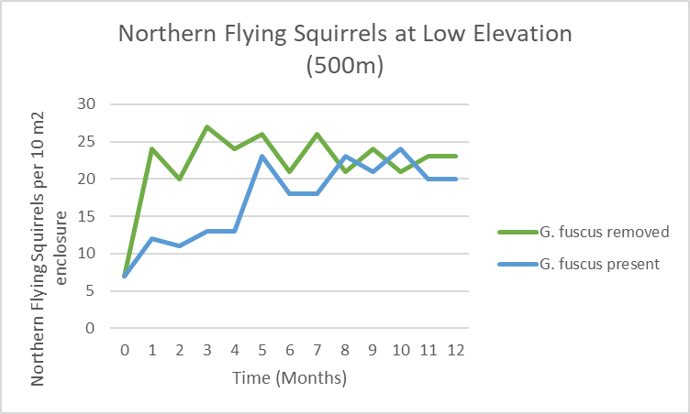
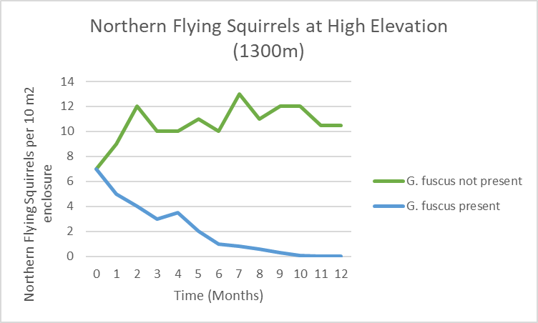
PCB 3043 Assignment 3 by: Valerie Escobar, Andrew Storms, Kyle Lee
Questions:
1.) There is interspecific competition between the two species of flying squirrels because they share the limited resource of mountain side elevation. Therefore, the realized niche for the Northern squirrels is smaller at higher elevations due to both species inhabiting the same area as the Southern squirrels move up in elevation.
2.) At lower elevations, the northern flying squirrels, G. sabrinus, survive and win in competition at this elevation, or realized niche, while the southern flying squirrels, G. fuscus, go extinct after the first few months.
3.) At higher elevations of around 1200-1300 m, G. fuscus survive and push G. sabrinus out of this realized niche to extinction.
4.) The two species co-exist in elevations around 1100 m- 1200 m, where they both survive and are not driven to extinction.
1

