Slide 1
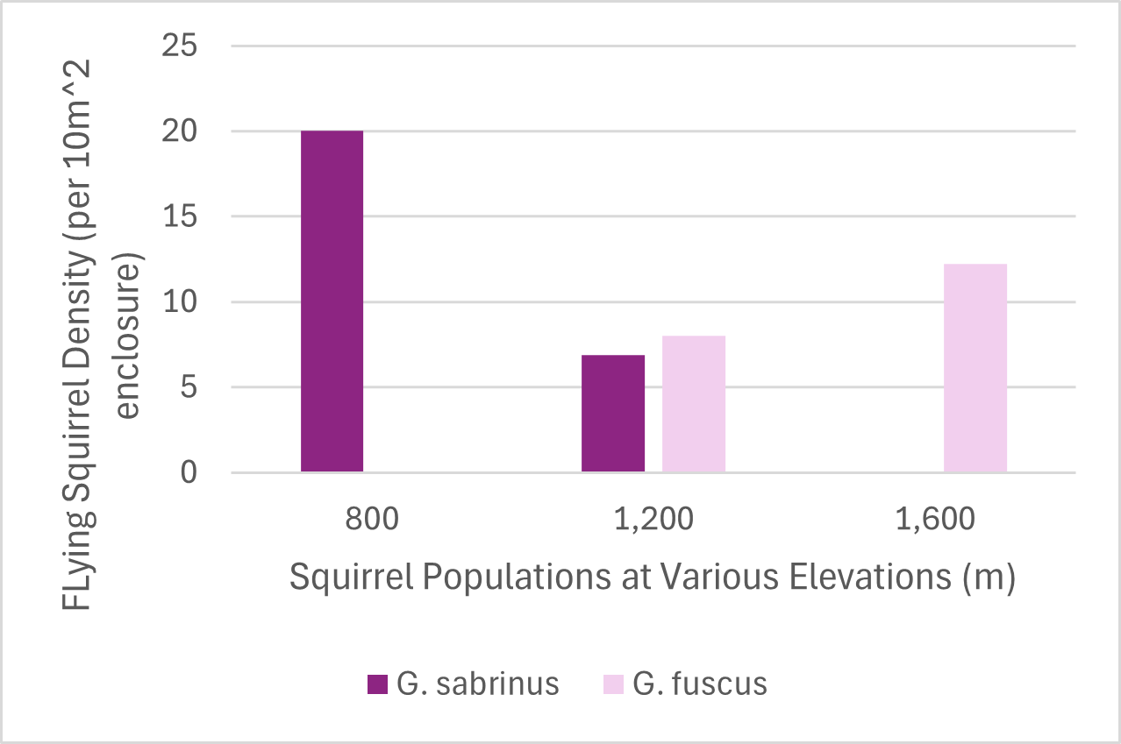
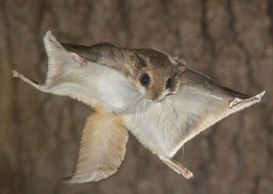
Assignment 3 Brentley Durham, Paige Flood, Abbe Kiritsy, and Sonali Shakya
There is competition between the two species, which is exhibited by the changes in elevation preference when only one species is present versus when both species are present.
Coexistence can occur at elevations of about 1200 meters when the squirrel populations have the same density; however, elevations below that have a prevalence of G. sabrinus and elevations above that have a prevalence of G. fuscus.
At elevations above and below 1200 meters, the less fit flying squirrel species exist at very low densities.
The reason behind these results could be because G. fuscus is better fit for survival at higher elevations than G. sabrinus and G. sabrinus is likely a better competitor at lower elevations.

