Slide 1
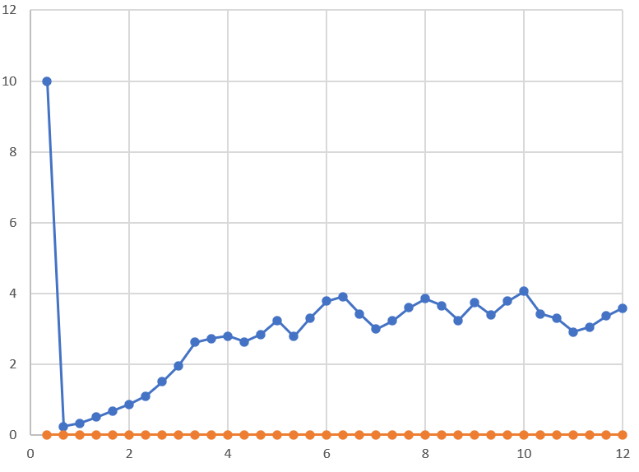
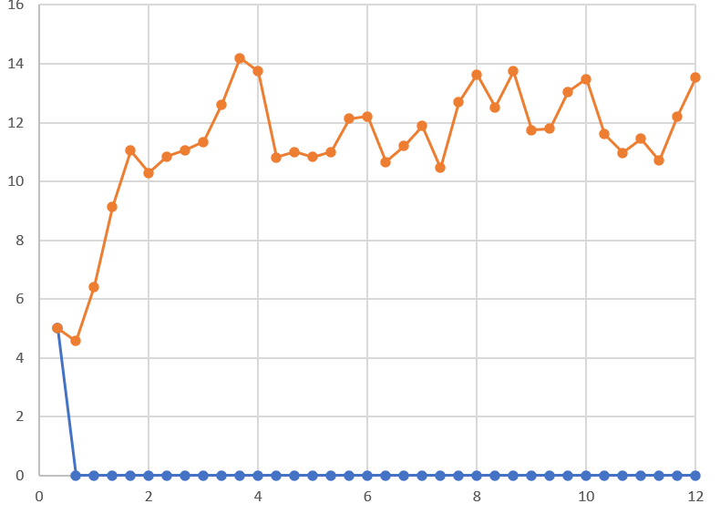
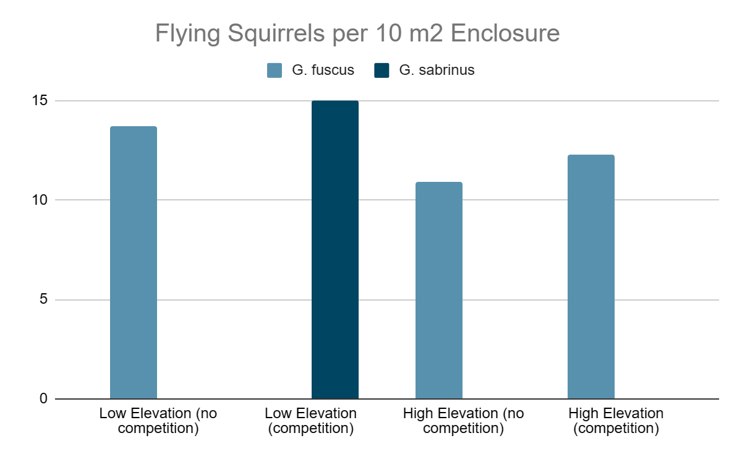
Elevation-Induced Interactions between Glaucomys sabrinus and G. fuscus
With any initial density ≥1, G. sabrinus always wins at low elevations (~100m) after 12 months in competition while G. fuscus always wins at high elevations (~1600m) in competition.
Averaging a few tests of intermediate elevations (~1100m), one species always wins, but overall, both species win relatively equally. Hence, this could signify unstable coexistence as one species always displays a trend towards extinction.
When in competition at 1600m, NFS become outcompeted by SFS and become near-extinct immediately due.
The upper boundary of both G. fuscus and G. sabrinus appear to limited by something other than competition (i.e. predation, habitat availability) as when one species wins, the other is either at a very low density or is extinct.
G. sabrinus without competition at high elevations
G. sabrinus with competition at high elevation

