Slide 1
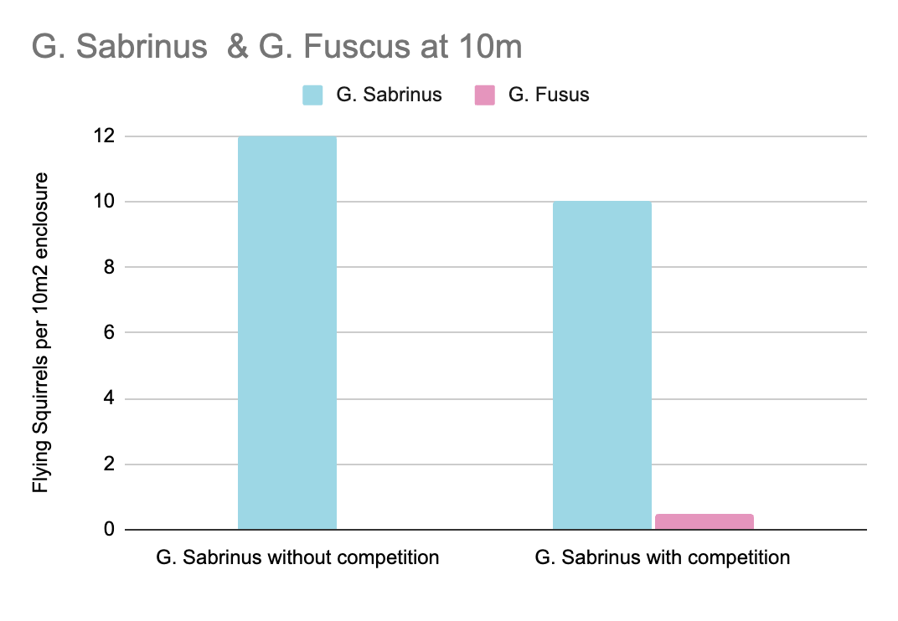
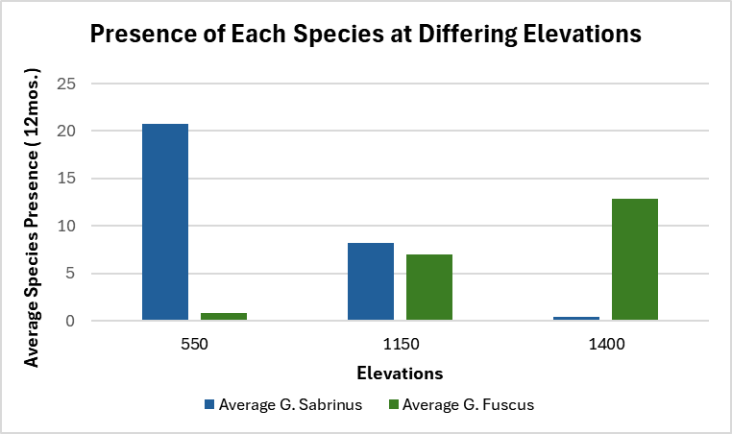
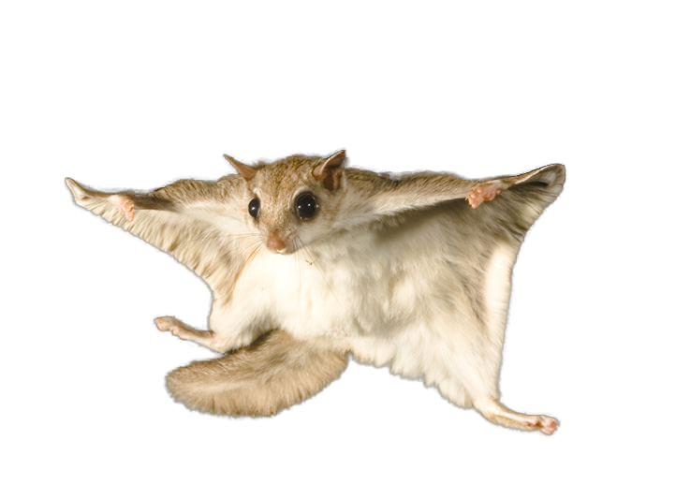
Is There Competition Between Glaucomys Fuscus and Glaucomys Sabrinus?
Competition experiments were done in varying elevations between Glaucomys fuscus and Glaucomys sabrinus.
We saw that Glaucomys sabrinus grew well with or without competition at 800 meters or less.
The two species coexist well at an elevation of 1,150.
Glaucomys sabrinus thrive at all elevations 1,100 and below, Glaucomys fuscus out compete at 1,200 and above.
By: Katie Cauthen &
Olivia Davis

