Slide 1
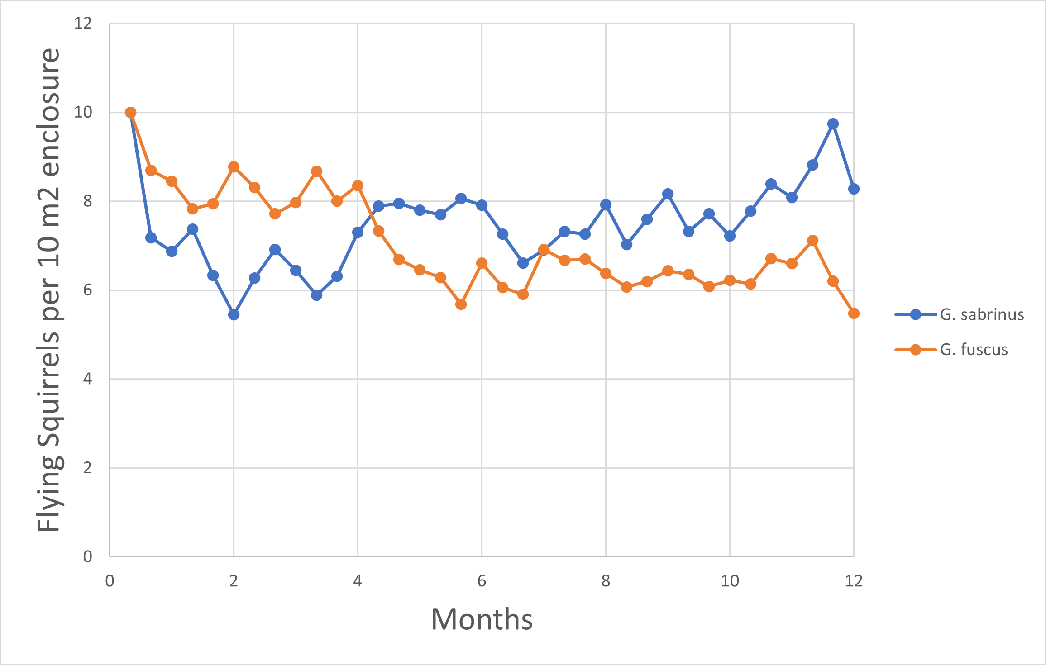
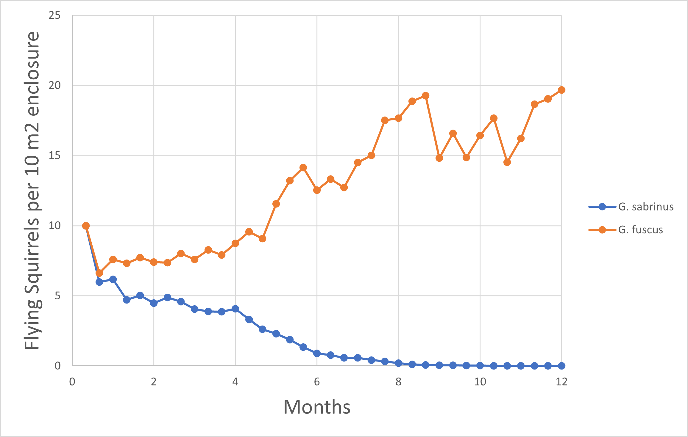
Assignment 3- Interactions between Glaucomys sabrinus and Glaucomys fuscus
Vanja Carlsson
Paul Engel-Penaloza
Timothy King
Our group found that yes, there is competition between the G. sabrinus and the G. fuscus species.
We found that there is competition because either species can survive on their own at any given elevation, but if the other species is introduced, one of the two will go extinct depending on the elevation they are at.
We found that these species will compete above an elevation of 1200m, where G. fuscus will always win out the competition, and also at an elevation below 1100m, where G. sabrinus will be the species that survives.
It was found that the two species can successfully coexist at any elevation between 1100m and 1200m, as neither species will go extinct.

