Slide 1
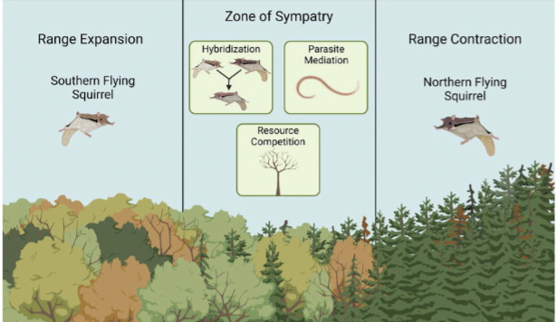
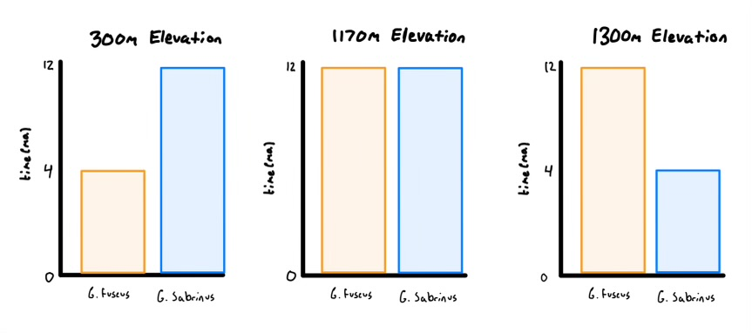
There is competition between the two species of flying squirrels because they are density dependent on each other as well as their environment.
At lower elevations(for example, 300 meters), G. sabrinus wins when each species starts at a population of 10 individuals.
At higher elevations(for example, 1300 meters), G. fuscus wins when each species starts at a population of 10 individuals.
We found that at 1170 meters, the two species coexist when each species starts at a population of 10 individuals.
Group Members:
Joey Campbell
Ethan Patel
Isabella Eaton

