Slide 1
Ecology: Assignment 3
Taylor Brown & Marissa Munroe

Slide 2
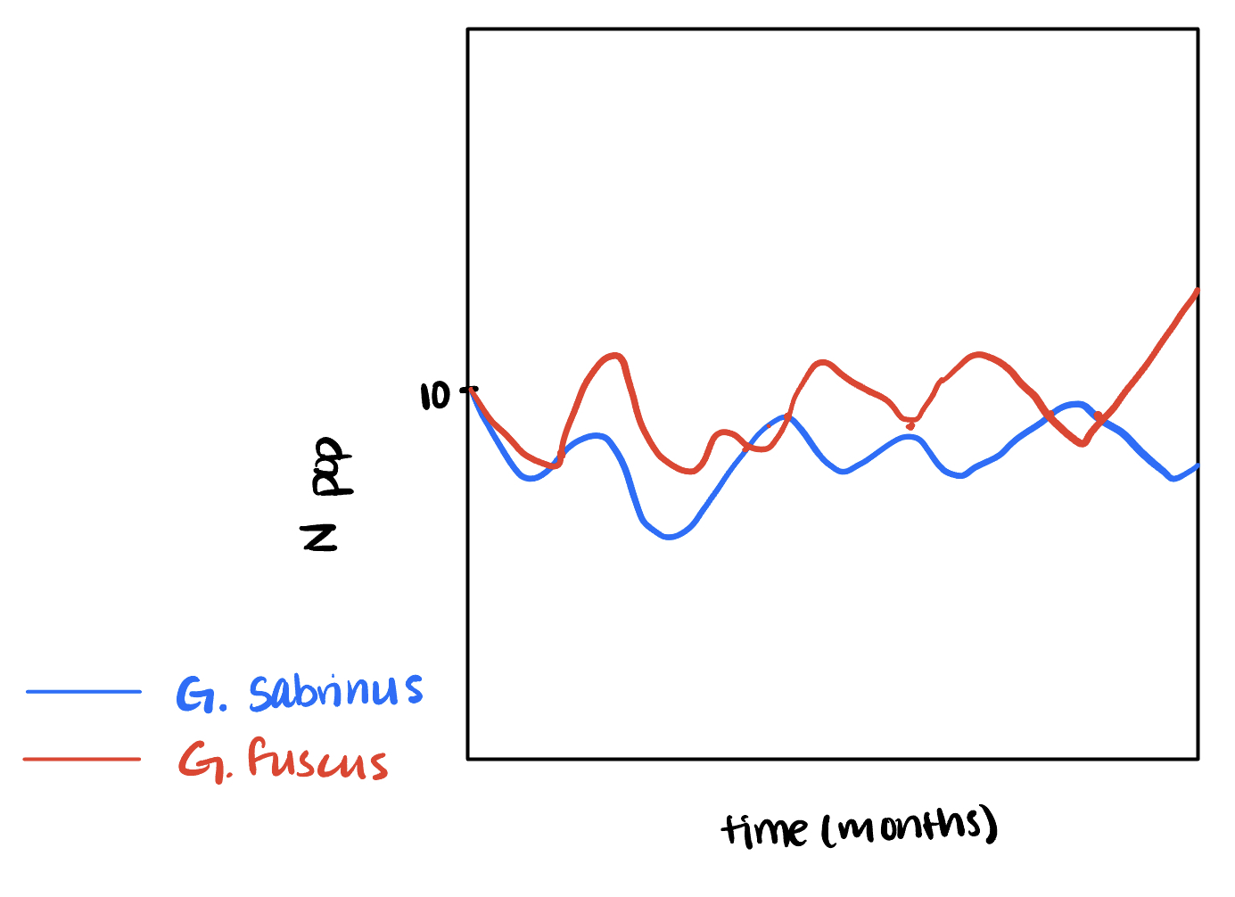
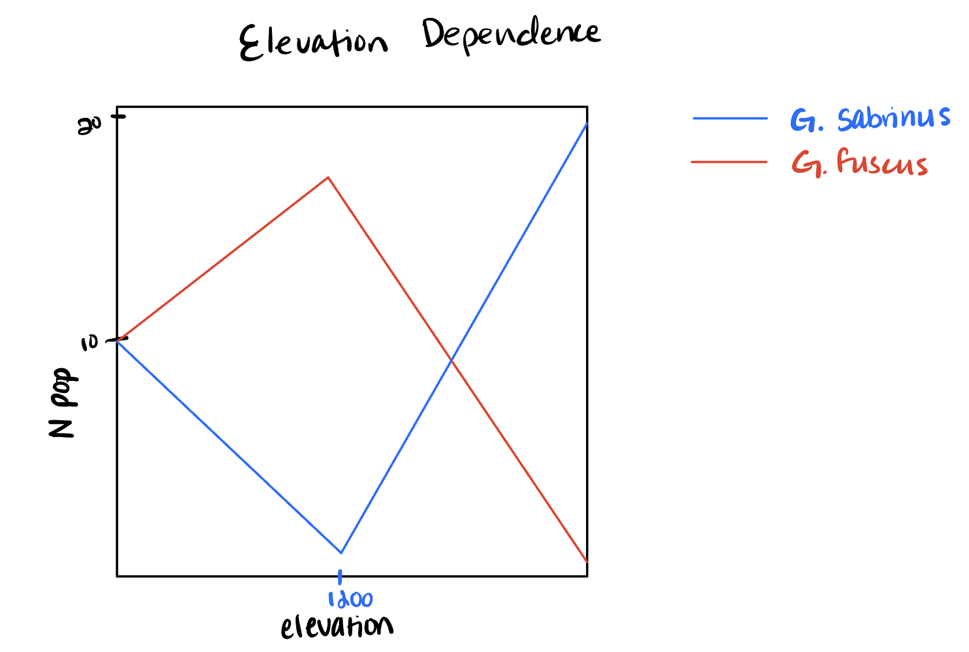
Experiment 1
When densities remain the same (at 10), G. Fuscus "wins" at an elevation below 1200 m, while G. Sabrinus "wins" at an elevation above 1200 m.
This shows that above and below an elevation of 1200 m, competition is present.
Experiment 2
Since we noticed that the populations both reached a relative minumum/maximum at 1200, we suspected that there would be coexistence at this elevation
With constant starting densities at 10 and an elevation of 1200 there are consistent oscillations that demonstrate coexistence between the two species.

