Slide 1
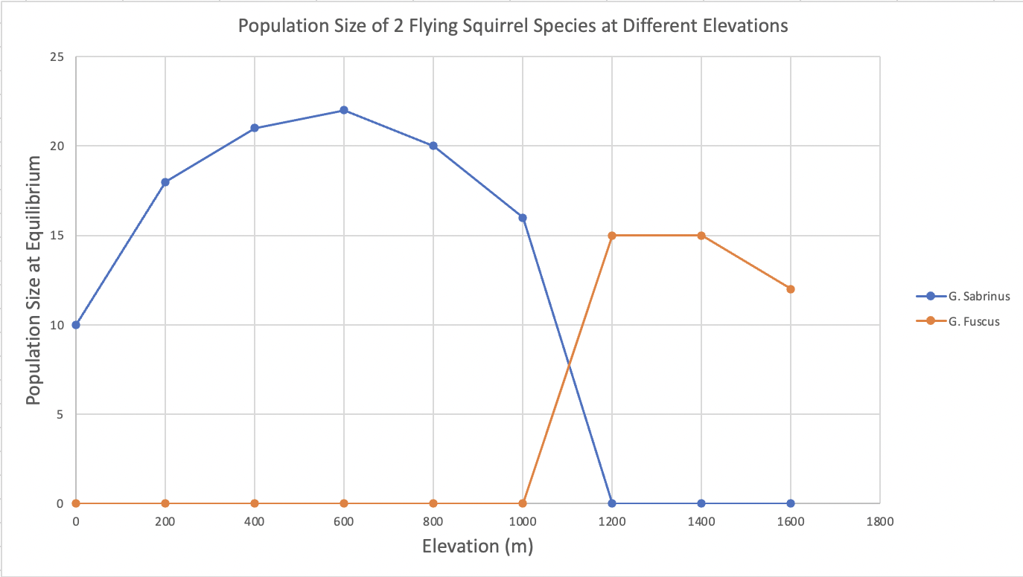
Assignment 3
G. Sabrinus completely outcompetes G. Fuscus from elevations of 0 to 1100 meters.
G. Fuscus completely outcompetes G. Sabrinus from elevations of 1200 meters and up.
Between 1100 and 1200 meters the 2 species coexist.
These species are competitors for the same resources, and they’re likely utilizing niche partitioning between elevations to avoid competition outside of the range where they coexist.
Tamesha Allen, Joel Nunez, Nathan Nguyen, Vanshika Patel, Ana Valdes-Herrera

