Slide 1
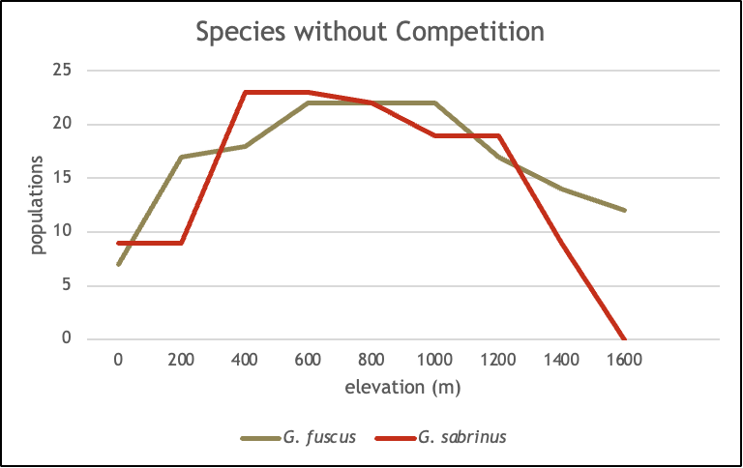
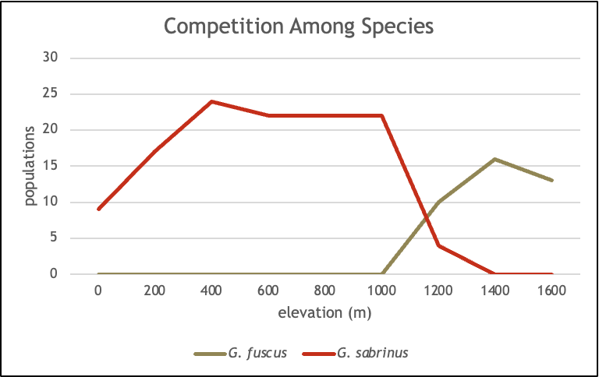
•G. fuscus can survive at elevations higher than 1200m, while G. sabrinus can’t, though both survive best around intermediate elevations when no competition is present.
•There is competition between the species G. fuscus and G. sabrinus, which can be seen in the graphs because the species have different population sizes at varying elevations and the population size changes depending on if the other species is also present or not.
•When in competition, G. sabrinus appears to survive better at elevations below 1200m, while G. fuscus survives better at elevations above 1200m.
•The two species coexist at elevations between 1000m and 1400m.
By: Nina Acosta and Claire Noble

