Slide 1
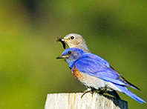
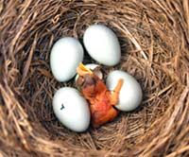
XX Lecture – December 8, 2016
-- The 2nd Seminar report is due Monday, December 12 by 5:00. Last talks!
-- Please give feedback on the course evaluations.
Thursday, December 8, 4:00 pm, 1024 KIN—BIOLOGICAL SCIENCE COLLOQUIUM,
"Integrating across scales to understand ecological and evolutionary dynamics,”
Friday, December 9, 4:00 pm, 1024 KIN—ECOLOGY AND EVOLUTION SEMINAR,
"Interspecific aggression, species borders and the dynamics of hybridization,”
Dr. Renee Duckworth, Department of Ecology and Evolutionary Biology, University of Arizona.

Slide 2
OLD CURVE
51%
60%
73%
84%
From 335 total points with lowest quiz dropped!

Slide 3
NEW CURVE
From 380 total points with lowest quiz dropped.

Slide 4
K’s = 60, red wins
Draw a graph with the appropriate isoclines for this scenario, labeling each isocline. Put in arrows within the zones, showing why red always wins when in competition.
Fish now coexist at (35,45) because reds have less effect on blues.
Draw the isoclines expected under high predation. Label your isoclines . Again, draw arrows in each zone to explain why we now find coexisting fish.
Kblue increases.
Now, draw the isoclines a third time, but with high predation on the redfish and improved food processing by the blue fish. Again, label your isoclines and draw arrows explaining the expected outcome of competition.

Slide 5
2. The figure on the left shows interactions between predator and prey through time, starting with 10 prey and 2 predators, until some equilibrium is reached.
A. Draw appropriate isoclines in the graph on the left that are consistent with the pattern shown.
B. Convert the information from the graph on the left to the graph on the right.

Slide 6
3. Consider remoras, these odd fish that must live on sharks. For this example, lets assume that all remoras must live on a shark, but they have negligible effects on the shark itself.
A. Please create simple population growth equations for both the number of remoras (R)and the sharks (S).
dR/dt = r_{r} * R * (c_{S}S – R)/c_{S}S
dS/dt = r_{S} or r_{S} * S * (K_{S} – S)/K_{S}
B. Now, determine the equations and graphs that indicate if the remoras and sharks might coexist, using your above equations.
set both equations to zero and solve for isocline:
R = Sc_{S}
S = K_{S}

Slide 7
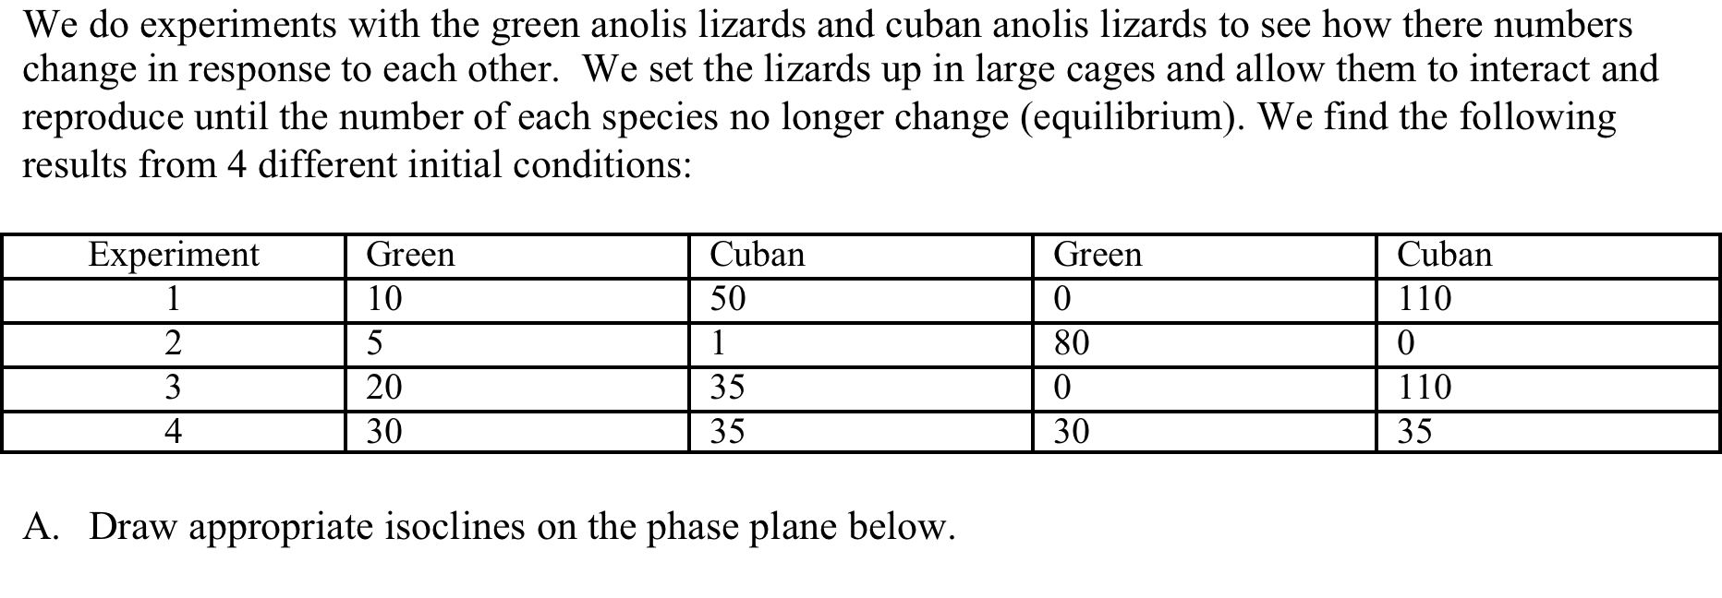

Slide 8
B. Now consider the native Green anoles if they are growing in our cages without Cuban anoles present. While they do have positive population growth when at very low abundances, they have problems finding each other for mating. The per-capita reproduction increases as their numbers get larger, and they reach their carrying capacity in about 80 weeks. Draw appropriate lines in the boxes below.

Slide 9
5. Kneitel and Miller studied the food web found in the water-filled leaves of the purple pitcher plant. Answer the following questions based on their experiment and the graph on the right.
1. Which of Paine’s three types of food webs was shown and discussed in the paper? Explain how you know
connectedness, energy flow, or functional
2. Which definition of the niche (role or needs of a species) was being evaluated in these experiments? Explain.
3. The experiment used 5 replicate leaves per treatment and the results above show the average species richness per leaf. Is this alpha, beta, or gamma richness? Explain.

Slide 10
4. In later experiments, Miller sent undergraduates out in the field every two days with pipettes to move liquid around among leaves, essentially creating corridors like Gilbert’s study of moss organisms. Based on Gilbert’s results, what would you expect to happen to pitcher plant richness with and without dispersal? Create a bar graph showing us your expected results.
5. These pitcher plants have mosquitoes that act as keystone predators. So, now draw a graph that shows the same results as above, but with and without the effects of a keystone predator. So, we want four bars for all combinations of with and without mosquitoes and with and without dispersal.

