Slide 1
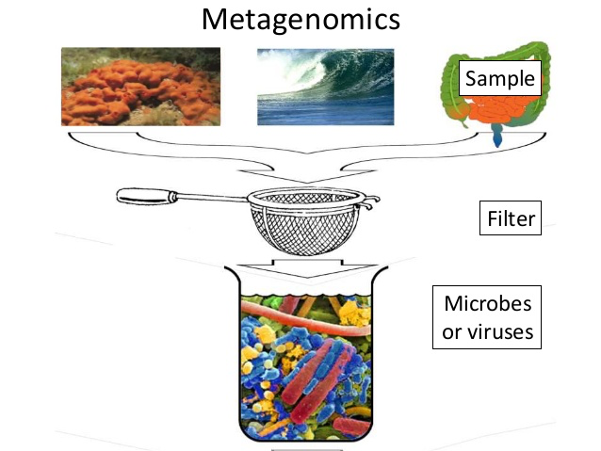
23rd Lecture – December 1, 2016
-- The 2nd Seminar report is due Monday, December 12 by 5:00.
-- Quiz next Tuesday
-- Please give feedback on the course evaluations!
December 2: Victoria Pearson, Department of Biological Science, Florida State University
"A view of the tiniest of the tiny: viral metagenomics in Northwest Florida"
Metagenomics is the study of genetic material recovered directly from environmental samples.

Slide 2
51%
60%
73%
84%
From 335 total points with lowest quiz dropped!

Slide 3
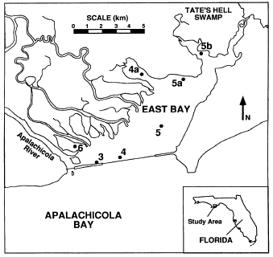
Ecosystem Ecology
B. Case Study
This is from Livingston, Niu, Lewis, and Woodsum. 1997, Ecological Applications 7:277-299.
9.5 year study addressed the effects of a drought on an estuarine system. Normally, estuaries are thought to be quite rich, because of influx of nutrients into an environment where predation is low, combined with generally shallow waters. (Shallow waters can be warmer and allow more light to hit the bottom).

Slide 4
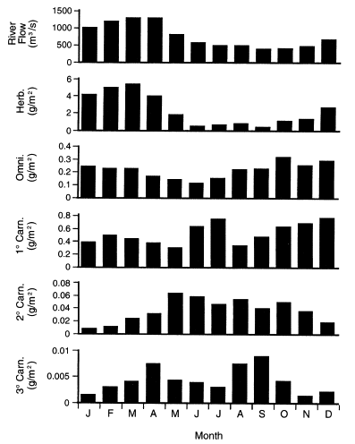
Ecosystem Ecology
E. Case Study
Flow of water is highest in the spring. Herbivores also tend to peak in the spring (nutrient increases lead to more plants), whereas omnivores peak in fall winter. Primary carnivores biomass peaks during the summer and early winter, whereas secondary and tertiary carnivore biomass peaks in the late spring and summer.

Slide 5
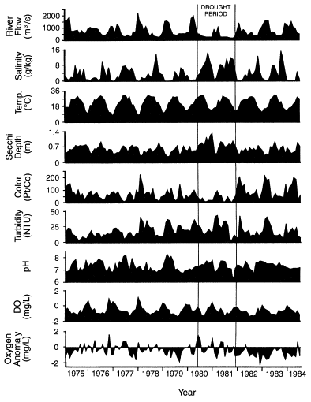
Ecosystem Ecology
E. Case Study
Big drought in 1980 and 1981, caused bunches of physical factors to change:
-- river flow decreases
-- salinity goes way up
-- water is more clear
-- water color decreases

Slide 6
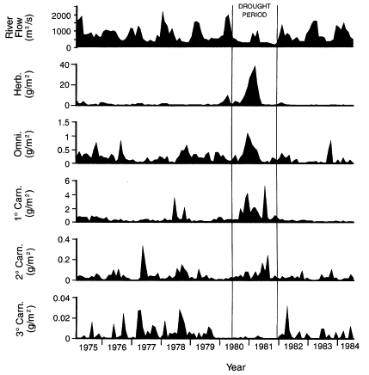
Ecosystem Ecology
E. Case Study
Increased light penetration due to cessation of river flow – led to more plants, which allowed more herbivores and omnivores. Other tropic levels do not respond as much because they are apparently limited more by biological factors such as predation.

Slide 7
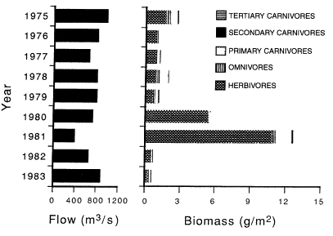
Ecosystem Ecology
E. Case Study
What happens to trophic structure?
-- herbivores go way up because of clearer and more shallow water,
despite greater salinity
-- effects work UP trophic levels -- responding to biological factors

Slide 8
Ecosystem Ecology
E. Case Study
Note that there is never any mention of individual species, a common feature of ecosystem studies. However, the ecosystem study does take into account the critical abiotic factors and whole ecosystem view necessary to understand the effects of drought.
A population based study would have focused on how the drought affected species diversity and behavioral interactions among trophic levels. For example, how does turbidity affect the ability of predators to find prey? What kind of changes in competition occurred after the large increase in the abundance of herbivores?
In doing so, population based approaches may put less emphasis on large ecosystem processes and questions. The best community ecology should consider integrating both population-based and ecosystem approaches.

Slide 9
VII. Invasive Species
A. Definitions
B. Importance
C. Examples
D. Mechanisms
1. Traits of species
2. Traits of communities

Slide 10
An introduced, alien, or exotic species, is a species living outside its native distributional range, which has arrived there by human activity, either deliberate or accidental.
An invasive species is a plant, fungus, or animal species that is not native to a specific location (an introduced species), and which has a tendency to spread to a degree believed to cause damage to the environment, human economy or human health

Slide 11
VII. Invasive Species
A. Definitions
B. Importance
C. Examples
D. Mechanisms
1. Traits of species
2. Traits of communities

Slide 12
Major limits to threatened or endangered species
Habitat degradation and loss 85%
Invasive species 49%
Pollution 24%
Overexploitation 17%
Disease 3%
Source: Wilcove et al.1998 BioScience

Slide 13
Estimated annual costs associated with non-native species:
Group costs (in millions)
Plants (purple loosestrife, weeds) $34,000
Mammals (feral pigs, rats) 37,000
Birds (pigeons, starlings) 2,000
Fishes 1,000
Arthropods (ants, termites, other pests) 19,000
Mollusks (zebra mussel, asian clam) 1,200
Microbes (plant pathogens, animal disease) 41,000
All organisms over $136 billion per year
Source: Pimentel et al. 2000 BioScience

Slide 14
VII. Invasive Species
A. Definitions
B. Importance
C. Examples
Kudzu, zebra mussels, carp, fire ants, pythons, lionfish
D. Mechanisms
1. Traits of species
2. Traits of communities

Slide 15
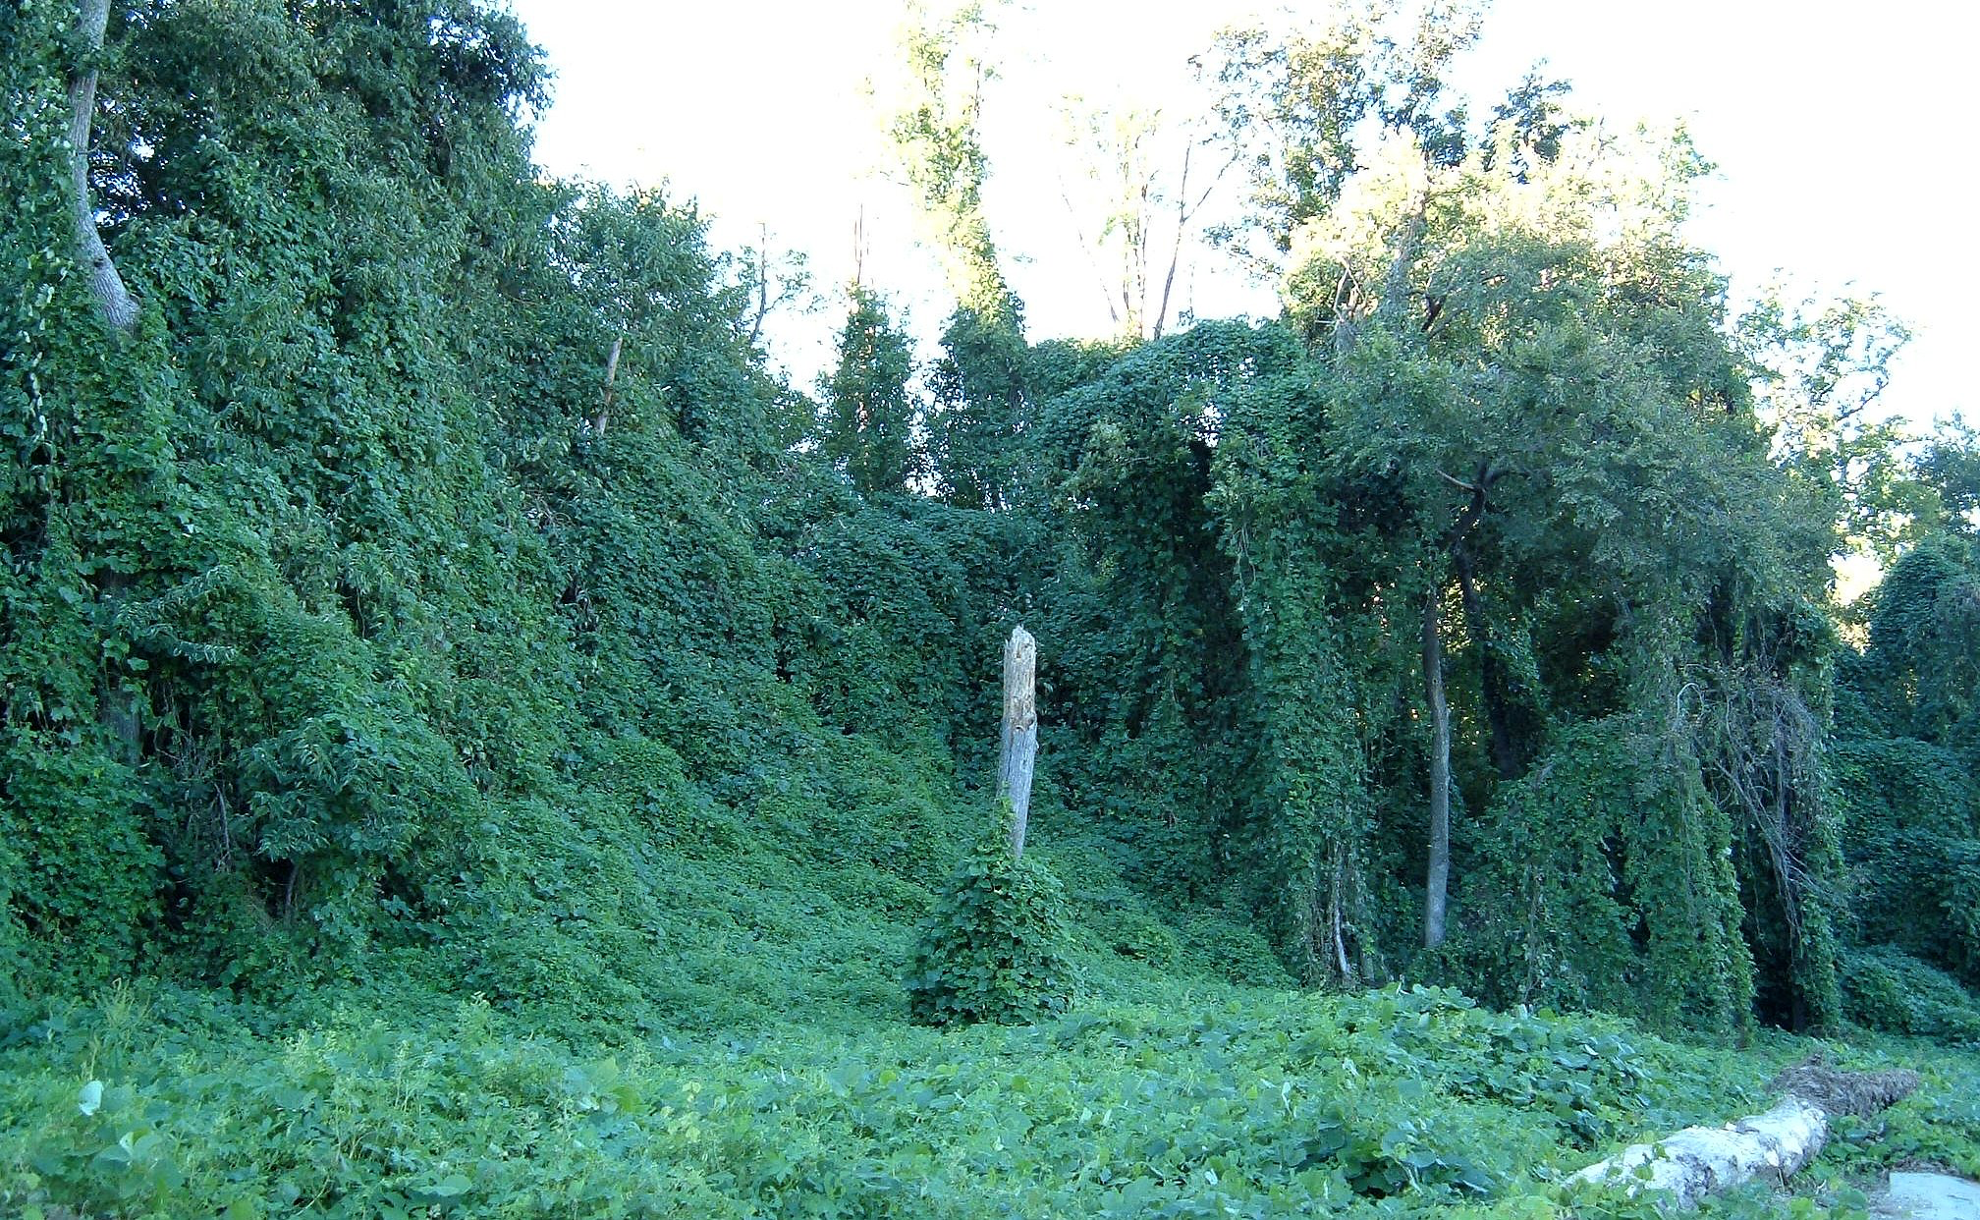
Kudzu was introduced to the United States as an ornamental bush and an effortless and efficient shade producer at the Philadelphia Continental Exposition in 1876. In the 1930s and '40s, the vine was rebranded as a way for farmers to stop soil erosion. Workers were paid eight dollars an hour to sow topsoil with the invasive vine.

Slide 16
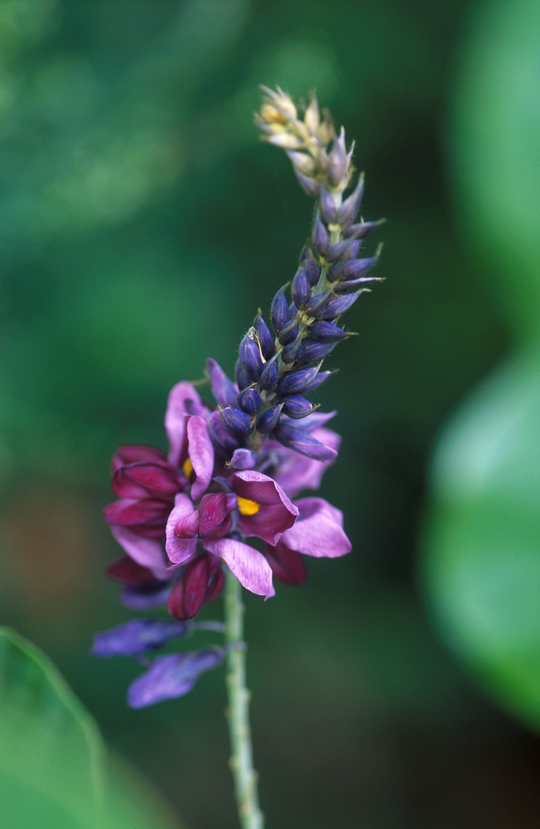
Kudzu spreads by vegetative reproduction via stolons (runners) that root at the nodes to form new plants. Kudzu will also spread by seeds, which are contained in pods and mature in the autumn. The hard-coated seeds can remain viable for several years.
Note that kudzu is a legume and so can fix nitrogen and change soil nitrogen levels. This can lead to soil acidification and an increase in atmospheric NO and NO₂

Slide 17
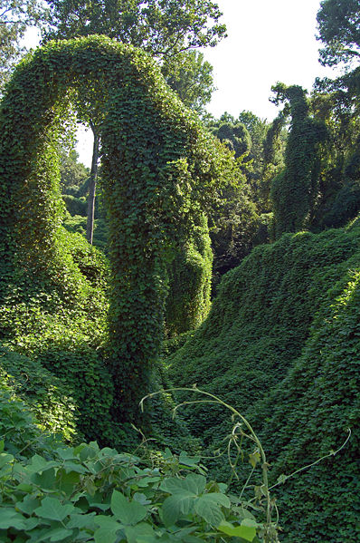
Kudzu's environmental and ecological damage results from acting through "interference competition", meaning it outcompetes other species for a resource. Kudzu competes with native flora for light by growing over them and shading them with its leaves.
Changes in leaf litter associated with kudzu infestation also result in changes to decomposition processes and a 28% reduction in stocks of soil carbon, with potential implications for processes involved in climate change.

Slide 18
Kudzu has become a very large problem for the forestry industry, since it can rapidly spread over large areas and is very difficult to get rid of, once established. The total productivity lost by agricultural and forestry businesses is over $500 millon a year. Power companies also suffer from kudzu invasion since the weight of kudzu vine often pulls down wires and causes power outages. It has been estimated that the amount of money they spend annually to remove it from poles and wires is around $1.5 million per year.
This does not include the crop damage caused by diseases carried by kudzu. It has been found that kudzu is a carrier of Phakopsora pachyrhizi , or soybean rust, which is one of the most widespread and damaging diseases in the Southeastern soybean crop.

Slide 19
A major reason kudzu has thrived in the Southeastern US is because it lacks natural predators, unlike the native species it competes against. In China all parts of the kudzu plant, the stems, the leaves, the roots, the seeds, are specifically attacked by various species of insect. In the United States, very little damage is seen and only the seeds and the leaves suffer routine damage from predators.
Kudzu has a distinct advantage as a non-native plant in that it has fewer barriers to expansion and has to allocate fewer resources to dealing with the effects of herbivores.

Slide 20
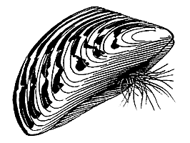
Zebra Mussel Biology
Zebra mussels originated in the Black and Caspian Seas. They spread across much of Europe in the 18th and early 19th century because of the development of extensive canal systems. These small mussels were first noted in North America in Lake St. Clair, near Detroit, in 1988. It appears that they were transported here in ballast water. Now they are spread both by diffusion and jump dispersal. Because they are so well monitored, they provide an opportunity for ecologists to study migration.
Zebra mussels grow quickly and can form dense mats (up to 750,000 per m² in water pipes in Lake Erie). They are very high-volume filter feeders, which can result in lakes being much cleaner with zebra mussels present. Like most bivalves, adults are sessile, but have a planktonic stage that can easily disperse.

Slide 21
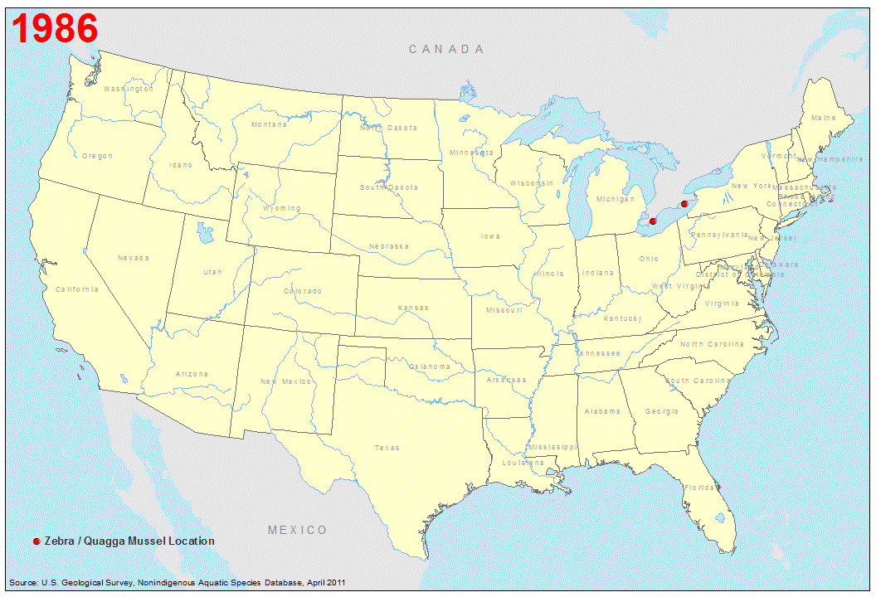
https://nas.er.usgs.gov/queries/SpeciesAnimatedMap.aspx?speciesID=5

Slide 22
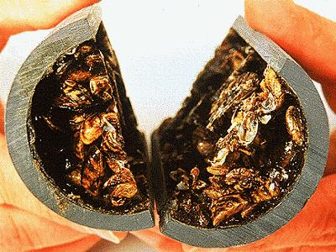
Zebra Mussel Effects
Zebra mussels have profound effects on ecosystems. They consume phytoplankton, as well as bacteria, protozoa, and even silt. Phytoplankton biomass can decrease by 85% or more, which has large negative effects on zooplankton, which in turn can cause decreased survival and biomass of planktivorous fish. It may also change fish habitats -- clearer water allows greater light penetration which has a large positive effect on aquatic macrophytes. Zebra mussels have also virtually eliminated many native species of clams by simply growing over them.
An important effect of zebra
mussels is in clogging water intakes
for cities, electrical power stations,
and other industrial facilities around
the Great Lakes.

Slide 23
Zebra Mussel Summary
-- were introduced in 1988 or before into a lake in Canada, probably through ballast water (jump dispersal)
-- settle and attach to hard substrates and grow rapidly
-- have highly dispersal offspring until they get large enough to settle out of the water column.
-- spread rapidly throughout the Great Lakes region and are now spreading down the Mississippi, mostly through diffusion dispersal along rivers and other waterways.
-- also spread on boats and equipment (jump dispersal), which has led to management criteria.
-- cause major damage by clogging pipes and killing endemic clam species.
-- also has effects on the local community. Removal of phytoplankton through filter feeding causes declines in zooplankton and possibly fish, while helping aquatic macrophytes.

Slide 24
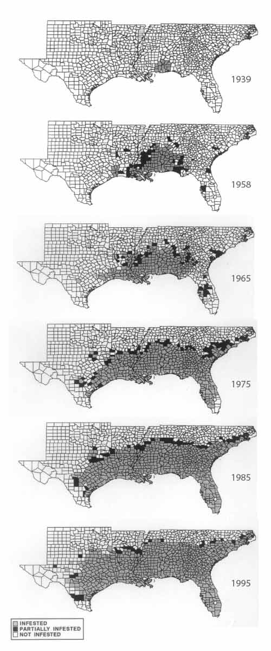
VII. Invasive Species (cont.)
A classic example of diffusion dispersal can be seen in fire ants. Fire ants are thought to have come in with shipping from South America to the US in Mobile Bay in 1918. They then spread rapidly, ultimately being limited by a combination of temperature and soil moisture.
(Fundamental or realized niche?)
Fire ants are harmful to humans and animals, as well as potentially outcompeting native ants. Mounds can also damage or prevent the use of harvesting and landscaping equipment.

Slide 25
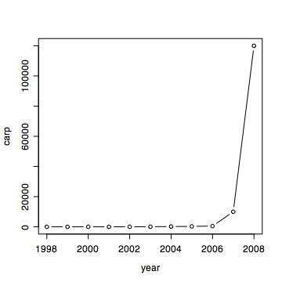
Exponential growth (density independent) can be common in invasive species:
Asian carp were brought to the US in the late 1970’s to clean algae out of fish farms. But, floods allowed the carp to enter the Mississippi waterways where they have spread. There is significant concern that the carp will eventually make it into the Great Lakes and decimate fisheries further north. They have built a $37 million underwater electric barrier to dissuade the fish from moving through the Illinois River into the Great Lakes.
asian carp video

Slide 26
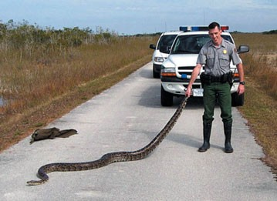
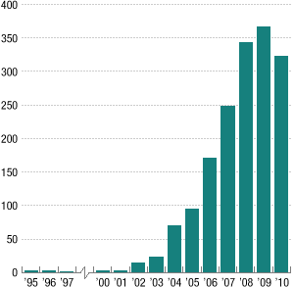
Invasive species:
Burmese pythons are legal pets, with over 30,000 imported into the US last year. However, they can grow to over 20 feet long and pet owners have been known to just release them when they get too big. This is causing problems in the Everglades, where they eat wood storks, mangrove fox squirrels, and eastern indigo snakes, as well as other protected and endangered species.
There are many, many more stories about invasive species, especially in Florida. We will discuss these later, but for now just want to briefly study the process of migration.

Slide 27
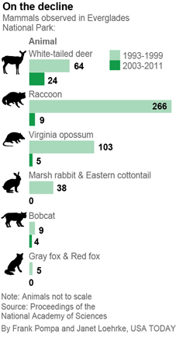

Invasive species:
This is causing problems in the Everglades, where they both common species, such as deer and raccons as well as protected and endangered species such as indigo snakes.
Python hunts have been largely unsuccessful in reducing the numbers of these large but secretive snakes.

Slide 28
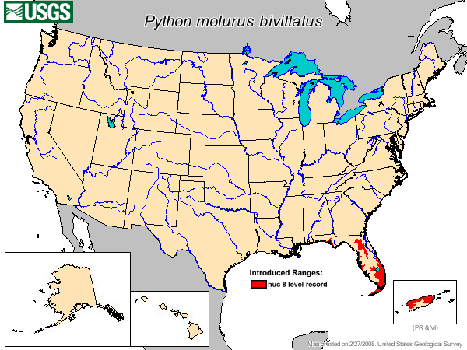

Slide 29
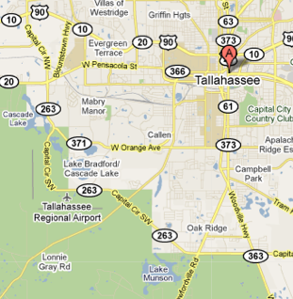
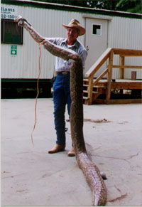
Invasive species:
I can find no information about this photo that is from a state webpage of miscellaneous photos. It is merely labeled “Oliver Cromwell holding up python found in Lake Munson.”

Slide 30
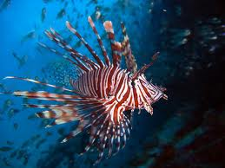
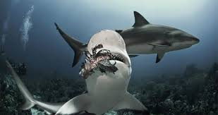
Invasive Lionfish
Pterois volitans; Pterois miles
Up to 18” long
Ambush predators
www.divingdr.com
daniellesdives.wordpress.com

Slide 31
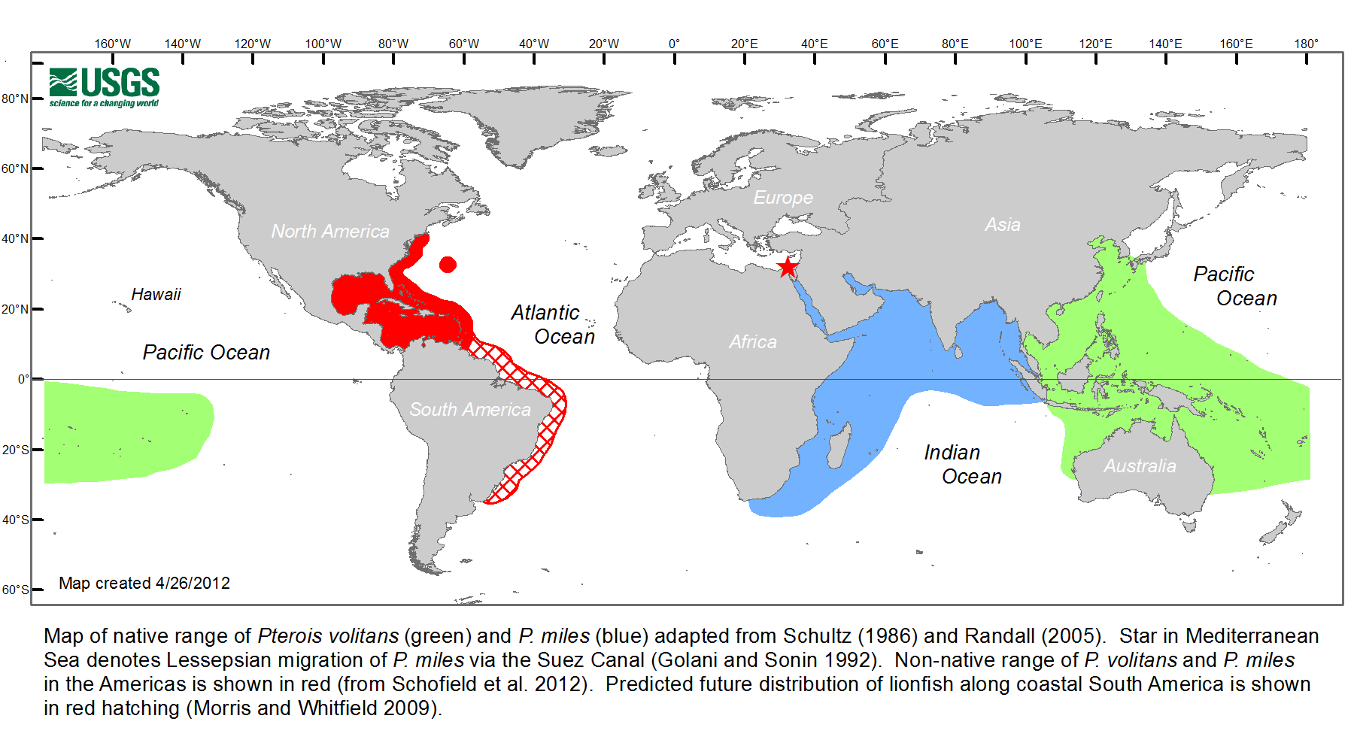
Spread of Lionfish
Notes:
Potential future range of lionfish based on the lethal thermal minimum of 10°C (Morris J.A. 2009).

Slide 32
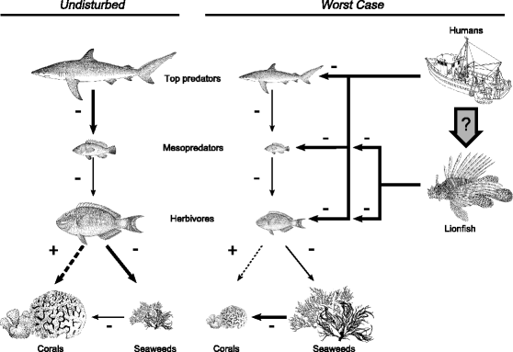
Shows a healthy food chain (left) versus one with fishing pressure and introduced lionfish, demonstrating the negative impact lionfish indirectly have on corals. Size of the organism indicates relative abundance and thickness of the arrow shows relative strength of the interaction. Solid arrows are direct effects and dashed arrows are indirect effects. Image taken from: Albins, M. A. and M. A. Hixon. 2011. Worst case scenario: potential long-term effects of invasive predatory lionfish (Pterois volitans) on Atlantic and Caribbean coral-reef communities. Environmental Biology of Fishes:1-7
speakupforblue.com
Notes:
As far as their effect on the reefs one of their prey targets are a family of fishes known as parrotfish. One of the major ecosystem functions of parrotfish is feeding on algae that otherwise outcompetes corals and in some areas where parrotfish and other herbivores are largely absent have led to a phase shift to an algal dominated ecosystem which provides very little habitat for juvenile fishes to shelter from predators among other things. By reducing the number of parrotfish on the reefs there is the potential for the lionfish to have further ramifications on the reefs by releasing the algae to outcompete the coral for space on the reef.

Slide 33

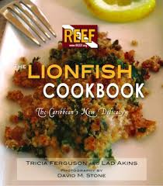
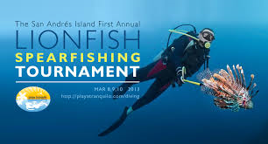
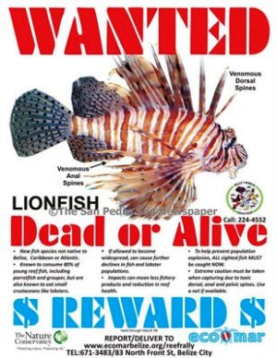
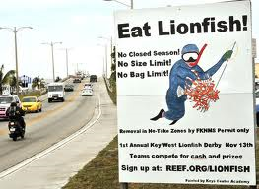
keysnews.com

Slide 34
These examples suggest that there are several stages common in invasions
1. Dispersal to new habitats (transport)
2. Establishment
3. Spread within new habitats
The invasion process is of interest to ecologist because it allows us to test ideas in ecology about population dynamics and community structure.
Species that successfully make it through these stages of invasion aren’t random. Successful invasive species do share a number of traits and different traits may be important at different stages.

Slide 35
VII. Invasive Species
A. Definitions
B. Importance
C. Examples
D. Mechanisms
1. Traits of successful invasive species
2. Traits of invaded communities

Slide 36
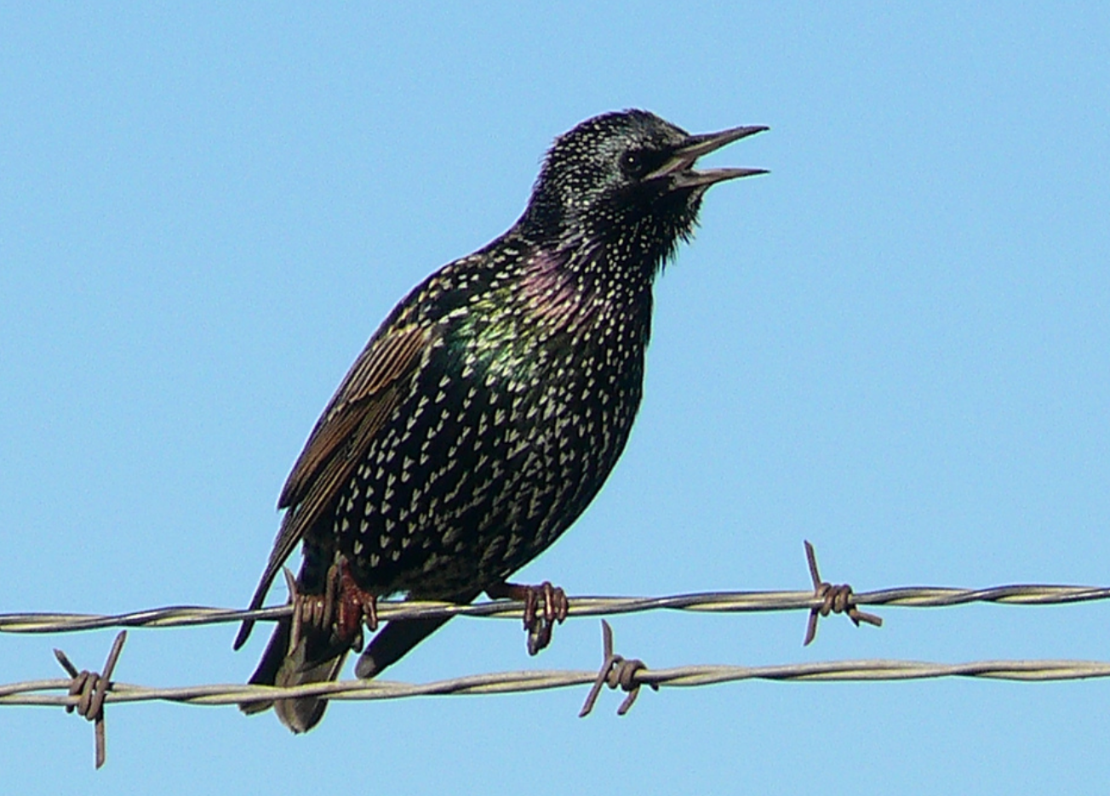
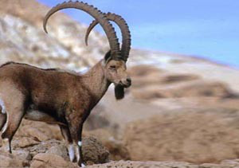
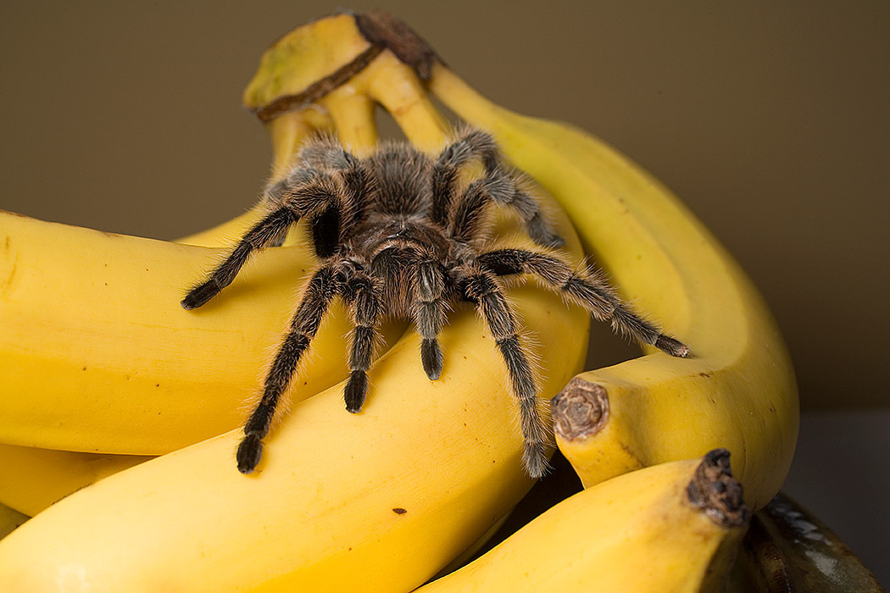
Dispersal of Invasive Species
Some introduced deliberately:
  naturalization societies
  Shakespeare fans
  game animals
  domestic animals
Some accidental:
  ballasts of ships
  unprocessed wood
  fruit shipments
  by-pass natural barriers

Slide 37
Characteristics of invasive species
general diet and habitat requirements
high abundance
small body size
high reproductive potential (r-strategy)
good competitors
social / gregarious
.

Slide 38
Traits of invaded communities
So, if certain traits make species more like to invade communities, are there certain types of communities that are more likely to be invaded?
Much of the study of invasive species has been influenced by Charles Elton's 1958 book The Ecology of Invasion by Animals and Plants. Elton proposed that communities “fill up”, just like we saw with Island Biogeography. If so, perhaps more diverse communities would be more likely to be invaded.

Slide 39
What makes certain ecosystems more vulnerable to invasion?
Diverse, undisturbed communities have few invaders
Disturbed habitats: full of invaders
Human residential areas: many European species that are commensal with humans
Islands: little history with competitors, predators, parasites, or diseases

Slide 40
Hypotheses for the success of introduced species? (where should we expect them and how might we manage them?):
Natural enemies hypothesis. They have escaped from enemies in their original communities.
EICA. Evolution of increased competitive ability allows them to outcompete native species (explains lag time)
Pre-adaption to disturbed environments (weeds in NA).

Slide 41
Study Guide Items from Lecture 23
Terms:
  Invasive species
  Exotic or introduced species
  Natural enemies hypothesis
  Evolution of increased competitive ability
Concepts:
  Costs of invasive species
  Traits of invasive species
  Stages of invasion for invasive species
  direct and indirect effects of invasive species (lionfish)
  What makes some species more likely to be invasive?
  What makes some communities more likely to be invaded?
  Case Studies:.
  Robert Livingston’s work on drought in the Apalachicola Bay ecosystem
  Kudzu
  Asian Carp in the US
  Zebra Mussels in North America
  Fire ants
  pythons! Under your house!
  Lionfish
Notes:
41

