Slide 1
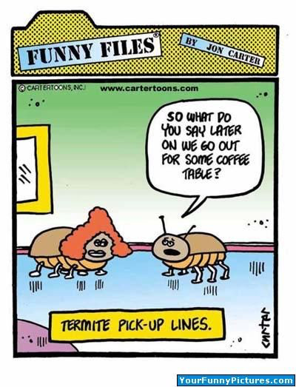
22nd Lecture – Nov. 29, 2016
-- The 2nd Seminar report is due Monday, December 12 by 5:00.
-- Quiz next Tuesday
December 2: Victoria Pearson, Department of Biological Science, Florida State University
"A view of the tiniest of the tiny: viral metagenomics in Northwest Florida"

Slide 2
IV. Community ecology
. . . .
E. What factors affect diversity and community structure?
1. Long-term Historical effects
    Dispersal, Migration, and Extinction
  3. Productivity/Climate
4. Competition
5. Predation
6. Case Studies
a. Kneitel and Miller’s work with pitcher plants
b. Jane Lubchenco’s intertidal work

Slide 3
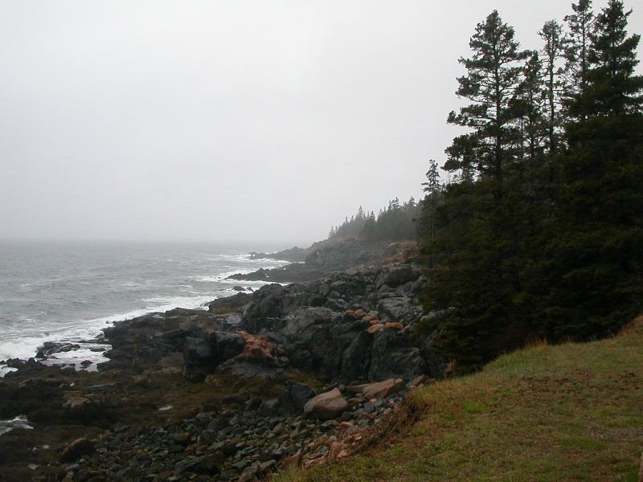
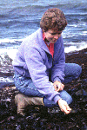
Jane Lubchenco’s intertidal work
Lubchenco observed that tide pools tended to either have high density of green alga or high density of red alga. She knew that Littorina snails graze on the alga, so she manipulated snail abundance to see if the abundance of the grazers affected alga density and the types of algae present

Slide 4
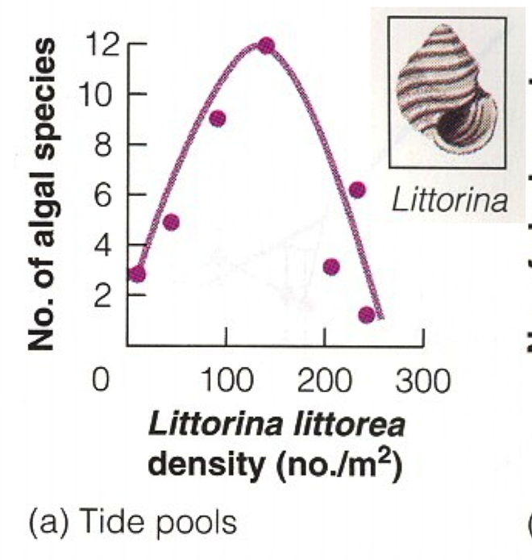
Jane Lubchenco’s intertidal work
  When there were lots of snails, the only possible alga that could survive was tough, nasty red algae. However when there are few snails, the dominant competitor, fast growing soft and tasty green algae, Enteromorpha (“sea lettuce”), was the competitive dominant.
green
red

Slide 5
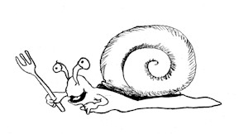
Jane Lubchenco’s intertidal work
There was an odd and interesting side finding of this study. So far, Lubchenco hasn’t explained why some tide pools have lots of alga and others do not. She has a proximal reason: they have different numbers of snails, but why do they have different numbers of snails?
It turns out that the snail numbers themselves are determined by the abundance of their predators, green crabs. Well, what determines the abundances of the crabs? Sea gull predation! Sea gulls will quickly eat all the crabs they can find, if they can find them. So, how do the crabs avoid being eaten? They hide in algae!
So, there were two alternate stable states possible for each pool:
Lots of Sea Gulls --> few crabs --> lots of snails --> lots of red --> low algal diversity
Few Sea Gulls --> Lots of crabs --> few snails --> Enteromorpha! --> low algal diversity

Slide 6
IV. Community ecology
. . . .
E. What factors affect diversity and community structure?
1. Long-term Historical effects
    Dispersal, Migration, and Extinction
  3. Productivity/Climate
4. Competition
5. Predation
6. Disturbance
7. Case Studies
a. Kneitel and Miller’s work with pitcher plants
b. Jane Lubchenco’s intertidal work

Slide 7
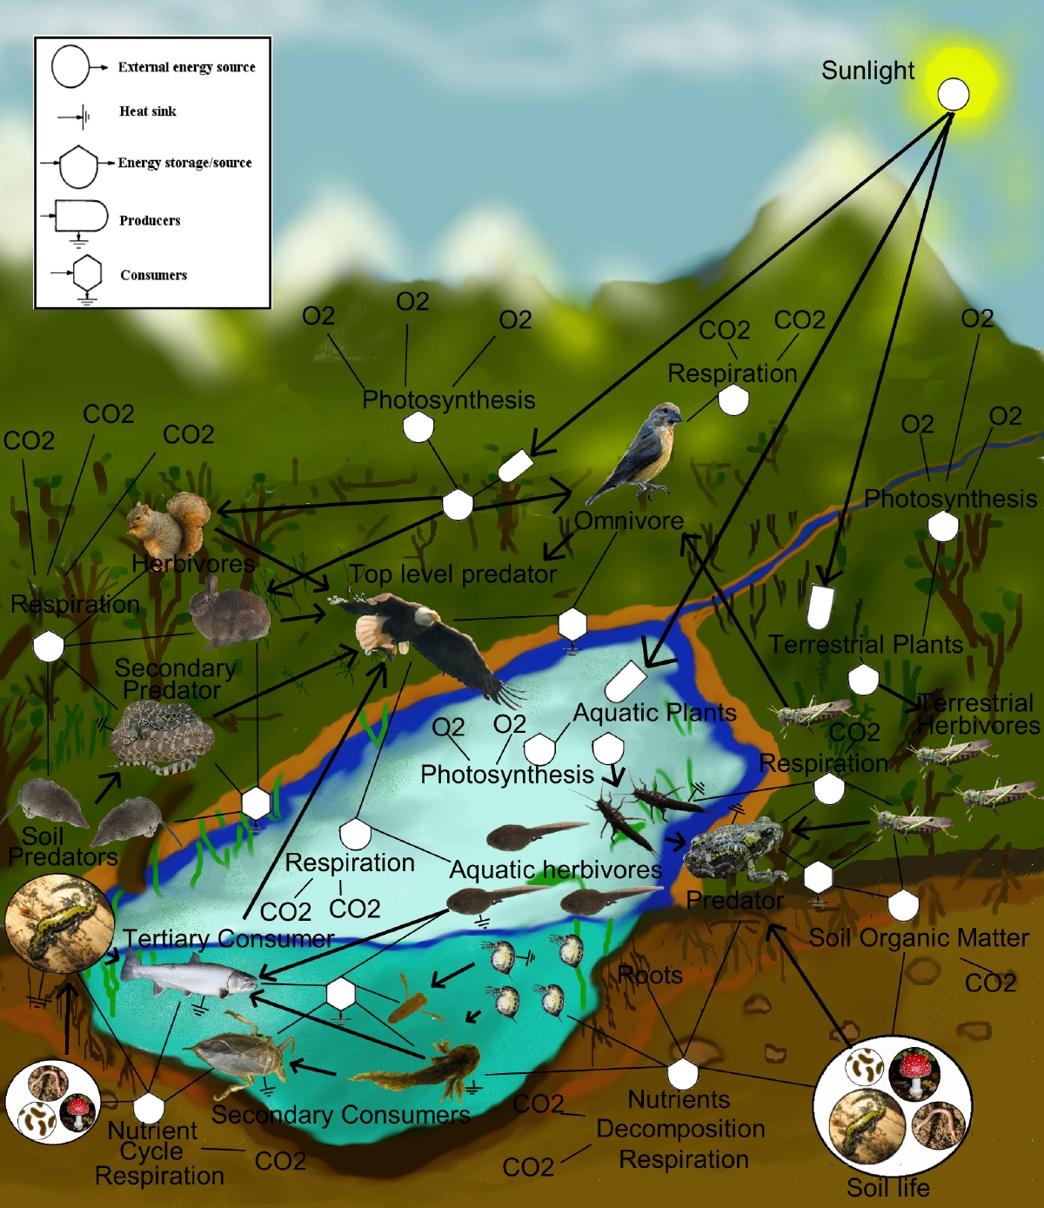
Ecosystem Ecology
A. Basics (very, very basics)
-- the biological community that occurs in some locale, and the physical and chemical factors that make up its non-living or abiotic environment.
Key thing to remember is that the currencies for ecosystem ecology are energy and nutrients, not population sizes (no dN/dt !)

Slide 8
V. Ecosystem Ecology
What is an ecosystem?
Important concepts
Processes of an ecosystem
Biogeochemistry
Ecosystem function and services

Slide 9
A. What is an ecosystem?
An ecosystem consists of the biological community that occurs in some locale, and the physical and chemical factors that make up its non-living or abiotic environment.
Usually the boundaries of an ecosystem are chosen for practical reasons having to do with the goals of the particular study.

Slide 10
Components of an Ecosystem
Examples:
ABIOTIC COMPONENTS BIOTIC COMPONENTS
Sunlight Primary producers
Temperature Herbivores
Precipitation Carnivores
Water or moisture Omnivores
Soil or water chemistry Detritivores
(e.g., P, NH₄+) etc.
etc.

Slide 11
B. Important Concepts:
Standing Stock = the amount of material in a "pool", such as the amount of oil in the ground or greenhouse gases in the atmosphere.
Material Flux Rate = the input or output of material from a system, such as the amount of oil we pump out of the ground each year, or the amount of greenhouse gas we pump into the atmosphere each year by burning fossil fuels.
Mass Balance = assumption that the inputs to any ecosystem or compartment therein must equal the outputs plus changes in storage. (example of lost N at Hubbard Brook)
Residence Time = the standing stock divided by the flux rate, which provides the average time that materials spent circulating in a pool - for example, the residence time of methane in the atmosphere is about 7 years.
Negative and Positive Feedbacks = negative feedbacks tend to slow a process, while positive feedbacks tend to accelerate a process. For example, in a warming world the ice caps will melt, which reduces the Earth's albedo, we retain more of the sun's heat energy, and that accelerates warming which in turn melts more ice cap -- this is a positive feedback.

Slide 12
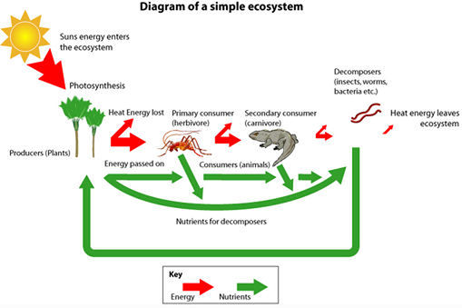
C. Processes of Ecosystems
There are two main concepts about how ecosystems
1. ecosystems have energy flows
2. ecosystems cycle materials.

Slide 13
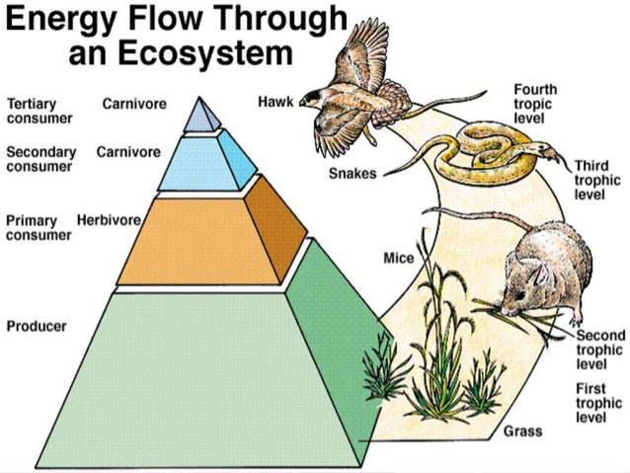
C. Processes of Ecosystems

Slide 14
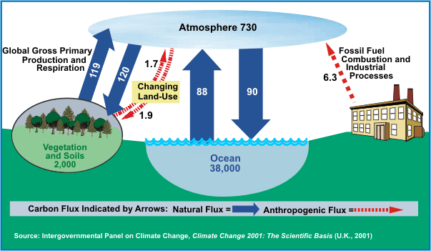
C. Processes of Ecosystems
2. ecosystems cycle materials.
Up: 215
Down: 212
Standing stock, flux rate, mass balance?

Slide 15
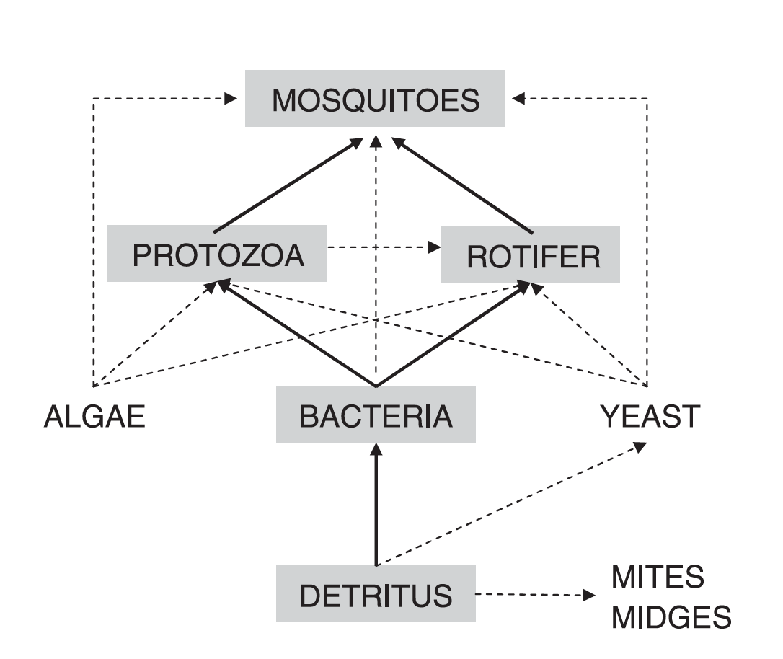
Ecosystem Ecology
  Pitcher plant leaf ecosystems

Slide 16
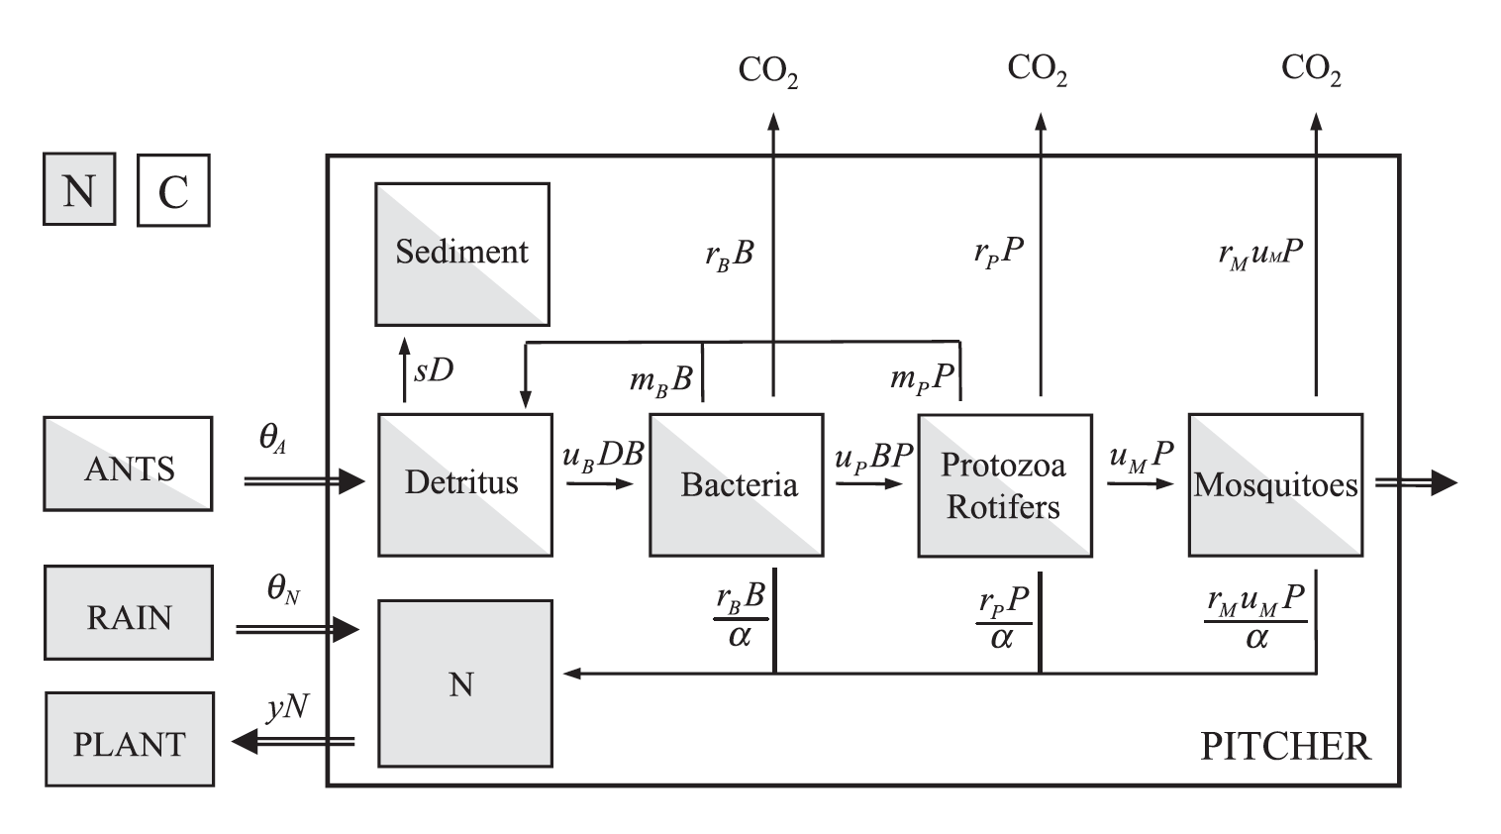
Ecosystem Ecology
Carbon cycle for pitcher plant leaf communities

Slide 17
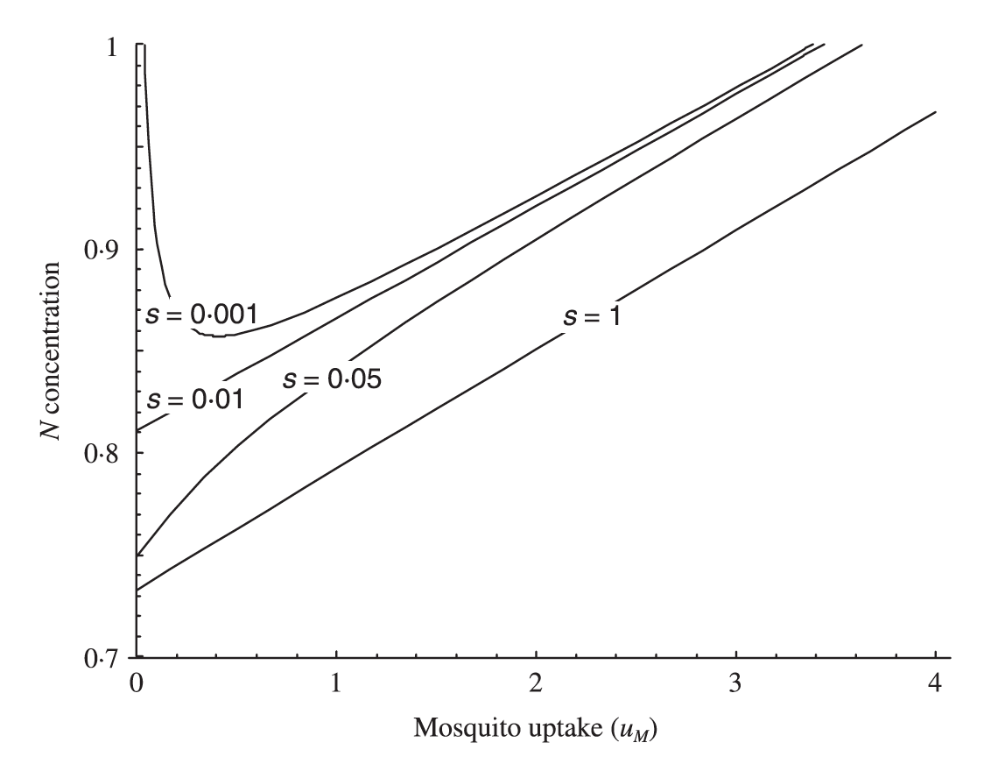
Ecosystem Ecology
Carbon cycle for pitcher plant leaf communities

Slide 18
D. Biogeochemistry
Biogeochemistry is defined as the study of how living systems influence, and are controlled by, the geology and chemistry of the earth. Thus biogeochemistry encompasses many ecosystem processes.
The principles and tools that we use can be broken down into 3 major components:
element ratios
mass balance
element cycling

Slide 19
D. Biogeochemistry
1. Element ratios
Important ecosystem elements, such as nutrients often occur in certain amounts in healthy ecosystems. It is easiest to think of these “conservative” elements in relation to other important elements in the ecosystem. For example, in healthy algae the elements C, N, and P have the following ratio, called the Redfield ratio after the oceanographer who discovered it:
C : N : P = 106 : 16 : 1

Slide 20
D. Biogeochemistry
the Redfield ratio :
C : N : P = 106 : 16 : 1
The Redfield ratio is instrumental in estimating carbon and nutrient fluxes in global circulation models and can indicate which nutrients are limiting in a given system.
The ratio can also be used to understand the formation of phytoplankton blooms (relatively high N and P) and subsequently hypoxia by comparing the ratio between different regions, such as a comparison of the Redfield Ratio of the Mississippi River to the ratio of the northern Gulf of Mexico.

Slide 21
Biogeochemistry
2. Mass Balance
Ecosystem ecology assumes that the inputs to any ecosystem or compartment therein must equal the outputs plus changes in storage. The equation is:
NET CHANGE = INPUT - OUTPUT + INTERNAL CHANGE
Mass balance can be applied at any scale, from a single organism or even cell, to the entire earth.

Slide 22
C. Processes of Ecosystems
2. ecosystems cycle materials.
Up: 215
Down: 212
Standing stock, flux rate, mass balance?

Slide 23
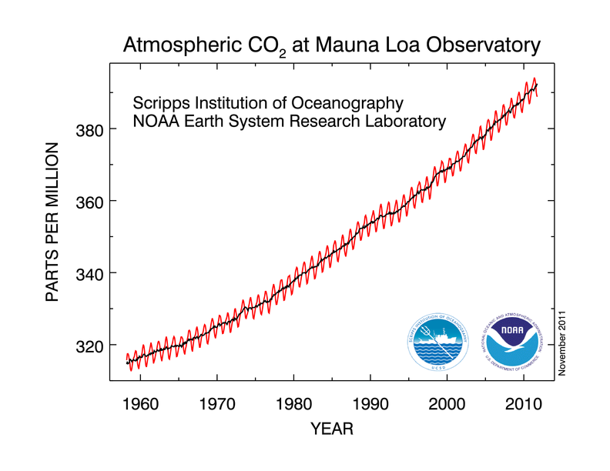
Ecosystem Ecology
Carbon cycle

Slide 24
Biogeochemistry
3. Element Cycling
Element cycling describes where and how fast elements move in a system. There are two general classes of systems that we can analyze: closed and open systems (just like open and closed populations and communities)
A closed system refers to a system where the inputs and outputs are negligible compared to the internal changes. Examples of such systems would include a cattle tank, or our entire globe.
In an open system there are inputs and outputs as well as the internal cycling. Thus we can describe the rates of movement and the pathways, just as we did for the closed system, but we can also define a new concept called the residence time. The residence time indicates how long on average an element remains within the system before leaving the system.

Slide 25
Decomposition is fundamental to ecosystem biomass production and mass balance. Most natural ecosystems are nitrogen (N) limited and biomass production is closely correlated with N turnover. Decomposition of plant litter accounts for the majority of nutrients recycled through ecosystems.

Slide 26
E. Ecosystem function
Ecosystem functions provide services that are essential to sustaining healthy human societies.
Water provision and filtration, production of biomass in forestry, agriculture, and fisheries, and removal of greenhouse gases such as carbon dioxide (CO₂) from the atmosphere are examples of ecosystem functions essential to public health and economic opportunity (not all functions are services!).
Nutrient cycling is an ecosystem function critical for agricultural and forest production.

Slide 27
E. Ecosystem function
Ecosystem services can be grouped into four broad categories:
provisioning, such as the production of food and water
regulating, such as the control of climate and disease
supporting, such as nutrient cycles and crop pollination
cultural, such as spiritual and recreational benefits.

Slide 28
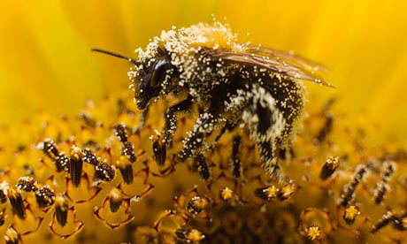
E. Ecosystem function -- example
Pollination of crops by bees is a good example of an ecosystem service. Insect pollination is required for 15-30% of U.S. food production; most large-scale farmers import non-native honey bees to provide this service. Wild bees alone could provide partial or complete pollination services or enhance the services provided by honey bees through behavioral interactions. However, intensified agricultural practices can reduce native pollinators. Increasing local habitat available for wild bees within 1–2 km of a farm can strongly stabilize and enhance the pollination services, thereby providing a potential insurance policy for farmers of this region.

Slide 29
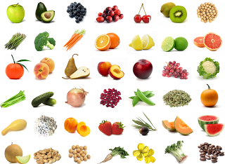
Crops pollinated by bees

Slide 30
Biomass productivity is perhaps the most important ecosystem function. Biomass accumulation begins at the cellular level via photosynthesis. Photosynthesis requires water and consequently global patterns of annual biomass production are correlated with annual precipitation. Amounts of productivity are also dependent on the overall capacity of plants to capture sunlight which is directly correlated with plant leaf area and N content.
Net primary productivity (NPP) is the primary measure of biomass accumulation within an ecosystem.
NPP = GPP – R_{producer}
Where GPP is gross primary productivity and R_{producer} is photosynthate (Carbon) lost via cellular respiration.

Slide 31
Ecosystems Summary
Ecosystems are made up of abiotic and biotic components, and these basic components are important to nearly all types of ecosystems.
Ecosystem Ecology looks at energy transformations and biogeochemical cycling within ecosystems.
Energy is continually input into an ecosystem in the form of light energy, and some energy is lost with each transfer to a higher trophic level.
Nutrients are recycled within an ecosystem, and their supply normally limits biological activity. So, "energy flows, elements cycle".
Energy is moved through an ecosystem via a food web, which is made up of interlocking food chains.The amount of primary production determines the amount of energy available to higher trophic levels.
The study of how chemical elements cycle through an ecosystem is termed biogeochemistry and can be studied using the concepts of ”element ratios", "mass balance", and "residence time".
Ecosystem functions can be quite beneficial to humans and are then referred to as ecosystem services. Such services are increasingly being used when making conservation and economic decisions.

Slide 32
VI. Climate Change

Slide 33
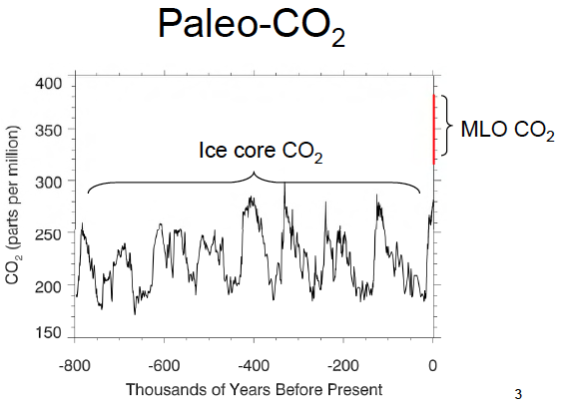
VI. Climate Change

Slide 34
VI. Climate Change
Increased atmospheric carbon is having two effects of particular concern:
-- climate change: a significant and lasting change in the statistical distribution of weather patterns over periods ranging from decades to millions of years.
-- ocean acidification: an increase in the pH of the oceans due to an increase in carbonate ions in the water as atmospheric CO₂ levels increase.

Slide 35
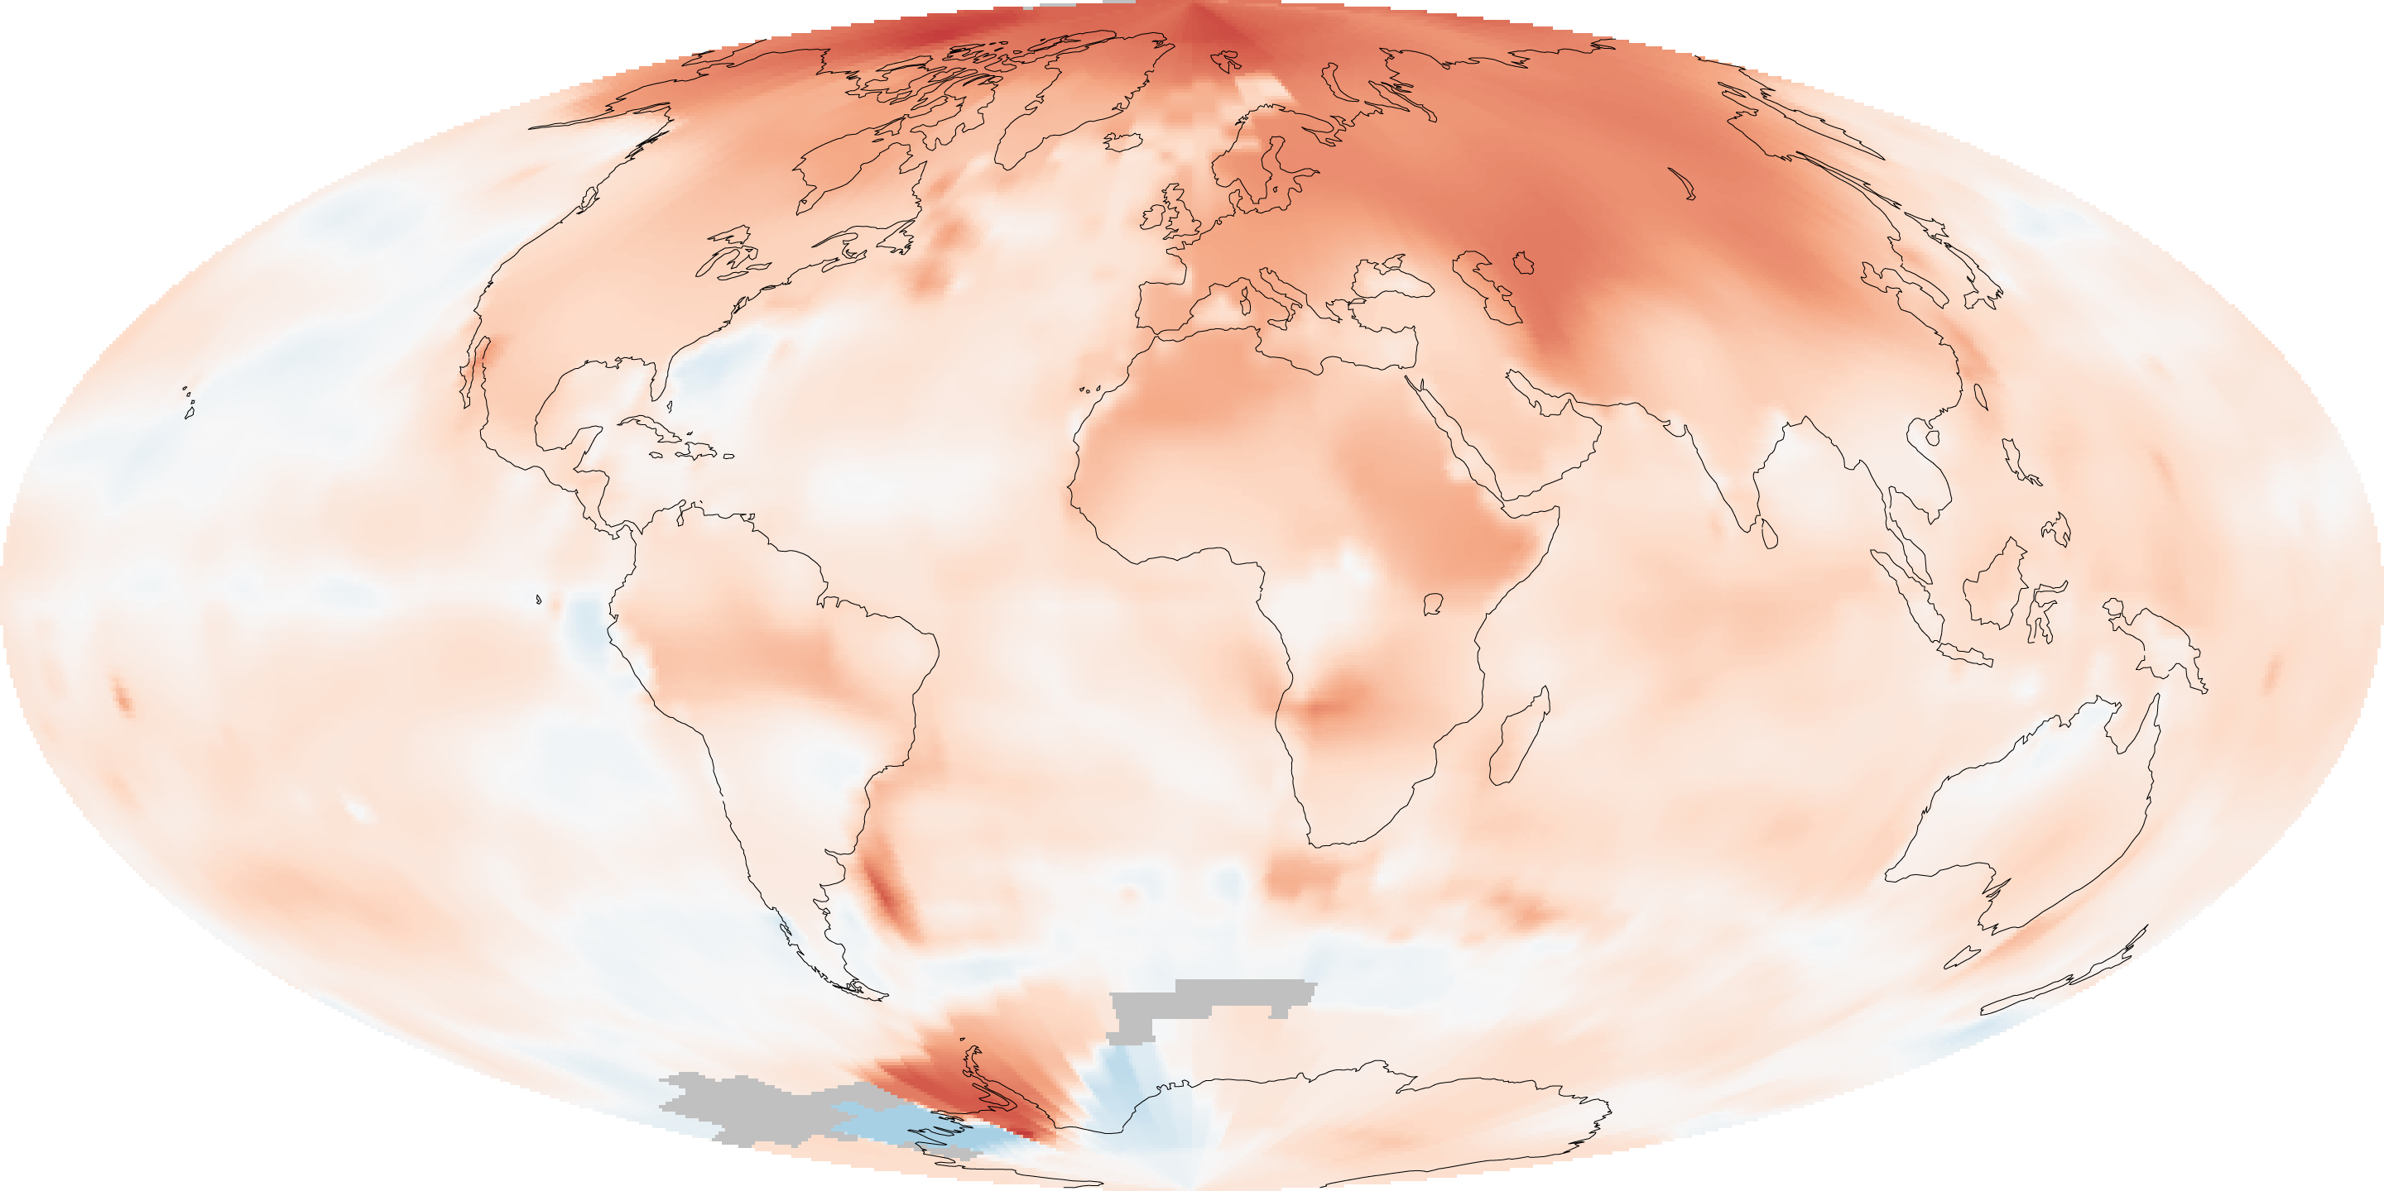
VI. Climate Change
C. Global warming patterns comparing 1951-1980 with 2000-2009

Slide 36
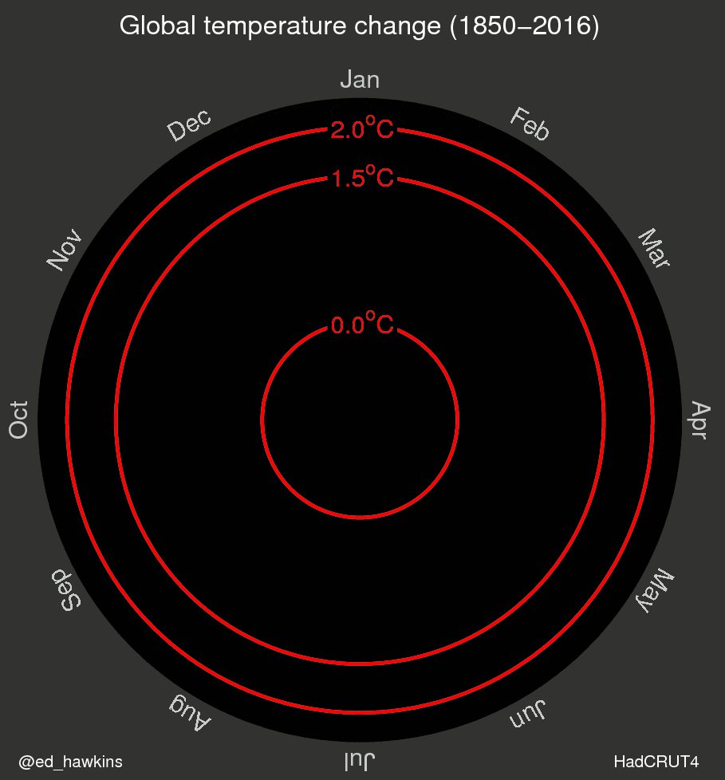
VI. Climate Change
C. Global warming patterns from 1850

Slide 37
VI. Climate Change
Average change in Tallahassee temperature over the last 37 years.

Slide 38
VI. Climate Change
Average change in Tallahassee temperature over the last 37 years.

Slide 39
VI. Climate Change
Average change in Tallahassee temperature over the last 37 years.

Slide 40
VI. Climate Change
Carbon cycle
Increased atmospheric carbon is having two effects of particular concern:
-- climate change: a significant and lasting change in the statistical distribution of weather patterns over periods ranging from decades to millions of years.
-- ocean acidification: an increase in the pH of the oceans due to an increase in carbonate ions in the water as atmospheric CO₂ levels increase.

Slide 41
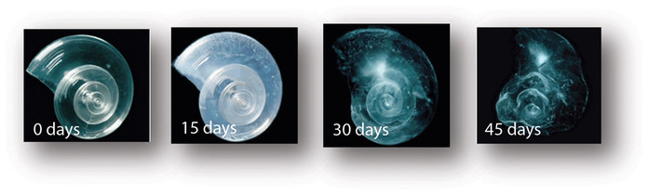
VI. Climate Change
Basics – ocean acidification
As ocean pH declines, so does the concentration of cabonate ions, and when carbonate becomes undersaturated, structures made of calcium carbonate are vulnerable to dissolution. These are largely living things and their skeletons, such as corals, echinoderms, crustaceans, and molluscs. There is a lot of uncertainty about the short and long term effects of this acidification.

Slide 42
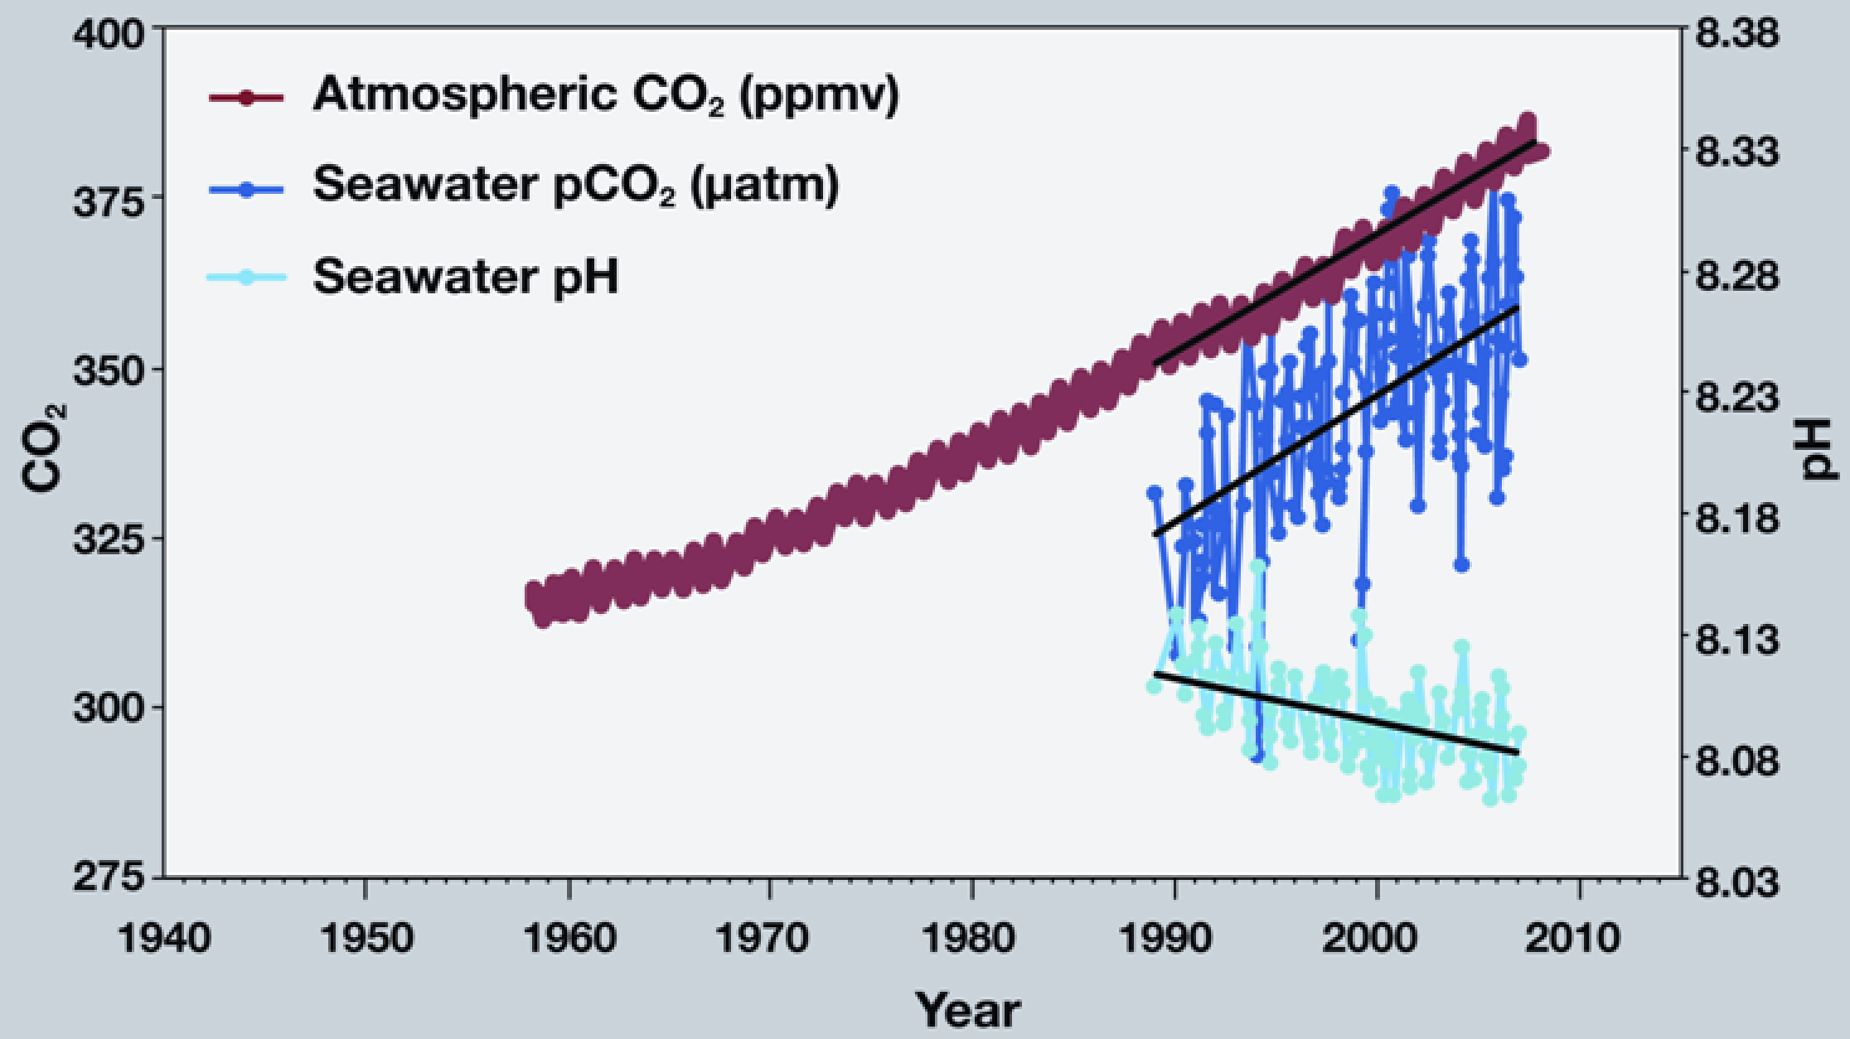
Here is the same Mauna Loa data on CO2, together with CO2 levels and pH in the nearby ocean.

Slide 43
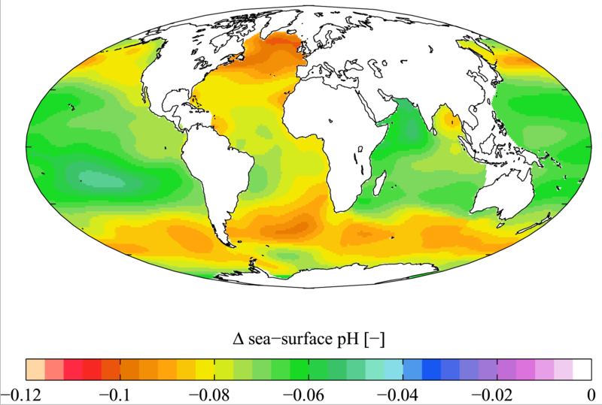
VI. Climate Change
As with the effects of carbon and temperature, ocean acidification is likely to be worse in same areas more than others. In particular, tropical areas are thought to be more susceptible to ocean acidification.

Slide 44
VI. Climate Change
Basics – ocean acidification
As ocean pH declines, so does the concentration of cabonate ions, and when carbonate becomes undersaturated, structures made of calcium carbonate are vulnerable to dissolution. These are largely living things and their skeletons, such as corals, echinoderms, crustaceans, and molluscs. There is a lot of uncertainty about the short and long term effects of this acidification.

Slide 45
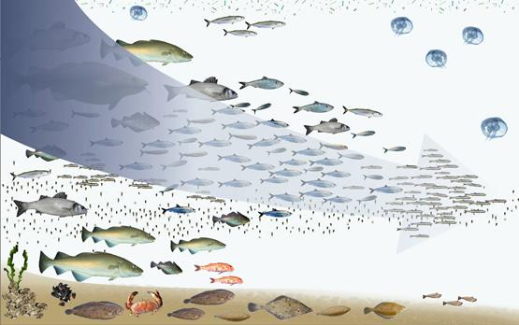
Shifting Baselines
http://www.ted.com/talks/daniel_pauly_the_ocean_s_shifting_baseline.html

Slide 46
Study Guide Items from Lecture 22
Terms:
Concepts:
  Energy is lost from ecosystems and must be replaced, while nutrients cycle from biotic to abiotic pools and generally not lost.
  Rates of flow between parts of ecosystem should add to zero, or they are building up somewhere (and being lost somewhere else)
  Know the basics of the Carbon cycle
  Relationship between carbon and global temperature increases
  Four types of ecosystem functions
  What is the basis for and potential effects of climate change
  Case Studies:
Jane Lubchenco’s study of algal diversity in tide pools.
  Ecosystem
  Standing stock
  Flux rate
  Mass balance
  Residence time
  Negative and positive feedbacks
  Ocean acidification
  Shifting baselines
Notes:
46

