Slide 1
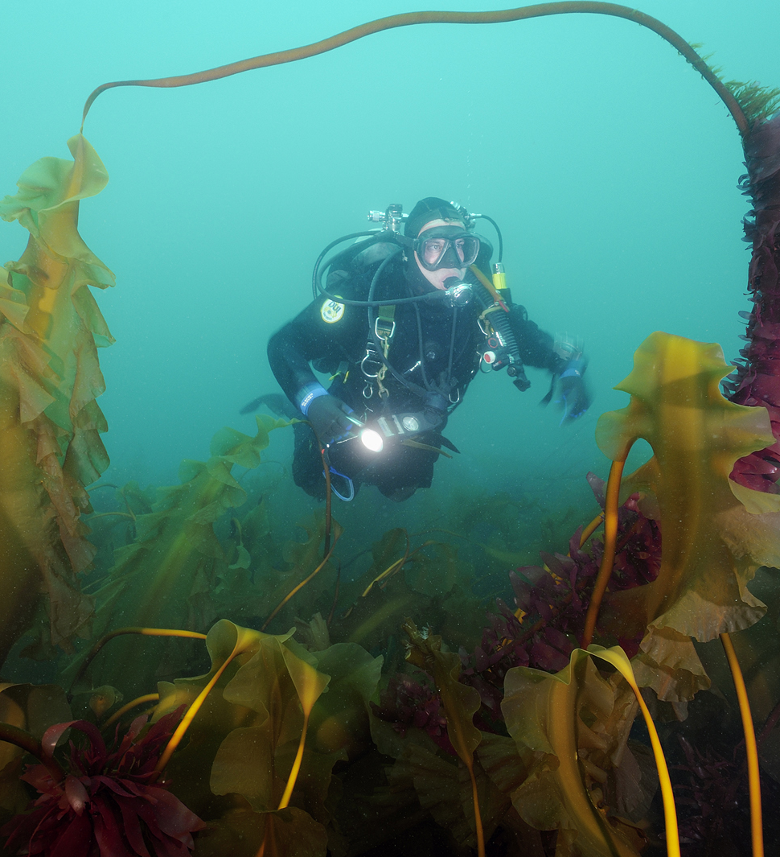
20th Lecture – November 17, 2016
-- read Kneitel and Miller 2002
-- quiz today!
-- old final exams on blackboard
Friday, November 18, 4:00 pm, 1024 KIN—ECOLOGY AND EVOLUTION SEMINAR,
Flips, locks & feedbacks: the lasting effects of fisheries on Maine's kelp forest ecosystem
Dr. Robert Steneck, School of Marine Sciences, University of Maine

Slide 2
The way forward to the end of the semester . . . .
IV. Community ecology
A. What is Community Ecology?
B. How do we quantify communities?
C. How do communities vary in space (biogeography)?
D. How do communities vary in time (succession)?
E. What factors affect diversity and community structure?
V. Ecosystem Ecology
A. the basics
B. carbon cycle as an example
C. climate change

Slide 3
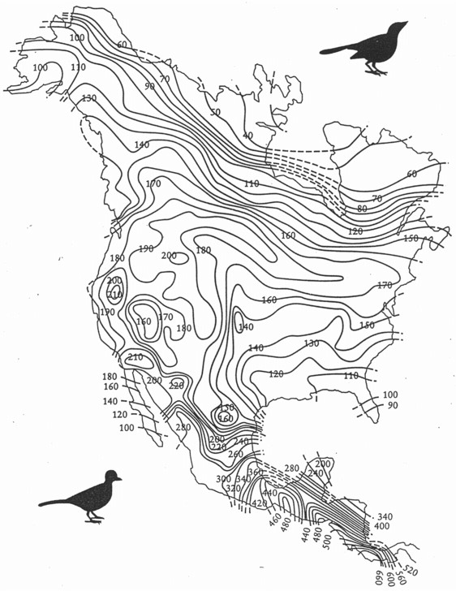
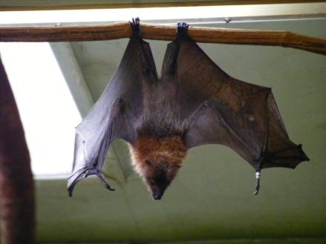
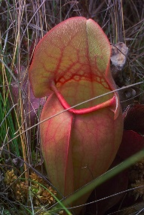
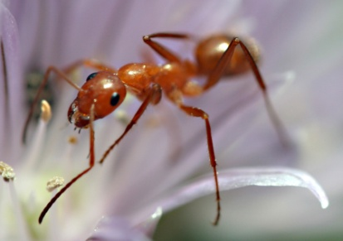
2. Spatial Patterns in Diversity
a. Latitudinal gradient
Birds in NA
Amazon plants vs. EU
Exceptions?
Less
# Species
More
Images: Bat: Marie Hale/ CC-BY; Ant: Samantha Henneke/ CC-BY
Notes:
-interest to modern biogeographers include broad spatial patterns in diversity;
-most important biogeographic pattern in diversity is the latitudinal gradient;
-override other patterns, with very few exceptions;
-species increases as you move from the north towards the equator;
-amazon plants in general, less than 3 acres of Amazon rainforest, more plant species than all of Europe, higher latitude;
-not universal, exceptions seen in ants, bats, and pitcher plants, opposite direction;

Slide 4
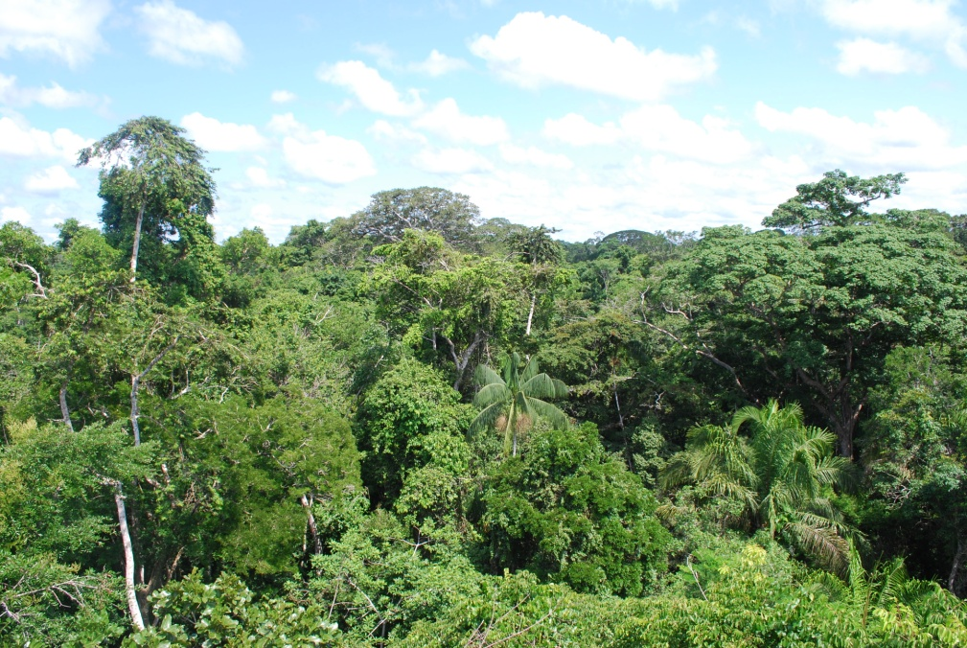
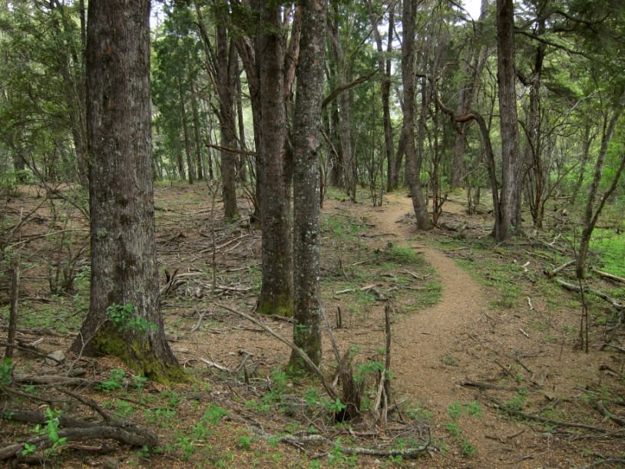
Some possible reasons why the tropics are more diverse: i. Tropics are more productive ii. Larger niche space iii. Larger population = less extinction
2. Spatial Patterns in Diversity
Images: Amazon: Ivan Mlinaric/ CC-BY; Temperate: Miguel Vieira/ CC-BY
Notes:
-Nobody really knows, few possible hypotheses;

Slide 5
Some possible reasons why the tropics are more diverse: iv. Tropics are older v. More time for evolution (of new species) vi. More specialization = ↑ species, narrower niche
2. Spatial Patterns in Diversity
Temperate
Tropics
Small
specialist
Large
specialist
Generalist
Frequency
small
large
small
Food Size
large
Food Size
Notes:
-temperate region have broader niches due to fluctuating conditions preventing niche specialization;

Slide 6
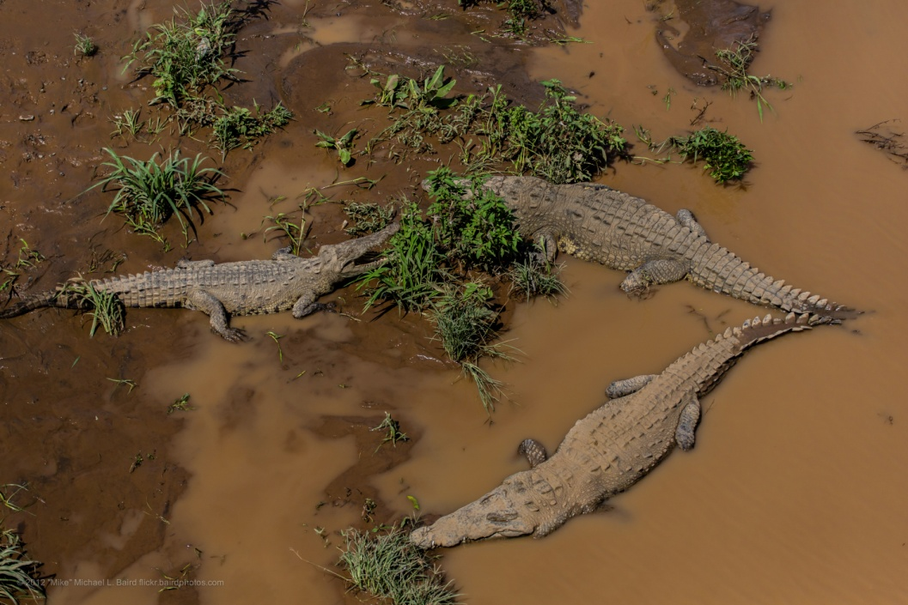
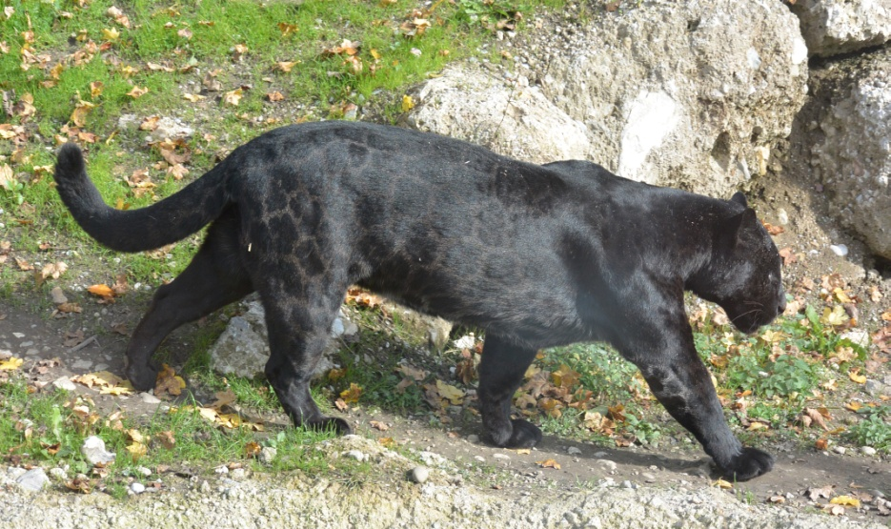
2. Spatial Patterns in Diversity
g. Tropics are more stable
Stable competition= more species packing
Keystone predators = increased prey coexistence
Images: Am Crocodile: Mike Baird/ CC-BY; Puma: Alois Staudacher/ CC-BY
Notes:
-more short term (due to less variation in the seasons as a consequence of latitudinal position) and long term (due to the effect of the glaciations being more sever north of the tropics) stability in the tropics;
-character displacement and specialization;
-more predators;

Slide 7
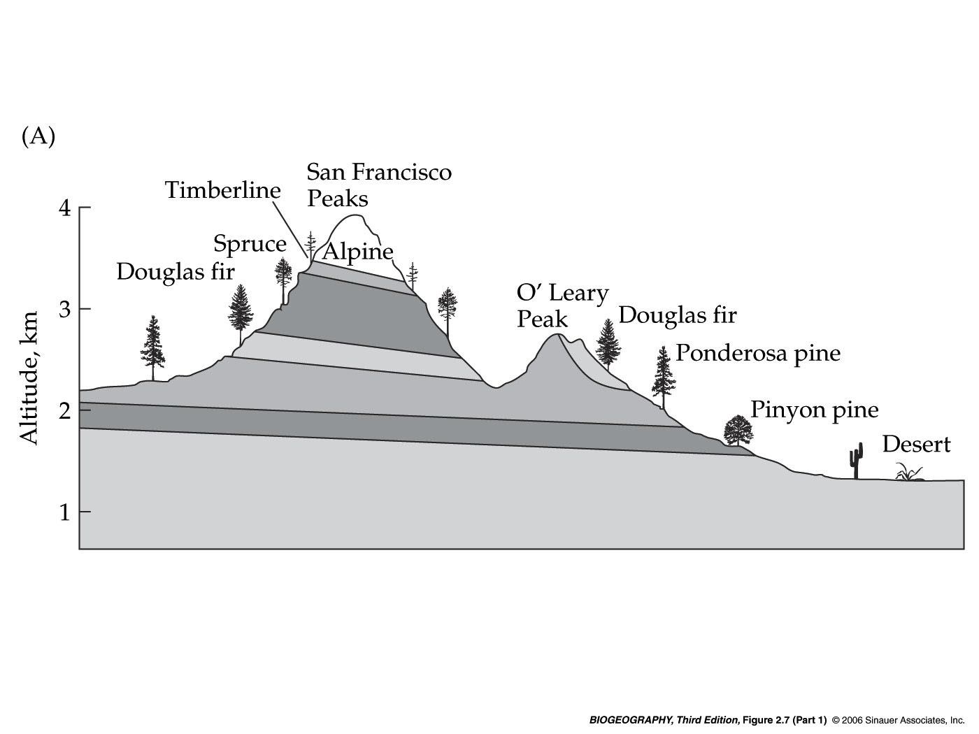
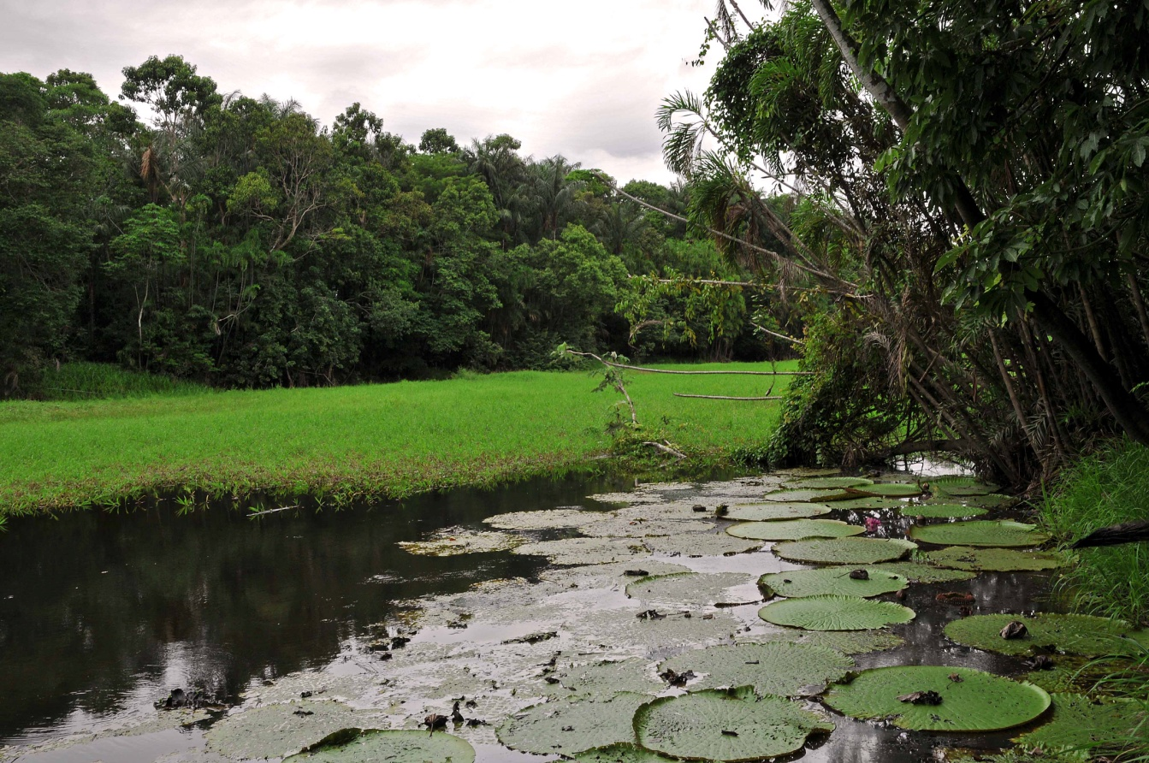
2. Spatial Patterns in Diversity
Merriam’s “life zones”
Climate vs. altitude = Climate vs. latitude
b. Topographic gradients- regions with mountains and rivers are more diverse
-- Why? Habitat
heterogeneity …..
Images: Mountain- ilkerender/ CC-BY; River- marek.krzystkiewicz/ CC-BY
Notes:
-diversity patterns are additive, second pattern sits on top of the latitudinal gradient;
-increase habitat heterogeneity;
-increase in variety of physical environments, species with different adaptations;
-relationship between climate and elevation;
-increases either latitude or altitude, both the climate and the vegetation changes, consumers with different adaptations;

Slide 8
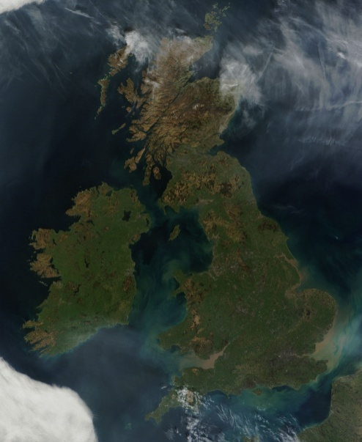
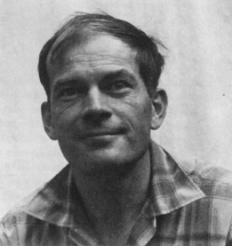
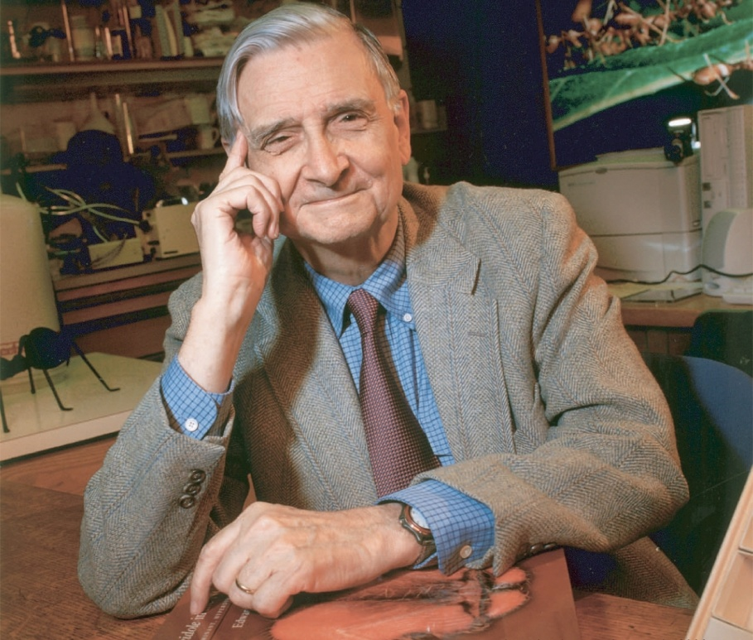
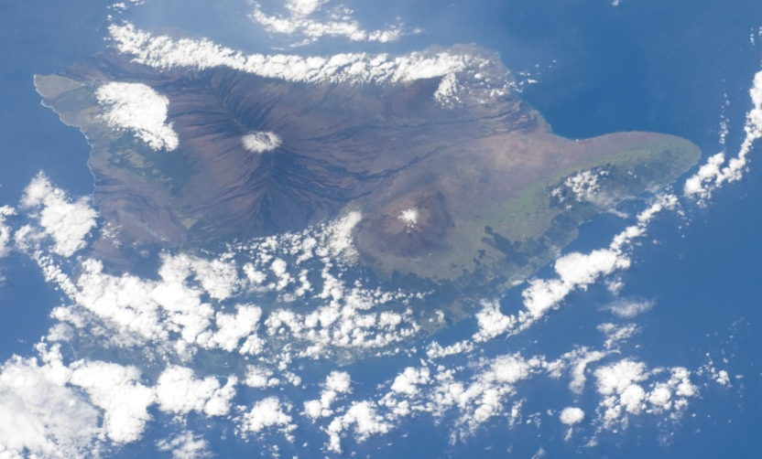
2. Spatial Patterns in Diversity
c. Equilibrium Theory of Island Biogeography suggests that species diversity in an area is determined by a balance between colonization vs. extinction …..
This is, again, a b-d balance!
Images: Hawaii- NASA's Marshall Space Flight Center/ CC-BY-NC; Great Britain- NASA Goddard Photo and Video/ CC-BY
Wilson images Jim Harrison/ CC-BY
Notes:
-rules that govern diversity on islands;
-colonization of species from the mainland and the extinction of established species;
-MacArthur and Wilson in the 1960s;
-Wilson, who came to visit last month and gave a seminar here;
-most well studied biogeographic pattern of diversity;

Slide 9
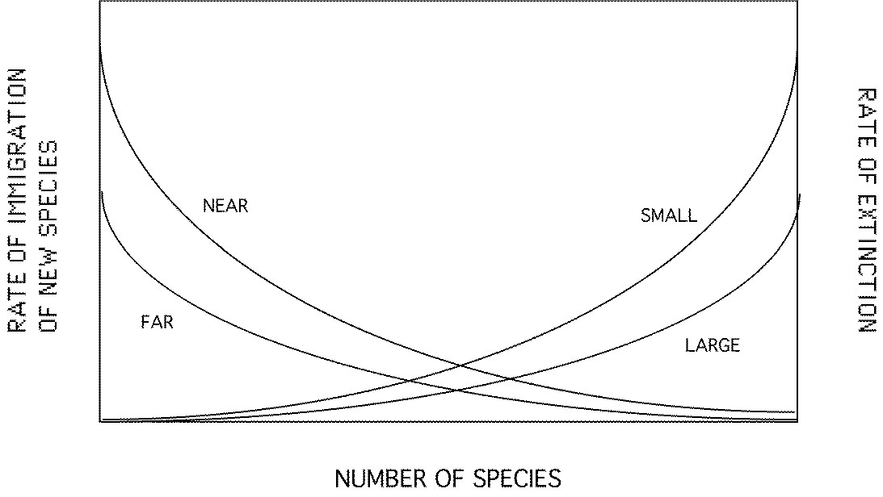
Equilibrium Theory of Island Biogeography
Notes:
-graph is a summary of island biogeography;
-If you understand this graph then you understand the Theory;
-go over it step by step;

Slide 10
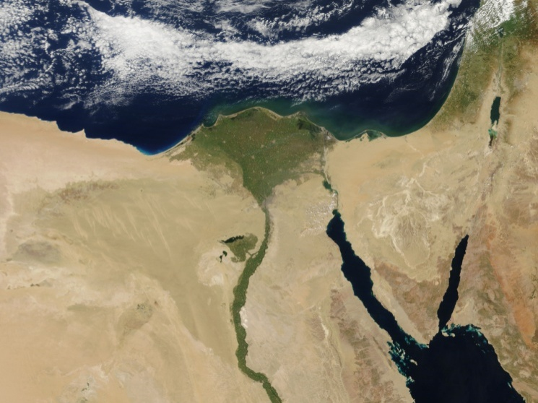
“Areas” are thought of as islands. But, in this theory, islands are more than you think . . .
All islands are habitat islands- isolated, favorable habitat surrounded by larger inhospitable habitat
Species specific
land island surrounded by water
water island surrounded by land (lakes)
oaisis within a desert
Images: River- marek.krzystkiewicz/ CC-BY; Egypt- NASA Goddard Photo and Video/ CC-BY; Great Britain- NASA Goddard Photo and Video/ CC-BY
Notes:
-mesic species, an oases in a desert would be a habitat island if they are not adapted;
-islands like mountaintops and peninsulas;
-differ from continents in being relatively more isolated;
-fewer species than continents;
-facilitating diversification and resulting in endemism;
-islands are typically depauperate in species richness relative to mainland;

Slide 11
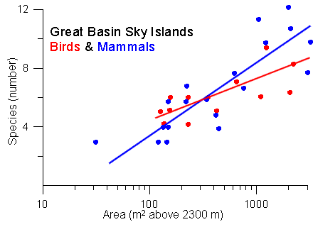
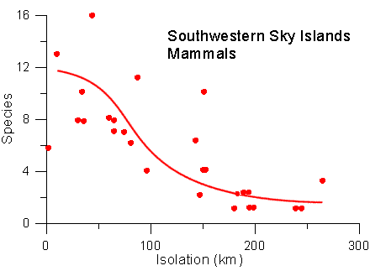
Island Biogeography Theory predicts that there will be more species as: -- Island size increases -- distance to a source decreases
Notes:
-Patterns that operate on islands also operate on mountaintops;
-patterns for birds and mammals are consistent with the theory of island biogeography;
-larger the mountaintop, the more species diversity;
-more isolated the mountaintop from other mountaintops, the less mammal species;

Slide 12
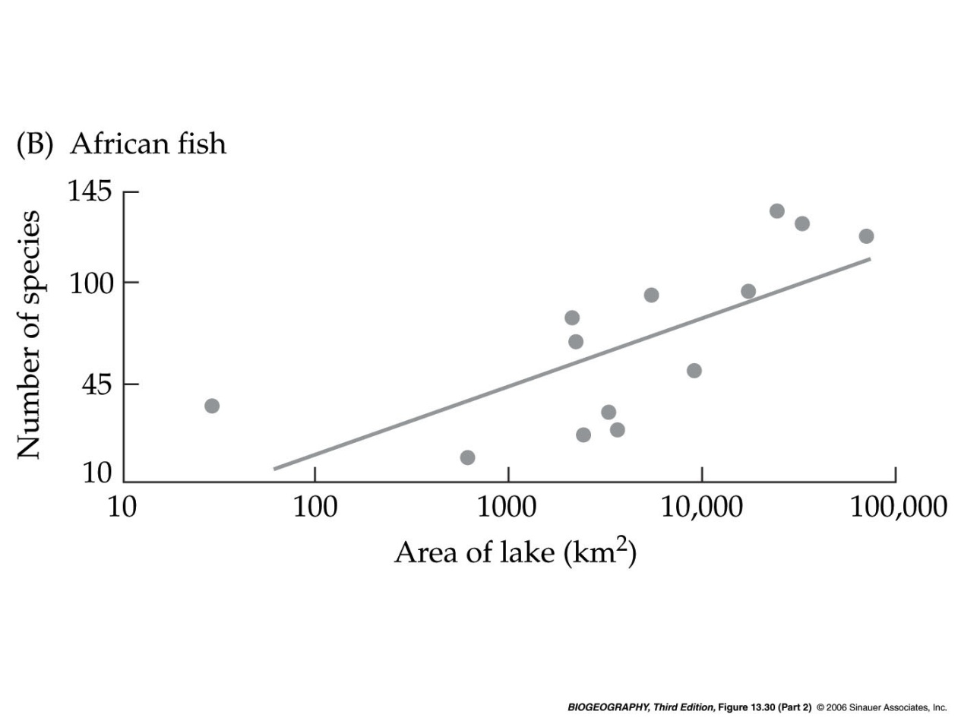
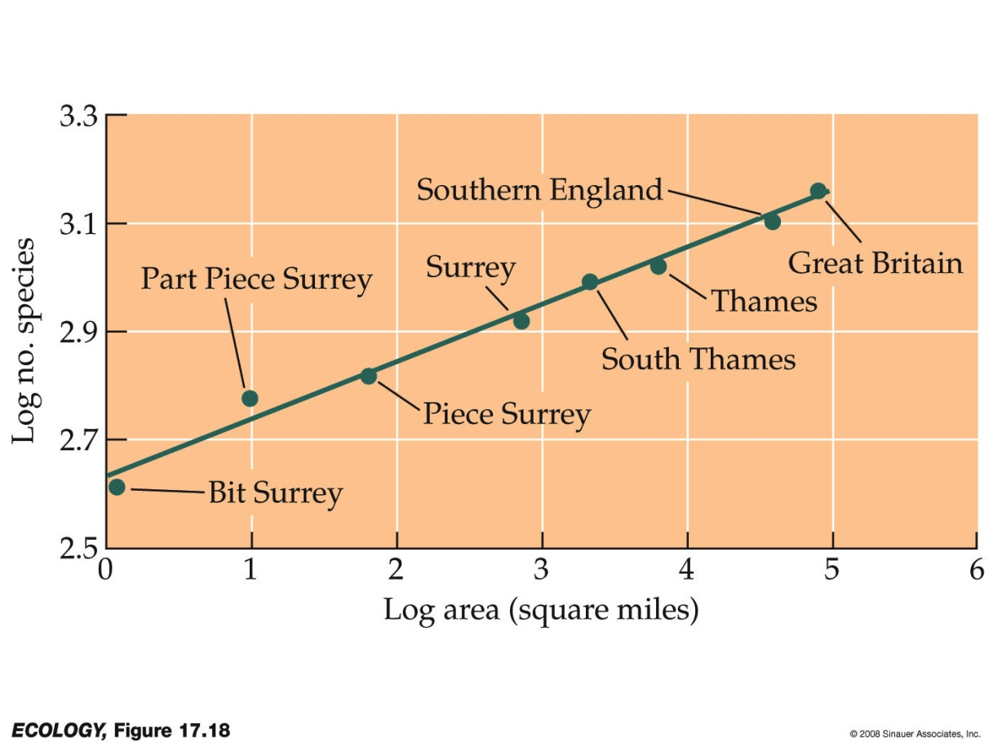
Island biogeography has been applied on may different scales, from individual lakes to continents
Fish in African lakes
All species in England
Notes:
-Patterns that operate on islands also operate on lakes, larger lakes in two continents housing more fish species;

Slide 13
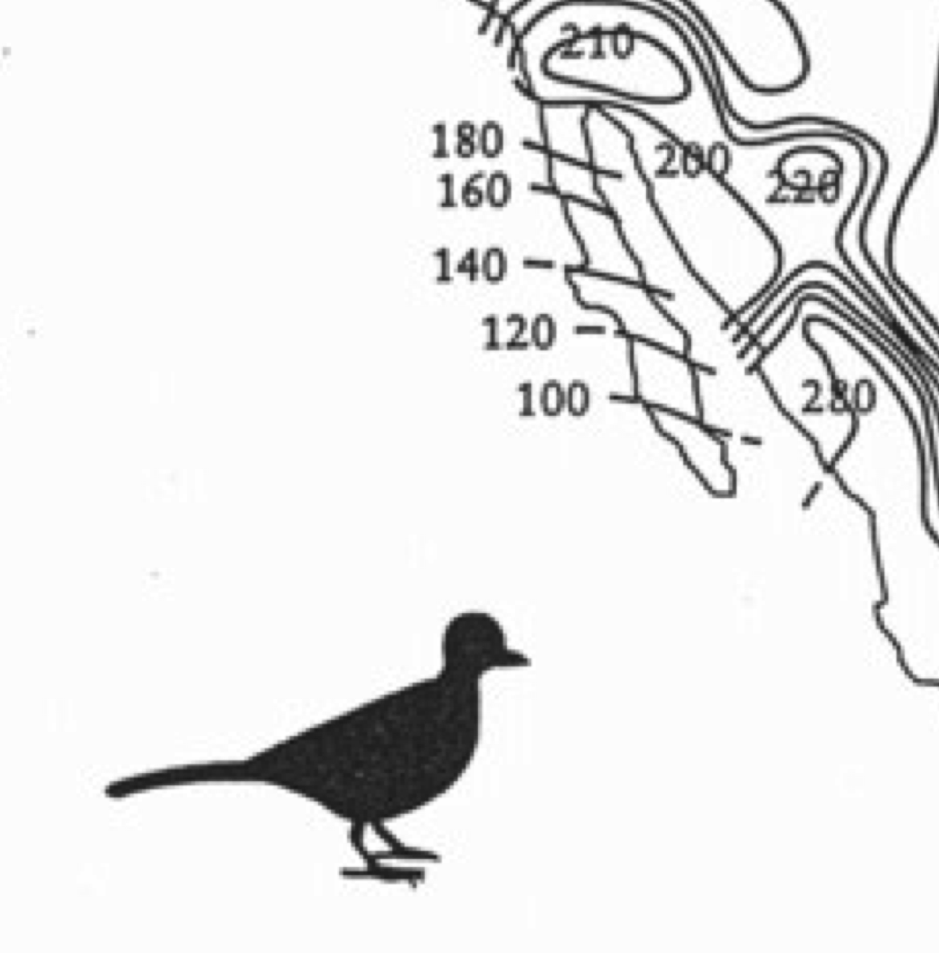
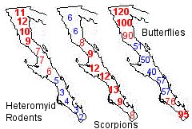
Equilibrium Theory of Island Biogeography – also works on areas that are “kind of like” islands, such as peninsulas.
Baja California
Notes:
-Patterns that operate on islands also operate in peninsulas;
-species decrease along peninsulas, further from a source of immigrants;
-pattern in the peninsula of Baja California;
-number of animal species in four groups of animals decreases along the peninsula;

Slide 14
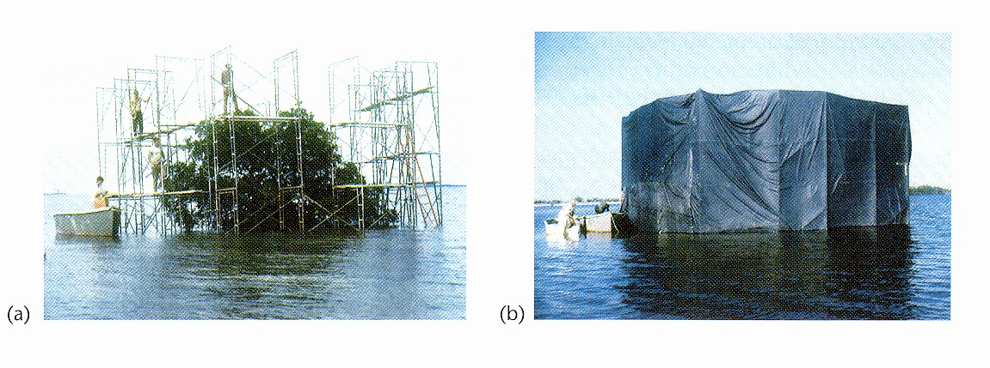
Experimental Evidence for Island biogeography theory. Simberloff &Wilson (1969) studied insect colonization on mangrove islands in FL keys
Notes:
-supported by experimental evidence;
-oldest and most well known experiment;
-islands of different sizes and distance from the mainland;
-tented these islands with tarps and gassed all the insects;
-test the predictions of the model, turnover, area effect, and equilibrium;

Slide 15
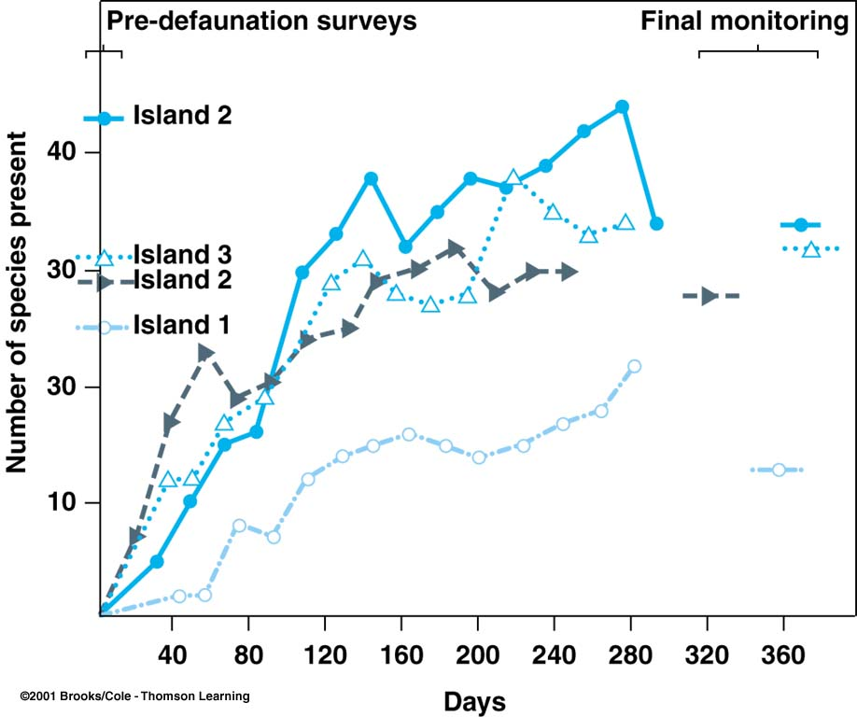
Near, large
20
Far, small
Notes:
-surveyed the process of insect re-colonization for 1 year;
-After 250 days, the number of species had returned to its original number, smaller, isolated islands having fewer species;
-Abundances did not recover as rapidly;
-at day 250, species richness and composition were similar to the un-fumigated controls except most distant island;
-makeup of the species, however, was not the same as the makeup of the species prior to the fumigation, evidence for species composition turnover;

Slide 16
The way forward to the end of the semester . . . .
IV. Community ecology
A. What is Community Ecology?
B. How do we quantify communities?
C. How do communities vary in space (biogeography)?
D. How do communities vary in time (succession)?
E. What factors affect diversity and community structure?
V. Ecosystem Ecology
A. the basics
B. carbon cycle as an example
C. climate change

Slide 17
IV. Community ecology
. . . .
E. How do communities vary with time (succession)?
1. What is succession?
succession: replacement of populations in a habitat through a regular progression to a stable state (climax).
b. sere: a series of stages of community change in a particular area leading toward a stable state.

Slide 18
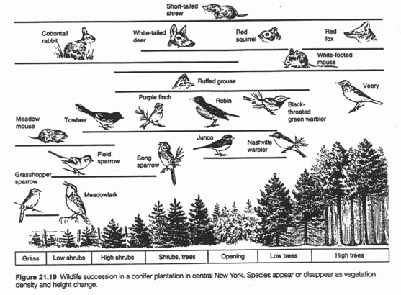

Slide 19
net production
diversity
biomass
gross production
colonization
Successional Time
climax

Slide 20
net production
diversity
biomass
gross production
colonization
Successional Time
climax
Diversity and/or species number increases with successional time as more species colonize an area. Up until mid- to late succession, the migration of new species is greater than the loss due to extinction. However, late in succession, there are no more new species to invade and competitive exclusion leads to a decline in diversity.
Biomass simply increases as more and more individuals are established and as larger individuals take over. Larger individuals have slower growth rates, which ultimately means that biomass increases more slowly and eventually levels off.
Production increases as there is more biomass present to fix CO₂. This is mitigated somewhat by the earlier species have faster growth rates and higher metabolic rates, which also accounts for the difference between gross and net production.

Slide 21
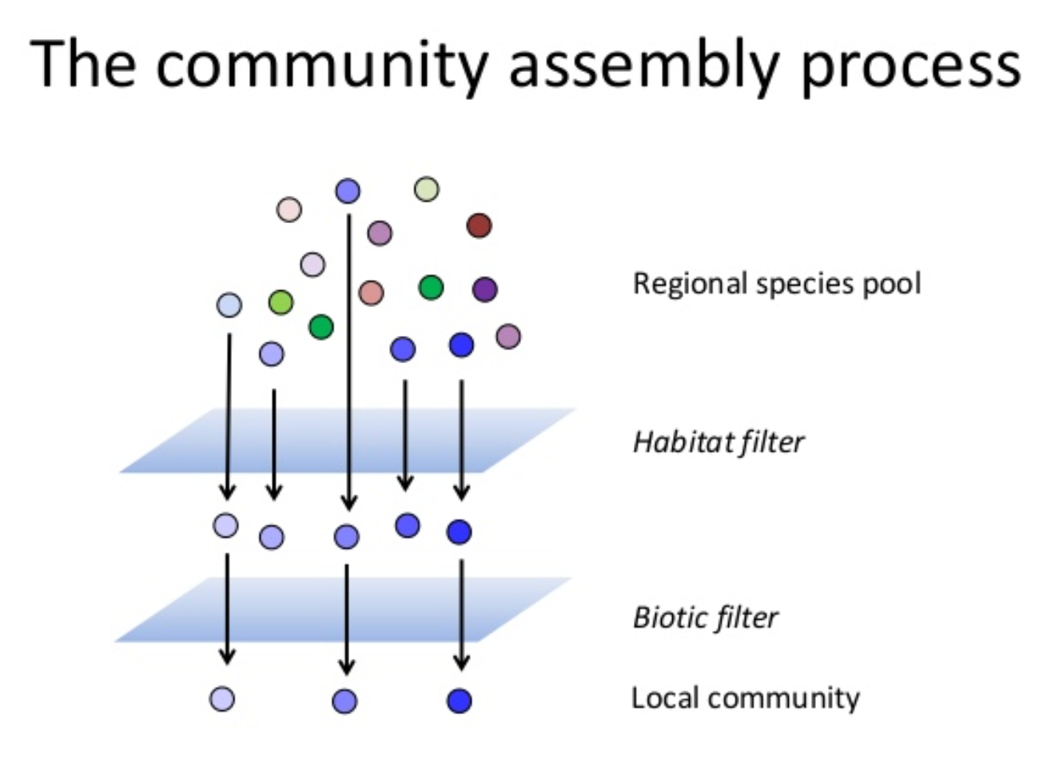
Succession can be viewed as assembly determined by when and which species pass through different filters. The first filter is based on who can get there (biotic, similar species traits), the second is based on who can grow in that habitat (abiotic, similar species traits), and the third is based on who can survive the various species interactions, especially competition (biotic, selects for species that occupy different niches.

Slide 22
IV. Community ecology
. . . .
D. How do communities vary: with time (succession)?
1. What is succession?
2. Different types of succession
a. Primary succession (sanddunes, lava, glaciation)
b. Secondary succession - pioneer species to climax species in organic soils where life had previously been before a disturbance.

Slide 23
IV. Community ecology
. . . .
D. How do communities vary: with time (succession)?
1. What is succession?
2. Different types of succession
3. Characteristics of species during succession:
early stages late stages
many seeds few seeds
small seeds large seeds
wind or animal dispersal gravity dispersal
long viability of dispersal propagules short viability of dispersal propagules
low root/shoot ratio high root/shoot ratio
fast growth slow growth
small size large size
low shade tolerance high shade tolerance
-- the same patterns apply to animals
-- what does this remind students of (r vs. K)

Slide 24
IV. Community ecology
. . . .
4. A simple model of succession. --
Henry Horn created a model of succession in a typical New England forest. This model works by simply assuming that, when a tree dies, it will be replaced by a sapling that is already beneath the tree. And, which sapling “wins” (replaces the previous adult) is random and therefore just based on their abundance beneath adults of different species.
A | E | D | C | C
A | B | D | E | D
B | C | B | A | B
B | E | E | E | D
D | C | A | C | A
A | E | D | c, d e a | C
A | B | D | E | D
B | b e aba | B | A | B
B | E | E | E | D
D | C | a a e | C | A
A | E | D | A | C
A | B | D | E | D
B | B | B | A | B
B | E | E | E | D
D | C | A | C | A

Slide 25
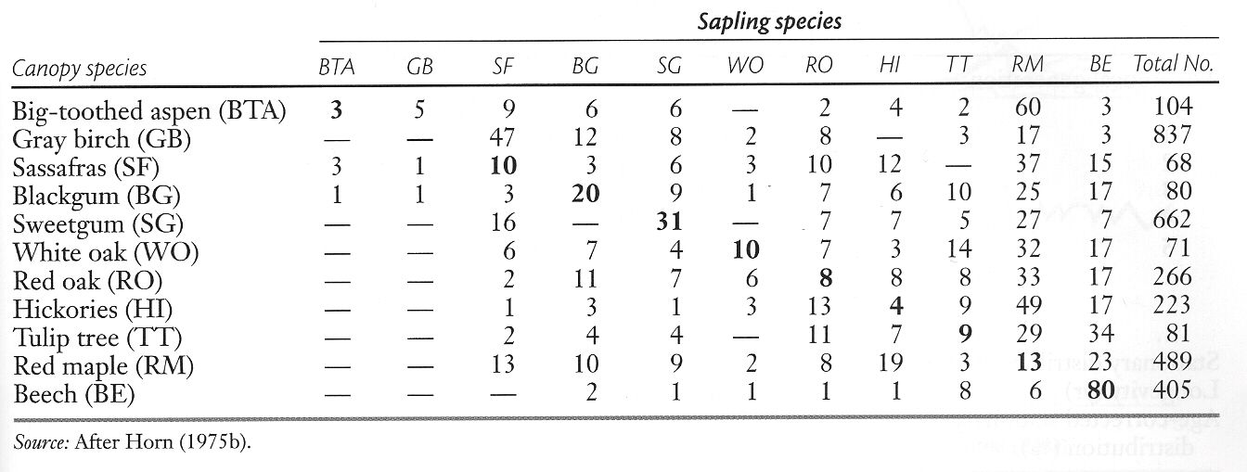
IV. Community ecology
. . . .
Horn’s Markovian Succession model:

Slide 26
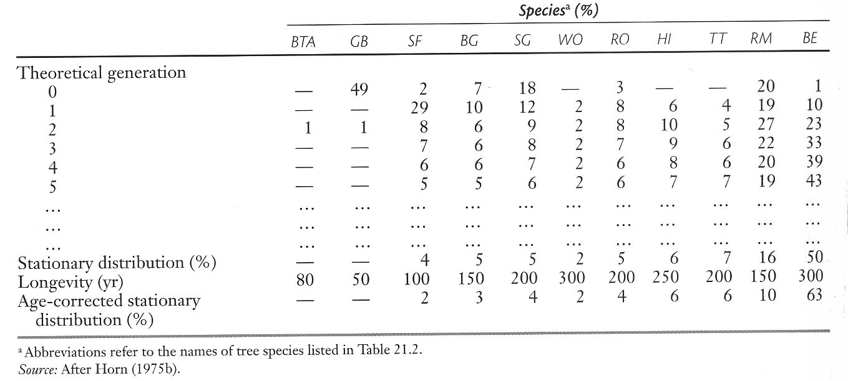
IV. Community ecology
. . . .
Horn’s Markovian Succession model:

Slide 27
IV. Community ecology
. . . .
4. A simple model of succession. --
So, the model predicts that Horn’s forest, composed mostly of Gray Birch, Sweet Gum, and Red Maple, should undergo succession to become mostly Beech and Red Maple. This is largely because of the successive sons of Beeches that occur -- Beech tends to replace itself.
5. Succession as an explanation of diversity:
A related hypotheses, Janzen-Connell, attempted to explain high diversity in tropical forests, based on the idea that perhaps seedlings didn’t do well under their parent trees, which might prevent a species from eventually dominating an entire forest.

Slide 28
Study Guide Items from Lecture 20
Terms:
Concepts:
Spatial patterns in species diversity
Island Biogeography (balances colonization with extinction, as a function of island size and distance from mainland)
Changes in diversity, biomass and production through successional time.
Characteristics of species during succession (like r vs. K)
Horn’s model of tree succession based on understory occupation
Case Studies:
Simberloff’s study using mangroves as islands
Horn’s data on tree succession in New England
Succession Secondary succession | Sere Primary succession Climax
Notes:
28

