Slide 1
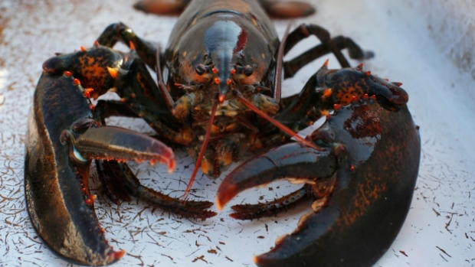
19th Lecture – November 15, 2016
-- read Kneitel and Miller 2002
-- quiz on Thursday
Friday, November 18, 4:00 pm, 1024 KIN—ECOLOGY AND EVOLUTION SEMINAR,
Flips, locks & feedbacks: the lasting effects of fisheries on Maine's kelp forest ecosystem
Dr. Robert Steneck, School of Marine Sciences, University of Maine

Slide 2
Average = 61

Slide 3
Average = 66
Includes some zero’s on quizzes that people will likely drop.

Slide 4
The way forward to the end of the semester . . . .
IV. Community ecology
A. What is Community Ecology?
B. How do we quantify communities?
C. How do communities vary in space (biogeography)?
D. How do communities vary in time (succession)?
E. What factors affect diversity and community structure?
V. Ecosystem Ecology
A. the basics
B. carbon cycle as an example
C. climate change

Slide 5
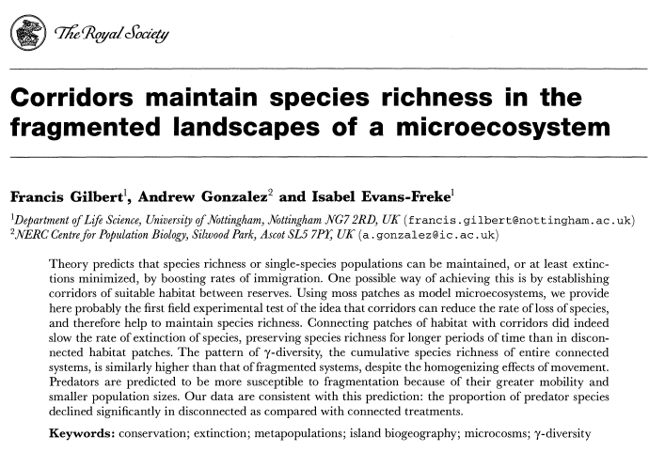
You should have read Gilbert et al.:

Slide 6
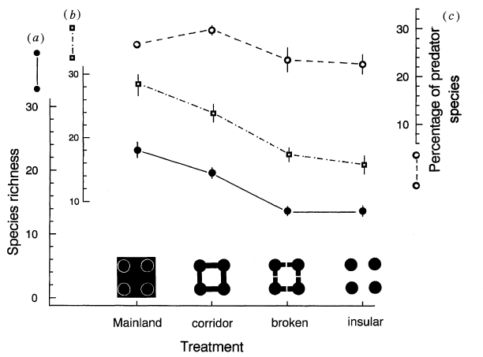
gamma diversity
alpha diversity

Slide 7
Gilbert, et al. found that:
-- connecting patches increased alpha richness (within patches).
-- connecting patches homogenized richness across patches, decreasing beta richness.
-- gamma richness increases with alpha richness, despite the decreased beta richness. So, corridors help preserve richness.
-- predators are more sensitive to fragmentation than consumers.

Slide 8
IV. Community ecology
A. What is community ecology?
B. How do we quantify communities?
1. Tools of community ecology
a. growth form and structure
b. diversity or species number
c. dominance/ relative abundance:
d. rank abundance curves
Most of the above stuff is best for guilds, but may not be informative about entire communities.
e. food or trophic webs
Notes:
Remind me: What is Community Ecology?
We are awesome, and community ecologists… why?
-Diversity! – a million named speces- estimates up to 10 mil. Species Interactions, niches ect.
-Conservation…
-restoration (sustainability)
Tools etc.

Slide 9
IV. Community ecology
. . . .
B. How do we quantify communities?
1. Tools of community ecology
a. growth form and structure
b. diversity or species number
c. dominance/ relative abundance:
d. rank abundance curves
e. food or trophic webs
-- Types of food webs

Slide 10
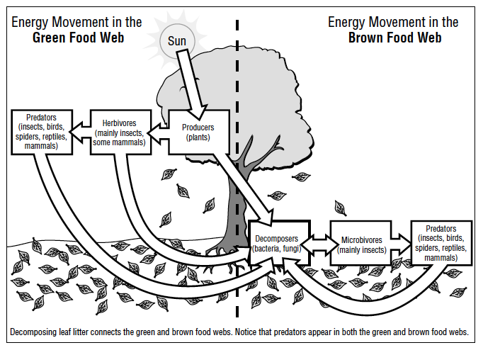
Green (plant-based) vs. Brown (detritus-based) food webs and their linkages
http://www.youtube.com/watch?v=kGMCaTwkKrc
Notes:
Two kinds of food webs…. (are they separate?)
Could there be any others? Talk about that for a minute
http://www.youtube.com/watch?v=kGMCaTwkKrc

Slide 11
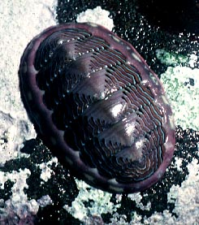
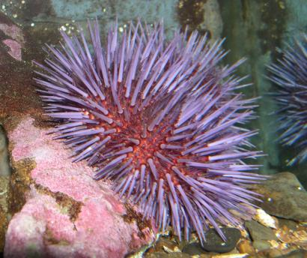
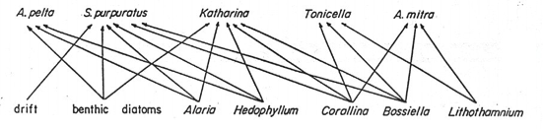
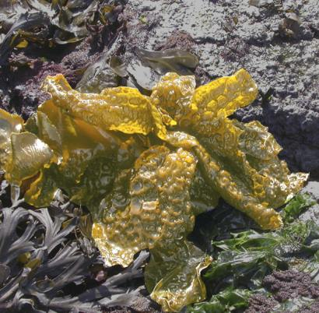
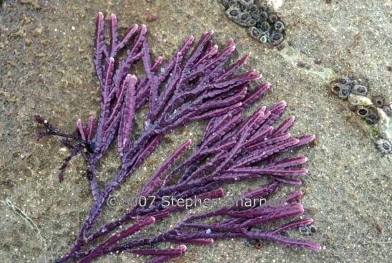
Bob Paine worked on intertidal food webs in Washington state. In this example, he considers a suite of diatoms and algal species that are consumed by urchins and mollusks .
--Acmaea pelta is a limpet, simple cone-shaped snails
--S. purpuratus is the purple sea urchin
--Katharina and Tonicella are chitons, primitive molluscs with plates
--Alaria is a brown algae (seaweed)
--Hedophyllum is a similar brown algae, called “sea cabbage”
--Corralina and Bossiella are coralline red alga
--Lithothamnium is another red algae.
Notes:
Who eats who ever?
Use some of the food web words to describe this.
Are all of these links equally important?

Slide 12
IV. Community ecology
….
e. food or trophic webs
Robert Paine suggests there are three kinds of food webs:
connectedness webs emphasize the feeding relationships among organisms
energy flow webs represent an ecosystem viewpoint in which energy flow between resource and consumers is emphasized
functional webs the importance of each population in maintaining the integrity of the community reflects
Notes:
But, not all food webs are the same. For example,
some represent population level effects
others may represent ecosystem effects of the flux of nutrients or calories.
Paine, a famous marine ecologist, proposed that we use three different types of food webs. [Go though these briefly, because it is going to be repeated on the next slide.]

Slide 13
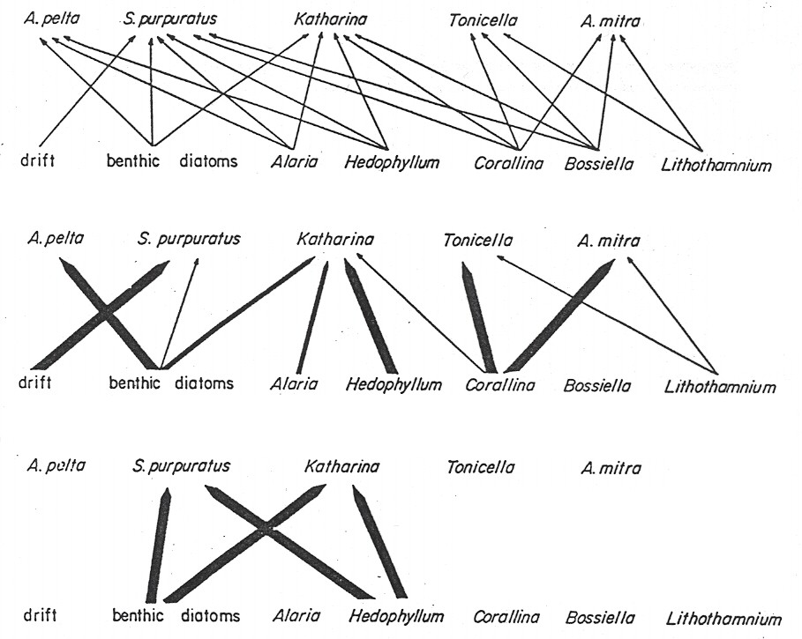
connectedness webs emphasize the feeding relationships among organisms
energy flow webs show energy flow between resource and consumers
functional webs links that maintain the integrity of the community
Note in particular, the large effect of S. purpuratus on Hedophyllum, even though it rarely eats it! This is due to indirect effects of the urchin S.purpuratus in eating competitors of the algae Hedophyllum. So, removing urchins results in a dramatic decrease in the algae.
Notes:
Anything odd about the functional web?

Slide 14
IV. Community ecology
….
e. food or trophic webs
Many ways to quantify food webs include:
-- green vs. brown webs
-- Paine’s energy and functional webs
-- food chain length (number of trophic levels) corn - pigs – man
-- ratios of mass or energy between trophic levels (10% biomass rule of thumb)
-- connectance (# actual links / # of possible links)
Notes:
There are many ways to quantify food webs,
food chain length (the food chain of Iowa (don’t expect students to laugh)),
ratios of mass or energy between trophic levels (trophic pyramids

Slide 15
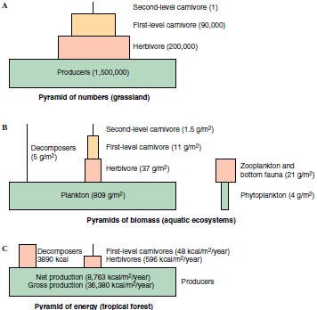
Ratios of mass or energy between trophic levels (10% biomass rule of thumb).
Notes:
Pyramids are meant to suggest that a lot of energy is lost between trophic levels as it moves up.
Don’t put too much belief in this 10% rule, but clearly there is a huge loss of power.
10% sounds good – doesn’t it
Does this suggest anything about sustainable eating habits for humans?

Slide 16
IV. Community ecology
….
e. food or trophic webs
Many ways to quantify food webs include:
-- green vs. brown webs
-- Paine’s energy and functional webs
-- food chain length (number of trophic levels) corn - pigs – man
-- ratios of mass or energy between trophic levels (10% biomass rule of thumb)
-- connectance (# actual links / # of possible links)
Notes:
There are many ways to quantify food webs,
food chain length (the food chain of Iowa (don’t expect students to laugh)),
ratios of mass or energy between trophic levels (trophic pyramids

Slide 17
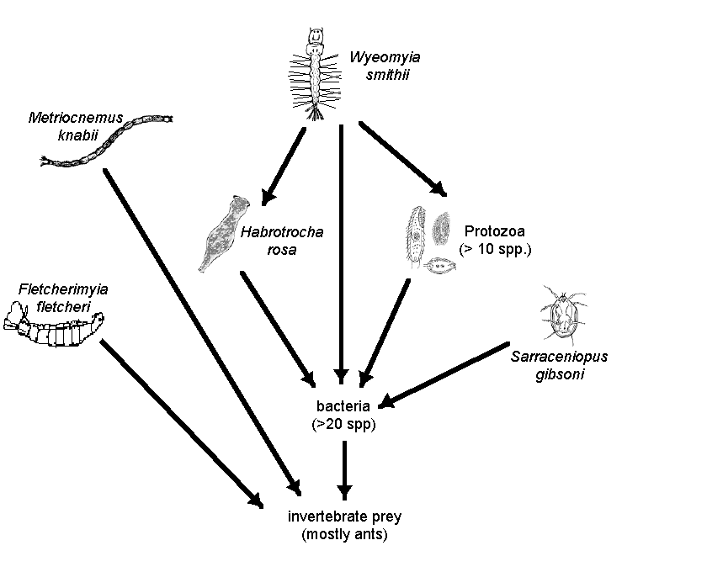
Do food webs consist of clear trophic levels with simple connections?
Notes:
Simple community
Number of species – check
connectance – check
diversity or rank abundance curve. (within guilds)- check
But will this work in more complex communities.

Slide 18
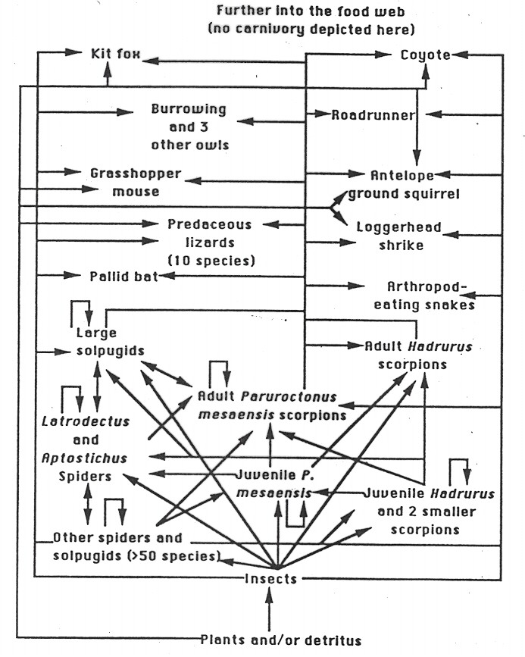
Gary Polis’ research where he attempted to construct the full food web for a “simple” real community in a California desert. This is only part of the food web.
He argued that food webs were way too complicated to apply simplistic measures such as compartments or even trophic levels.
Notes:
Gary Polis
went into an extreme desert in California. - really species-poor system –
to track the interactions f the community
this is only part of the foodweb
What he found was an incredibly complex web of interactions. There are lots of links, including a lot of surprising links, such as bats eating scorpions. There are weird links such as omnivory and cannibalism.
Here it would seem really difficult to figure out some community measures
, such as food chain length, connectence, and compartmentalization.
So, perhaps communities are too complex to really measure?

Slide 19
So, as Polis suggests, are food webs too complicated to be viewed as simple chains of interactions with discrete trophic levels? Maybe . . but, remember Paine’s three types of food webs. If we consider the energy flow or functional foodwebs, each of which considers the strengths of the interactions, then many of the links in Polis’ complicated foodwebs will disappear. So, we generally feel that trophic levels still have some meaning and that, functionally, communities aren’t really quite as complex as suggested by Polis.
Notes:
I think the answer can be found by going back to Paine’s different types of food webs. Polis built a connectedness web that shows all possible pathways, regardless of strength or importance. If he had instead restricted his analysis to energy flow webs or functional webs, he would have found a much simpler picture, that would be more readily quantified by the measures we have discussed in class.

Slide 20
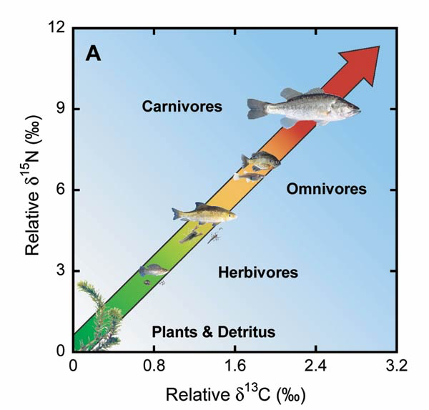
Recent work using stable isotopes has also suggested that the concept of trophic levels is difficult.
Natural isotopes will stay in tissues at different rates. By looking at the proportion of these rare isotopes in tissues, the number of “feeding steps” or trophic levels can be estimated.
Notes:
I think the answer can be found by going back to Paine’s different types of food webs. Polis built a connectedness web that shows all possible pathways, regardless of strength or importance. If he had instead restricted his analysis to energy flow webs or functional webs, he would have found a much simpler picture, that would be more readily quantified by the measures we have discussed in class.

Slide 21
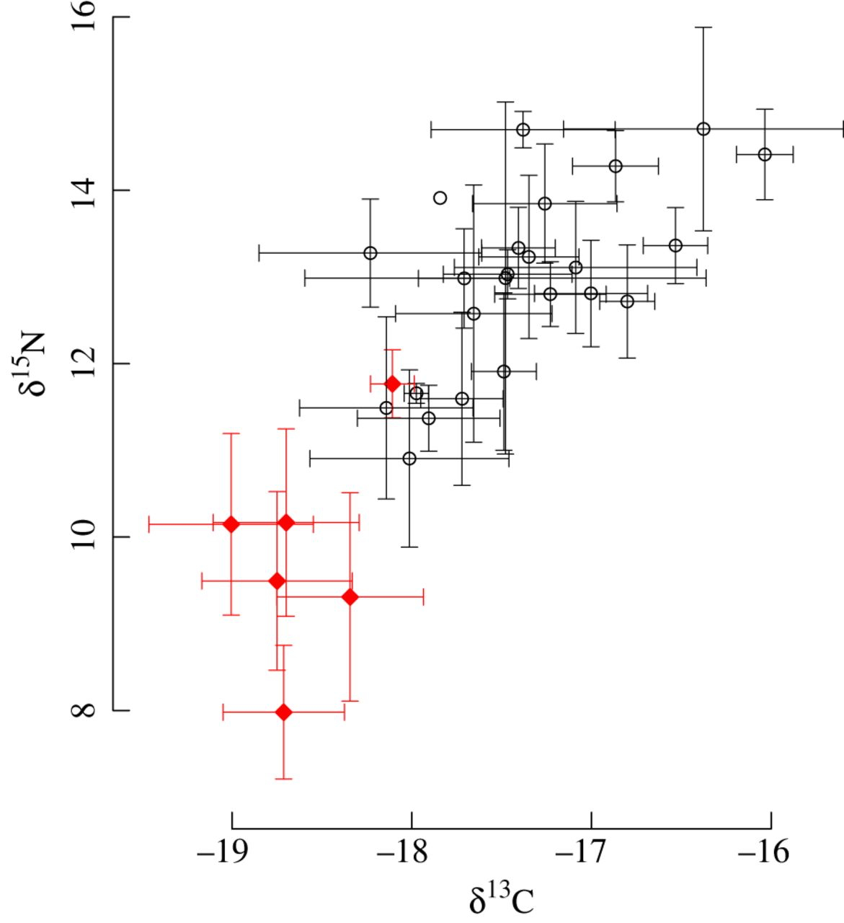
When many species in the same community are studied with stable isotopes, it is often very difficult to identify discrete trophic levels.
Notes:
I think the answer can be found by going back to Paine’s different types of food webs. Polis built a connectedness web that shows all possible pathways, regardless of strength or importance. If he had instead restricted his analysis to energy flow webs or functional webs, he would have found a much simpler picture, that would be more readily quantified by the measures we have discussed in class.

Slide 22
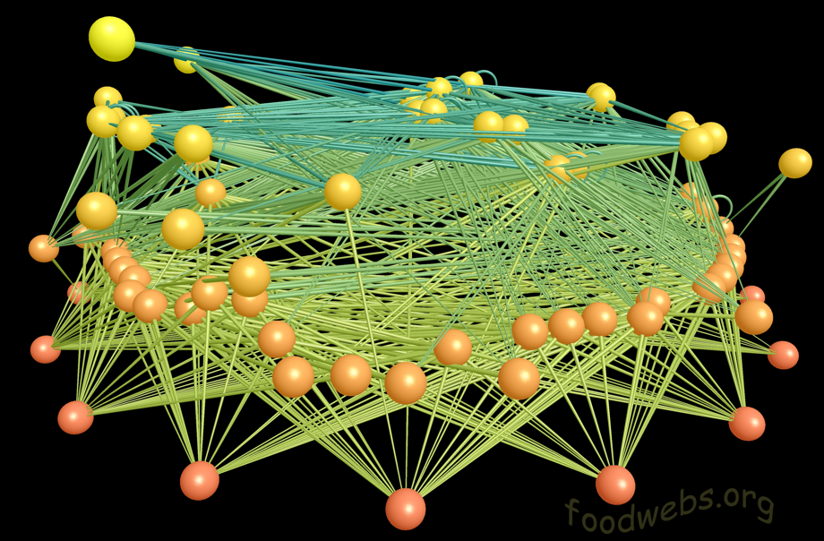
Modern approaches mirror Polis’s work, but with better graphics, and faster computers, and identify which links are most important for community stability.

Slide 23
IV. Community ecology
A. What is community ecology?
B. How do we quantify communities?
1. Tools of community ecology
2. the organization of communities - are communities and food webs a natural unit of organization?
(Yes and No…)
Yes - this was the view of F. Clements who thought of communities as discrete units with sharp boundaries (superorganism view resulting in a closed community). A species within a community can be thought of as an organ inside an organism -- its functioning and dynamics cannot be understood without considering the whole organism
No- Gleason and Cooper viewed communities as a chance or fortuitous association of organisms whose adaptations enabled them to live together under the particular physical and biological conditions found at the particular location (individualistic view leading to an open community). (similar to Redundancy Model in Krebs)
Notes:
Ok, we’ve been talking about within foodwebs. But how do they meet each other?
Do you think it’s a good idea to break communities up into discrete chunks like we have?

Slide 24
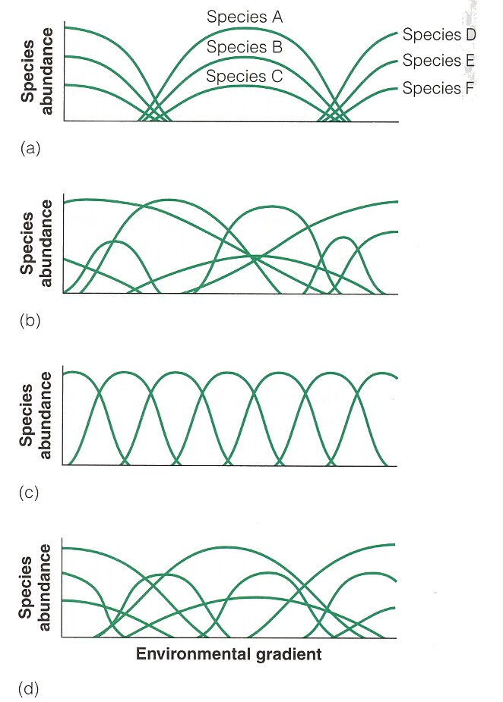
Different predictions
Clement’s superorganism, closed communities
Gleason’s Individualistic, open communities
Idealized Niche communities with resource partitioning
Resource partitioning with several strata

Slide 25
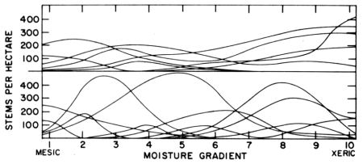
IV. Community ecology
2. the organization of communities - are communities a natural unit of organization?
a. Yes - Clements’ superorganism, closed, communities
b. No- Gleason and Cooper’s individualistic, open communities
c. Evidence
-- continuity and discontinuity of stands
-- gradient analysis (Robert Whittaker)
Species populations of forest trees along a moisture gradient in the Siskyou Mountains, Oregon (above) and the Santa Catalina Mountains, Arizona. (below)

Slide 26
IV. Community ecology
2. the organization of communities - are communities a natural unit of organization?
a. Yes - Clements’ superorganism, closed, communities
b. No- Gleason and Cooper’s individualistic, open communities
c. Evidence
-- continuity and discontinuity of stands
-- gradient analysis and ordination show individualistic
-- dynamic relations between species populations: at some
level, species must be organized by obligate
interrelationships.
To some degree, predators depend on certain prey or plants depend on certain pollinators, etc., which requires that species distributions are non-independent. So, both “superorganism” and “individualistic” views may apply, although most patterns suggest individualism.

Slide 27
Community ecology
A. What is community ecology?
B. How do we quantify communities?
  Community patterns at large spatial scales
  -- this is Biogeography.
Notes:
Remind me: What is Community Ecology?
We are awesome, and community ecologists… why?
-Diversity! – a million named speces- estimates up to 10 mil. Species Interactions, niches ect.
-Conservation…
-restoration (sustainability)
Tools etc.

Slide 28
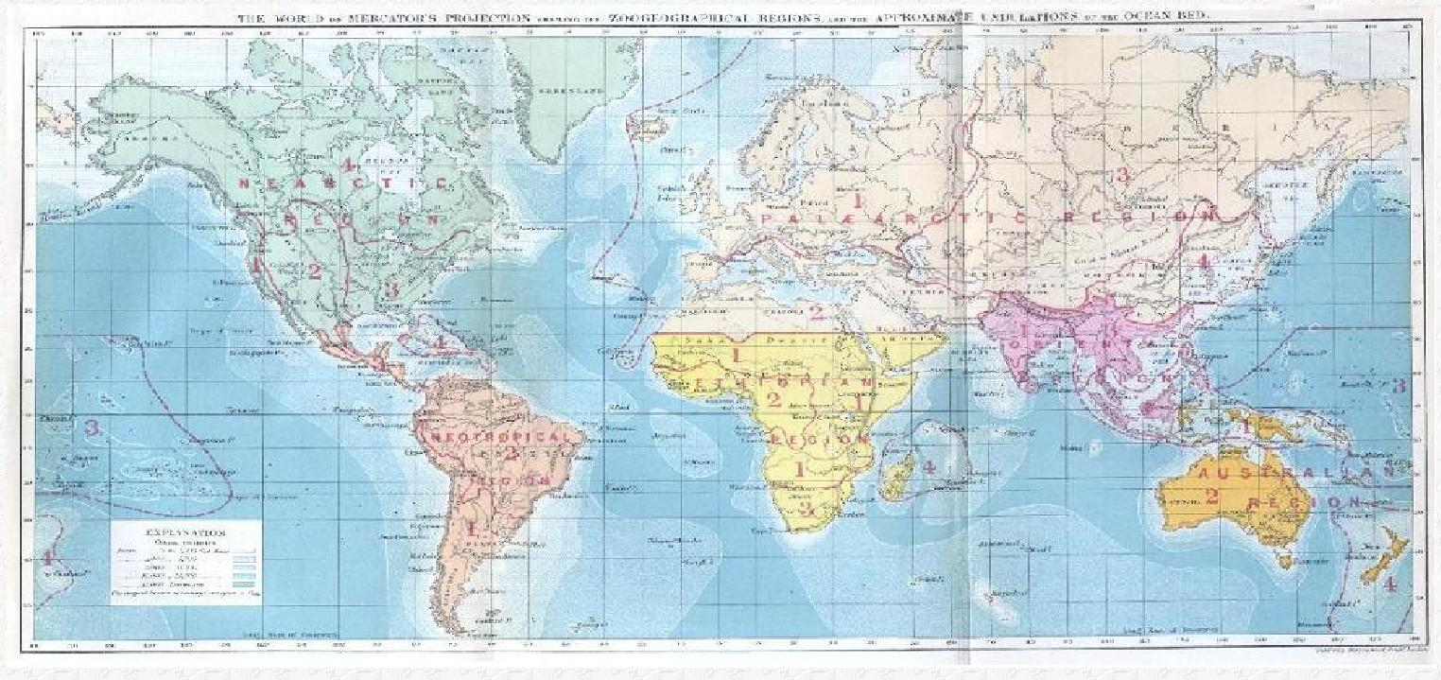
C. Community Patterns at Large Scales: Biogeography
Geographic distribution of biodiversity
  Historical (evolutionary): distribution = past events
  Ecological: distribution = current environment
Ecology
Evolution
Geography
Genetics
Biogeography
Paleontology
Systematics
Notes:
-past and present distributions, variation within these distributions;
-two main approaches;
-result of past events including adaptation and speciation, large spatial and temporal scales;
-consequence of the current environment and niche;
-how diversity and community structure change across space;
-integrative field, methods and data from ecology, evolution;

Slide 29
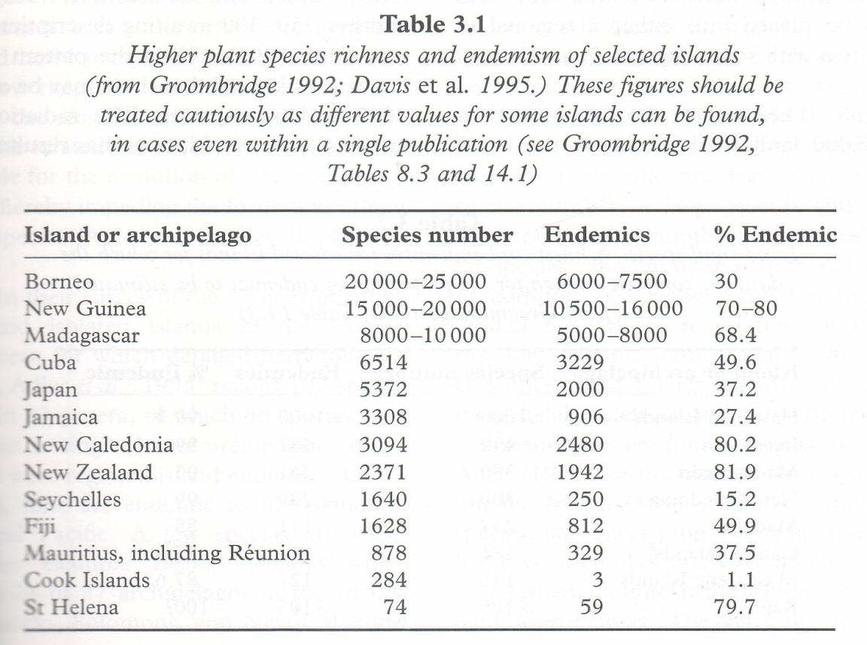
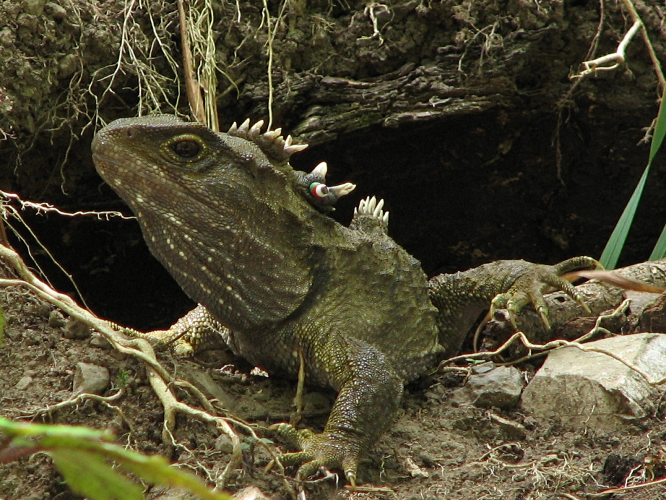
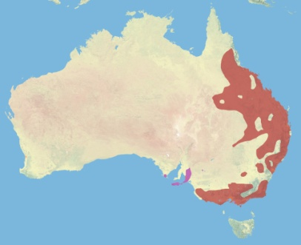
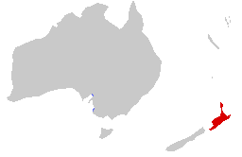

Community Patterns at Large Scales: Biogeography is the study of patterns in species distributions
Unique, non-uniform
Endemic- found in one region
NZ endemism
UK: 47 endemics
Images: Koala- Steve Evans / CC-BY; Koala Map- Nrg800 / CC-BY-SA; Tuatara- Michael / CC-BY-NC-SA; Tuatara Map- Adapted from Sarefo and Samsara / CC-BY-SA
Notes:
-distinctive taxa;
-found in that region and nowhere else;
- ‘Tua-tara’, although it looks like a lizard, part of a different lineage common ancestor squamates (lizards and snakes);
-tuatara are of great interest in the study of the evolution of lizards and snakes;
-highest percentage of plant endemism in the world, separated from continental, 80 million years;

Slide 30
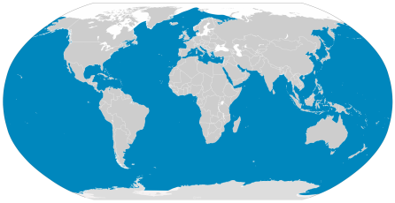
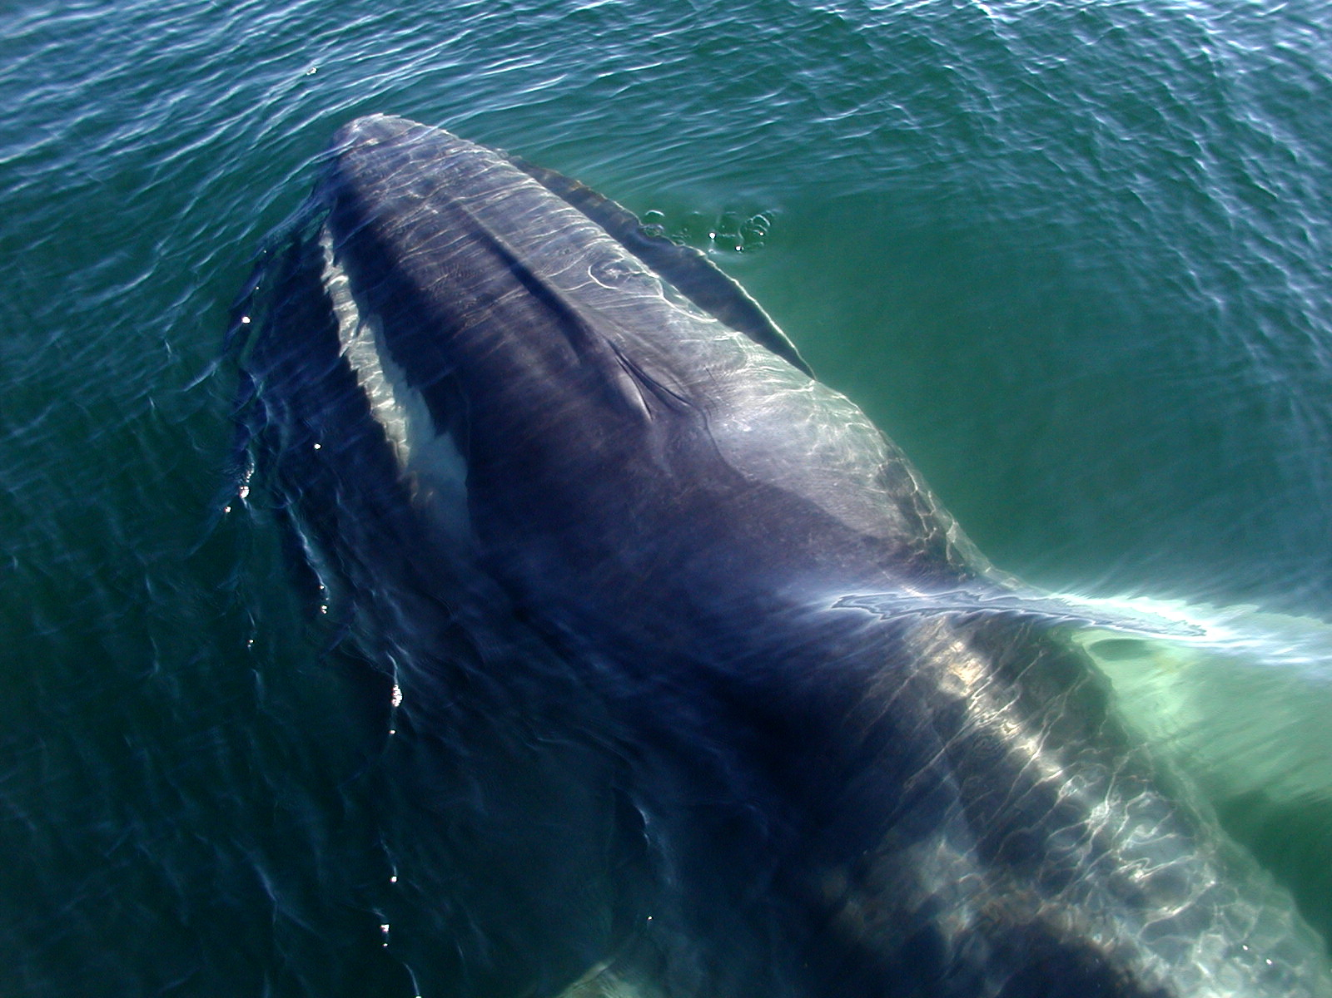
Cosmopolitan- found worldwide
-Fin Whale
-Other examples?
Images: Fin Whale- Sonja Pauen / CC-BY; Fin Whale Map- chris buelow/ CC-BY-NC; Maplab / CC-BY-SA
Notes:
-blue regions of the map;
-include humans;

Slide 31
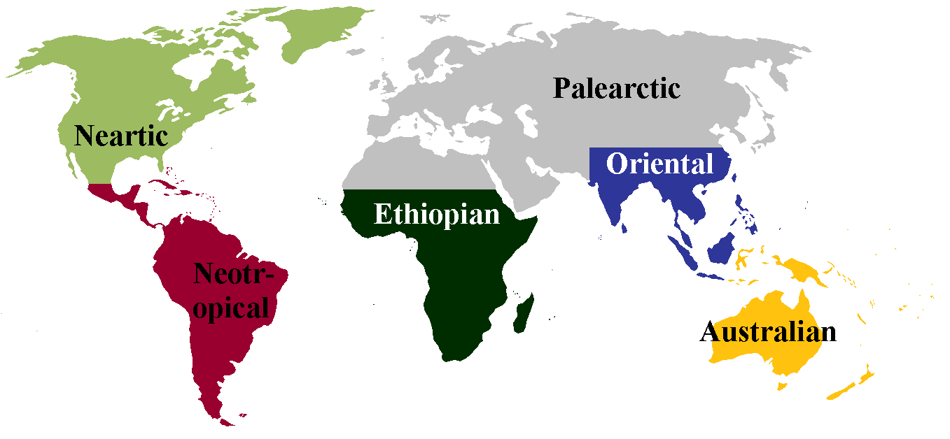
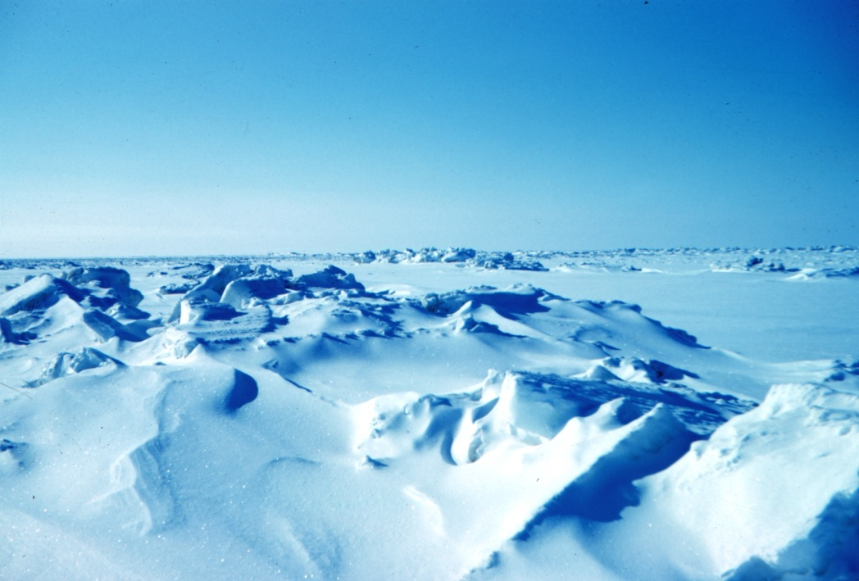
Community Patterns at Large Scales: Biogeography
  1. History of Biogeography
Classical biogeography
  Descriptive
  Distribution - where
Modern biogeography
  Quantitative
  Hypothesis testing
  Distribution - why
Arctic- NOAA/ Public Domain
Notes:
-two main phases;
-sorting geographic regions, species assemblages;
-where species are found;
-why taxa are found in certain places and not others;
-impact of glaciations, distribution of desert animals?

Slide 32
Classical Biogeography revealed that many current patterns can be explained by large-scale barriers to dispersal between zones
Different habitats
Physical boundaries
Notes:
-divided based on barriers to dispersal;
-climatic such as the division between north and south america, division between sub-Saharan Africa and the palearctic;
-physical such as the Himalayas, deep ocean currents;

Slide 33
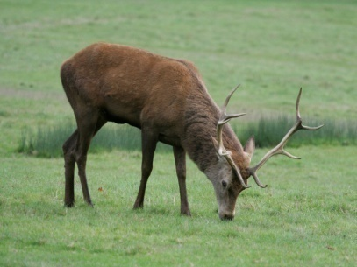
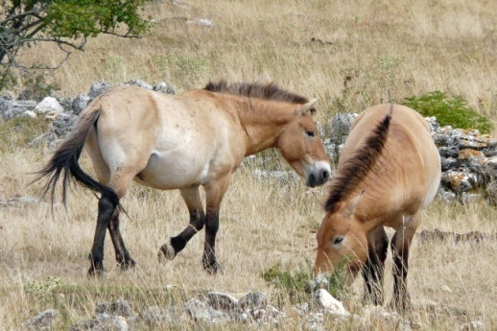
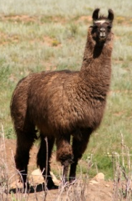
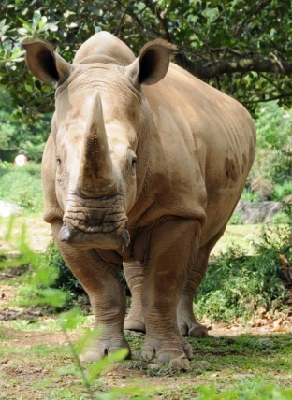
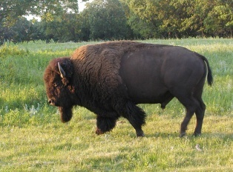
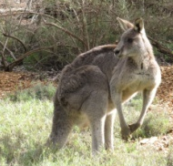
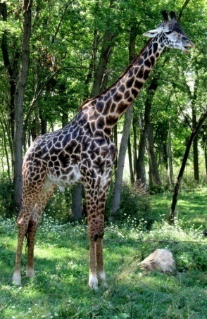
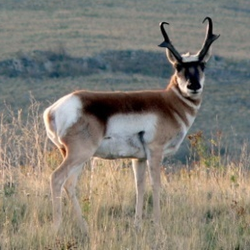
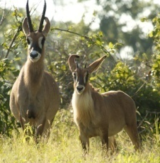
Consequence of Dispersal Barriers
Similar ecological niche in each zone occupied by different families
E.g. large herbivore niche
Notes:
-buffalos and pronghorns;
-llama;
-different animals in the other continents;
-zones are among the first and most important observations in biogeography, also known as Buffon's rule;

Slide 34
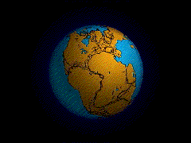
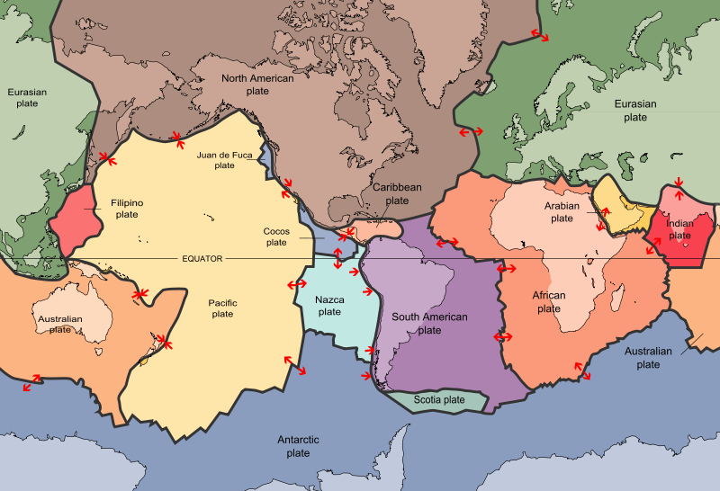
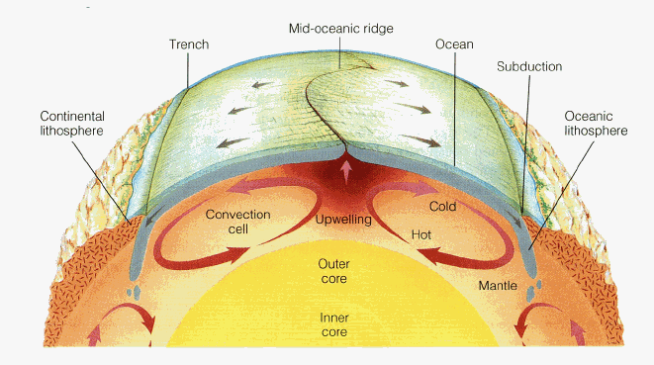
Plate Tectonics Drives Geographical Location of Continents
The earth’s crust is divided into a number of rigid plates that sit on top of convection currents that go through periods of collision and breakup
Figures: Mantle-BIOGEOGRAPHY, Third Edition, (C) 2006 Sinauer Associates, Inc.; Plate Tectonics- USGS/ Public Domain
Notes:
-zones consequence of the geographic location of continents driven by plate tectonics;

Slide 35
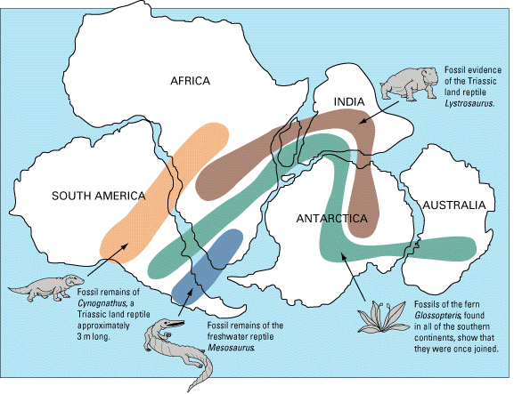
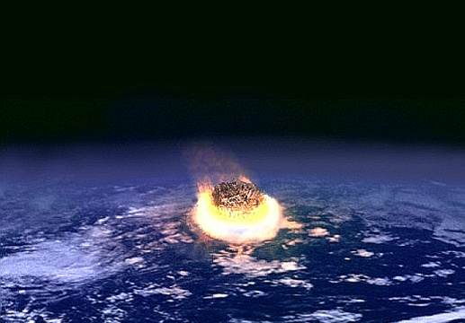
Evidence for Plate Tectonics–Fossil Distributions
Mesozoic – Pangaea
Figures: USGS/, NASA Public Domain
Notes:
-directly measure tectonic plate movement using GPS, cm/ year;
-paleontological evidence;
-200 Mya, all continents were joined;
-Fossil remains of extinct ‘Cy-no-gnath-us’ land reptiles, south American, west Africa, nowhere else;
-extinct freshwater reptiles, south America, southern Africa nowhere else;
-various extinct dinosaurs and plants;
-fossils highly suggests that the continents were once joined;
-ancient distribution, before the meteorite caused them to all go extinct, colored regions;

Slide 36
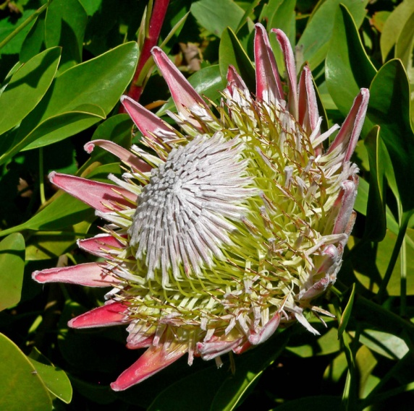
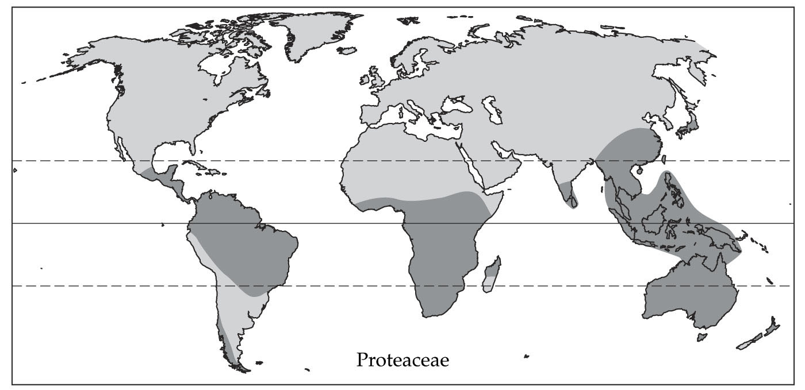
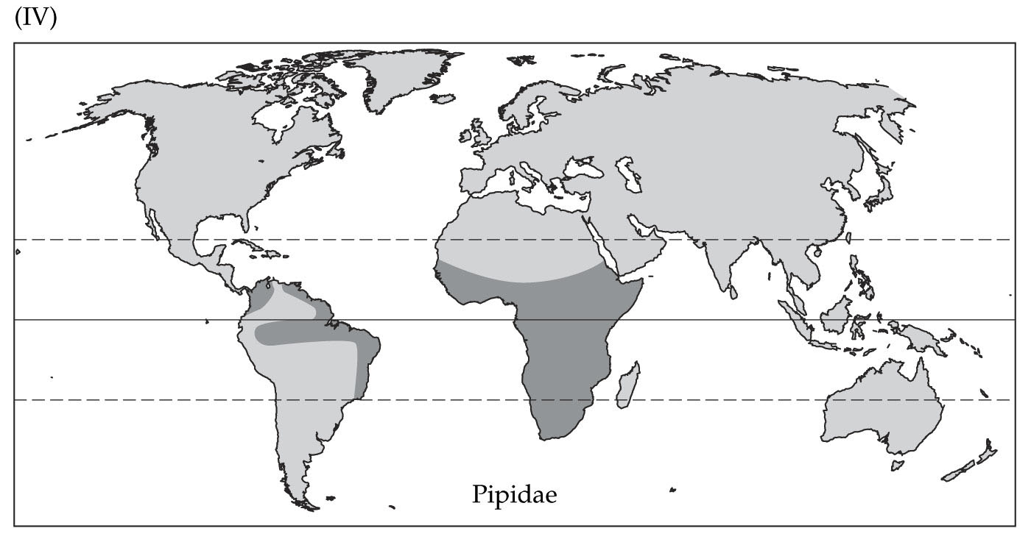
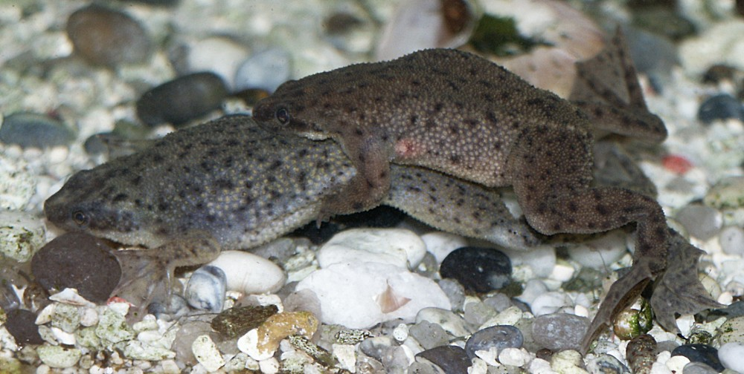
Evidence for Plate Tectonics– Disjunct Distributions
Evergreen shrubs
Clawed Frogs
Notes:
-disjunct distributions of many extant taxa;
-groups that are related but widely separated;
-restriction of the distribution of these taxa to these regions, suggests that these continents were once joined;

Slide 37
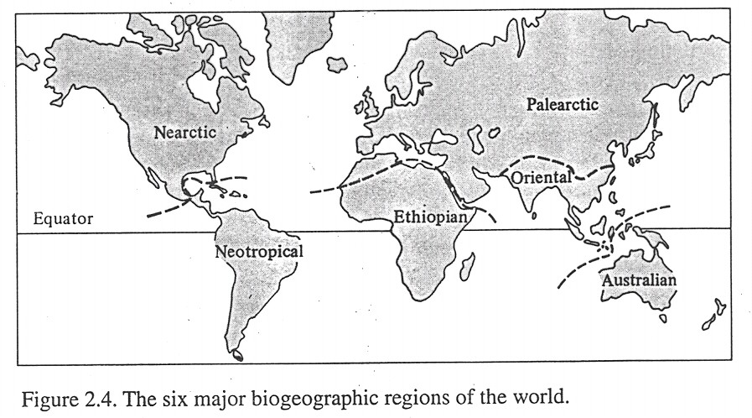
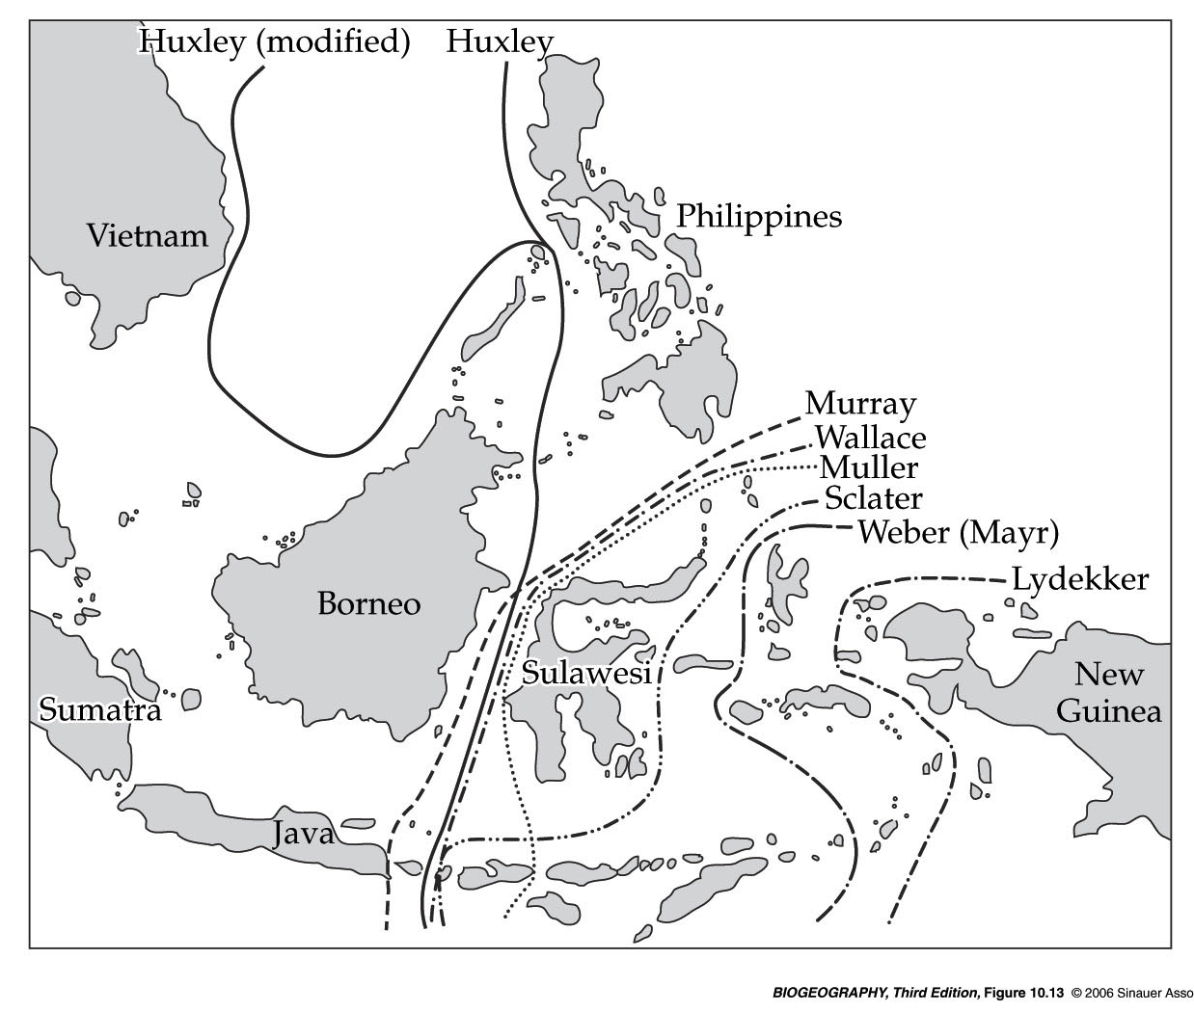
Consequences of Plate Tectonics for Dispersal
Dispersal barriers keep species in zones
Wallace’s line
  Abrupt limit in animal distribution
  Two different continental shelves
Wallace’s
line
Notes:
-tectonics only explains some of the distributions, show later a few cases;
-already described some of these dispersal barriers, Saharan desert, Himalayas;
-most well studied biogeographical boundary, Wallace’s line, isolates Australia from southeast asia by deep ocean currents;
-fish, bird, and mammal groups are abundantly represented on one side, poorly or not at all on the other side;
-visible geographically, contours of the continental shelf;
-west of the line are joined together and to souetheast asia by the sunda shelf;
-east of the line are joined together and to Australia by the sahul shelf;

Slide 38
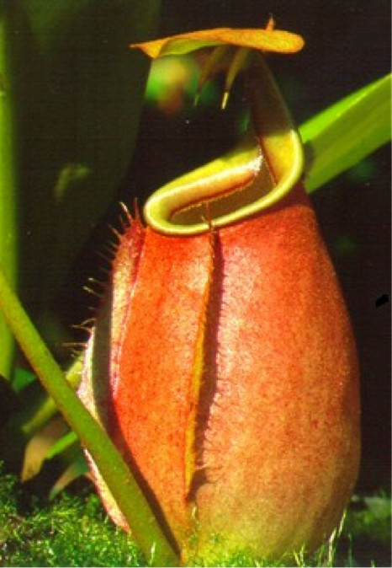
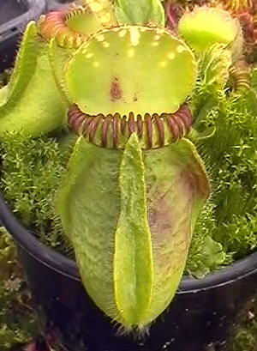
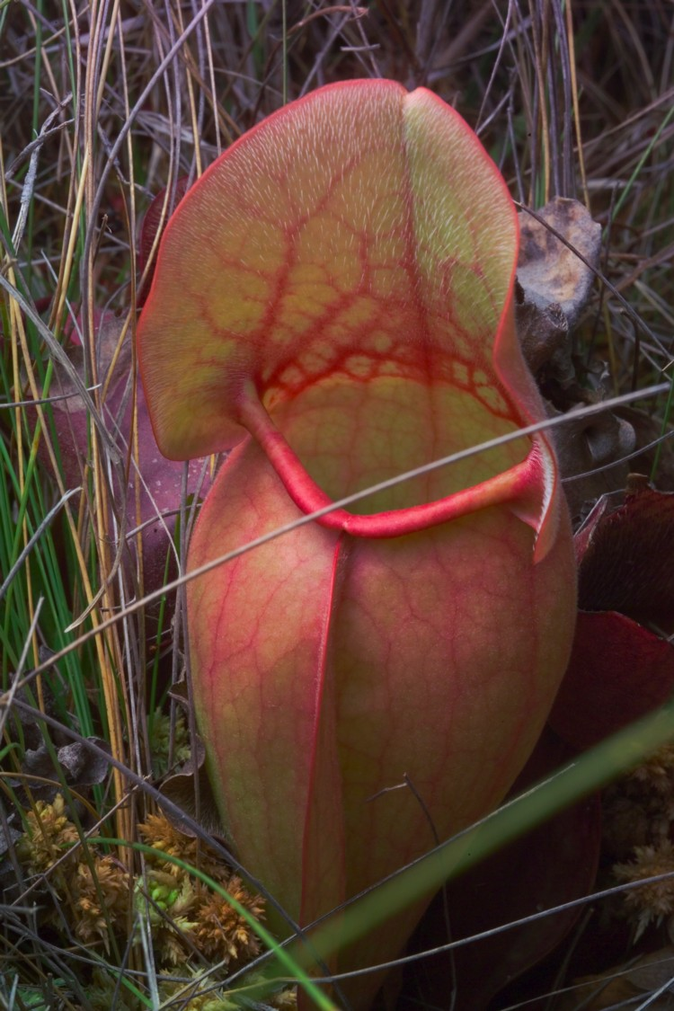
Despite differences among biogeographic zones, often unrelated species can look quite similar due to convergence
Nepenthes
(Indonesia)
Cephalotus
(Australia)
Sarracenia
(N. Florida)
Notes:
-similar ecological niche;
-carnivorous plants capture prey by means of a pitfall trap, evolved independently on at least 4 times;
-collected or secreted into specialized containers, trapping and digestion of animal prey;

Slide 39





Evidence of convergence- molecular phylogenetics
Phylogeny of
major plant
groups
Diff types of carnivorous plants:
Bladderworts= bladder-like traps
Butterworts= sticky leaves
Sarracenia
(NW Pitchers)
Nepenthes
(Indonesian Pitchers)
Dionaea
(Venus flytraps)
Cephalotus
(Australian Pitchers)
rbcl gene sequence phylogeny from Albert, et al. 1992
Notes:
-without symbol = non-carnivorous plants;
-all closely related to non-carnivorous plants;
-evidence from molecular phylogenetics;
-Indonesian pitchers closely related to the Venus flytraps snap traps similar to a mouse trap, than they are to pitcher plants;
-other 2 pitchers plants also have closer relatives that employ means;
-common ancestor of all pitchers is does not look like they;

Slide 40
Study Guide Items for Lecture 19
Terms:
Concepts:
  Ways to quantify and compare foodwebs (e.g., food chain length)
  Brown vs green food webs
  Trophic biomass, abundance, and energy patterns (10% rule not so good!)
  Superorganism (closed) vs. individualistic (open) views of communities
  Paine’s three types of foodwebs (connectedness, energy, and functional)
  Polis’ view that communities are too complex to identify trophic levels
  Biogeographic zones: areas with shared evolutionary history due to geographic isolation
  Plate tectonics is supported by multiple lines of evidence in extinct and extant taxa.
Case Studies:
  Paine’s intertidal food web to demonstrate different types of webs
  Convergence in carnivorous pitcher plant species, using DNA interpretation
  Gilbert, et al. study of effects of corridors in moss on species richness of little critters
Habitat corridor Connectance Superorganism Gradient analysis Compartmentalization Biogeography Wallace Line | Open and closed communities Brown food web Green food web Evolutionary convergence Endemic vs. cosmopolitan Biogeographic zone Species convergence
Notes:
40

