Slide 1
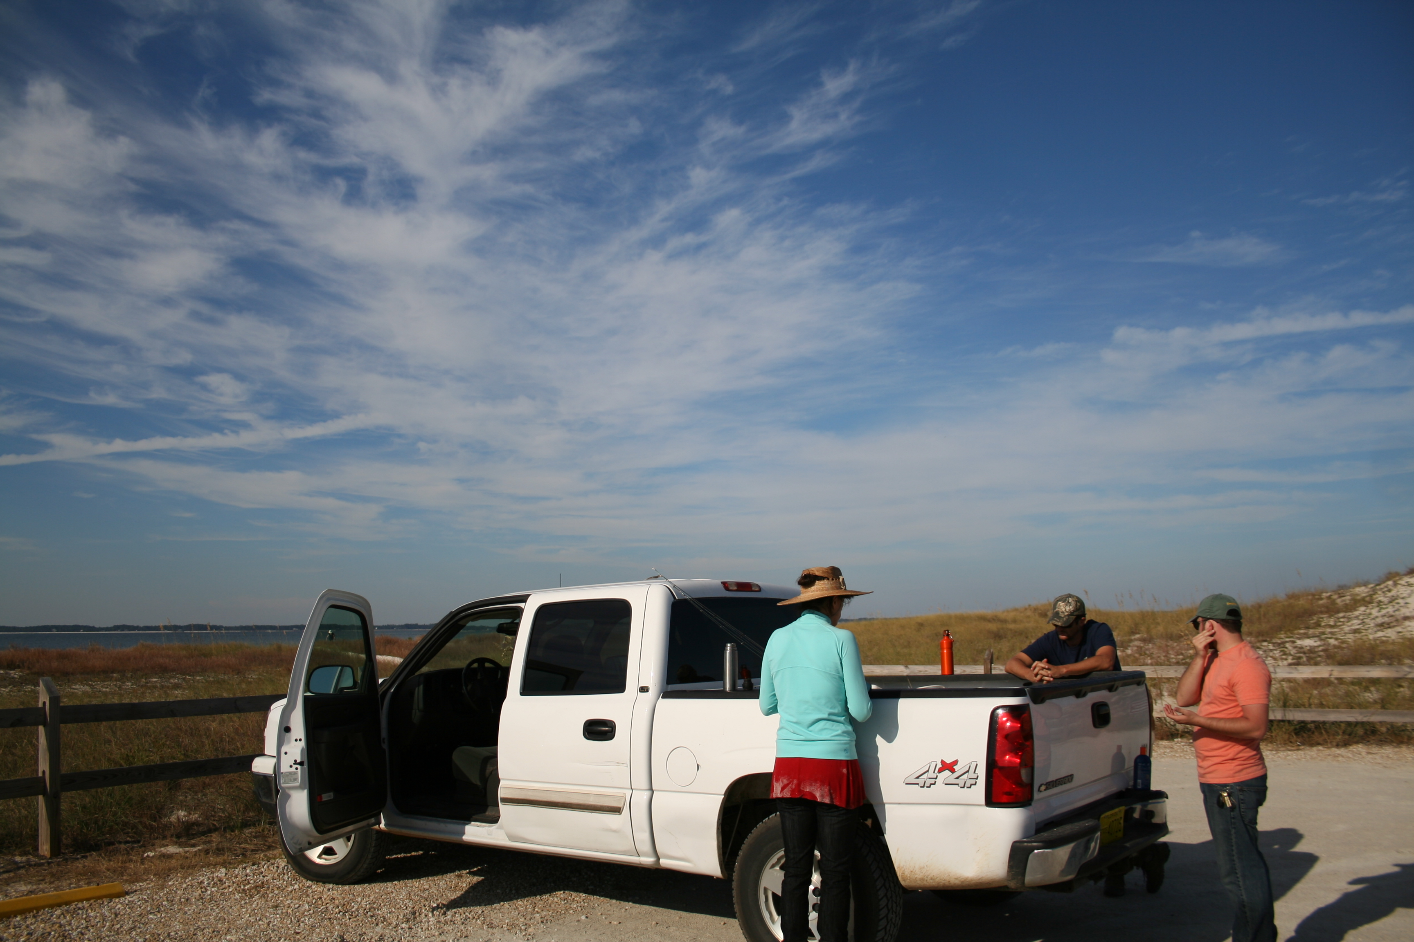
17th Lecture – November 8, 2016
-- exam returned next week.
This lecture needs to be rewritten in my words
Wednesday, November 9, 7:00 pm, 101 CARRUTHERS—BOOK TALK, "Rain: a natural and cultural history," Cynthia Barnett.
Thursday, November 10, 4:00 pm, 1024 KING—BIOLOGICAL SCIENCE COLLOQUIUM, TBA, Dr. Tan A. Ince, University of Miami.

Slide 2
HAIRWORMS!
https://www.youtube.com/watch?v=TO8A5aGw_jw
Closely related to nematodes. Well known parasites on beetles, cockroaches, mantids, grasshoppers, and crustaceans. Appear to take over the behavior of host in order to get to water, where the adults are freeliving.
Thanks, Toni!

Slide 3
IV. Populations and Biotic Influences
A. Types of Species Interactions
B. Competition
C. Predation
D. Positive interactions
1. commensalism
3. mutualism
3. indirect mutualism
3. facilitation
3. evolution of mutualism

Slide 4
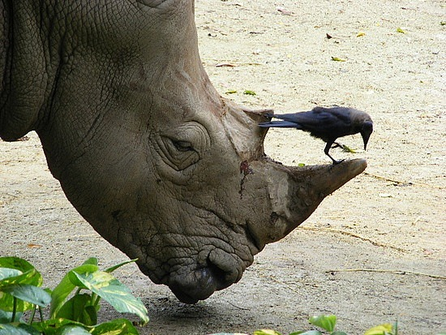
Commensalism, Mutualism and Facilitation

Slide 5
Classification of species interactions
facilitation

Slide 6
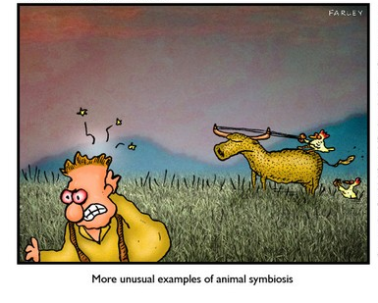
All these species interactions involve some positive effects between species
Commensalism
Mutualism
a. Obligate vs. Facultative
b. Transient vs. Permanent
Indirect Mutualism
Facilitation
Evolution of mutualism

Slide 7
Two important considerations…
Mutualism is not the result of fuzzy teamwork, but of mutual exploitation
Many mutualist relationships likely evolved out of parasitism or predation

Slide 8
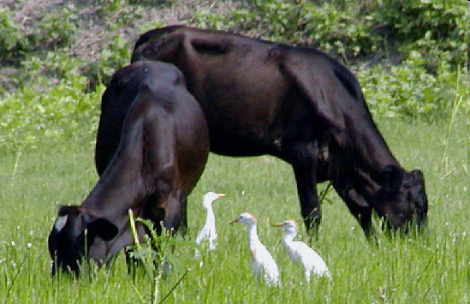
A. Commensalism (+, 0)
Definition: An interaction where one species benefits and the other is unaffected.
1. Feeding Commensalism:
Birds (+), Cow (0):
Cattle Egrets and Cattle- Livestock rustle up insects while feeding that the birds can capture easily.

Slide 9
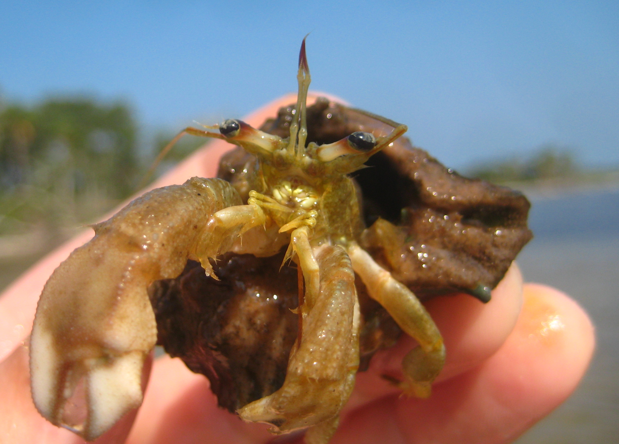
2. Shelter Commensalism:
Hermit crab (+), Snail (0):
Hermit crabs depend on snail created shells but never interact with the live snail
3. Transportation Commensalism:
Ramora (+), Shark (0):
Ramoras ride on sharks across oceans and feed on scraps left after feeding, but don’t affect shark
Notes:
Ramoras are in the perch superfamily

Slide 10
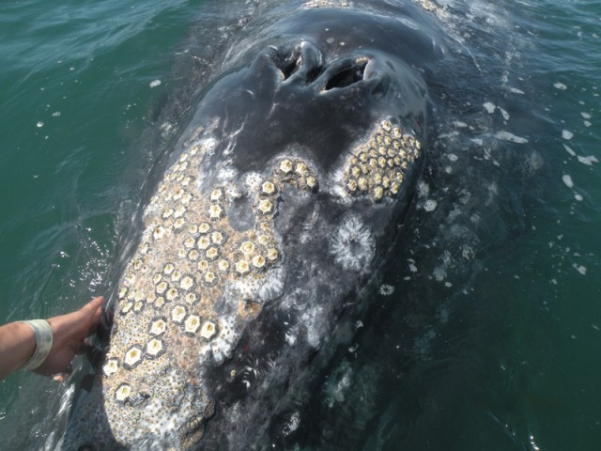
4. Habitat Commensalism:
Barnacle (+), Whale (0):
Whale Barnacles occur only on the skin of whales (obligate), but there are no documented positive or negative effects on the whale’s fitness

Slide 11
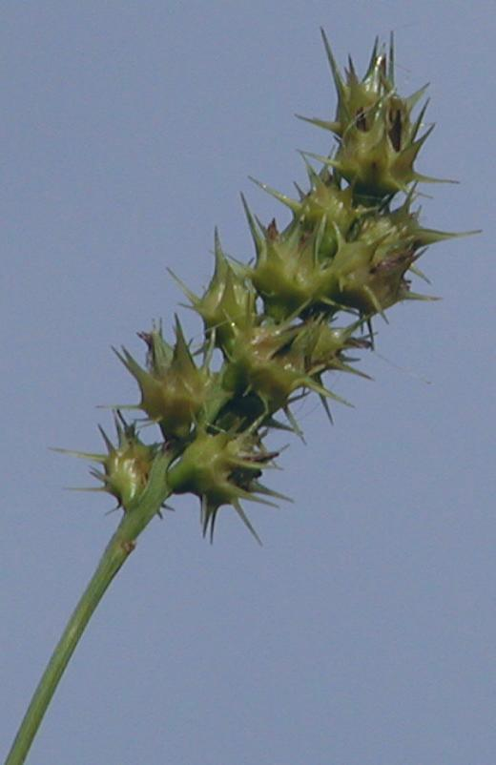
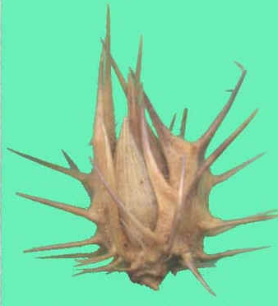
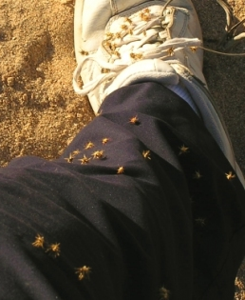
5. Dispersal or Reproductive commensalism:
Sand Spurs (+), Animal dispersal agent (0):
The barbed seeds of many plants get stuck in the hair (or socks) of animals and may be transported great distances. Major fitness advantage to the plant, major annoyance but minor fitness cost to animal

Slide 12
B. Mutualism (+,+)
Definition: A direct or indirect species interaction where both species benefit (incur net positive effects)

Slide 13
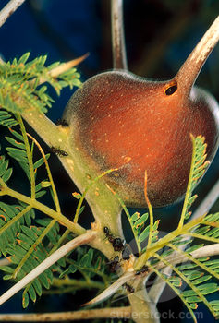
1. Food for Protection
Acacias and their ants:
Mutualist Acacia trees lack chemical defenses
Produce hollow thorns that house and nectary structures that feed ants

Slide 14
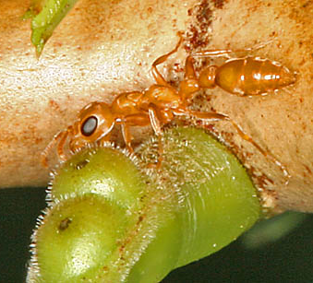
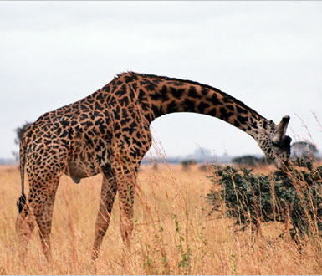
Food for Protection
Ants feed on special nectar at nectary structures and specialized, nutrient rich leaf tips on Acacias
In return, ants defend host tree against herbivores and strangling vines. Often, individual ants die defending the host tree

Slide 15
Measuring costs and benefits
There are big costs associated with mutualisms (such as dying!)
To have (+, +) relationship, benefits to both species fitness must outweigh cost of relationship
Fitness of both parties must be higher in mutualism than when living alone
Dan Janzen (1966): Removed ants from some Acacia trees in Mexico and measured growth rates and survival versus trees with ants…

Slide 16
Janzen 1966 results
After 1 year, he found:
 | With Ants | Without Ants
Survival | 72% | 43%
Avg. Weight of new tissue | 597.9 | 43.9
Avg number of new leaves | 108 | 52
Avg. number of new thorns | 103 | 39
(Adapted from Janzen 1966)
Clearly, Acacias do much better with ants present regardless of the cost of producing specialized structures

Slide 17
Summarizing Ant-Acacia interaction
 | Cost | Benefit
Ants | Spend energy and bodies defending host | Reliable food source and shelter
Acacia | Must produce energetically “expensive” nectar, leaf bodies and thorn structures | Ants defend against herbivores and competing vines, allowing long term existence

Slide 18
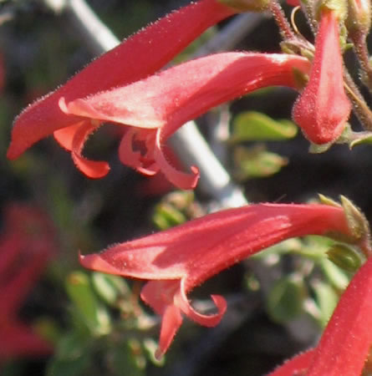
2. More mutualisms: Food for Reproduction
Ex: hummingbirds and “hummingbird” flowers
Flowers tend to evolve a suite of characteristics suited toward their main pollinators
Specializing for hummingbirds decreases the efficiency of pollination by bees, beetles, etc.
Hummingbird pollinated flower traits:
Flowers
Red
Long, thin tubes
No “landing platform
Nectar
Thin, watery
Lots produced
Pollen
Sticky packets on long anthers
(Adapted from Thompson et al 2000)

Slide 19
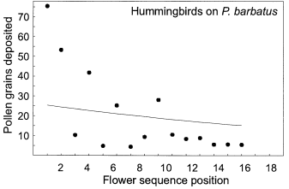
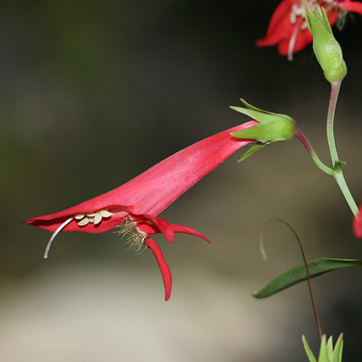
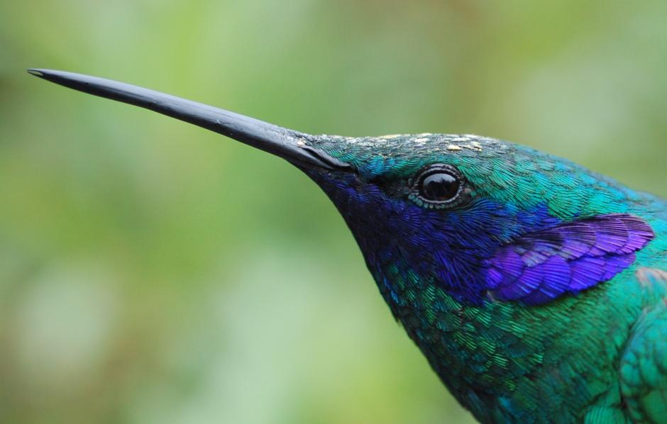
Penstemen pollinator success
Bees carried no pollen after visiting P. barbatus
Hummingbirds carried pollen to up to 16 different flowers
Castellanos et al 2004

Slide 20
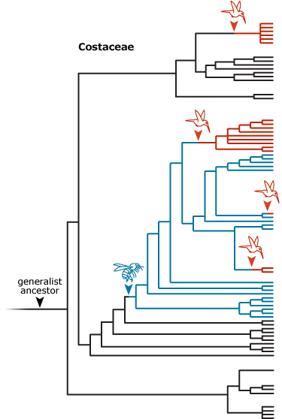
Summary of Penstemen pollination
Mutualist partners of each Penstemen species transfer more pollen and transfer pollen to more flowers than other potential flower visitors.
Other studies have been done showing that hummingbirds receive the best nectar “reward” – most sugar with the least handling time – from the red flowers (Baker 1961)
Hummingbirds also show a preference for flowers with these similar traits (Haley and Wilson 2010, Schemske and Bradshaw 1999)

Slide 21
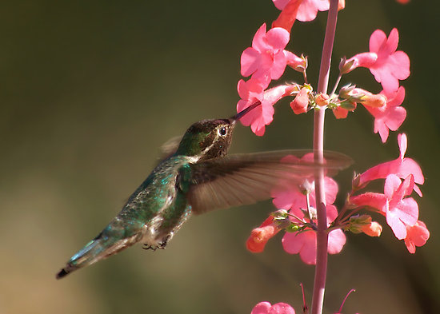
Food for Reproduction
 | Cost | Benefit
Humming- Birds | Dependent on finding specific plants | Reliable food source, low competition
Penstemons (flowers) | Production of nectar requires energy | Efficient pollen transfer, minimizes other pollen/nectar thieves

Slide 22
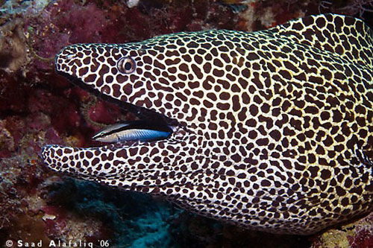
3. Food for parasite removal
On reefs, large fish will seek out small fish, even prey species, to remove external parasites
The large fish use behavior and posturing to request “cleaning service” and indicate safety to the small fish
Often “cleaning stations” occur in particular locations on the reef, where a group of small wrasses will clean many large fish

Slide 23
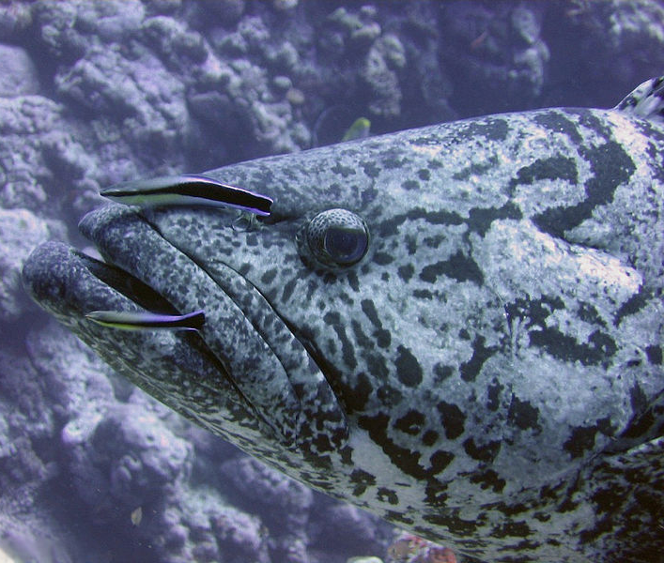
3. Food for Parasite Removal Ex: Caribbean “cleaning stations”
 | Cost | Benefit
Wrasse (cleaner) | Potential of being eaten | Reliable and easy food source
Grouper (“Client”) | Cleaners occasionally damage protective mucous layer, cheater mimics take advantage | Thorough parasite removal

Slide 24
4. Food for nutrients
Example: Corals and Zooxanthellae
Many corals have a single celled algal symbiont living inside their cells called Zooxanthellae
Algae takes nitrogen, phosphorus and carbon dioxide waste products from coral tissue as raw materials in photosynthesis
In return, Algae provide oxygen, sugars and amino acids to coral tissue
In some corals, up to 90% of energy produced by algae is transferred to host

Slide 25
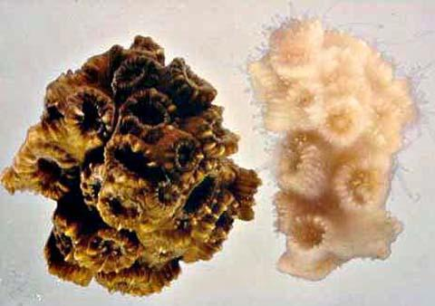
Food for Nutrients
 | Cost | Benefit
Coral (host) | Dependent on algae, Algae may leave in bad conditions | Receives food and oxygen
Algae | Loses lots of energy to host | Receives nutrients for photosynthesis, protection
In low light or high temperature conditions, algae leaves or gets expelled leading to coral “bleaching”. Coral is able to live for a short period of time and may be re-colonized by algae when conditions improve, but will die if algae does not return

Slide 26
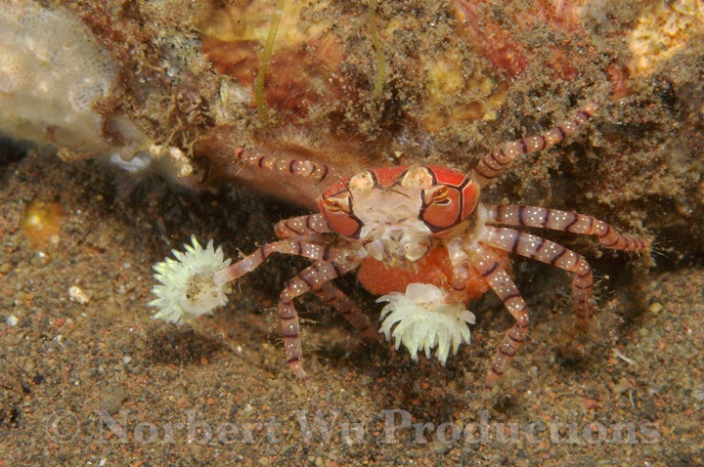
5. Boxer crabs and Anemones

Slide 27
Boxer crabs and Anemones
Not well studied, but we know:
Crabs in the wild are always found with anemones
In fights, crabs display the anemones but avoid touching each other with them
When one anemone is removed, the crab rips the remaining anemone in half and the anemone becomes two clones
Crabs have been observed grooming the tentacles and eating captured prey from them
(Karplus et. al 1998)
What hypotheses should we test to show this is a mutualism??

Slide 28
Interactions can be classified as:
Obligate: Required for the survival or fitness of one or both species
Facultative: Not required, by increases fitness when it happens
And
Transient: Occurs for a brief time or one phase of life
Permanent: Occurs for length of life
Permanent
Acacia- ants
Coral and Algae
Facultative
Obligate
Fish cleaning stations
Transient

Slide 29
Other examples to Google:
Shelter for reproduction- Fig wasps and Fig trees
Digestion for food/shelter – Gut bacteria and cows (and humans, and almost everything else…)
Nitrogen for food – Mycorrhizal bacteria and plant roots
Defense for Defense – clown fish and anemone
Shelter for food - Humans and Dogs

Slide 30
C. Indirect Mutualisms
Occur when more than 2 species interact such that one benefits another by way of its impact on a third species
The enemy of my enemy is my friend….

Slide 31
Direct vs. Indirect interactions
Direct mutualism
Indirect mutualism
+
A
+
B
A
_
B
_
C
+
+
+
+
A directly affects B
B directly affects A
A directly affects B
B directly affects C
So, A indirectly affects C
And C indirectly affects A

Slide 32
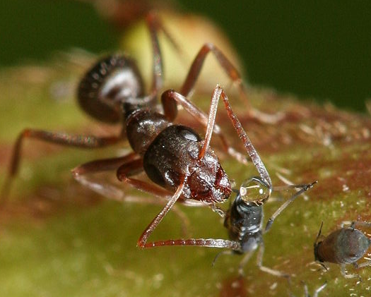
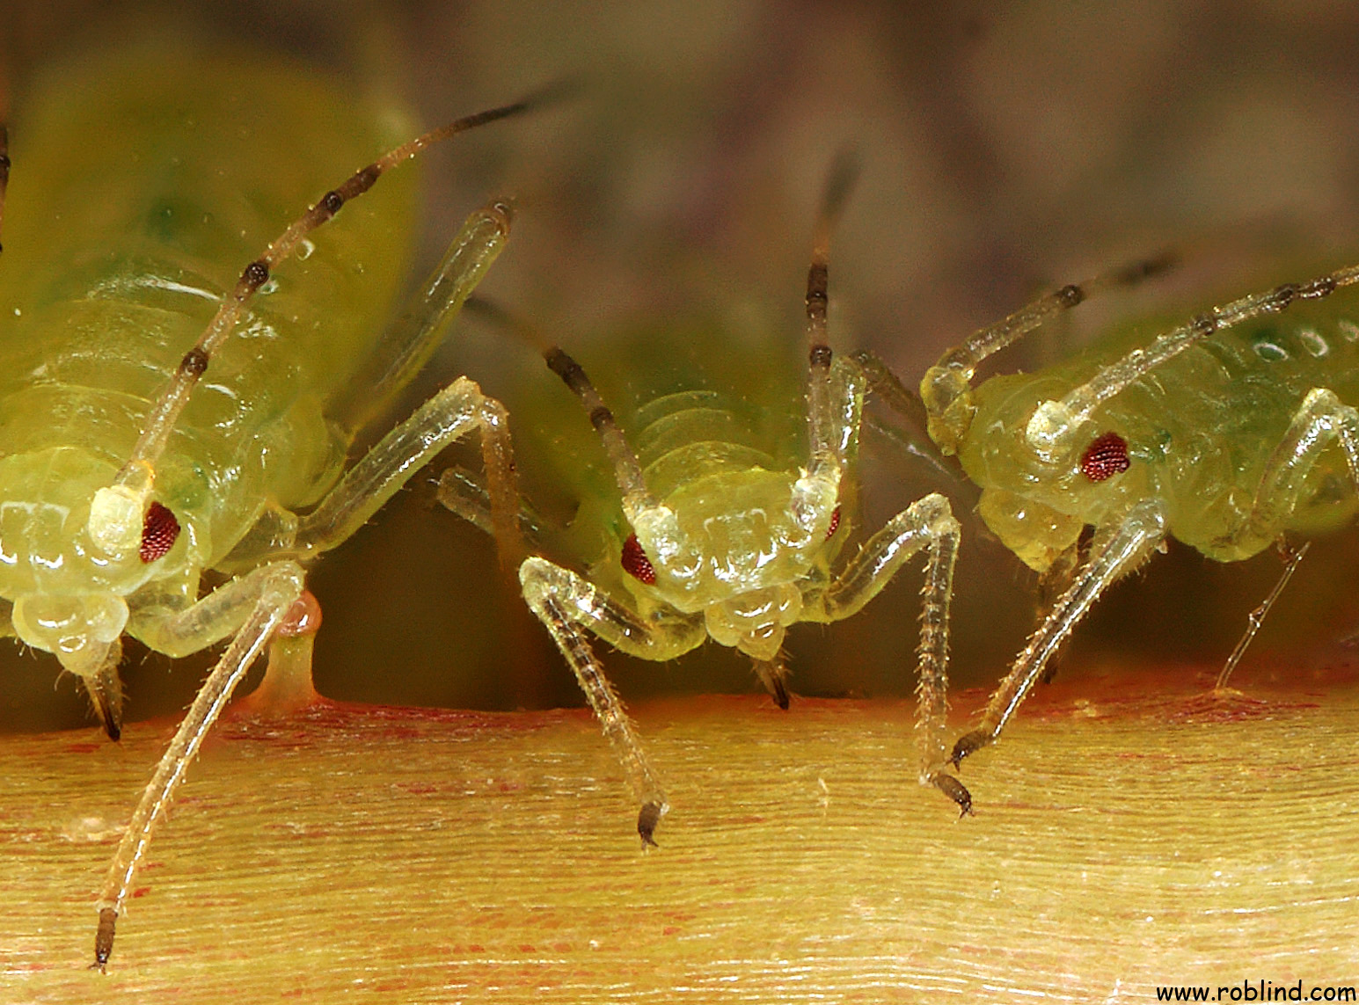
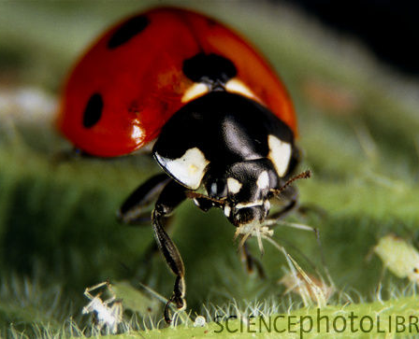

Slide 33
Complex mutualism
beetles
plants
ants
aphids
Bach 1991

Slide 34
Plants without ants have more beetles
No Ants
Beetles per stem
With Ants
Time (months)
beetles
plants
aphids
Adapted from Messina 1981

Slide 35
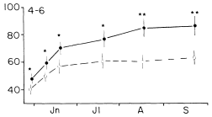
Plants with Ants grow better
With Ants
Plant Height (cm)
No Ants
Time (months)
beetles
plants
ants
aphids
Adapted from Messina 1981

Slide 36
“X has this effect on Y”
X
 | Ants | Aphids | Beetles | Plant
Ants |  | Aphids provide Ants with “honeydew” food source | Beetles indirectly reduce ants food source by competing with aphids | Plants indirectly feed ants through aphids
Aphids | Ants defend aphids from predators and competitors, move aphid larvae to good habitat |  | Beetles compete for food resource, kill aphids | Plants are a food source for aphids
Beetles | Ants remove beetle larvae from plant | Aphids compete against these and other herbivores |  | Plants are a food source for beetle larvae
Plants | Ants prevent honeydew build-up, preventing fungal growth, remove highly damaging herbivores | Aphids feed on sap, cause fungal growth via honeydew | Beetles Damage plants through herbivory
Y

Slide 37
D. Facilitation (+, 0)
Facilitation occurs when one species changes the environment to be more suitable for a second species. Basically, an indirect form of commensalism
Spartina stabilizing marsh soil
Azolla fixing nitrogen on rice paddies
Serengetti grazers

Slide 38
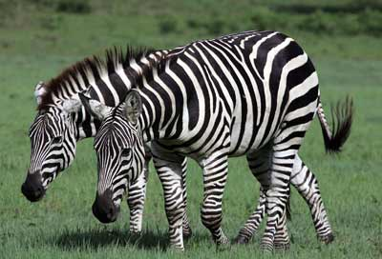
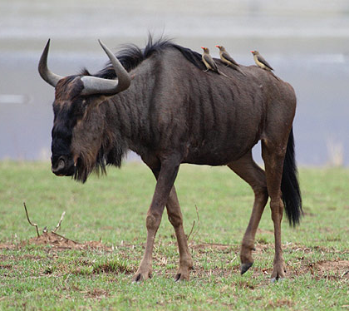
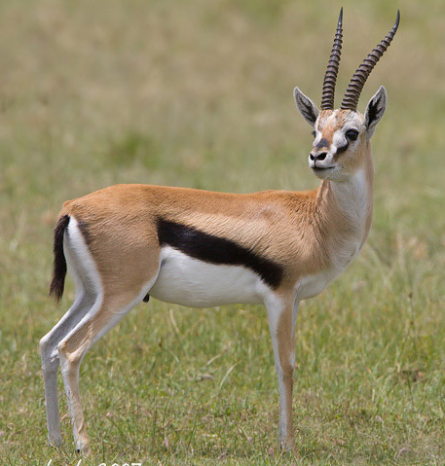
Herbivores on the Serengeti Plains
Zebras eat long grass stems
Then, Wildebeests graze down grasses and trample ground
Then, Thomson’s gazelles eat the short grass sheaths and herbs exposed by trampling Wildebeests
McNaughton (1976) fenced off areas to prevent wildebeest grazing and showed that gazelles avoided the areas that had not been grazed down by wildebeest – An example of grazing facilitation, where the action of one species increases the available food supply of another species

Slide 39
Mutualisms likely evolve out of predator or parasite interactions
Mycorrhizae evolved out of parasitic fungi
Seed dispersers evolved out of seed predators
Pollinators evolved out of Pollen predators

Slide 40
Mutualisms likely evolve out of predator or parasite interactions
Mycorrhizae evolved out of parasitic fungi
Seed dispersers evolved out of seed predators
Pollinators evolved out of Pollen predators
Coolest and maybe most important example:
In the 1970’s Lynn Margulis proposed the Endosymbiotic Theory: that modern eukaryotes originated from symbiotic, mutualistic relationships. Eukaryotes engulfed aerobic bacteria as precursors to mitochondria, and later engulfed cyanobacteria as precursors to chloroplasts.

Slide 41
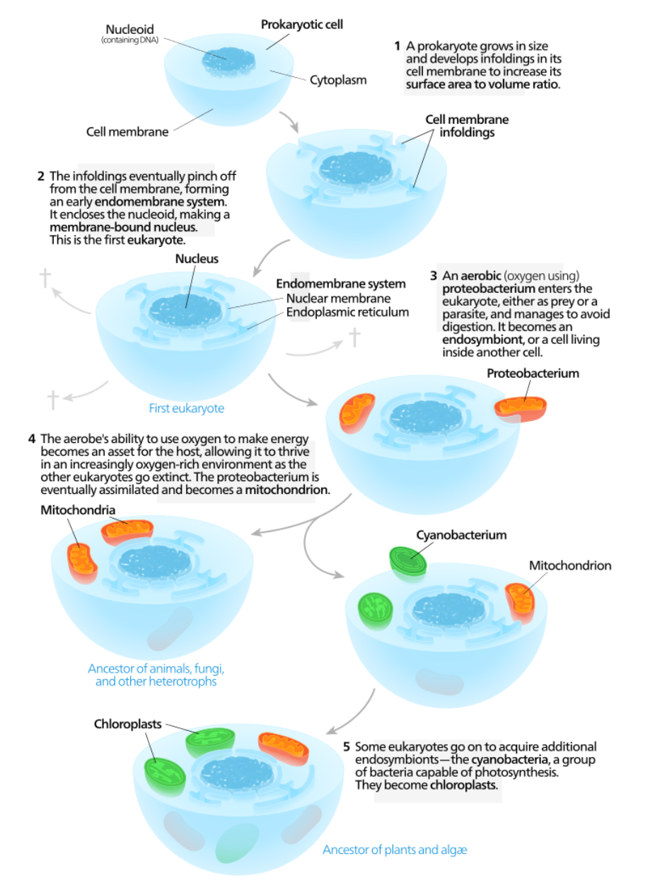
Endosymbiotic Theory:
-- internal foldings of the cell membrane pinch off, eventually leading to a membrane bound nucleus.
-- other prokaryotic cells enter the first cell, either as prey or parasites, and become endosymbionts.
-- aerobic endosymbionts help the host and eventually become obligates, then mitochondrion.
-- similarly, other endosymbionts become chloroplasts.

Slide 42
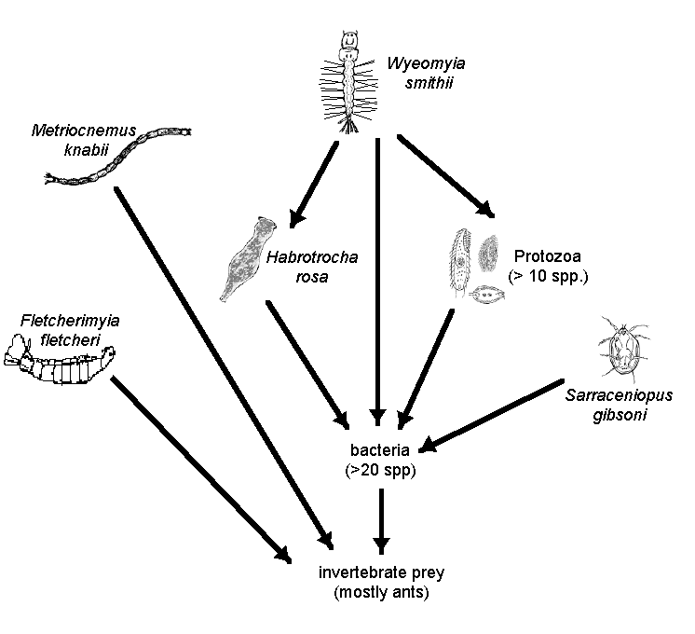
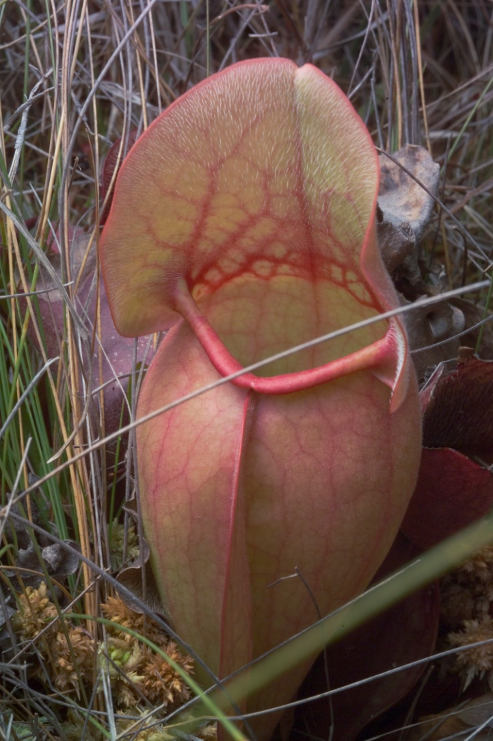
Now, we move on to Community Ecology!
food webs and trophic structure
Notes:
So, here is the food web inside pitcher plants, with a mosquito that eats a rotifer and several protozoa species. All these, plus a mite, eat bacteria, and the bacteria feed on the dead bugs captured by the plants. And, there are some other species as well that directly consume the ants.
How do we describe the complexity?

Slide 43
Study Guide Items from Lecture 17
Terms:
Community
indirect mutualism
• facilitation
• commensalism
Concepts:
Types of commensalism
Types of mutualisms
Costs and benefits of mutualisms
Obligate vs. Facultative interactions
Transient vs. Permanent interactions
Endosymbiotic theory
Case Studies:
Ants and acacias
Cleaner fish and hosts
Corals and Zooxanthellae
Ants, Plants, aphids and beetles w/ indirect mutualisms
Notes:
43

