Slide 1
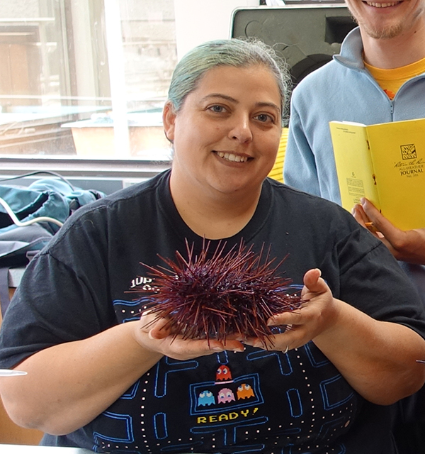
16th Lecture – Nov.1, 2016
-- Exam Thursday. Use Tegrity videos and posted exams.
Friday, November 4, 4:00 pm, 1024 KIN—ECOLOGY AND EVOLUTION SEMINAR,
"Untangling interactions between gamete traits and the sperm environment in a broadcast spawner,"
Ellen Kosman, Department of Biological Science, Florida State University.

Slide 2
IV. Populations and Biotic Influences
. . .
D. Predation
1. definition
2. how do predator and prey numbers affect one another’s abundances?
  3. functional types
4. Prey: Effects of predation on prey behavior and evolution
-- immediate response in some cases is that prey dies.
-- escape responses:
- escape in space
- escape through behavior
- escape by chemical/physical defenses (i.e. scales, spines, distasteful or harmful chemical compounds)
- ecology of fear

Slide 3
IV. Populations and Biotic Influences
. . . .
D. Predation
4. Prey: Effects of predation on prey behavior and evolution
-- Ultimate evolutionary effect can turn predation into a
mutualism or commensalism. Examples:
-- pollen dispersal in insects. Thought to have evolved
from wind dispersal and pollen or flower eating beetles.
-- seed dispersal: scarification of seeds, the Dodo
example with Calvaria major on Maritious.
For this class, the primary effect of predators on prey is to affect prey numbers and thus population growth rate (and distribution and dispersion)

Slide 4
IV. Populations and Biotic Influences
. . . .
D. Predation
. .
4. Prey: Effects of predation on prey behavior
5. Responses of predators to prey:
a. numerical responses: we have already covered this in Lotka-Volterra models
b. Functional (behavioral) responses = is the intake rate of a consumer as a function of food density.

Slide 5
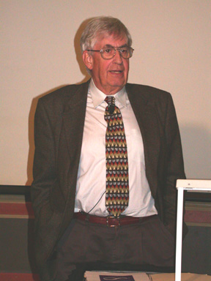

Holling’s (1959) disc equation:
Holling, C. S. 1959. The components of predation as revealed by a study of small mammal predation of the European Pine Sawfly. Can. Ent. 91:293-320.

Slide 6
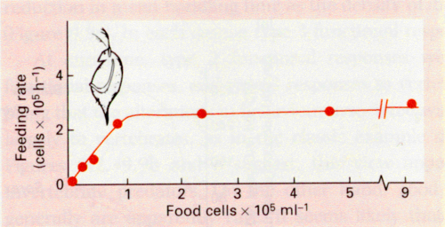
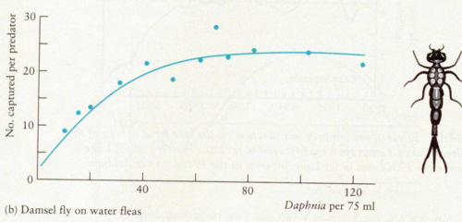

Slide 7
IV. Populations and Biotic Influences
. .
  5. Responses of predators to prey:
a. numerical responses
b. functional responses: the relationship between food (prey)
density and the predator’s consumption rate
- Type I response curves - linear increase in prey taken until
maximum is reached. Maximum is set by some minimum
handling time per prey.
handling time is the time required to capture, subdue, and consume
an individual prey item.
- Type II response curves - caused by satiation, predator gradually slows down. First obtained by Holling with blindfolded secretaries choosing sandpaper discs
- Type III response curves - sigmoidal. High density portion
is similar to type II. Low density may be caused by choice
hiding places being taken at low prey densities or by
learning.
Notes:
Discs on the desk and see how many she found, at some point she can’t capture them any faster

Slide 8
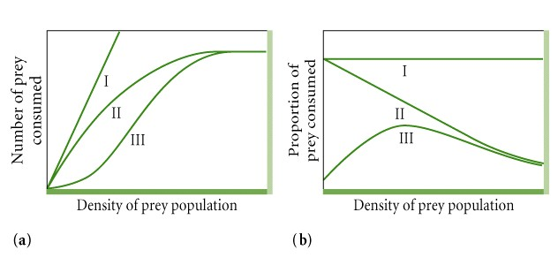
functional responses

Slide 9
IV. Populations and Biotic Influences
. . .
D. Predation
1. definition
2. how do predator and prey numbers affect one another?
a. Modeling predator-prey relationships - Lotka-Volterra
models again.
b. lab tests of Lotka-Volterra equations
  3. functional types
  4. Effects of predators on prey
  5. Responses of predators to prey
  6. Applied value of predator-prey dynamics
  a. optimal harvesting
  Remember that theory says to harvest populations back to where they are growing the most quickly (highest dN/dt). Also understand stock-recruitment curves!

Slide 10
IV. Populations and Biotic Influences
. . .
D. Predation
1. definition
2. how do predator and prey numbers affect one another?
a. Modeling predator-prey relationships - Lotka-Volterra
models again.
b. lab tests of Lotka-Volterra equations
  3. functional types
  4. Effects of predators on prey
  5. Responses of predators to prey
  6. Applied value of predator-prey dynamics
  a. optimal harvesting
  b. biological control

Slide 11
Biological control
    48% of the worlds crops are lost to pests
    2.5 billion kg of toxic pesticides applied annually
    with higher use of pesticides, pests have not declined
    Pesticides only short term solution as they harm other species (us!), they hurt beneficial pests, and pests evolve resistance

Slide 12
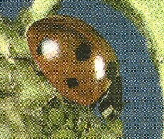
b. Biological control
i) magnitude
ii) examples
-- cottony cushion scale
-- rabbits in Australia
-- rats on Micronesia
Around the turn of the century, cottony cushion scale was a serious pest in Florida citrus, and the vedalia beetle was imported from Australia, via California, to help control it. Vedalia is a highly specialized predator that feeds on little else. Since cottony cushion scale is now quite rare in Florida, the vedalia beetle is also rare, although it persists at low density throughout Florida citrus groves. The vedalia beetle is one of the most widely recognized examples of successful classical biological control in citrus.

Slide 13
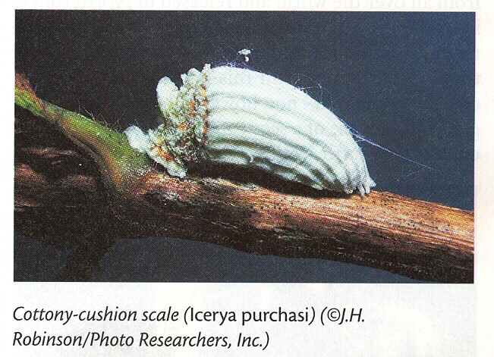
b. Biological control
i) magnitude
ii) examples
-- cottony cushion scale
-- rabbits in Australia
-- rats on Micronesia
small insect that sucks sap from leaves and twigs in citrus
scale first found in California in 1872
entire citrus industry threatened by 1887
cyanide is best control agent, but not practical
US government sends agent to Australia for predator in 1888
the agent sent back a dipteran parasite that failed
also sent back vedalia, a predaceous ladybird beetle
vedelia was released in controlled conditions, eliminated scale within 3 months
by 1891, virtually all cottony cushion scale was eliminated

Slide 14
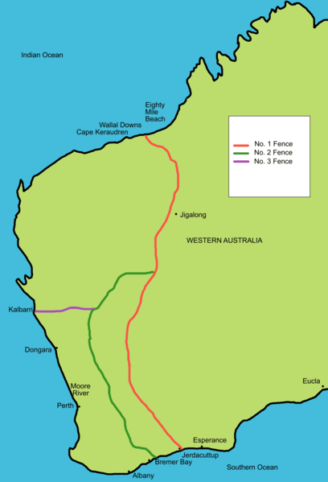
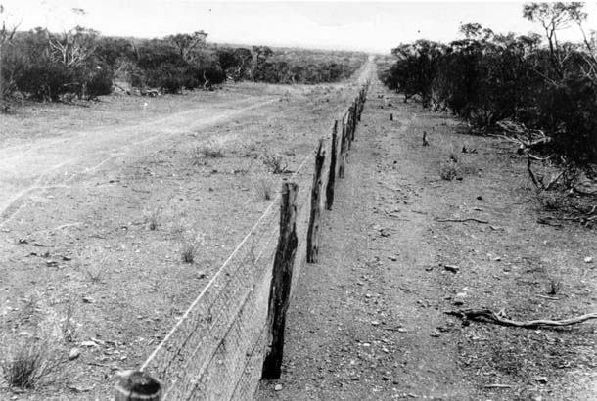
Rabbits in Australia
On Christmas Day In 1859, Thomas Austin released 24 rabbits, 5 hares and 72 partridges for hunting on his property, just outside of Geelong in Victoria. From there, the rabbits spread north and west, and, by 1890, the rabbit population in Australia reached plague numbers.
Between 1901 and 1907, the longest anti-rabbit fence was constructed to protect properties in western Australia. It was 1833 kilometres long, running from Starvation Boat Harbour in the south, to Cape Keraudren in the north. However, by the time that most rabbit-proof fences were finished, rabbits had already crossed into the area the protected area.
Several other fences were constructed to try so protect smaller areas. I believe at least one of the fences is still maintained.

Slide 15
Hunting and poisons became the primary methods of trying to control rabbits. However, they continued to cause major problems, especially for farmers and sheep. However, in the 1950s and after some study of its effects on native species, a viral disease, Myxomatosis, was released. The disease is spread by direct contact with an affected animal or by being bitten by fleas or mosquitoes that have fed on an infected rabbit. The myxomatosis virus does not replicate in these insect hosts, but can be physically carried by an insect's mouthparts. When it was first released in the 1950s it had a 99% mortality rate, reducing the numbers of rabbits from more than 600 million to less than 100 million over two years.
When the rabbits evolved some immunity (and the virus evolved to be less virulent), Australian authories introduced European rabbit flea in 1957 and a Spanish rabbit flea in 1993. A calicivirus was introduced in 1995. Each had some effect, but eventually the numbers came back up.
Rabbits are still the number one vertebrate pest in Australia. They compete directly with native animals for food and shelter and this has contributed to the extinction of some native species. Rabbits destroy large numbers of native plants and trees, eating seedlings and damaging established plants by stripping them of leaves, bark and even roots. Rabbits also continue to have a considerable impact on agriculture, causing losses of more than $600 million every year through crop and pasture damage.

Slide 16
b. Biological control
i) magnitude
ii) examples
i. cottony cushion scale
ii. rabbits in Australia
iii. rats on Micronesia

Slide 17
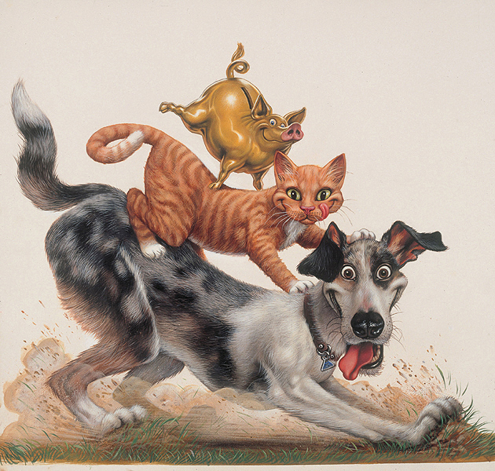
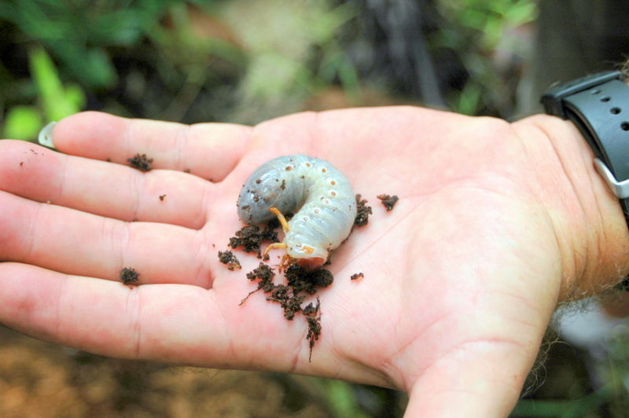
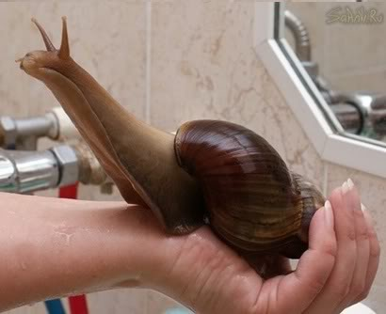
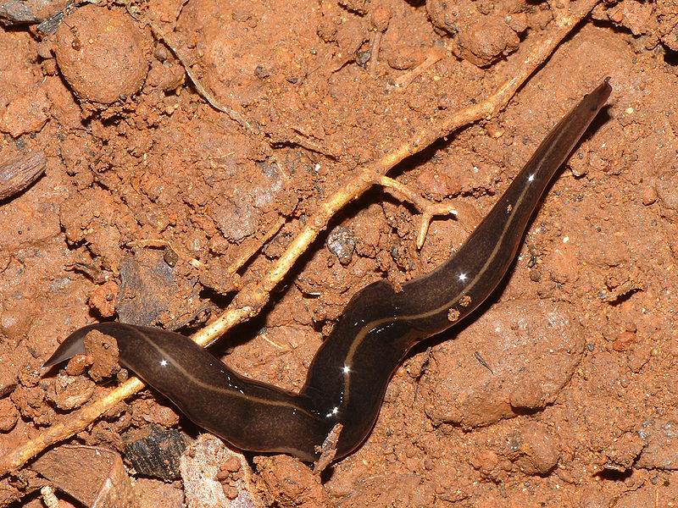
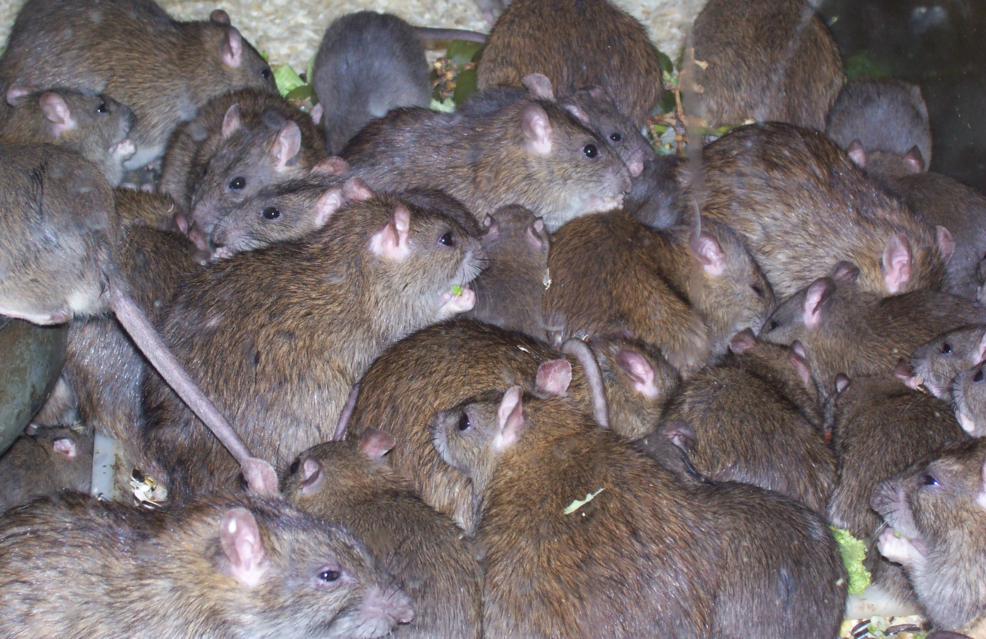
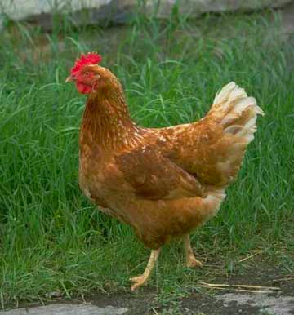
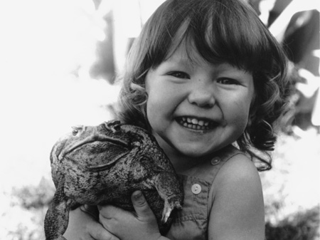
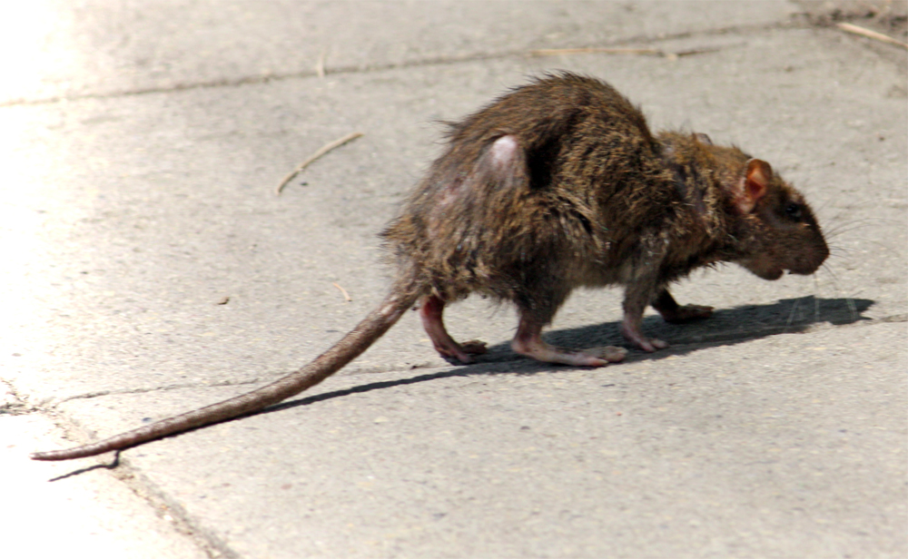
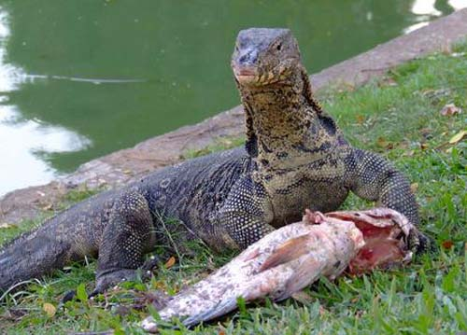

Slide 18
iii. rats on Micronesia
Rats were a major problem when introduced to Micronesia.
They imported giant monitor lizards to control the rats. This was useless, because the rats feed at night, while lizards, being coldblooded, must feed during the day. So, the monitors turned to eating everybody’s poultry instead.
In 1945, they introduced an enormous South American toad, the cane toad, to give the monitors something else to eat. It secretes a strong venom in its skin and a large number of monitors were poisoned. As the monitors died, a coconut pest that it turns out chickens and monitors had been eating , a rhinoceros beetle, greatly increased in number. With the monitors gone, the toads population went exponential as well.
Cats, dogs, and pigs went after the toads and were killed by the poison. Then the rat population went wild because the cats and dogs had been eating the rats.
The giant African snail, brought in by the Japanese as a possible food, went ballistic as well, perhaps because of all the carrion in the form of cat and dog carcasses.
A predatory flatworm was introduced to control the snails, which it failed to do. However, it is killed off virtually all of the native snail fauna in Micronesia.

Slide 19
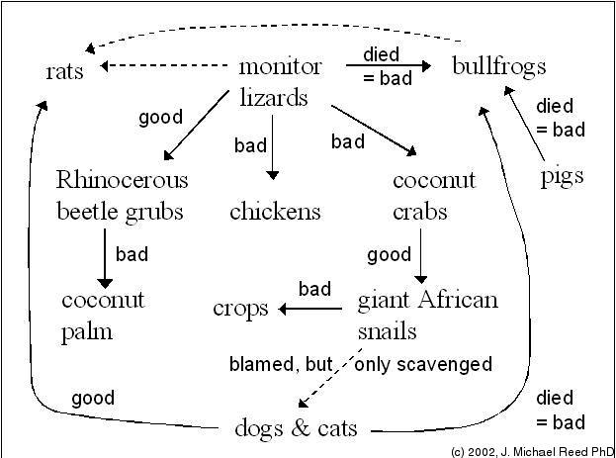
Solid line = eats, dashed line = should have eaten

Slide 20
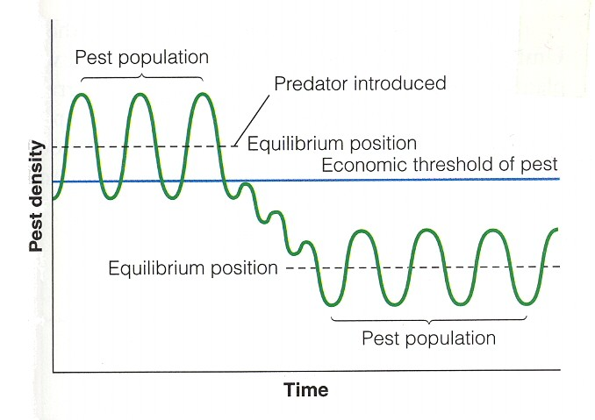
b. Biological control
i) magnitude
ii) examples
iii) Theory of Biological Control
Classic theory using predator-prey models
  getting rid of the pest is only a partial solution as it will likely re-invade and re-establish as a pest
  It would be best to have control agent (predator) that will keep the pest in check, but continue to coexist with the pest.

Slide 21
b. Biological control
i) magnitude
ii) examples
iii) Theory of Biological Control
Classic theory using predator-prey models
-- adding predators will result in oscillations that may be difficult to control.
-- if predator does manage to eliminate pest, then it also will generally go extinct, which may allow the pest to reinvade.
-- the predator-prey relationship could be stabilized (go to an equilibrium coexistence), such that the predator keeps the prey in check at some lower abundance.
This would require particular combinations of r, m, and θ.

Slide 22
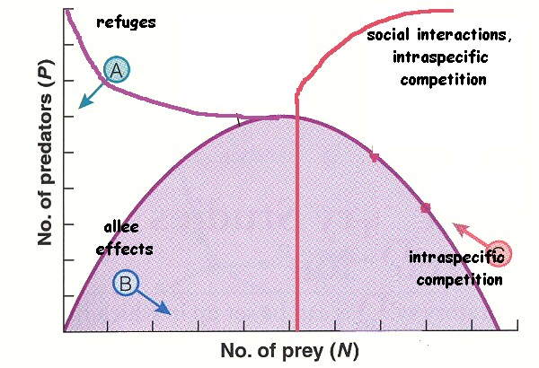
Here is the predator-prey model -- what conditions here will increase the likelihood that our control agent (predator) will coexist with the prey?

Slide 23
b. Biological control
i) magnitude
ii) examples
iii) Theory of Biological Control
Classic theory using predator-prey models
So, MacArthur and Rosenzweig suggest that there are four factors important for “classic” biological control.
1. Refuges for the pest populations (!)
promotes stable coexistence (predicted from isoclines)
2. Density dependence in the parasitoid attack rate
prevents control agent numbers from getting too high (from isoclines)
3. Parasitoid and predator aggression
control agent should concentrate attacks on high density patches of prey
4. Metapopulations of hosts
allows regional coexistence, even if local extinctions occur

Slide 24
Biological control
a. magnitude
b. Examples
c. Theory of Biological Control
i. Classic theory using predator-prey models
Everything from the classic model suggests that things like insect parasitoids might be the best control agents, rather than predators in general. Most predators are generalists and not synchronous with prey and have much lower r values than the prey. And they may feed on other, beneficial, species.
But, remember that we have had very little success so far with biocontrol agents. So, maybe our logic is wrong.

Slide 25
Biological control
a. magnitude
b. Examples
c. Theory of Biological Control
i. Classic theory using predator-prey models
ii. Nonequilibrium theory (by Bill Murdoch)
  Murdoch had a kind of metapopulation view, with the predator chasing the prey around a more complex habitat (think of Huffaker’s mites). Local populations are not at equilibrium.
Model | Stable pest populations at low densities | Density-dependent mortality in host | Predator spatially aggregates to host | Predator is host specific | Predators synchronized with host
Classic | Yes | Yes | Yes | Yes | Yes
Non-equilibrium | No | Not necessary | Not necessary | Not necessary | No

Slide 26
Biological control
a. magnitude
b. Examples
c. Theory of Biological Control
i. Classic theory using predator-prey models
ii. Nonequilibrium theory (by Bill Murdoch)
Murdoch compares the two models using a number of successful biological control studies. He finds that his non-equilibrium model provides a better prediction of what makes a good biological control agent

Slide 27
Biological control
a. magnitude
b. Examples
c. Theory of Biological Control
i. Classic theory using predator-prey models
ii. Nonequilibrium theory (by Bill Murdoch)
iii. Real-world data. Looking at successful and unsuccessful introductions generally supports the non-equilibrium view (see above) and also suggests that:
-- the predator has to have the ability to track prey abundances and to migrate (high r)
-- there should be some habitat stability (insects controlled on K plants have had greater success than those on r plants).
-- annuals and grasses have been less controllable as pests than others
-- Other generalizations cannot yet be made! It is hard to
predict when a biocontrol species will work or be a disaster.

Slide 28
Biological control
a. magnitude
b. Examples
c. Theory of Biological Control
i. Classic theory using predator-prey models
ii. Nonequilibrium theory (by Bill Murdoch)
    Real-world data.
    Integrated Pest Management
Integrated pest management (IPM) is an integrated approach of crop management to solve ecological problems when applied in agriculture.
These methods are performed in three stages: prevention, observation, and intervention. It is an ecological approach with a main goal of significantly reducing or eliminating the use of pesticides while at the same time managing pest populations at an acceptable level. Uses pest levels to determine management.

Slide 29
Biological control
a. magnitude
b. Examples
c. Theory of Biological Control
i. Classic theory using predator-prey models
ii. Nonequilibrium theory (by Bill Murdoch)
    Real-world data.
    Integrated Pest Management
Integrated pest management (IPM) uses a combination of innovative methods, including crop rotation, the use of fence rows to promote natural predators, and even intercropping of two types of crops that may enhance each other’s growth or minimize each other’s pests. It can also include the use of allelopathy → the chemical inhibition of one plant by another.

Slide 30
E. An ecologist grows a prey species by itself (monoculture) at various densities and measures it's per-capita growth rate. He uses this information to create the graph above on the left. He then grows this species with a predator, finding that the predator and prey exhibit damped oscillations that stabilize at some positive abundance for both species -- they coexist.
1. (10 pts) Draw appropriate isoclines for this situation in the graph on the right. Label all isoclines and intercepts.
2. (4 pts) Now, through time, the prey species evolves (but not the predator) to resist being captured when encountered, by having a harder shell. How do you expect this to change your isoclines?
Notes:
30

Slide 31
Here is the answer to the previous problem. The solid line is the prey isocline and the dashed line is the predator isocline. The black lines are the initial solution to question 1. The green lines are the solution to question 2, when the capture efficiency decreases. Remember the y intercept is r/θ_{c}, while the x intercept is m/θ_{c}θ_{r}
1. (10 pts) Draw appropriate isoclines for this situation in the graph on the right. Label all isoclines and intercepts.
2. (4 pts) Now, through time, the prey species evolves (but not the predator) to resist being captured when encountered, by having a harder shell. How do you expect this to change your isoclines?
Notes:
31

Slide 32
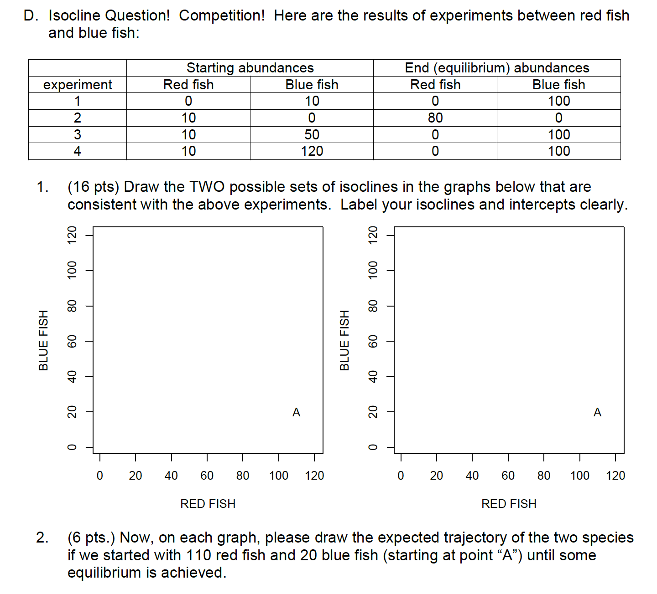
Notes:
32

Slide 33
Notes:
33

Slide 34
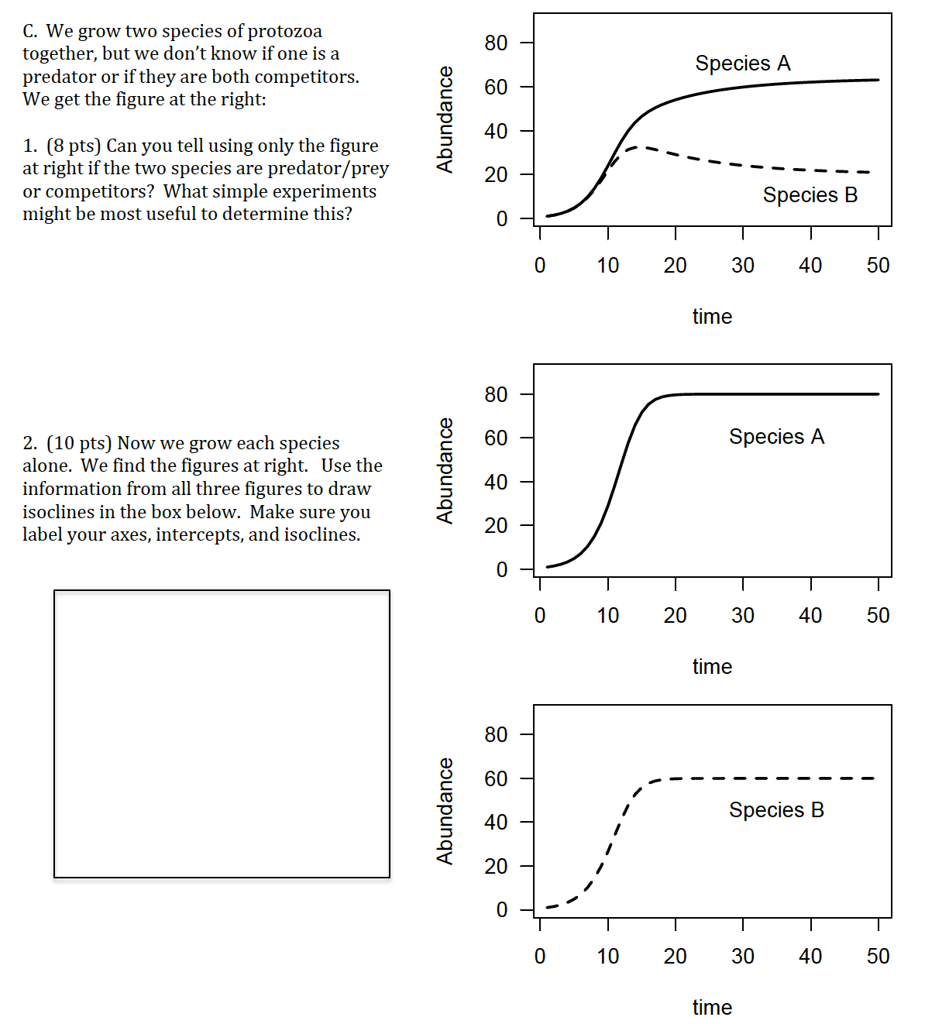
Notes:
34

Slide 35
You cannot tell from just the top figure. It could be coexisting predators or coexisting predator prey. To test which, you can jus grow each species alone. Predators would go extinct without prey.
Notes:
35

Slide 36
Study Guide Items from Lecture 16
Terms:
  Biological control • Trophic cascade
  Functional response • Integrated pest management
  myxomatosis • handling time
Concepts:
  Effects of predators on prey behavior
  Effects of prey on predator behavior
  Types of functional response curves
  Evolutionary instability of predator-prey relationships
  Successes and failures of biological control
  “classic” vs. “non-equilibrium” approaches to pest management
  What types of species work or don’t work for biological control
  Steps of integrated pest management
Case Studies:
  cottony cushion scale and vedalia on citrus
  rabbits and myxomatosis in Australia
  rats in Micronesia
Notes:
36

