Slide 1
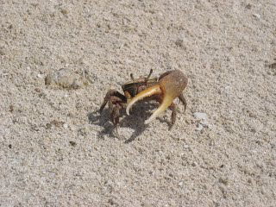
15th Lecture – Oct. 27, 2016
-- Next Exam is November 3, one week!
-- Two practice exams are posted
Friday, October 28, 4:00 pm, 1024 KIN—ECOLOGY AND EVOLUTION SEMINAR,
"Influences of multiple species pools on fiddler crab associated microbial communities,"
Dr. Catalina Cuellar Gempeler, Department of Biological Science, Florida State University.

Slide 2
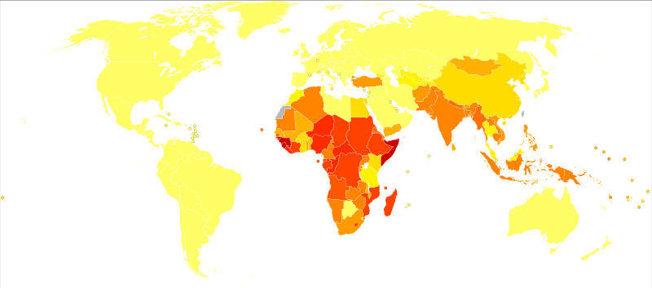
Host parasite interactions:
We didn’t have a theory of microbes until the 1870’s, and so models of epidemiology did not begin until early in the 20th century. (= the study of the incidence, distribution, and possible control of diseases).
-- First models were
to control measles.
-- in the 1920s, they
realized that the density of
individuals susceptible to a
disease had to exceed a
threshold number before an
epidemic could take hold.
-- There was then lots of epidemiology conducted that was ignored by ecologists until the late 1970’s.

Slide 3
Host-parasite interactions:
-- SIR model (susceptible, infected, or recovered – see upcoming Zombie example) In this case, the abundance of the parasite in the host is ignored (measles) and instead we use is the number of infected people.
-- In macroparasites such as intestinal worms, the abundance of the parasite in the host DOES matter and must be taken into account.
-- Sometimes there are intermediate hosts that also must be understood. Schistosomas are such parasites of humans that require a snail intermediate host. 100 million people carry at least one worm.

Slide 4
-- In all cases, parasites can be transmitted vertically (mother to offspring) (hepatitis B, HIV) and horizontally (individual to individual through common environment).
-- Horizontal transmission can be direct (colds, STD) or indirect that involved animal transmission between humans (malaria, rabies, Lyme disease).
N = S + I + R
Susceptible → dS/dt = bN – mS – βSI + γR
Infected → dI/dt = βSI – (m + α + v)I
Recovered → dR/dt = vI - mR – γR
(these should look vaguely familiar,
as all are basically dN/dt = b-d)

Slide 5
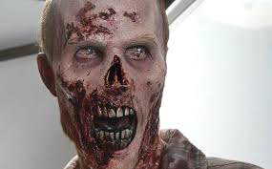
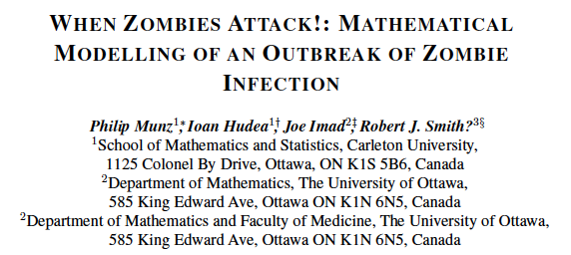
Robert Smith?’s Zombie Model
P. Munz, I. Hudea, J. Imad and R.J. Smith? When zombies attack!: Mathematical modelling of an outbreak of zombie infection (Infectious Disease Modelling Research Progress 2009, in: J.M. Tchuenche and C. Chiyaka, eds, pp133-150).

Slide 6
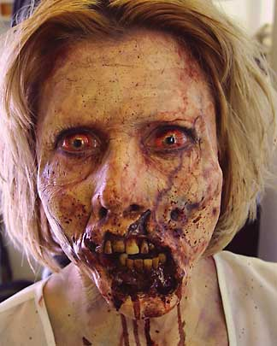
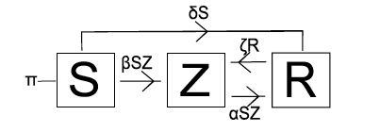
Robert Smith?’s Zombie Model
Susceptibles → dS/dt = ΠS - βSZ - δS
Removed → dR/dt = δS + αSZ – ζR
Zombies → dZ/dt = βSZ + ζR – αSZ
Π is the birth rate. Susceptibles are normal humans that can die through natural causes (δ) or encounters with zombies (β). The Removed class may be those who died naturally or from Zombie attacks, some of whom may be resurrected as Zombies with probability ζ. Thus, the Zombie growth rate is the number of Susceptibles converted and the number of dead resurrected, minus Zombies that are “killed”, generally by removing their head or otherwise having their brain destroyed.

Slide 7
Smith and his group did the same thing that we have done with competition and predator-prey equations – now set to zero and solve.
Interaction | Make equations (b-d) | Equilibrium (dN/dt = 0) | Phase-space isoclines | Make predictions
competition |  |  |  | Who wins? Coexistence?
predation |  |  |  | Coexistence? Oscillations?

Slide 8
Robert Smith?’s Zombie Model
At equilibrium (assuming Π and δ = 0 over short timescales):
-βSZ = 0
βSZ + ζR – αSZ = 0
αSZ – ζR = 0
The phase plane with three species is a bit complicated. But, basically these equations only can be true at two different stable states. Either S = 0 and it is all Zombies or Z = 0, we have no Zombies, and the population is healthy.

Slide 9
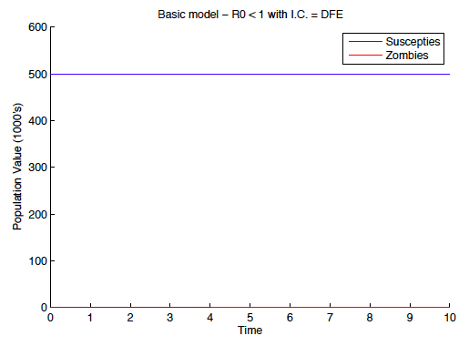

Slide 10
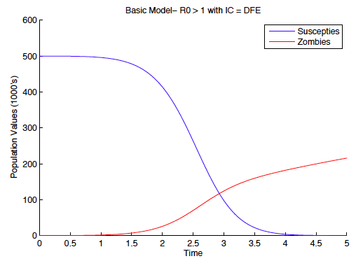

Slide 11
Robert Smith?’s Zombie Model
At equilibrium (assuming Π and δ = 0 over short timescales):
-βSZ = 0
βSZ + ζR –αSZ = 0
αSZ – ζR = 0
The phase plane with three species is a bit complicated. But, basically these equations only can be true at two different stable states. Either S = 0 and it is all Zombies or Z = 0, we have no Zombies, and the population is healthy.
So, the model suggests that Zombie-Human coexistence is impossible! Run! Hide! Or learn to like brains.

Slide 12
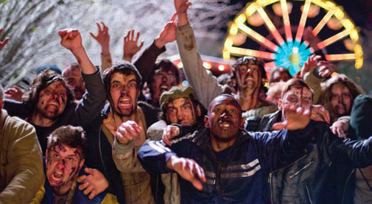
Robert Smith?’s Zombie Model
Susceptibles → dS/dt = ΠS - βSZ - δS
Removed → dR/dt = δS + αSZ – ζR
Zombies → dZ/dt = βSZ + ζR – αSZ
More seriously, this is very much the sort of model used to study usually terminal infectious diseases such as HIV.

Slide 13
A novel infectious disease has recently arisen and has begun spreading through populations all over the world. It is particularly endemic in the developed world and is age-dependent, primarily (although not exclusively) affecting children. Unchecked, it may consume our youth. This disease is Bieber Fever.
Bieber Fever has similar properties to other infectious diseases, such as a rapid rate of transmission in large populations, eventual recovery and debilitating scarring (in the form of inappropriate tattoos of Justin Bieber’s name/face). Symptoms include uncontrollable crying and/or screaming, excessive purchasing of memorabilia, making poor life choices (e.g. copycat hairstyles), and distraction from everyday life.

Slide 14
Understanding the Dynamics of Emerging and Re-Emerging Infectious Diseases Using Mathematical Models, 2012: 157-177 ISBN: 978-81-7895-549-0 Editors: Steady Mushayabasa and Claver P. Bhunu
Chapter 7. A mathematical model of Bieber Fever: The most infectious disease of our time?
Valerie Tweedle and Robert J. Smith?
Our results show that, in any population of young people exposed to Justin
Bieber, there will be an outbreak of Bieber Fever, even if no one is initially
infected. This makes the disease very dangerous and any population extremely
susceptible. The only methods to help control the spread of infection are to
publish more negative media stories about him than positive, such as involving
him in a sex scandal or exploit his bad haircut choices and increasing the
number of times those negative stories appear in the media. These measures may seem extreme, but they will need to be weighed against the possibility of our youth driving the general public mad with their obsession with Justin Bieber.

Slide 15
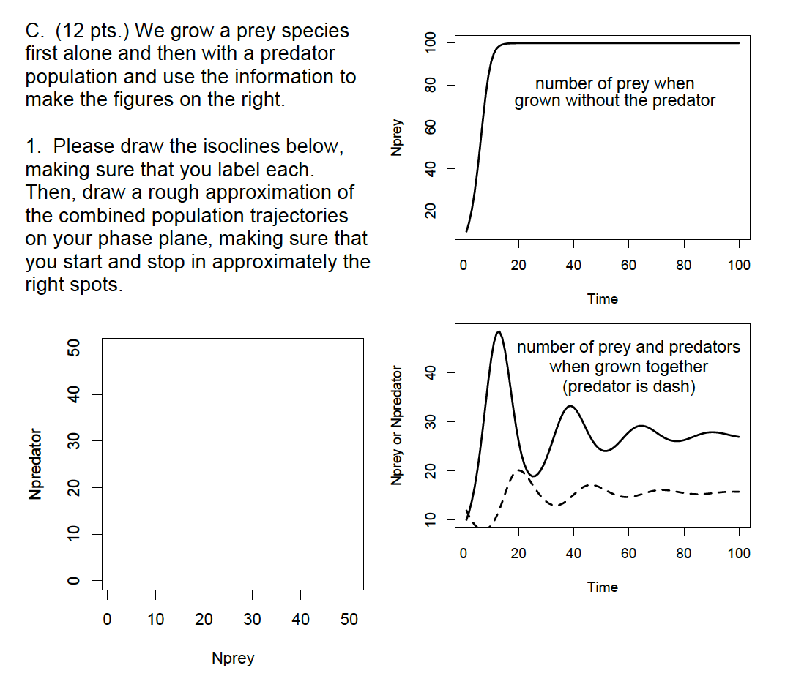
Notes:
15

Slide 16
IV. Populations and Biotic Influences
. . .
D. Predation
1. definition
2. effects of predator and prey on abundances?
a. Modeling predator-prey relationships - Lotka-Volterra
models again.
b. lab tests of Lotka-Volterra equations
3. functional types
4. Effects of predators on prey

Slide 17
IV. Populations and Biotic Influences
. . . .
D. Predation
3. functional types
a. true predators (predator-prey) - catch and kill prey immediately: wolves to whales to seed-eating rodents. Note their effect on the numbers of individuals in prey populations.
b. parasites and parasitoids (parasite-host)
→ parasites - also consume only part of living prey, but generally do not kill the prey -- specialize on one to a few prey during their life; tapeworms (diet pills), measles, mistletoes, aphids. Note no effect on the numbers of individuals in prey population.
→ parasitoids (larvae of wasps and flies) - free living adults which lay eggs in, on, or near other insects, generally consuming a living prey, while slowly killing it. Mostly resemble predators, because it changes numbers of individuals in prey populations. Tomato-horned worms.
c. grazers (plant-herbivore) - remove only part of many prey, rarely lethal; sheep, leeches, mosquitoes

Slide 18
IV. Populations and Biotic Influences
. . . .
D. Predation
3. functional types
a. true predators (predator-prey) - catch and kill prey immediately: wolves to whales to seed-eating rodents. Note their effect on the numbers of individuals in prey populations.
b. parasites and parasitoids (parasite-host)
→ parasites - also consume only part of living prey, but generally do not kill the prey -- specialize on one to a few prey during their life; tapeworms (diet pills), measles, mistletoes, aphids. Note no effect on the numbers of individuals in prey population.
→ parasitoids (larvae of wasps and flies) - free living adults which lay eggs in, on, or near other insects, generally consuming a living prey, while slowly killing it. Mostly resemble predators, because it changes numbers of individuals in prey populations. Tomato-horned worms.
c. grazers (plant-herbivore) - remove only part of many prey, rarely lethal; sheep, leeches, mosquitoes

Slide 19
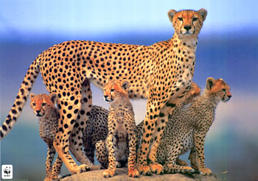
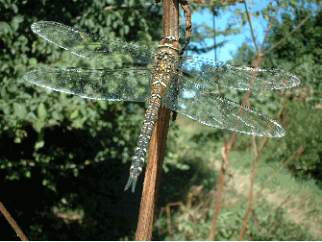
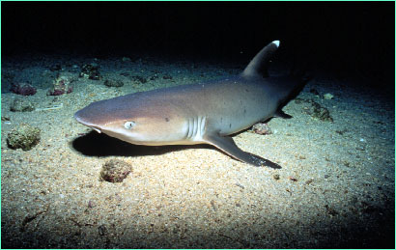
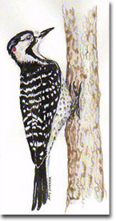
True predators kill prey immediately and generally consume many prey during their lifetime

Slide 20
IV. Populations and Biotic Influences
. . . .
D. Predation
3. functional types
a. true predators (predator-prey) - catch and kill prey immediately: wolves to whales to seed-eating rodents. Note their effect on the numbers of individuals in prey populations.
b. parasites and parasitoids (parasite-host)
→ parasites - also consume only part of living prey, but generally do not kill the prey -- specialize on one to a few prey during their life; tapeworms (diet pills), measles, mistletoes, aphids. Note no effect on the numbers of individuals in prey population.
→ parasitoids (larvae of wasps and flies) - free living adults which lay eggs in, on, or near other insects, generally consuming a living prey, while slowly killing it. Mostly resemble predators, because it changes numbers of individuals in prey populations. Tomato-horned worms.
c. grazers (plant-herbivore) - remove only part of many prey, rarely lethal; sheep, leeches, mosquitoes

Slide 21
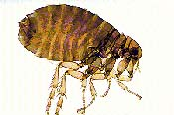
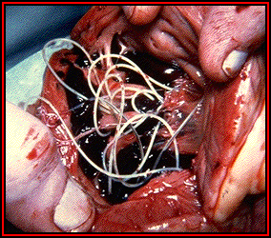
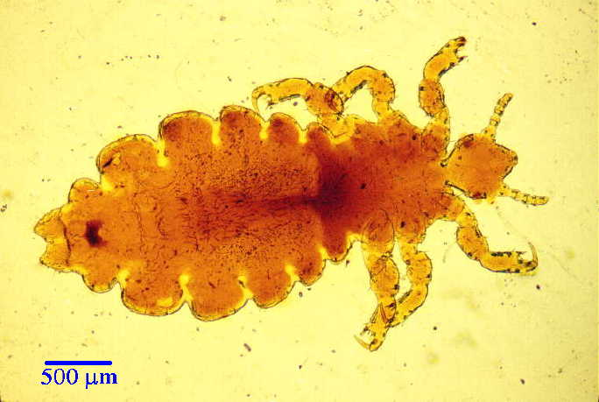
Parasites consume only part of prey, don't kill, generally live in or on one to few hosts during lifetime.
Human flea
Adult heartworms in dog heart
Human louse

Slide 22
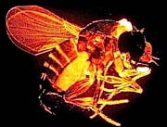
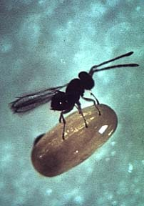
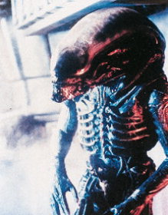
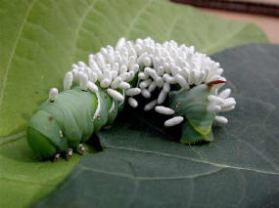
Parasitoids are usually insects with a free living adult which forage for a living host on or in which to lay eggs. Larvae usually kill host. Often disgusting.
Pseudacteon curvatus, a South American species that parasitizes fire ants in the saevissima complex
Anaphes flavipes (cereal beetle parasitoid)
Parasitoid from film “Aliens”
parasitoid on caterpillar

Slide 23
IV. Populations and Biotic Influences
. . . .
D. Predation
3. functional types
a. true predators (predator-prey) - catch and kill prey immediately: wolves to whales to seed-eating rodents. Note their effect on the numbers of individuals in prey populations.
b. parasites and parasitoids (parasite-host)
→ parasites - also consume only part of living prey, but generally do not kill the prey -- specialize on one to a few prey during their life; tapeworms (diet pills), measles, mistletoes, aphids. Note no effect on the numbers of individuals in prey population.
→ parasitoids (larvae of wasps and flies) - free living adults which lay eggs in, on, or near other insects, generally consuming a living prey, while slowly killing it. Mostly resemble predators, because it changes numbers of individuals in prey populations. Tomato-horned worms.
c. grazers (plant-herbivore) - remove only part of many prey, rarely lethal; sheep, leeches, mosquitoes

Slide 24
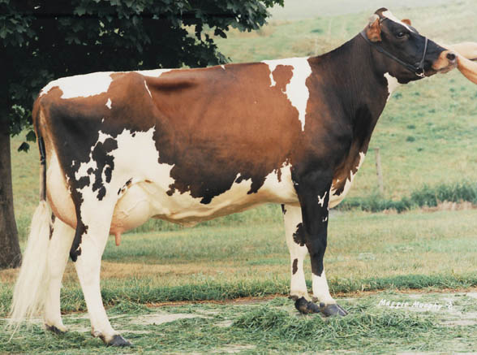
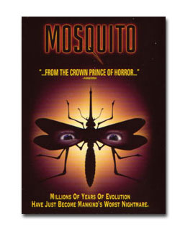
Grazers only consume part of prey, generally without killing, but also generally consume many prey during their lifetime

Slide 25
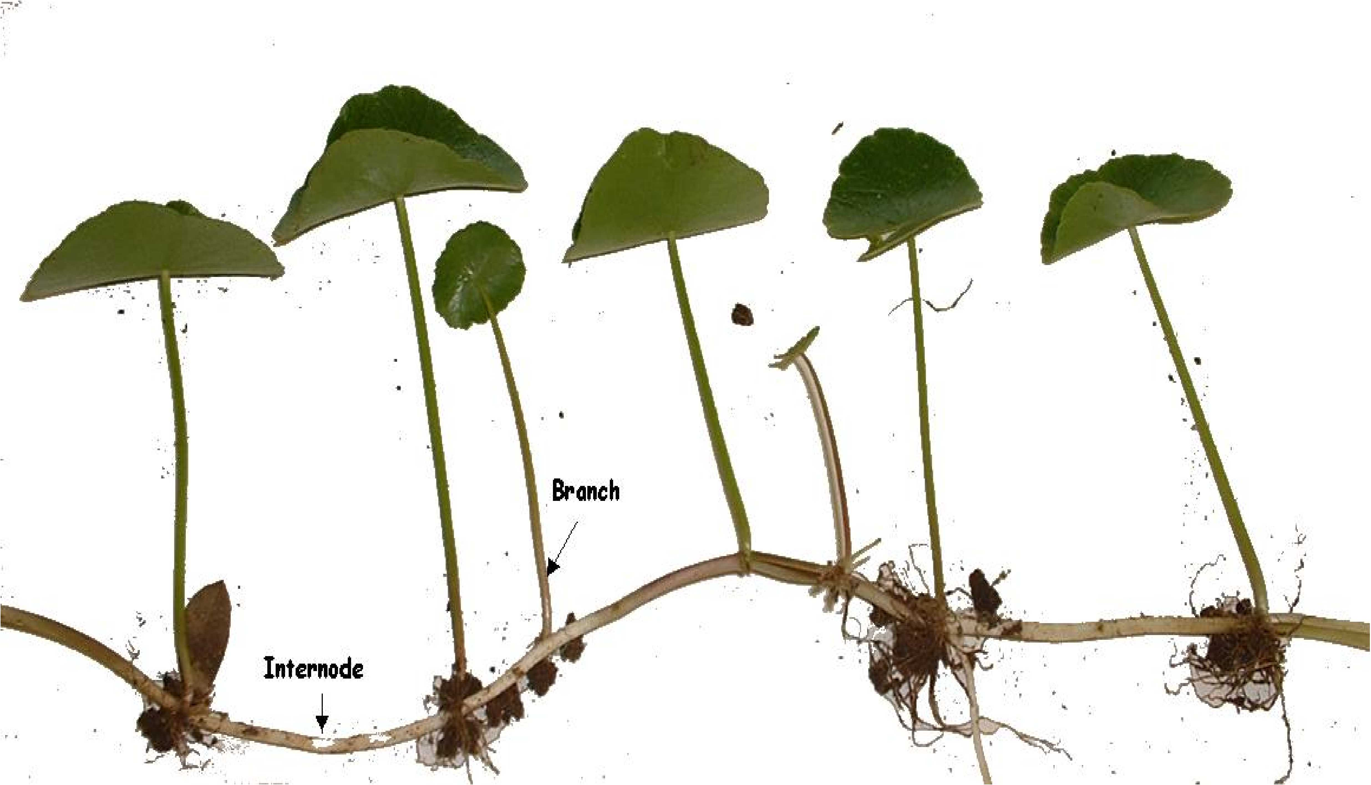
Plants don’t generally fall into predator categories because they have abiotic resources, but they clearly forage for these resources.
Dollarweed
Notes:
I have in my notes that this is dollarweed? Is that right?

Slide 26
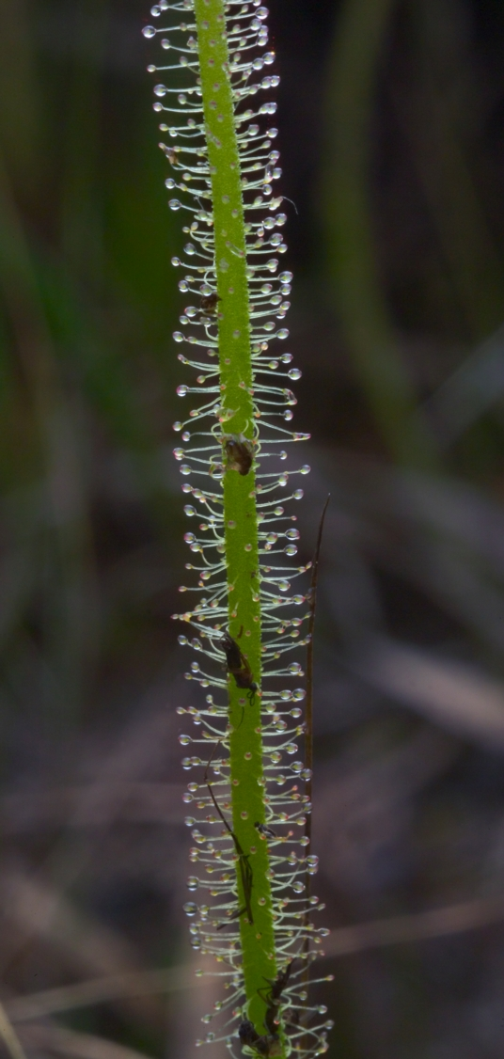
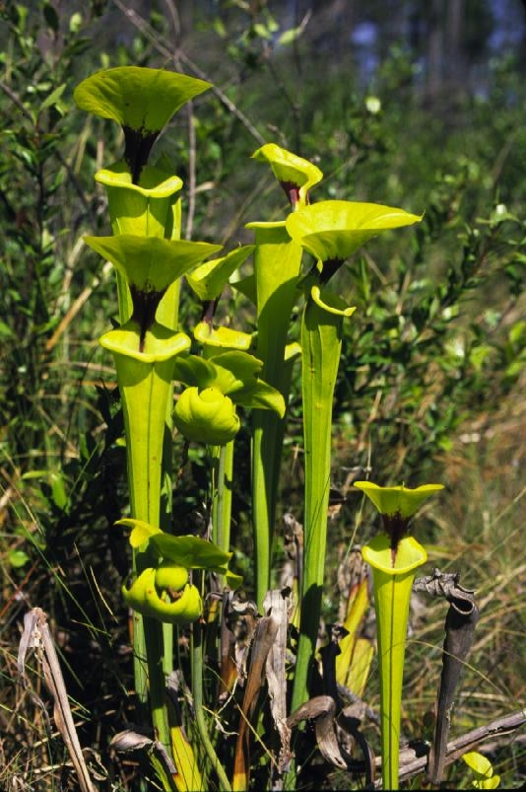
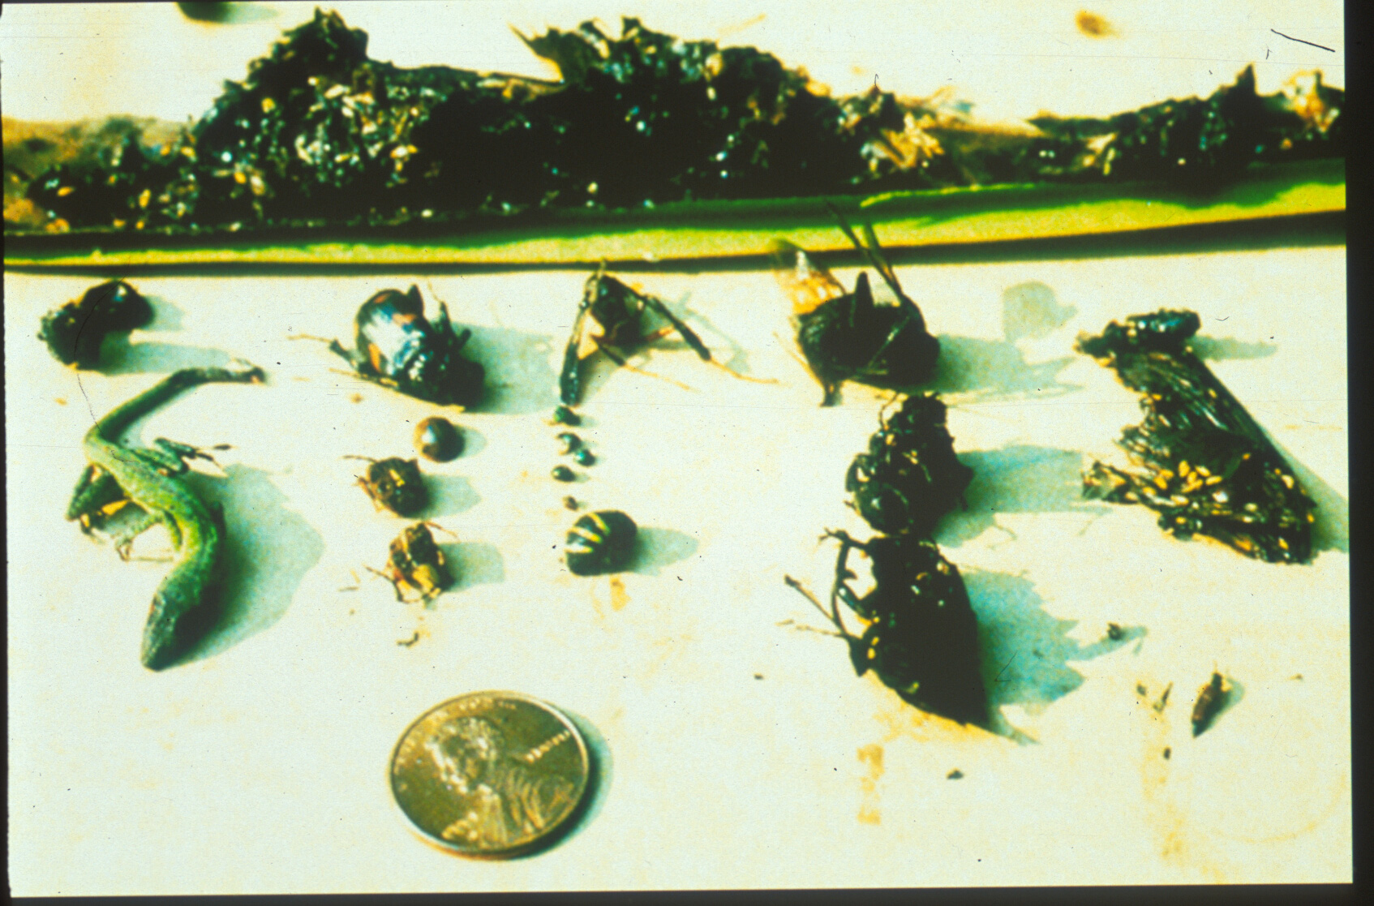
Carnivorous plants are active true predators
Bugs stuck on dew-thread.
Prey found in S. flava leaves

Slide 27
IV. Populations and Biotic Influences
. . .
D. Predation
1. definition
2. how do predator and prey numbers affect one another’s abundances?
  3. functional types
4. Prey: Effects of predation on prey behavior and evolution
-- immediate response in some cases is that prey dies. Even parasitoids usually prevent the individual from reproducing, if not killing them immediately. Clearly this effects numbers, in ways that we will soon discuss more explicitly
-- escape responses:
- escape in space: prey can be widely dispersed, or all together, depending on which makes it harder for a predator
- escape through behavior: prey can select for coloration or distraction schemes that make them seem distasteful or give them more time to get away from a predator
→ Cryptic (camouflage) coloration for hiding
→ Confusing patterns, i.e. mimicry (Batesian and Mullerian)
→ Startle, flash, and aposematic patterns
- escape by chemical/physical defenses (i.e. scales, spines, distasteful or harmful chemical compounds)

Slide 28
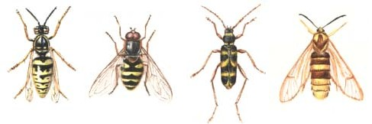
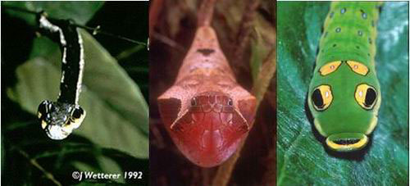
Batesian mimicry = harmless organisms resemble poisonous or distasteful
Common Wasp, Vespula vulgaris, and some of its mimics - the Hoverfly, Syrphus ribesii, the Wasp Beetle, Clytus arietis, and the Hornet Moth, Sesia apiformis.
These caterpillars all mimic snakes, organisms a bit more dangerous than tasty caterpillars.

Slide 29
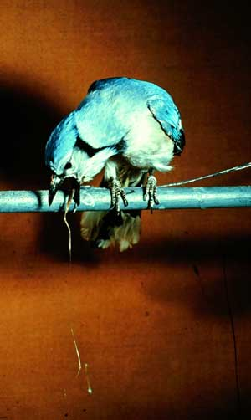
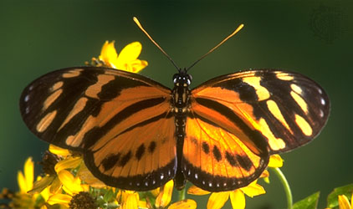
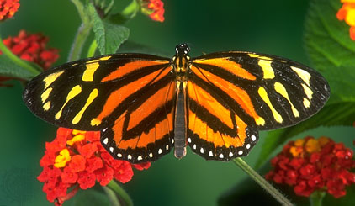
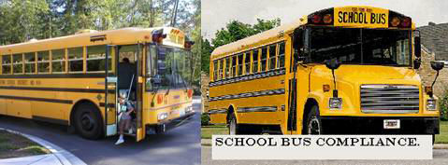
Mullerian mimicry - poisonous resemble poisonous
Noxious heliconid and noxious danaid butterflies cause birds to throw up. This doesn’t save the butterfly’s life, but might save the offspring.

Slide 30
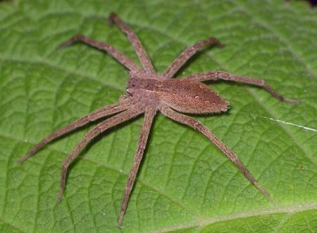
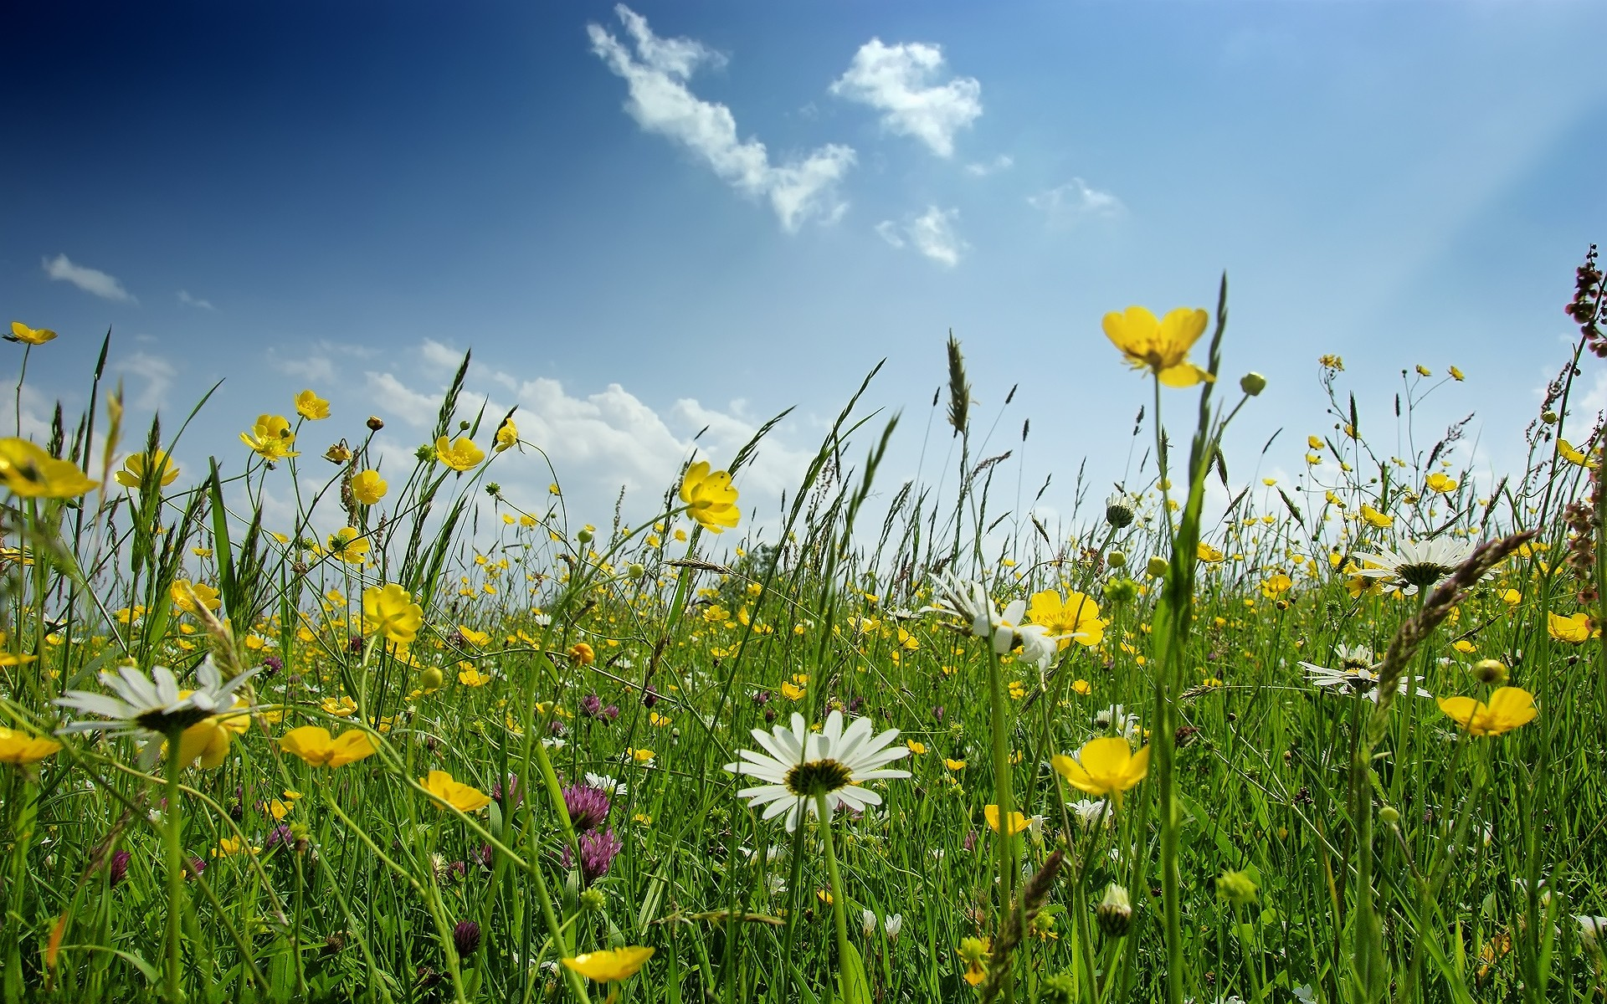
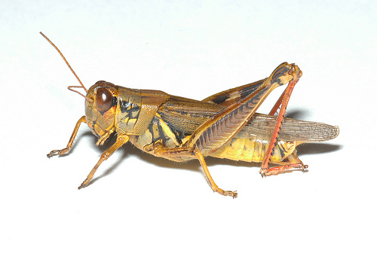
IV. Populations and Biotic Influences
. . . .
D. Predation
4. Prey: Effects of predation on prey behavior and evolution
-- escape responses:
-- ecology of fear
Oz Schmitz work on spiders.
-
-
+
+
“Trophic cascade” of spiders on grasshoppers on plants

Slide 31
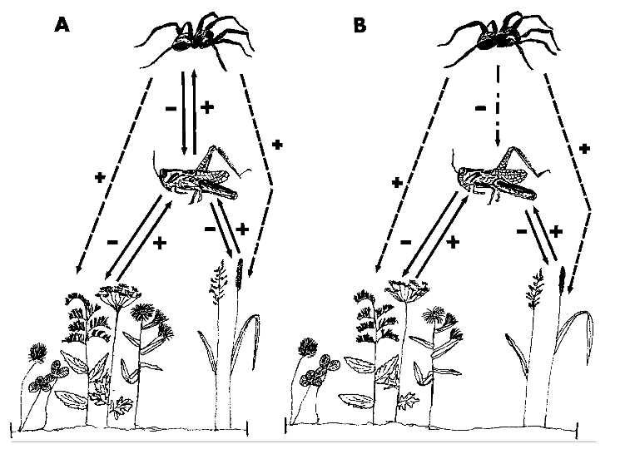
Free spiders
Glued spiders
Schmitz, et al. 1997. Ecology 78:1388–1399

Slide 32
-- Herbivores alone suppress plants
-- Spiders suppress herbivores, which releases plants
-- But, this effect can also be accomplished just with the fear of spiders

Slide 33
Study Guide Items from Lecture 15
Terms:
  Parasites • parasitoids
  true predators • grazers
  Batesian mimicry • Trophic cascade
  Mullerian mimicry • handling time
  Functional response • horizontal disease transmission
  direct disease transmission • vertical disease transmission
  indirect disease transmission
Concepts:
The basic form of SIRS and zombie models (don’t need to memorize equations)
Predators can come in many forms, depending on how many prey they have during their life and whether or not they kill their prey
These types are true predators, parasites, parasitoids, and grazers.
  Effects of predators on prey behavior
  Effects of prey on predator behavior
  Types of functional response curves
Case Studies:
Smith?’s study of zombies
  Schmidt’s ecology of fear with spiders and grasshoppers
Notes:
33

