Slide 1
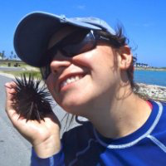
14th Lecture – Oct. 25, 2016
-- Next Exam is November 3.
-- Third Assignment due today by 5:00
-- Practice exam is posted
-- Quiz Thursday!
Friday, October 28, 4:00 pm, 1024 KIN—ECOLOGY AND EVOLUTION SEMINAR,
"Influences of multiple species pools on fiddler crab associated microbial communities,"
Dr. Catalina Cuellar Gempeler, Department of Biological Science, Florida State University.

Slide 2
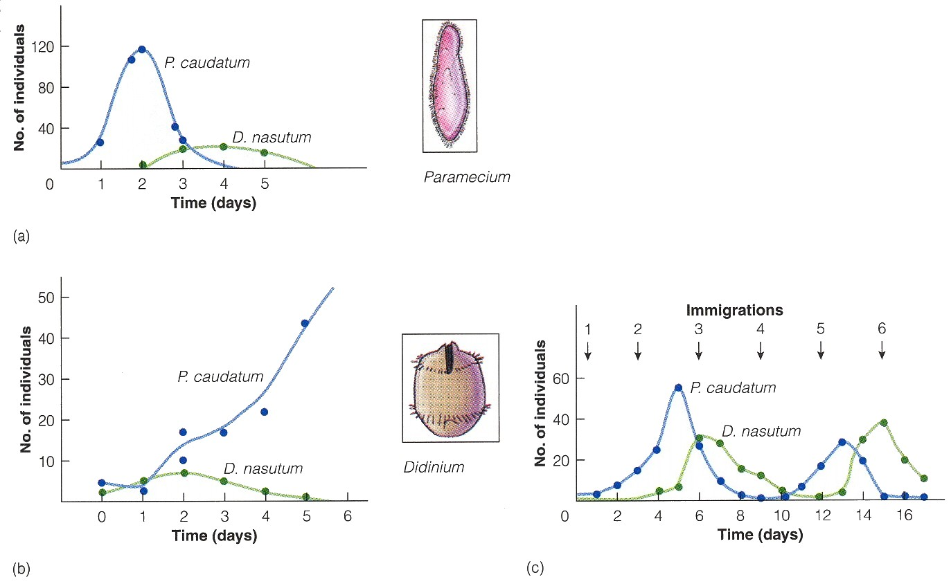
Gause’s work with protozoans shows that feedbacks often causes extinctions and oscillations for predator and prey. Can models help us understand these dynamics?
Oat medium
Oat medium w/sediment
Oat medium w/ migration
prey
predator

Slide 3
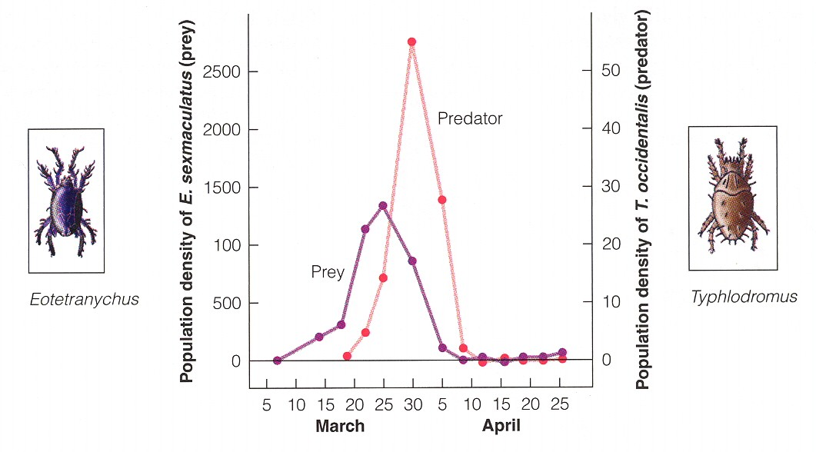
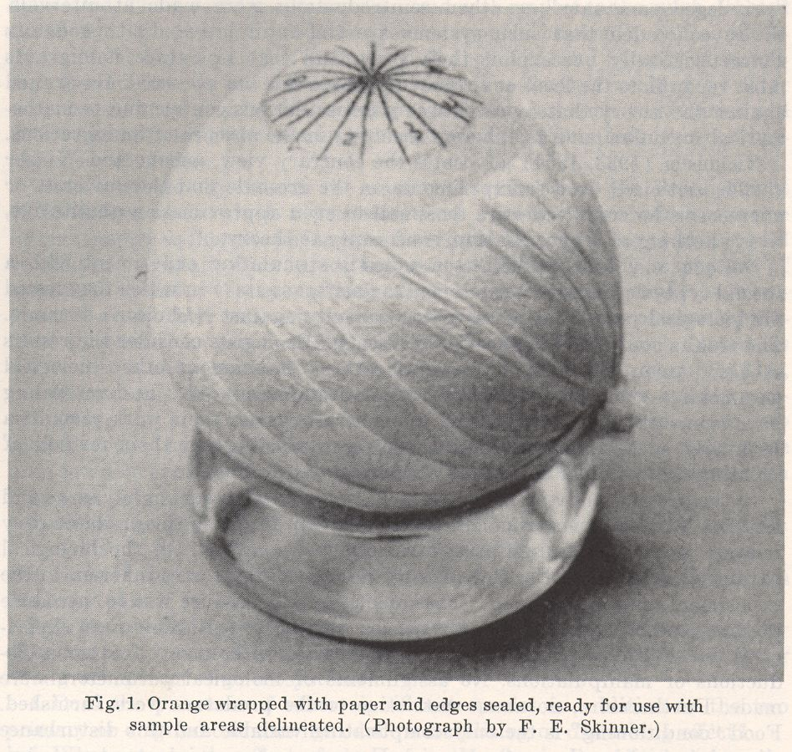
Laboratory studies of predation -- Huffaker’s mites
Huffaker studied how predator and prey might coexist using mites on oranges.
1) First, he introduced the prey onto a single orange. Then usually 11 days later, he would introduce the predator. The predator would rapidly eat all the prey.
2) Huffaker used a bunch of oranges, but covered some of each orange to create "patches" of food that added up to the same surface area as he had before. Again the predator rapidly found all the prey and ate them. But the prey persisted slightly longer, so he was encouraged.

Slide 4
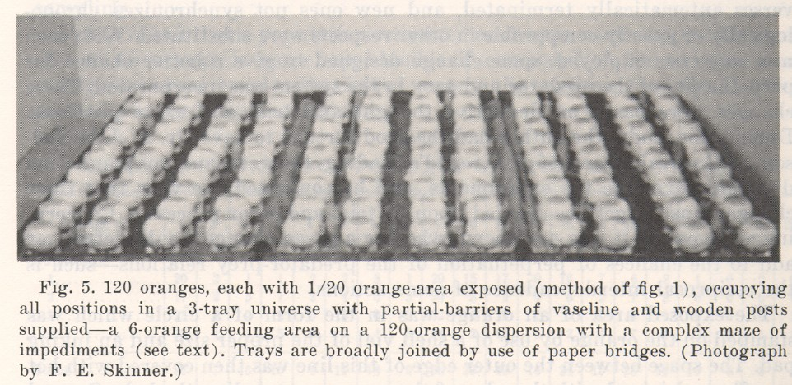
c. Laboratory studies of predation
Huffaker’s mites
3) Then he set the oranges on trays, interspersing the real oranges with rubber balls. Again, the prey were able to survive a little bit longer, but the predator eventually found the prey and eliminated them.

Slide 5
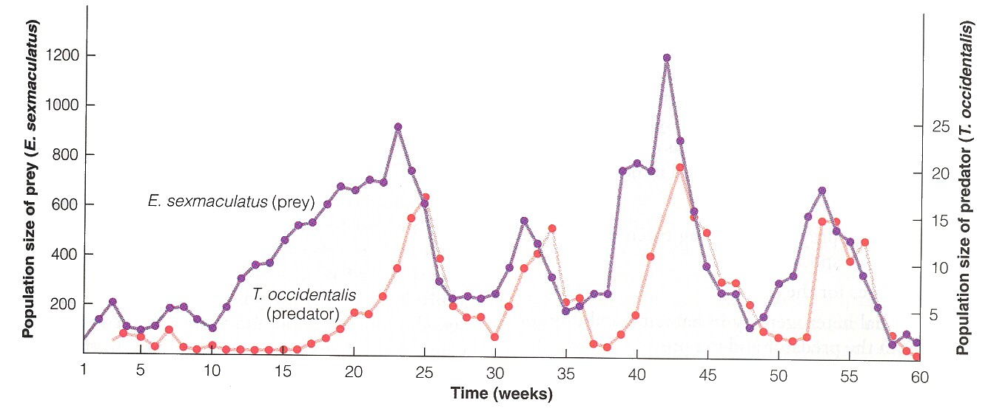
c. Laboratory studies of predation
Huffaker’s mites
4) Huffaker put vaseline barriers in areas. This again helped, prolonging coexistence, but certainly not leading to any stable situation.
5) Finally, he tried to increase the prey dispersal by adding little posts. He got about three oscillations of the two together, coexisting for over 7 months. Eventually, however, the predator eliminated the prey, thus eliminating themselves.

Slide 6
c. Laboratory studies of predation
  What can be concluded?
  -- predator-prey frequently oscillate, even if for <1 gen.
  -- very difficult to get coexistence.
  -- in this case, factors that affect dispersal may be critical for allowing coexistence (Gause and Huffaker).
  -- some of the factors that Huffaker manipulated should have led to longer coexistence and they did. For example, the smaller surface area of the oranges increases DD of prey (matches Rosenzweig/MacArthur model). Barriers of various sorts create refugia.
  -- models have generally been insightful into lab dynamics of predators and prey
  -- real-world systems also show oscillations, but may be due to other factors
  -- real-world systems often do show predator control of prey #’s

Slide 7
b. Modeling predator-prey relationships - Lotka-Volterra models again.
Interaction | Make equations (b-d) | Equilibrium (dN/dt = 0) | Phase-space isoclines | Make predictions
competition |  |  |  | Who wins? Coexistence?
predation |  |  |  | Coexistence? Oscillations?

Slide 8
b. Modeling predator-prey relationships - Lotka-Volterra models again.
For the prey:
For the predator:

Slide 10
r/θ
prey isocline
predator abundance
predator isocline
m/θθ
prey abundance

Slide 11
b. Modeling predator-prey relationships - Lotka-Volterra models again.
Interaction | Make equations (b-d) | Equilibrium (dN/dt = 0) | Phase-space isoclines | Make predictions
competition |  |  |  | Who wins? Coexistence?
predation |  |  |  | Coexistence? Oscillations?

Slide 12
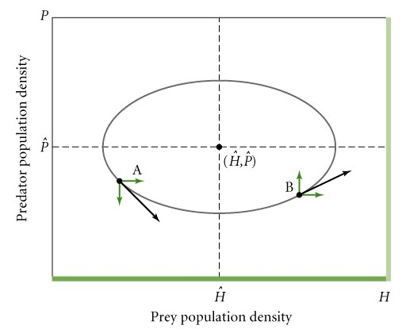
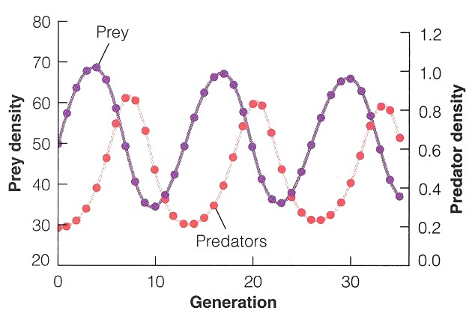
b. Modeling predator-prey relationships
i) simple dynamics predict oscillations
(may or may not be stable)

Slide 13
b. Modeling predator-prey relationships
i) simple dynamics predict oscillations
Even if stable, may suffer from the “atto-fox” problem (10⁻⁸)
ii) may often be unstable!

Slide 14
Gause’s work with protozoans
Oat medium
Oat medium w/sediment
Oat medium w/ migration
prey
predator

Slide 15
IV. Populations and Biotic Influences
. . .
D. Predation
b. Modeling predator-prey relationships - Lotka- Volterra models again.
i) simple equations
ii) oscillations and instability
iii) more complex assumptions (Rosenzweig- MacArthur modifications)

Slide 16
b. Modeling predator-prey relationships - Lotka-Volterra models again.
For the prey:
For the predator:

Slide 17
b. Modeling predator-prey relationships - Lotka-Volterra models again.
For the prey:
Assumes:
-- exponential growth
-- linear effects of density on growth
For the predator:

Slide 18
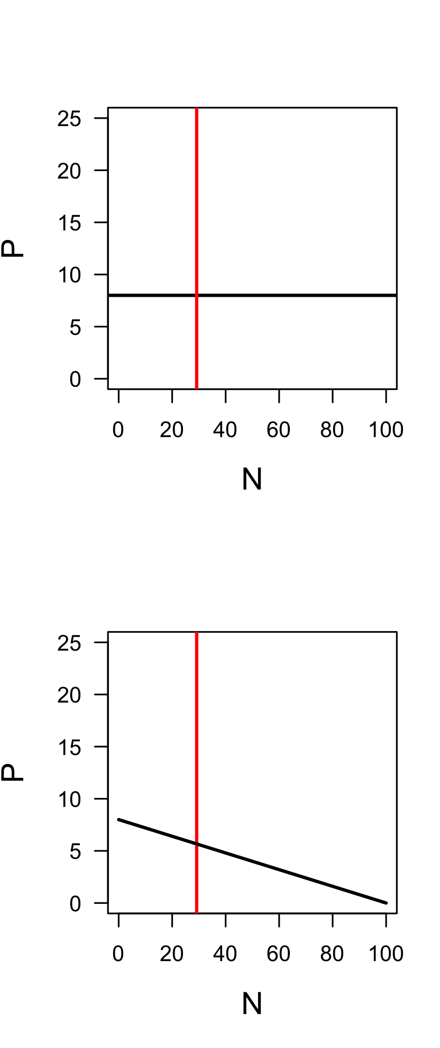

Slide 20
b. Modeling predator-prey relationships - Lotka-Volterra models again.
For the prey:
Assumes:
-- exponential growth
-- linear effects of density on growth
For the predator:

Slide 21
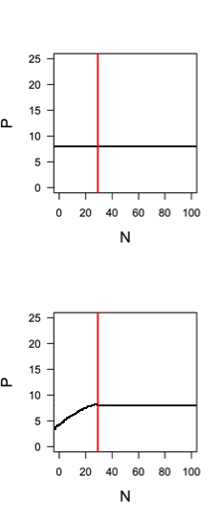
Allee Effect?

Slide 22
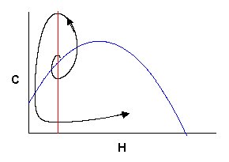
Allee effect at low densities destabilizes.
Intraspecific competition at high densities stabilizes.

Slide 23
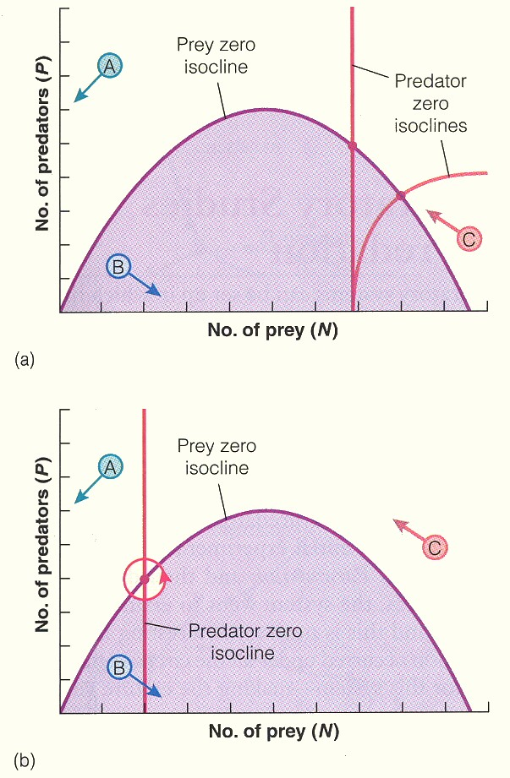
b. Modeling predator-prey relationships - Rosenzweig-MacArthur variation
Should tend to stabilize predator-prey numbers
Depends on x intercept, which is m/(θ_{c} x θ_{r})
So, higher mortality will tend to stabilize, but higher efficiencies will destabilize
- Should tend to destabilize predator-prey numbers

Slide 24
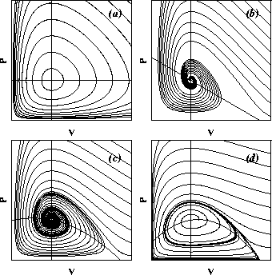
b. Modeling predator-prey relationships - Rosenzweig-MacArthur variation
Lotka-Volterra
Intraspecific competition of prey stabilizes predator and prey
Also intraspecific competition of prey if predator isocline is shifted right
Allee effects destabilizes predator and prey if isocline is shifted left.

Slide 25
b. Modeling predator-prey relationships - Lotka-Volterra models again.
For the prey:
Assumes:
-- exponential growth
-- linear effects of density on growth
For the predator:
Assumes:
-- reproduction scales with density
-- linear effects of density on growth

Slide 26
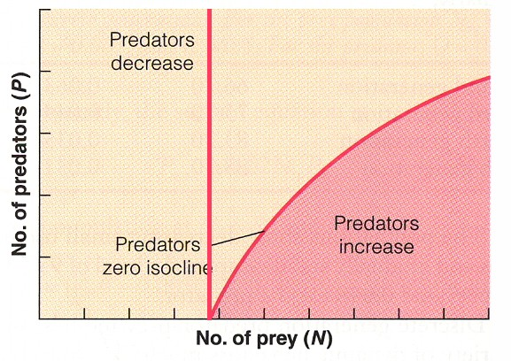
b. Modeling predator-prey relationships - Rosenzweig-MacArthur variation

Slide 27
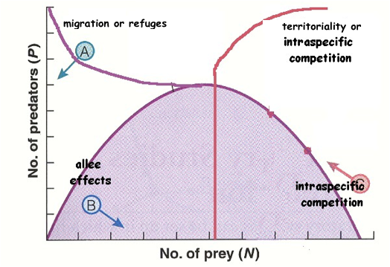
b. Modeling predator-prey relationships - modifications to assumptions (remember clockwise == tend to stabilize)

Slide 28
Study Guide Items from Lecture 14
Terms:
Concepts:
  Assumptions of the basic predator-prey equations
  Rosenzweig-MacArthur variation (adding competition and Allee effects)
  Effects of intraspecific competition in predators on stability of predator-prey
  Effects of refuges or migration of prey on stability of predator-prey
Case Studies:
Gause’s protozoa
Huffaker’s mites on oranges
Notes:
28

