Slide 1
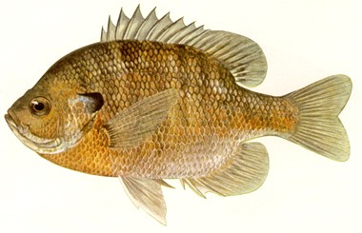
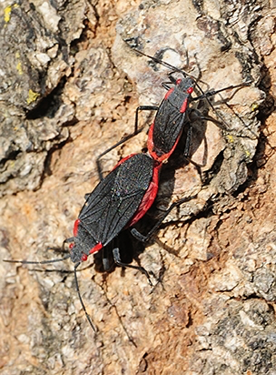
13th Lecture -- October 20, 2016
-- Read Werner and Hall paper on Blackboard.
-- Third assignment now posted and due Tuesday, Oct. 25
-- 2nd Exam is Nov. 3. I’ve started posting old exams.
Thursday, October 20, 4:00 pm, 1024 KIN—BIOLOGICAL SCIENCE COLLOQUIUM, "An experimental study of adaptation in the real world in real time," Dr. Joseph Travis, Department of Biological Science, Florida State University.
Friday, October 21, 4:00 pm, 1024 KIN—ECOLOGY AND EVOLUTION SEMINAR, "The breakdown of local adaptation in soapberry bugs: the consequences of switching to an invasive host plant," Dr. Meredith Cenzer, Department of Biological Science, Florida State University.
Notes:
Remind the students that their first of two written assignments is due in mid-October.

Slide 2
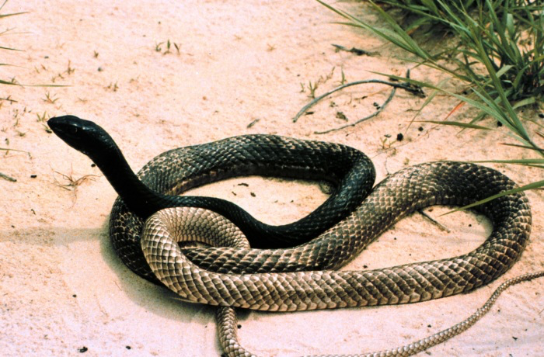
A myth of the rural southeastern United States is that whipsnakes, when disturbed, could chase a person down, wrap him up in its coils, whip him to death with its tail, and then make sure he is dead by sticking its tail up the victim's nose to see if he is still breathing.

Slide 3
5. Evidence of competition:
What type of evidence is sufficient to demonstrate that competition is occurring in the wild?
i) observation of interactions (insufficient)
ii) correlations in abundance (insufficient)
iii) experimental manipulations
YES! This is the most common and, perhaps,
satisfactory evidence of competition.
iv) evolution of traits
Notes:
Read werner and hall!!!! -PROOF

Slide 4
Niche Shifts in Sunfishes: Experimental Evidence and Significance
Earl E. Werner; Donald J. Hall
Science, Vol. 191, No. 4225. (Jan. 30, 1976), pp. 404-406.

Slide 5
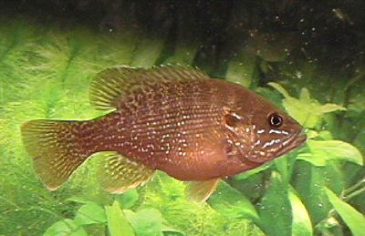
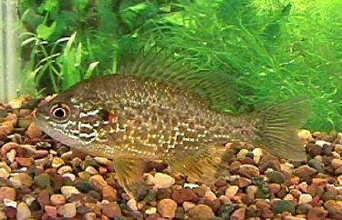
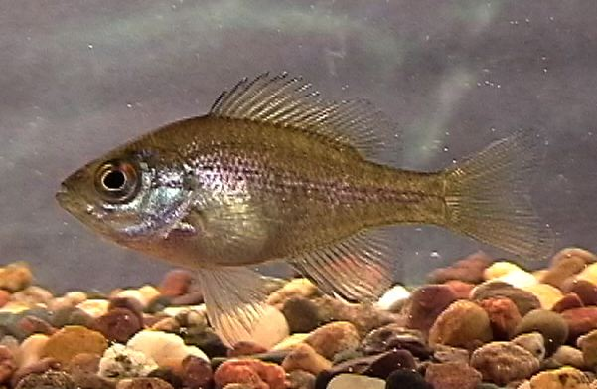
5. Evidence of competition:
iii) experimental manipulations
Werner and Hall (Science 191:404-406) took ponds in Michigan that contain several different fish species: bluegills, green sunfish, and pumpkinseed sunfish. They set up ponds with each species alone at 900 individuals and pond with all three species together at 2700 fish/pond.
green
pumpkinseed
bluegill

Slide 6
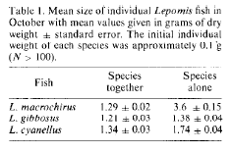
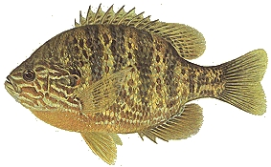
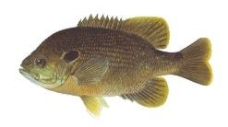
Bluegill sunfish
Pumpkinseed sunfish
Green sunfish

Slide 7
5. Evidence of competition:
iii) experimental manipulations -- Werner and Hall demonstrated that competition was occurring (-, - effects)
blue
pumpkin
green

Slide 8
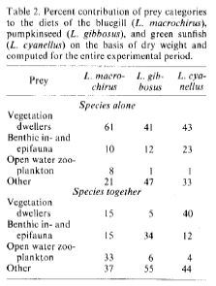
5. Evidence of competition:
iii) experimental manipulations -- Werner and Hall also demonstrated that competition is correlated with a shift in diets
Alone, each species prefers prey in vegetation
When competing, L. cyanellus still takes vegetation prey, but L. gibbosus shifts to benthic fauna and L. macrochirus shifts to an open water diet.

Slide 9
Summary of Werner and Hall (Science 191:404-406)
Used experiments to demonstrate the necessary conditions for competition -- that the presence of each species suppresses the population size of the other species (-,-).
Good example of comparing species with and without other species in order to demonstrate how they interact. They created monocultures and a three-species mixture and then determined later individual sizes of fish.
Also shows niche (resource) partitioning. If left alone, all the fish would feed in the vegetation. However, in competition, the dominant species, L. cyanellus, stays in the vegetation, while the other two species are forced to suboptimal parts of the habitat
This shows that the species are probably interacting through limiting food supplies -- so, it is probably resource rather than interference competition.

Slide 10
5. Evidence of competition:
What type of evidence is sufficient to demonstrate that competition is occurring in the wild?
i) observation of interactions (insufficient)
ii) correlations in abundance (insufficient)
iii) experimental manipulations (convincing)
iv) evolution of traits -- character displacement

Slide 11
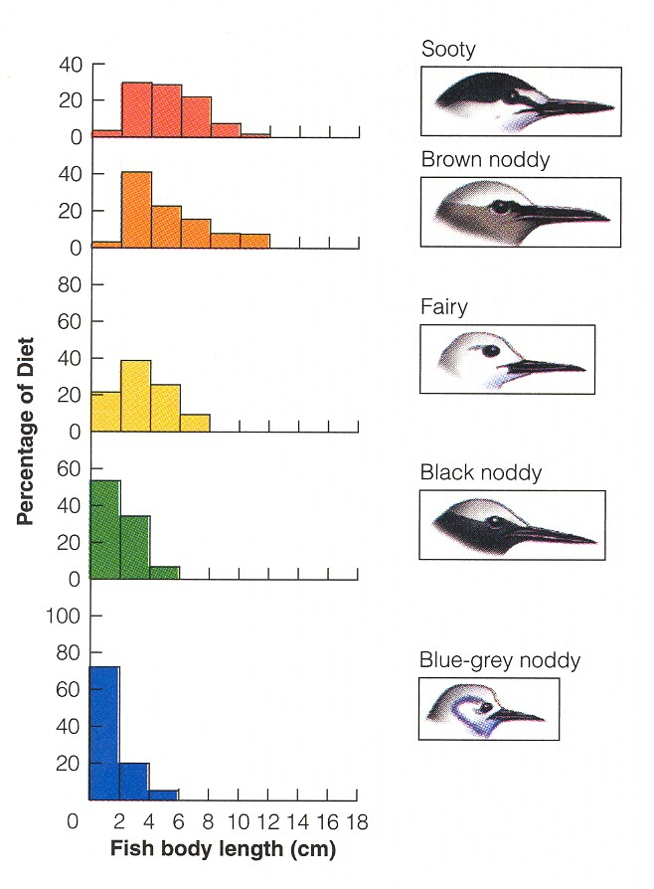
5. Evidence of competition:
iv) evolution of traits -- character displacement
Some character differs among species, apparently allowing them to coexist, according to Gause’s competitive exclusion principle. The character may be morphological or some aspect of their behavior such as diet.
Here terns are arranged in order from largest (top) to smallest. Sooty and Brown Noddy terns have very similar diets, but Sooty’s feed far at sea, while Brown Noddy terns feed near shore.

Slide 12
5. Evidence of competition:
What type of evidence is sufficient to demonstrate that competition is occurring in the wild?
iv) evolution of traits -- character displacement
Is this sufficient evidence that competition is occurring?
Two problems:
Other factors such as chance could produce the pattern
This may all be evolution as the result of competition in the past, but the species may now differ so much that they are not competing

Slide 13
5. Evidence of competition:
What type of evidence is sufficient to demonstrate that competition is occurring in the wild?
iv) evolution of traits -- character displacement
Is this sufficient evidence that competition is occurring?
Two problems:
Other factors such as chance could produce the pattern
The mere fact that species differ in some trait related to resources does not mean that the competition is occurring or is involved in the evolution of the trait.

Slide 14
5. Evidence of competition:
iv) evolution of traits -- character displacement
A group of faculty and students at Florida State published several articles critical of character displacement studies. They proposed that the patterns produced by the characters must be non-random to considered as the result of competitive interactions. To test if they are non-random, they proposed testing such models against a random or “null” distribution.

Slide 15
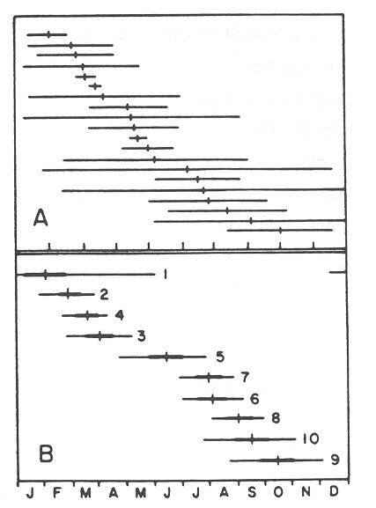
5. Evidence of competition:
iv) evolution of traits -- character displacement
The top pattern is a random pattern of flowering times for different species of plants generated by a computer. The bottom pattern is an actual flowering pattern of plants that were proposed to be competing for pollinators. The real pattern is not significantly different from a random pattern.
We could get the same pattern by ranking students by height!
Notes:
Plants flower at different times – evidence?
Must do it in a non-random way
Need a null wodel

Slide 16
5. Evidence of competition:
What type of evidence is sufficient to demonstrate that competition is occurring in the wild?
iv) evolution of traits -- character displacement
A group of faculty and students at Florida State published several articles critical of character displacement studies. They proposed that the patterns produced by the characters must be non-random to considered as the result of competitive interactions. To test if they are non-random, they proposed testing such models against a random or “null” distribution.

Slide 17
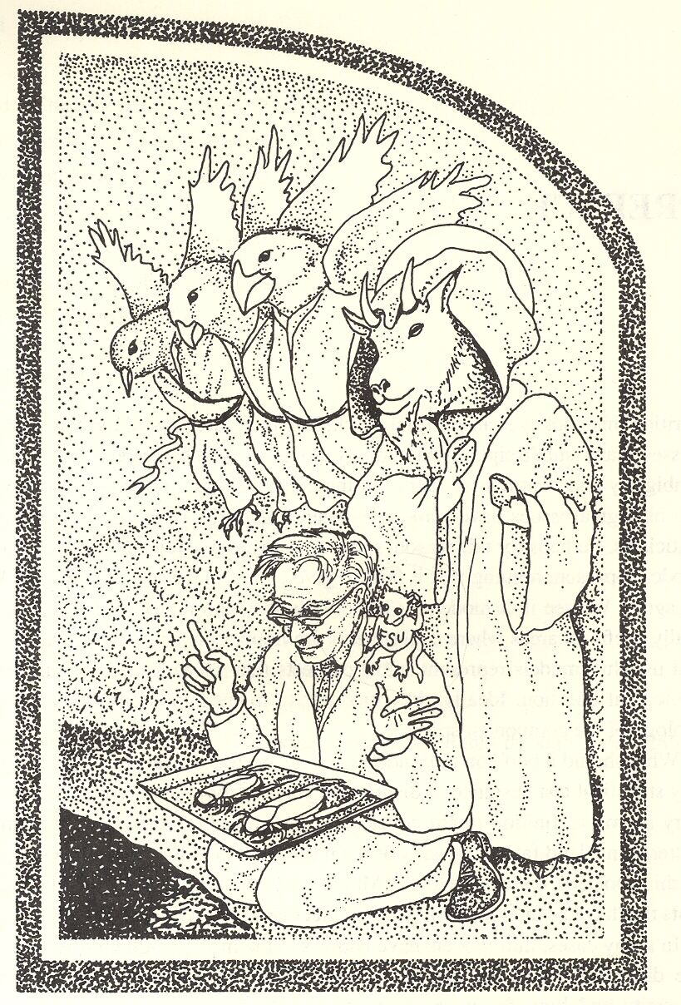
Shahid Naeem’s xmas card, demonstrating the effect of the Florida State ‘mafia” on ecology.

Slide 18
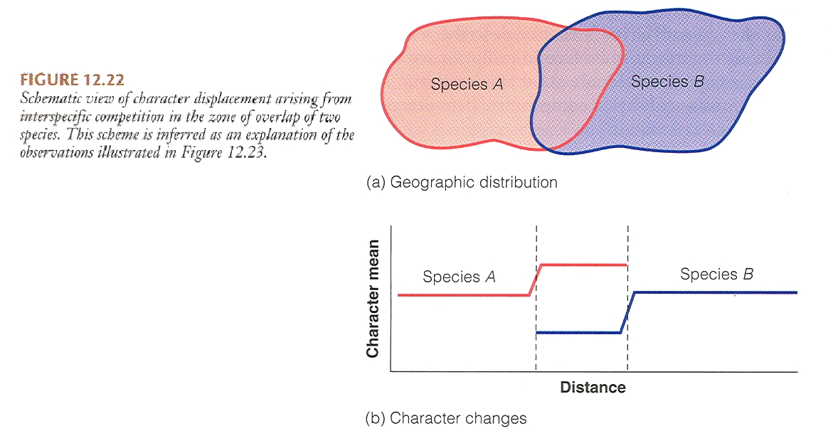
Species patterns in allopatry (occurring in different areas) and sympatry (occurring in the same area) is stronger evidence of character displacement.

Slide 19
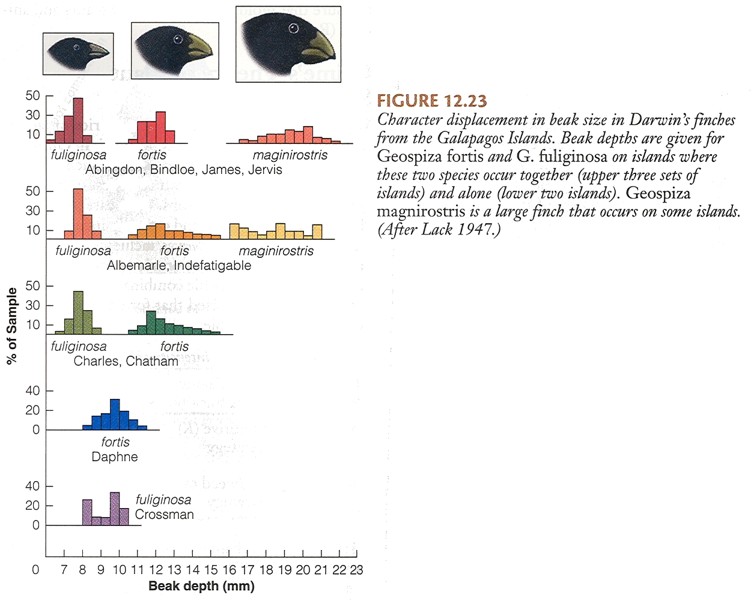
Best example is Darwin’s finches on the Galapagos Islands

Slide 20
V. Populations and Biotic Influences
A. Migration
B. Types of Species Interactions
C. Competition
1. Definition:
2. Types of competition (resource vs. interference)
3. Simple Models of Competition --
4. Examples of Competition in Real Populations
a. Tansley’s plant study
b. A. C. Crombie ( beetles and moths)
c. Thomas Park (flour beetles)
d. Violating the assumptions of L-V (Ayala’s Drosophila)
5. Evidence of competition:
6. r and K selection (a reminder)
Notes:
R and k selection is evolution of competitive ability

Slide 21
V. Populations and Biotic Influences
A. Migration
B. Types of Species Interactions
C. Competition
-- Evolution may lead to very different species syndromes, depending on whether the species are limited by resources (K, competition) or their ability to grow fast (r, disturbance/predation).
factor r-selection K-selection
competition variable or weak strong
climate variable constant
mortality DI, often catastrophic DD, competition
survivorship often type III often type I or II
propulation size variable at or near K
selection favors rapid development slow development
high rm low rm
early reproduction delayed reproduction
small body size large body size
semelparous iteroparous
short life span longer life span (>1 yr.)

Slide 22
IV. Populations and Biotic Influences
A. Migration
B. Types of Species Interactions
C. Competition
D. Predation
1. definition - consumption of one organism (the prey) by another (the predator), in which the prey is alive when the predator first attacks. (classified by a +/- relationship)
2. numerical responses (feedback between predator and prey)

Slide 23
Classification of species interactions
Symbiosis: close association between two species

Slide 24
But, before we go further, we are going to take a quick look at theory again, very similar to our competition equations. Remember that with competition, each species affects the growth rate of itself and the other species.
-
N_{A}
N_{B}
-
With predation, again each species can have an effect on one another, but this time one is positive and one negative:
-
N_{A}
P_{B}
+

Slide 25
Let’s first consider the effect of the predator on the prey numbers.
Remember: Logistic Growth…We can draw the growth curve (Nt vs. time) or we can draw the same things as Nt vs. Nt+1. This second way of graphing the data illustrates where the population grows the most and is often called a “stock- recruitment curve”.
Nt
Nt+1
Nt
time
Time | Nt | Nt+1 | new N
1 | 1 | 2 | 1
2 | 2 | 4 | 2
3 | 4 | 8 | 4
4 | 8 | 15 | 7
5 | 15 | 28 | 13
6 | 28 | 47 | 19
7 | 47 | 72 | 25
8 | 72 | 92 | 20
9 | 92 | 99 | 7
10 | 99 | 100 | 1
11 | 100 | 100 | 0
12 | 100 | 100 | 0
13 | 100 | 100 | 0
new
Nt+1 (recruitment)
Nt
Nt (stock)

Slide 26
The “stock- recruitment curve” can predict how we should manage a self-replacing “stock”, such as fisheries or deer population. Simple curve, but frustrating to understand sometimes.
Nt+1 (recruitment)
new
Nt
Nt (stock)

Slide 27
IV. Populations and Biotic Influences
. . .
a. optimal harvesting demonstrates how predators can
control prey numbers.

Slide 28
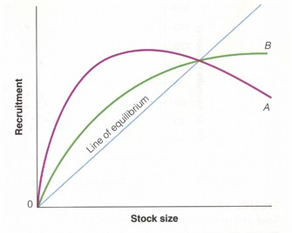
a. Optimal harvesting of populations:
Other population growth models could be used, such as the Beverton and Holt model which is more exponential with less strong intraspecific limitation (better for long-lived species).
Fig. 17.7
Beverton-Holt
Ricker
Notes:
I think you wanted to take this out? Just checking…

Slide 29
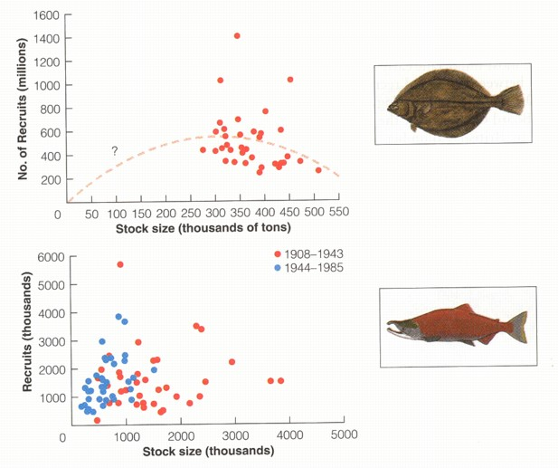
a. Optimal harvesting of populations:
Actual relationship for real data is hard to discern

Slide 30
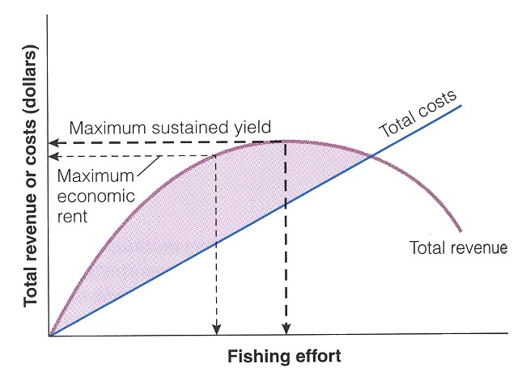
Optimal harvesting of populations:
Optimization model can be different if real-world costs are included -- economic optimization
Notes:
Other ways to figure out numbers that you should take (takes into account fishers cost)

Slide 31
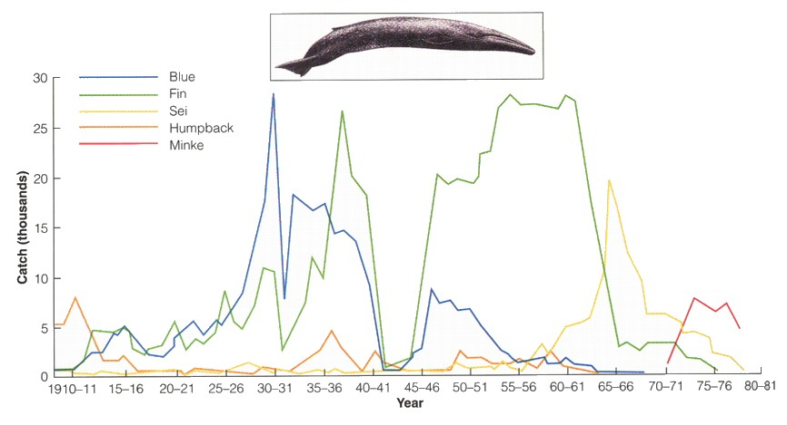
a. Optimal harvesting of populations:
Case study: Antarctic Whaling
“Fishing down” = targeting increasingly large quantities of smaller species of fish with less commercial value.

Slide 32
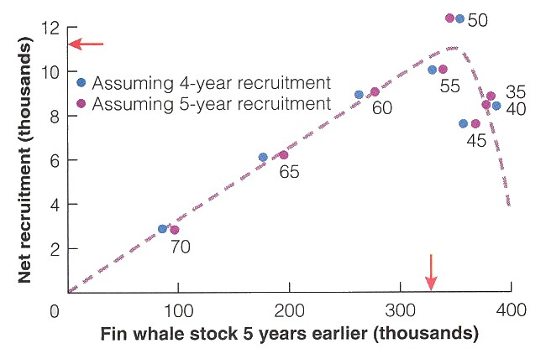
a. Harvesting populations:
Case study: Antarctic Whaling
→ Fin whales experience maximum sustainable yield much closer to their carrying capacity

Slide 33
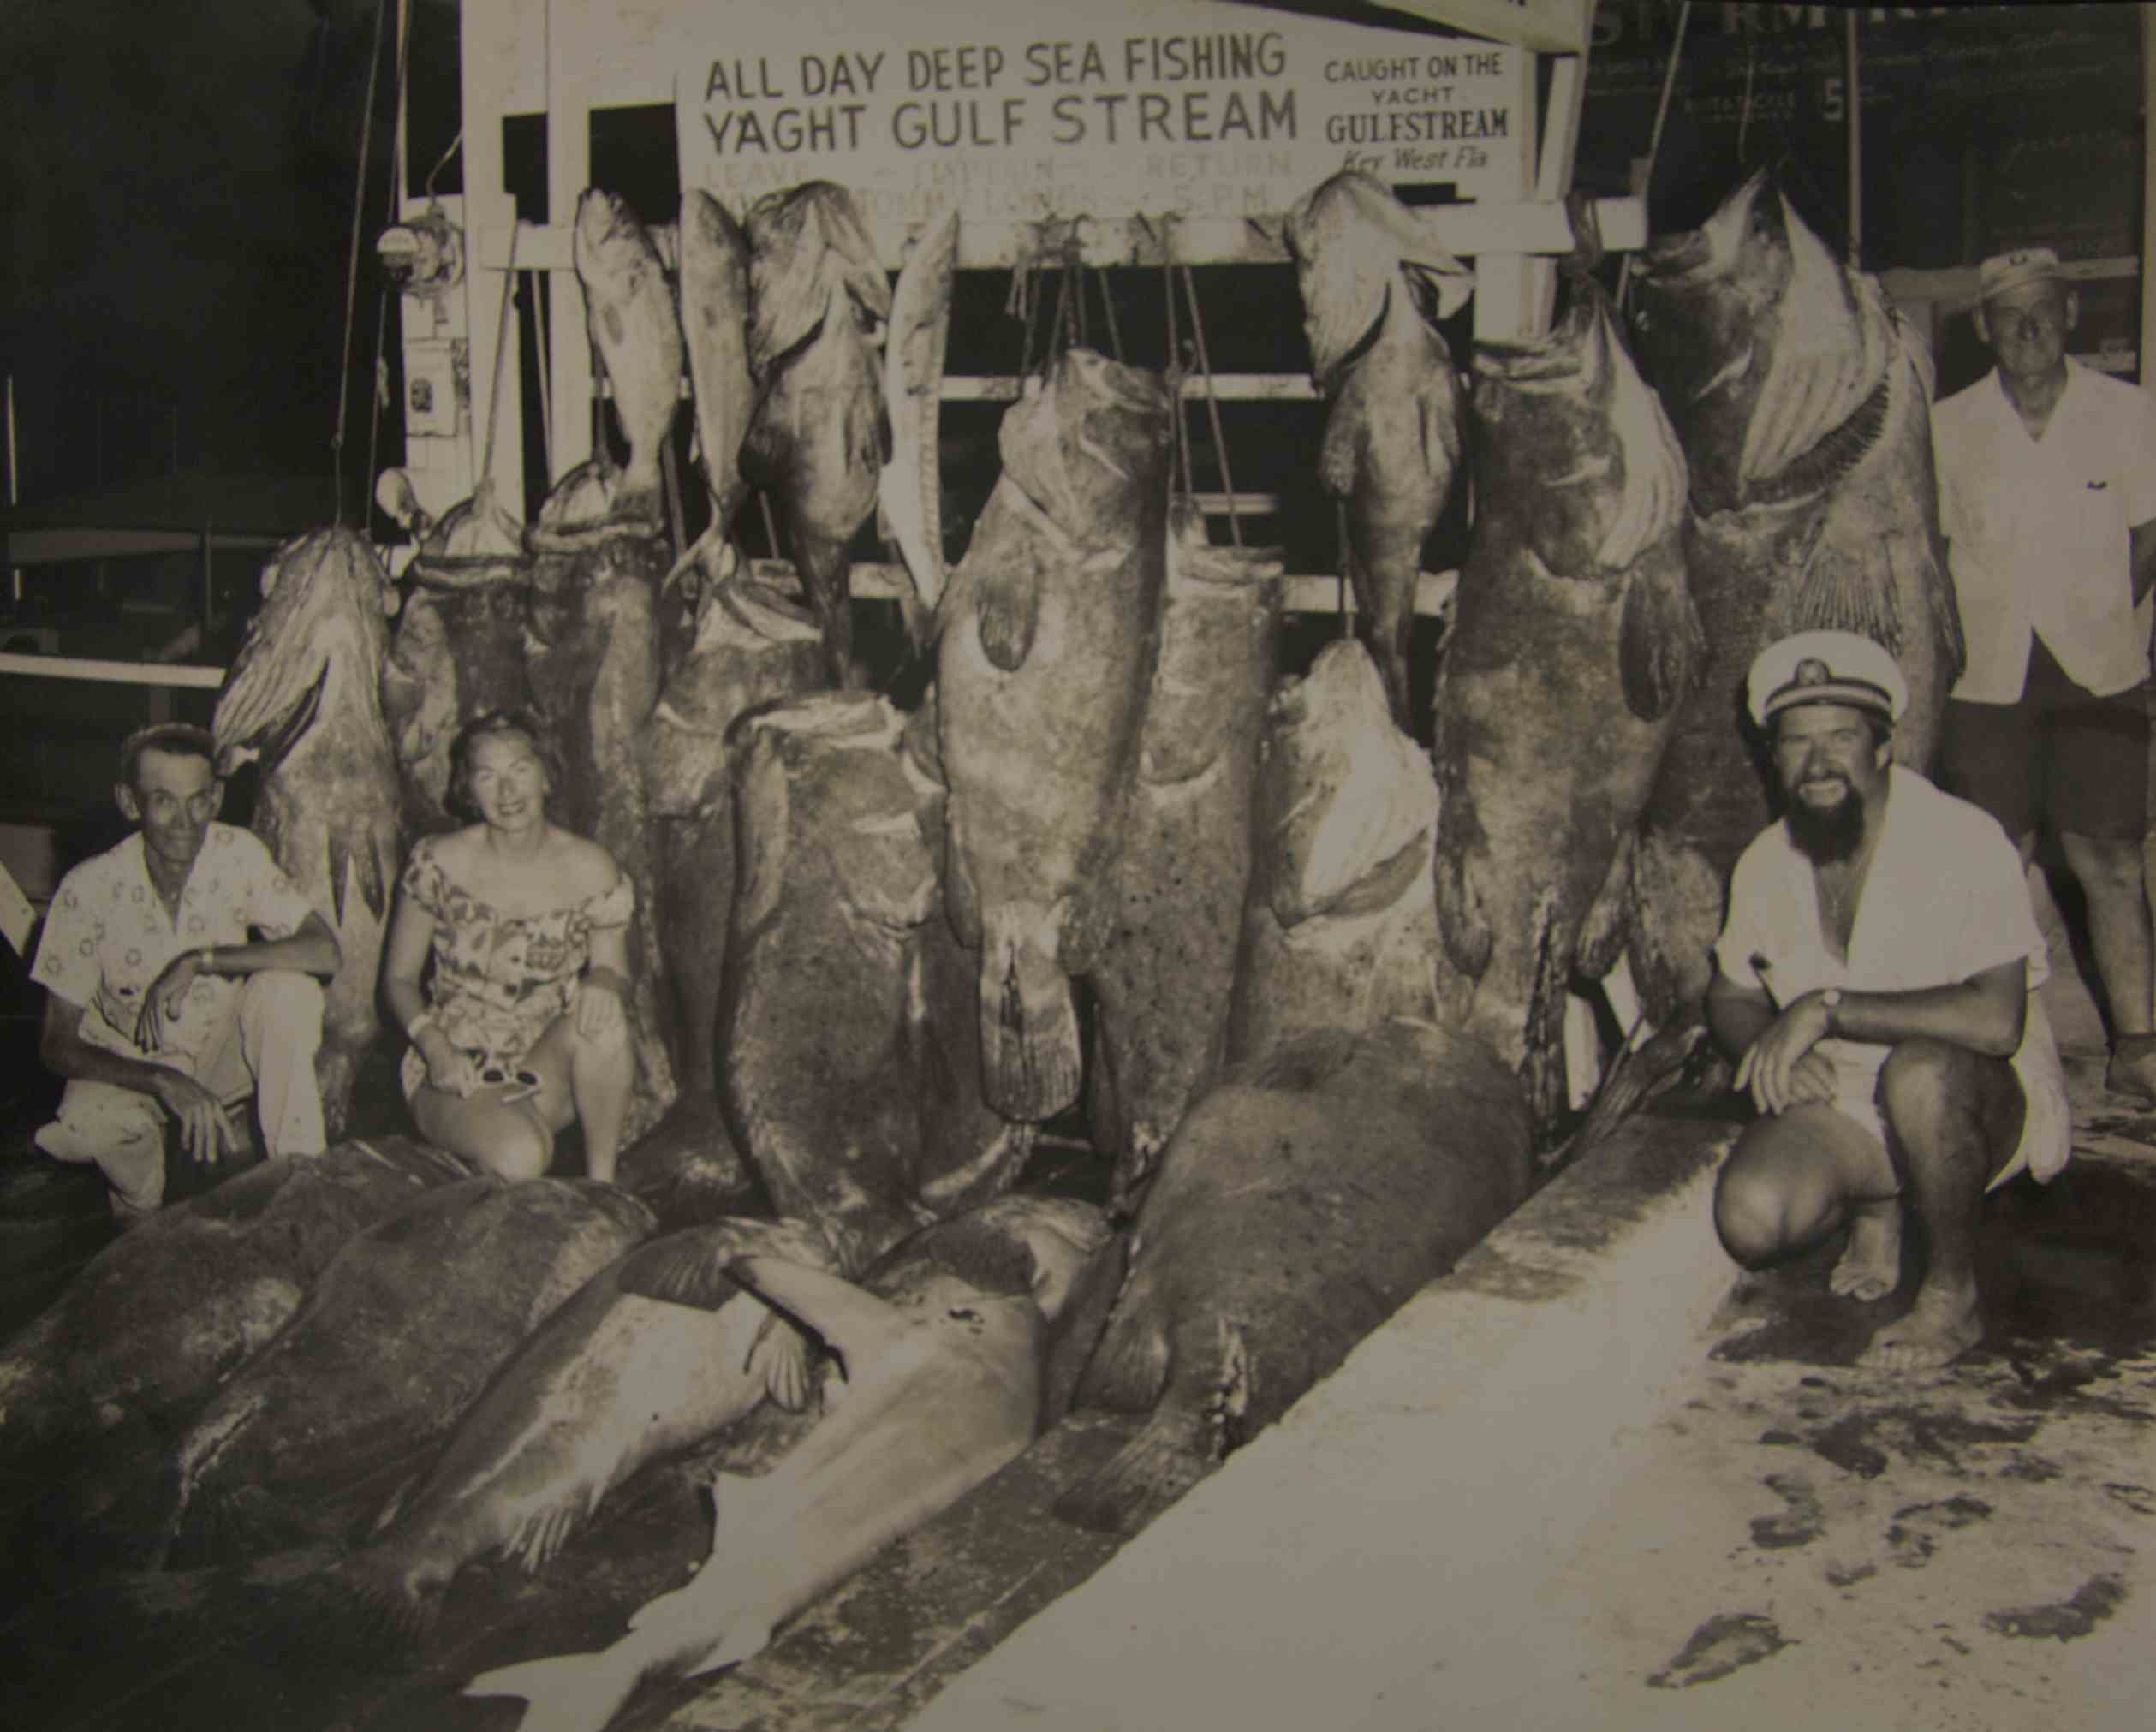
Fishing can also have long-term effects on size and species, as well as catch
1950’s

Slide 34
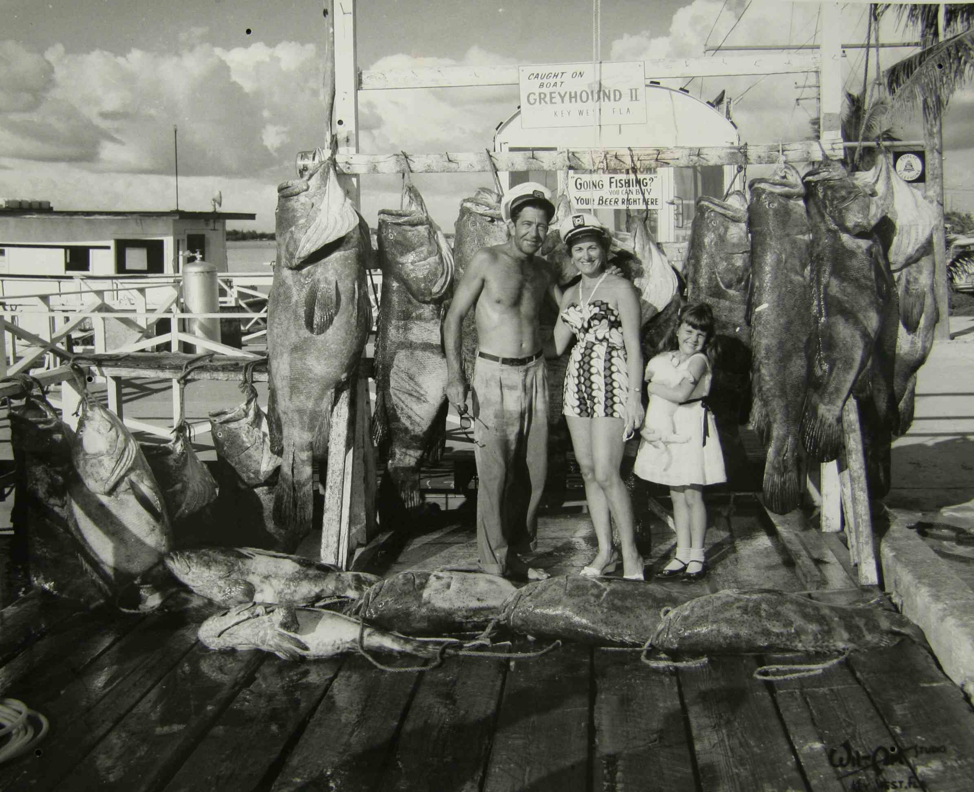
1950’s

Slide 35
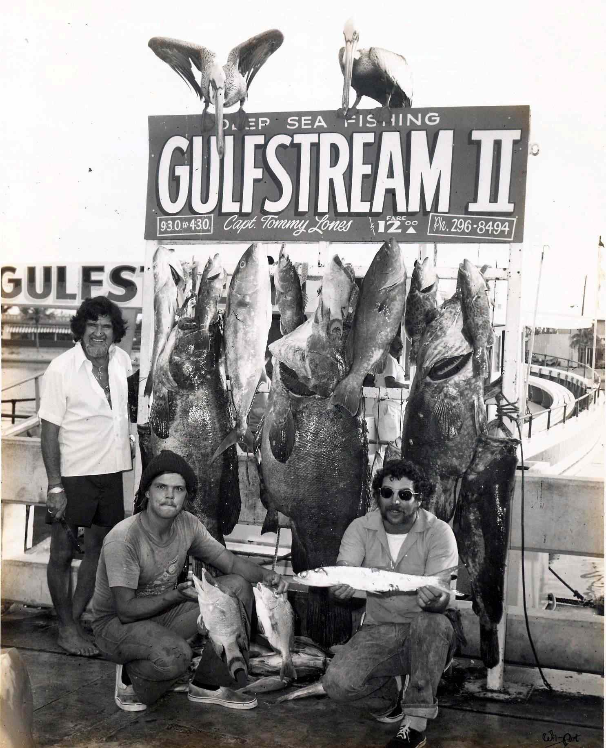
1970’s

Slide 36
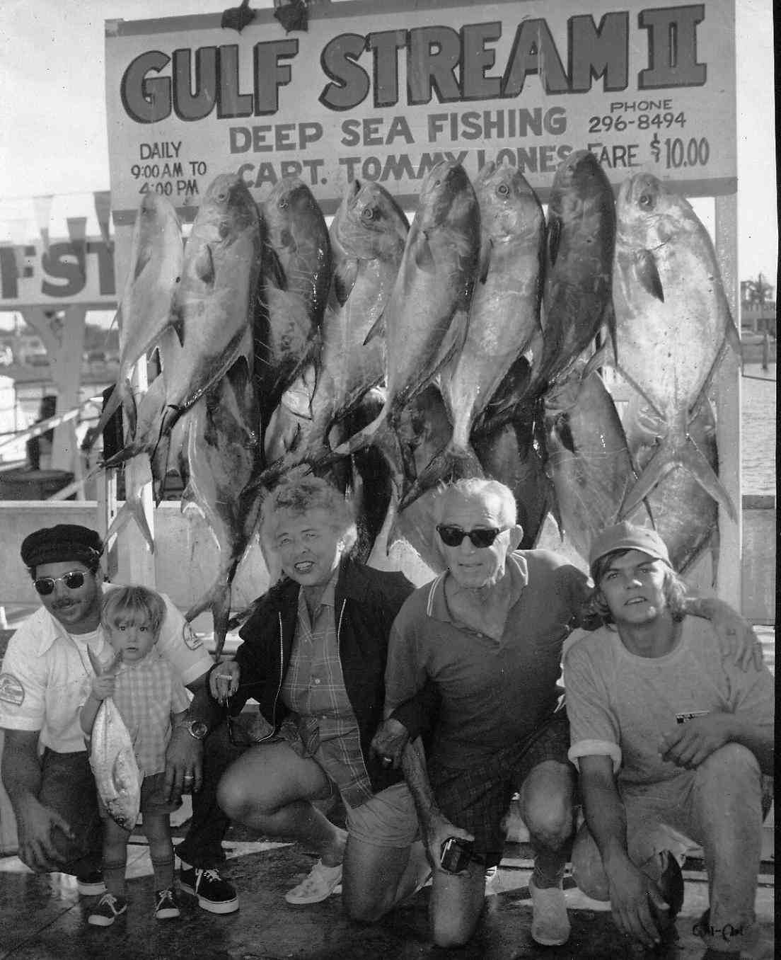
1970’s

Slide 37
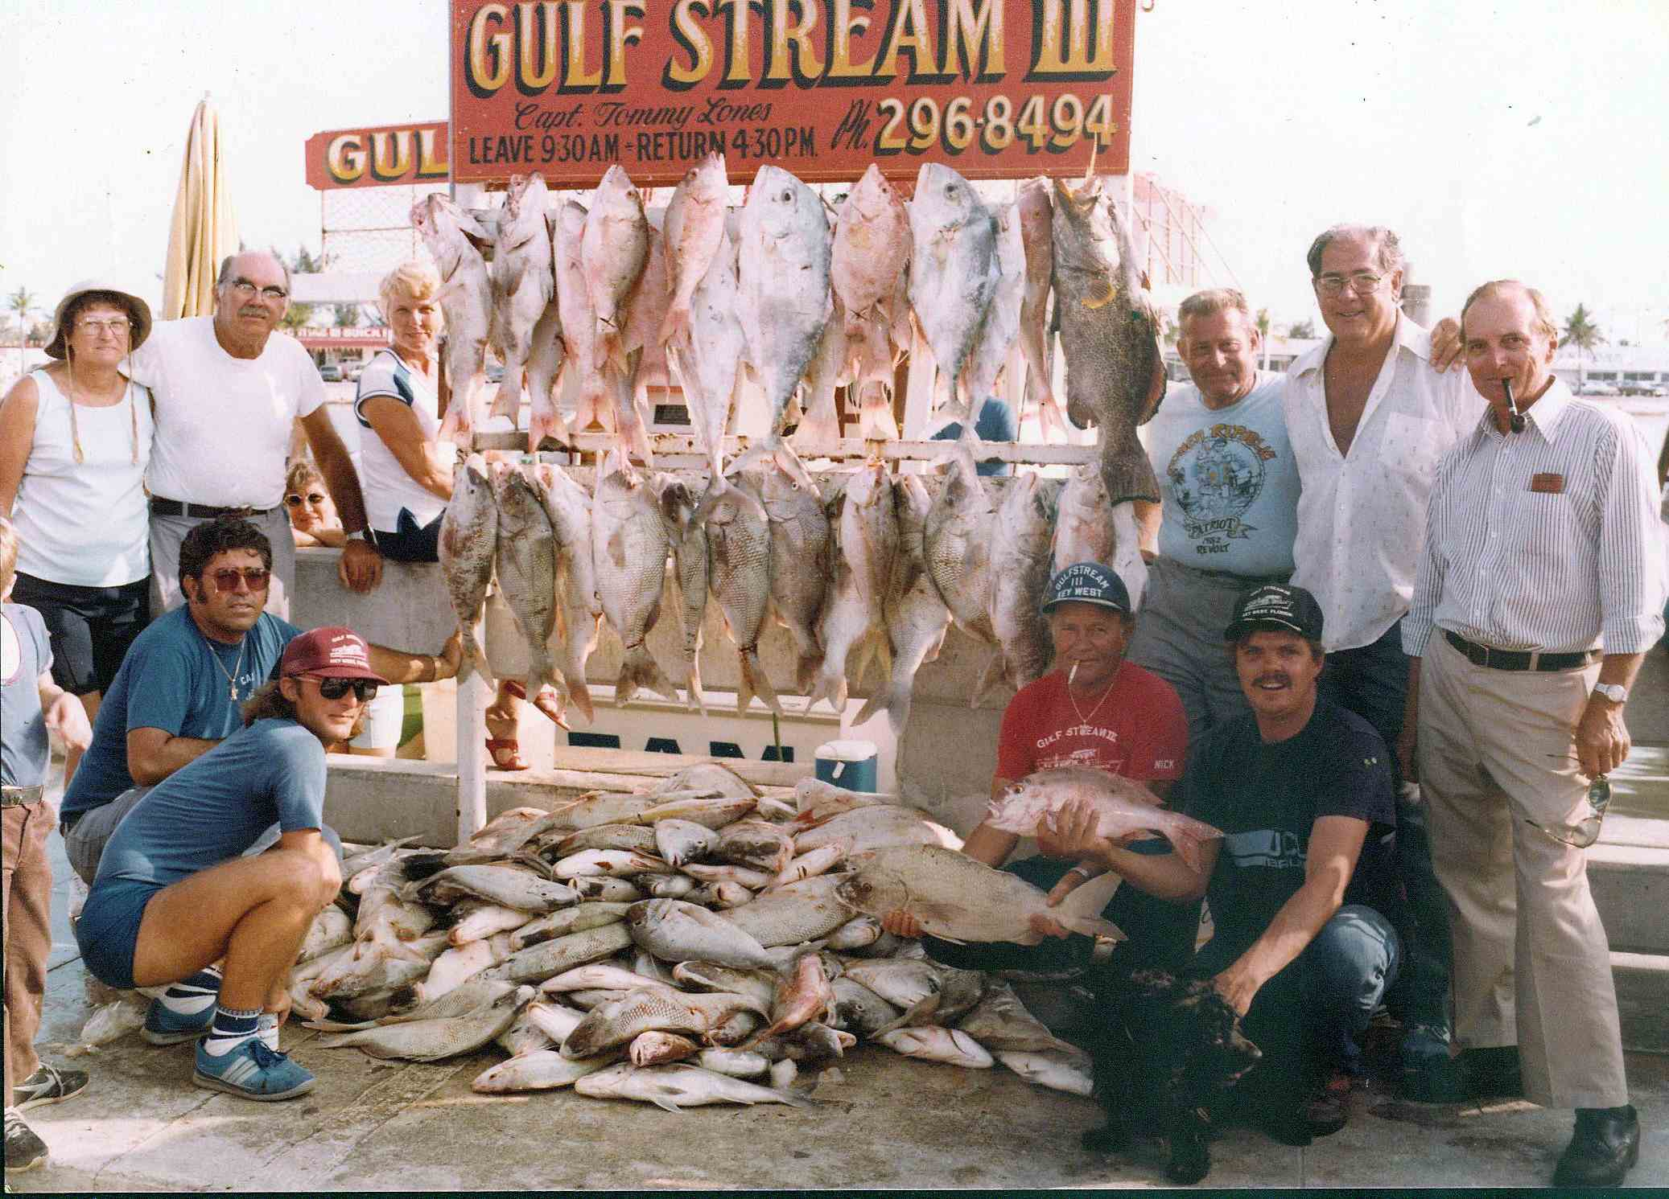
1980’s

Slide 38
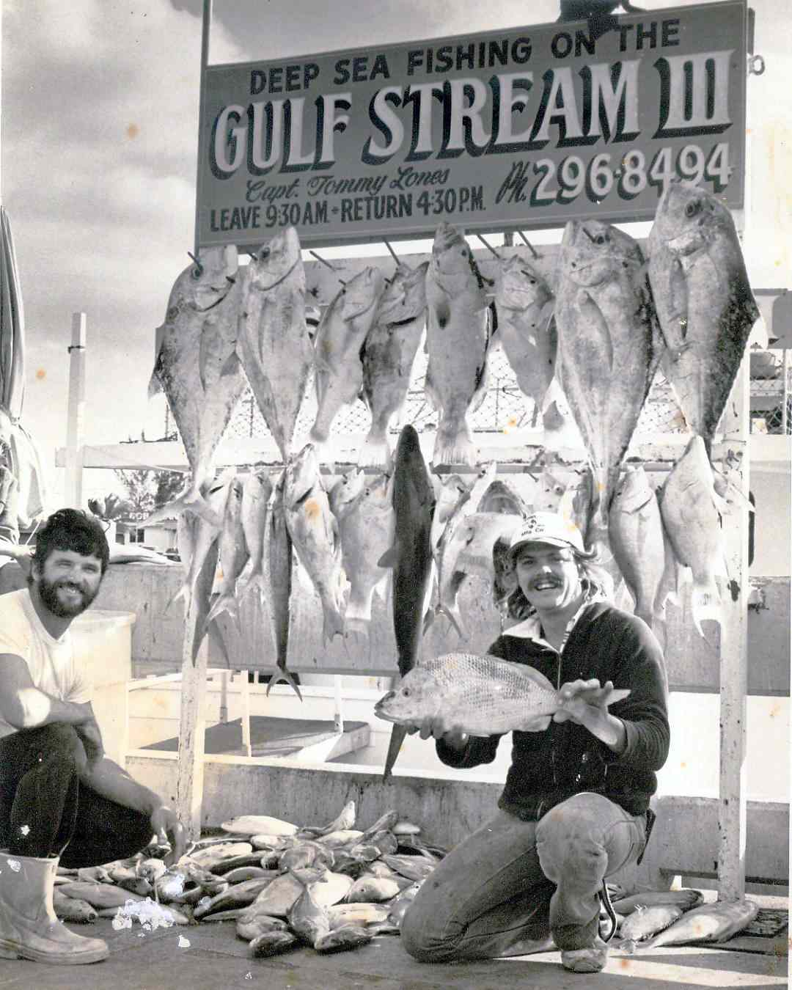
1980’s

Slide 39
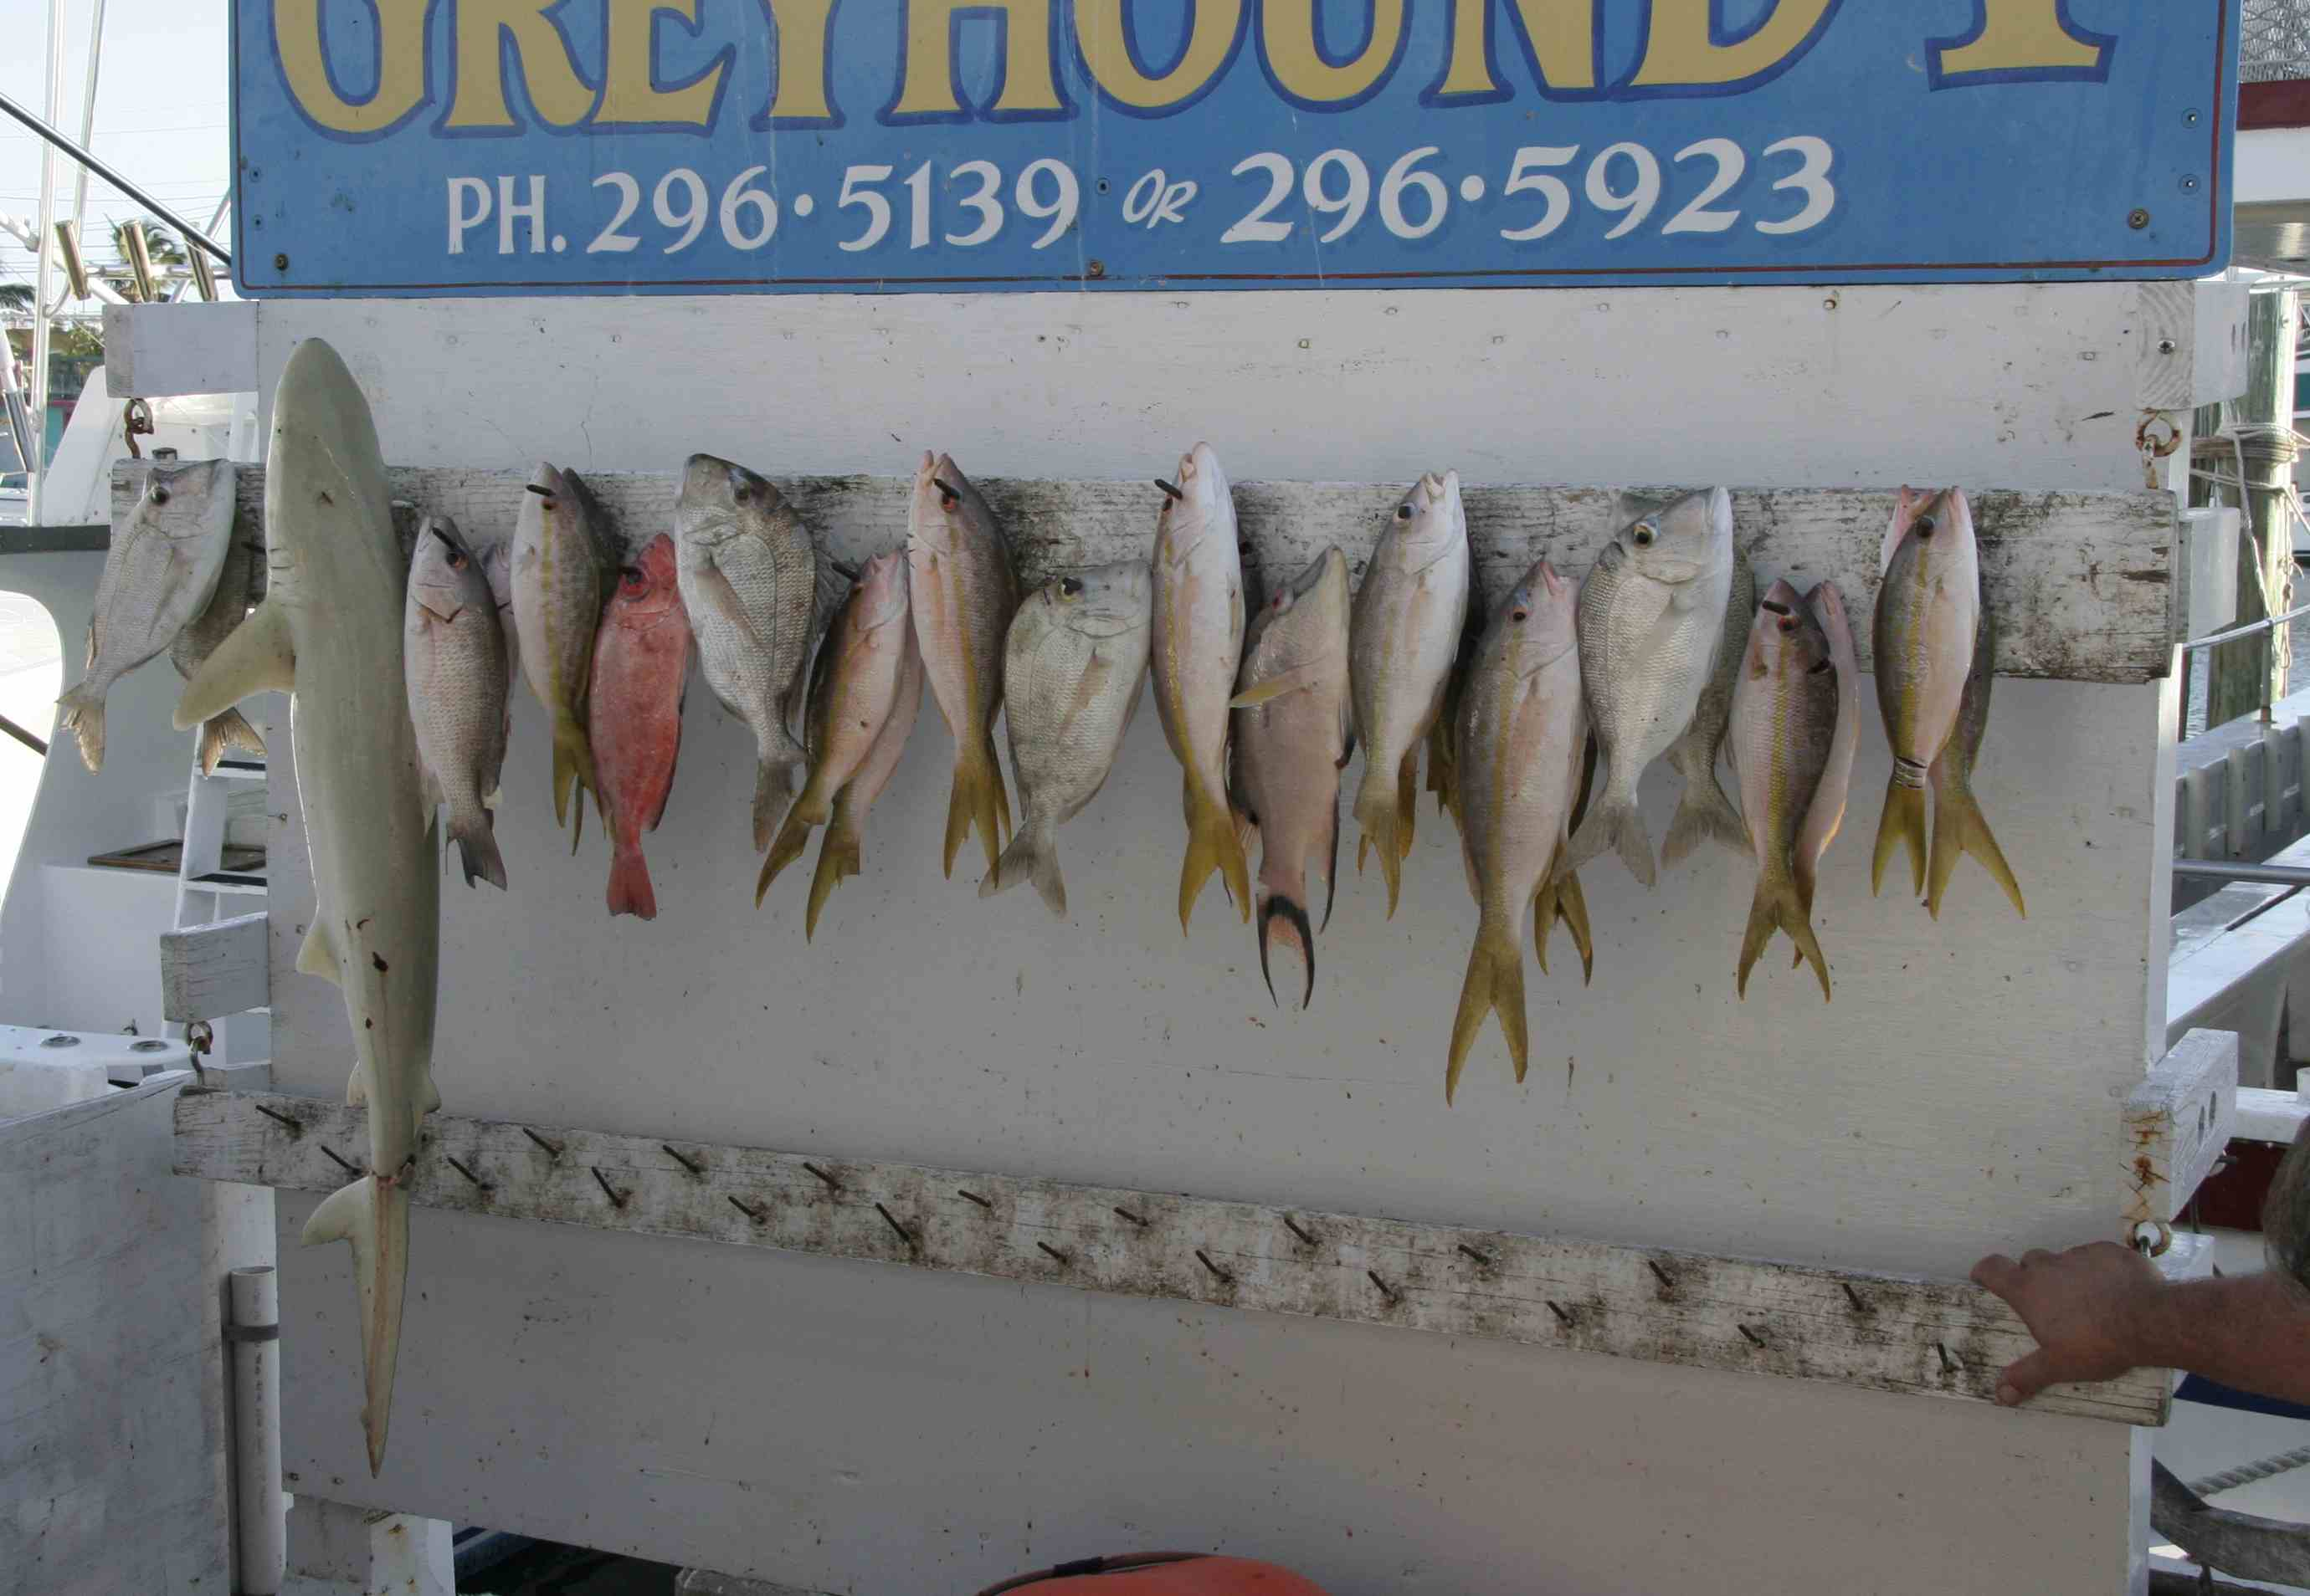
2007

Slide 40
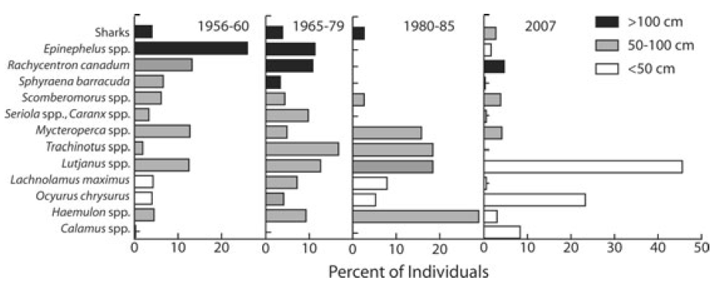
groupers
snappers
Loren McClenehan’s analyses of photos shows that fishing has shifted from catching mostly groupers (Epinephelus) in the late 50’s to now catching mostly snapper (Lutjanus and Ocyurus).
Notes:
Here are some of Loren’s data, showing a big switch from large groupers in the 1950’s (color gives size), to small snappers in the 2000’s.

Slide 41
Okay, but remember that this stock-recruitment approach only considers growth of the prey – but does not keep track of the predator abundances. With predation, again each species can have an effect on one another, but this time one is positive and one negative:
-
N_{A}
P_{B}
+
So, fisherman affect the fish abundances, but if we depended only on fish, then the fish abundance would also affect the fisherman abundance!

Slide 42
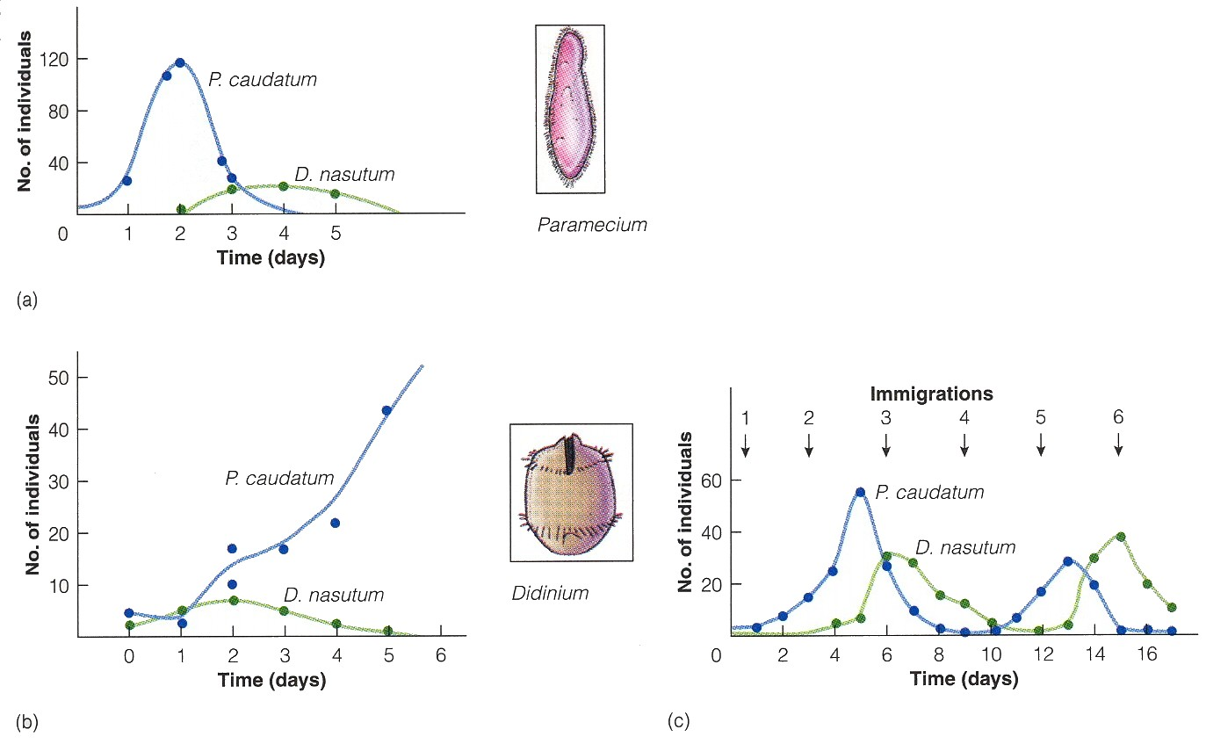
Gause’s work with protozoans shows that this feedback often causes extinctions and oscillations for predator and prey. Can models help us understand these dynamics?
Oat medium
Oat medium w/sediment
Oat medium w/ migration
prey
predator

Slide 43
b. Modeling predator-prey relationships - Lotka-Volterra models again.
Interaction | Make equations (b-d) | Equilibrium (dN/dt = 0) | Phase-space isoclines | Make predictions
competition |  |  |  | Who wins? Coexistence?
predation |  |  |  | Coexistence? Oscillations?

Slide 44
capture
efficiency
probability of predators
encountering prey
exponential
growth
restrictions on growth due to predation

Slide 45
reproductive
efficiency
birth rate
death rate

Slide 46
b. Modeling predator-prey relationships - Lotka-Volterra models again.
Interaction | Make equations (b-d) | Equilibrium (dN/dt = 0) | Phase-space isoclines | Make predictions
competition |  |  |  | Who wins? Coexistence?
predation |  |  |  | Coexistence? Oscillations?

Slide 47
b. Modeling predator-prey relationships - Lotka-Volterra models again.
For the prey:
For the predator:

Slide 48
b. Modeling predator-prey relationships - Lotka-Volterra models again.
Interaction | Make equations (b-d) | Equilibrium (dN/dt = 0) | Phase-space isoclines | Make predictions
competition |  |  |  | Who wins? Coexistence?
predation |  |  |  | Coexistence? Oscillations?

Slide 49
r/θ
prey isocline
predator abundance
predator isocline
m/θθ
prey abundance

Slide 50
Study Guide Items from Lecture 13
Terms:
character displacement
allopatry
Sympatry
Null model
optimal harvesting models
predation
fishing down
Concepts:
Evolutionary responses to competition, including character displacement?
Use of null models for testing character displacement
r and K selection as related to types of competitors
predator-prey numerical responses and (Lotka-Volterra) equations
predator prey phase planes and abundances through time
Case Studies:
Werner and Hall’s study of competition among three species of sunfish
Character displacement in terns
“fishing down” in whales
McClenehan’s study of recreational fish catch in Florida since 1950
Gause’s predator-prey protozoa experiments showing oscillations

