Slide 1
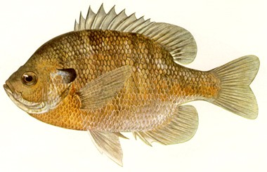
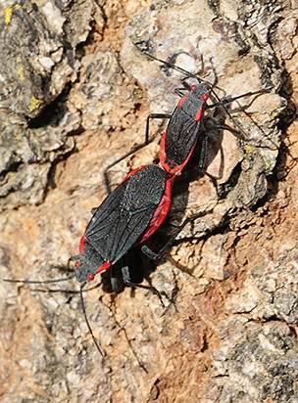
12th Lecture -- October 18, 2016
-- Read Werner and Hall paper on Blackboard
-- Third assignment now posted and due Tuesday, Oct. 25
Thursday, October 20, 4:00 pm, 1024 KIN—BIOLOGICAL SCIENCE COLLOQUIUM, "An experimental study of adaptation in the real world in real time," Dr. Joseph Travis, Department of Biological Science, Florida State University.
Friday, October 21, 4:00 pm, 1024 KIN—ECOLOGY AND EVOLUTION SEMINAR, "The breakdown of local adaptation in soapberry bugs: the consequences of switching to an invasive host plant," Dr. Meredith Cenzer, Department of Biological Science, Florida State University.
Notes:
Remind the students that their first of two written assignments is due in mid-October.

Slide 2
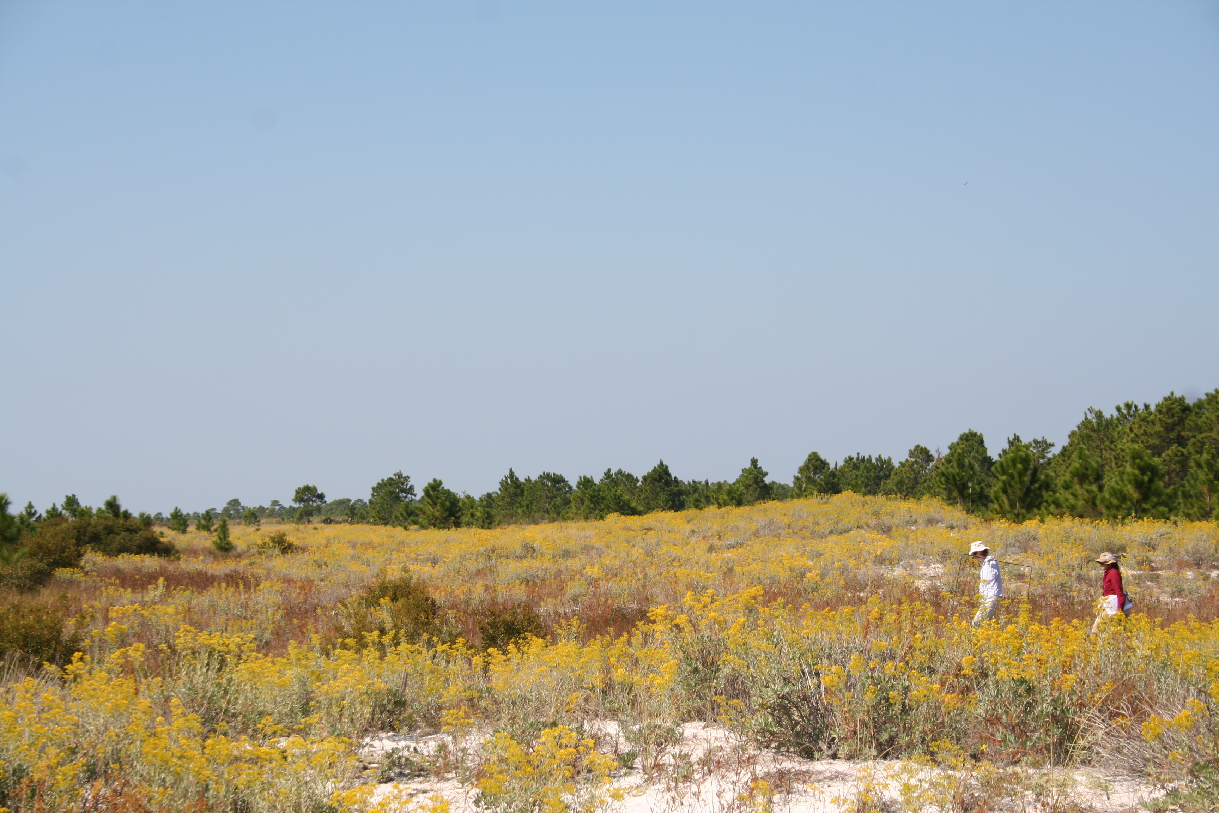

Slide 3
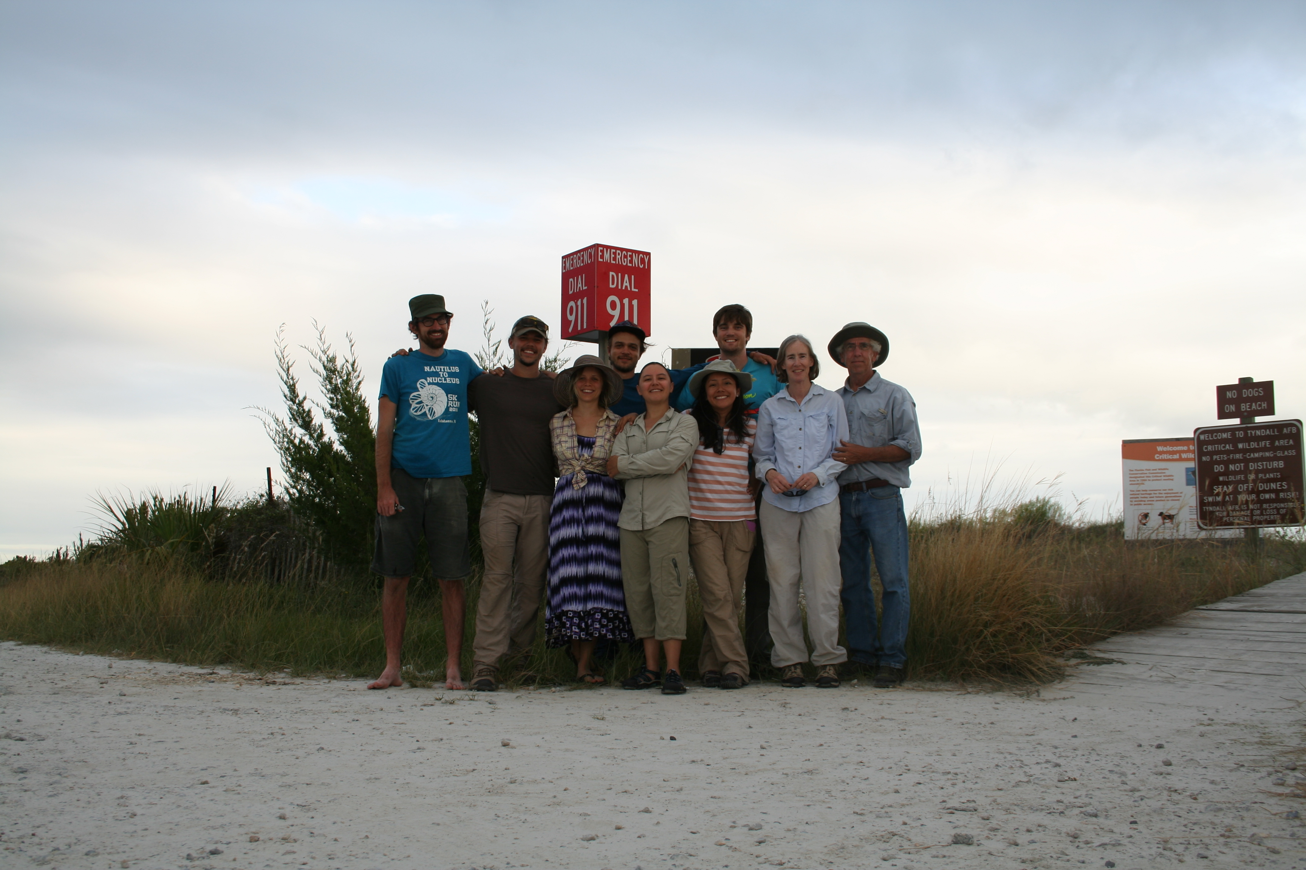

Slide 4
Remember the mantra:
BIOLOGY
MATH
GRAPHS

Slide 5
V. Populations and Biotic Influences
. . . . . . .
  3. Simple Models of Competition --
a. Lotka-Volterra equations and isoclines
i) extend logistic equation to two species
exponential
intraspecific
competition
Interspecific
(and intraspecific)
competition

Slide 6
V. Populations and Biotic Influences
. . . . . . .
  3. Simple Models of Competition --
a. Lotka-Volterra equations and isoclines
i) extend logistic equation to two species
But, these just tell us the growth rates of the two species, not who wins in competition or if they coexist. The outcome of competition involves looking at when dN/dt = 0.

Slide 7
V. Populations and Biotic Influences
. . . . . . .
  3. Simple Models of Competition --
a. Lotka-Volterra equations and isoclines
i) extend logistic equation to two species
ii) set equations to zero and derive isoclines
In both the previous two scenarios seen in the graphs, the growth rates of the two species go to zero. So we can set our growth equations to zero to figure out what happens at equilibrium, when the growth rate of the species is zero.

Slide 8
V. Populations and Biotic Influences
. . . . . . .
  3. Simple Models of Competition --
a. Lotka-Volterra equations and isoclines
i) extend logistic equation to two species
ii) set equations to zero and derive isoclines

Slide 9
V. Populations and Biotic Influences
. . . . . . .
  3. Simple Models of Competition --
a. Lotka-Volterra equations and isoclines
i) extend logistic equation to two species
ii) set equations to zero and derive isoclines
What does this mean? This is true when the growth rate of the species is zero.
It also describes a line on our graph of N₁ against N₂.

Slide 10
b. Lotka-Volterra models.
Interaction | Make equations (b-d) | Equilibrium (dN/dt = 0) | Phase-space isoclines | Make predictions
competition |  |  |  | Who wins? Coexistence?
predation

Slide 11
PHASE PLANE
Number of Blue fish (N_{B})
Number of Red fish (N_{R})

Slide 12
PHASE PLANE
Isocline where dN/dt = 0 for red fish
-
-
-
dN/dt < 0
-
-
-
-
-
-
+
-
-
+
Number of Blue fish (N_{B})
-
-
+
+
-
+
dN/dt > 0
+
+
+
+
+
-
+
Number of Red fish (N_{R})

Slide 13
PHASE PLANE
-
-
-
dN/dt < 0
-
-
-
-
-
-
+
-
-
Number of Blue fish (N_{B})
-
-
+
+
-
+
dN/dt > 0
+
+
+
+
+
+
+
Number of Red fish (N_{R})

Slide 14
PHASE PLANE
Remember that the growth rate of each species on its isocline is ZERO.
Number of Blue fish (N_{B})
Number of Red fish (N_{R})

Slide 15
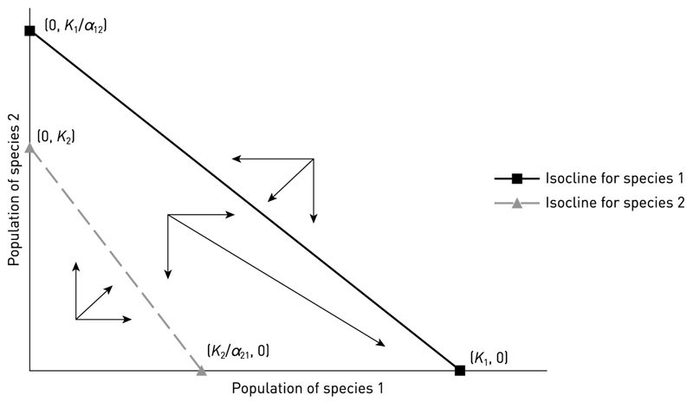
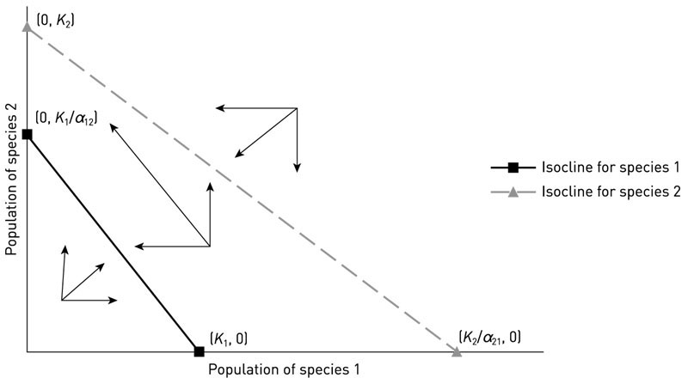
Species 1 wins
Species 2 wins

Slide 16
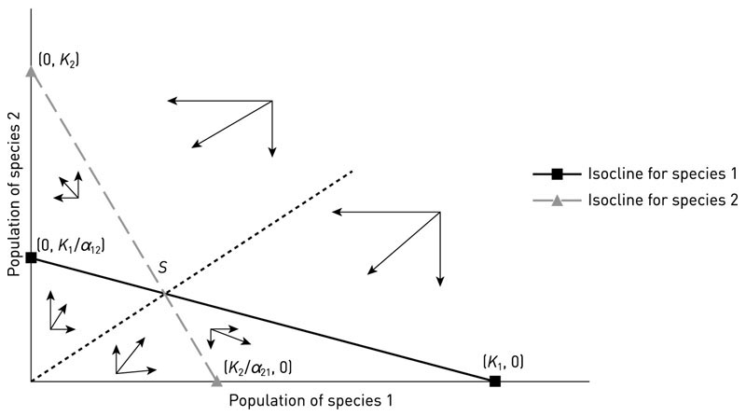
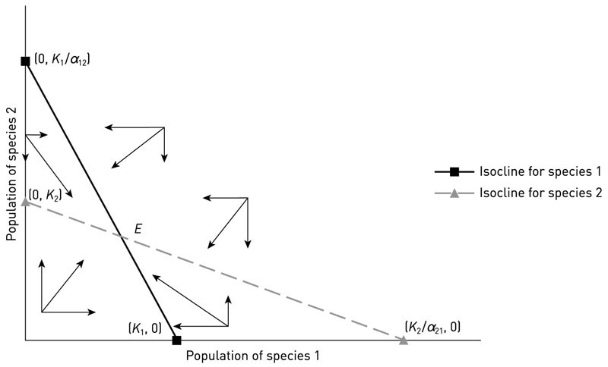
Unstable equilibrium
Stable equilibrium

Slide 17
V. Populations and Biotic Influences
. . . . . . . .
  3. Simple Models of Competition --
a. Lotka-Volterra equations and isoclines
b. Predictions: The model allows us to make predictions about what factors determine competitive outcomes.
i. Competition can lead to one of four outcomes (1 always wins, 2 always wins, 1&2 coexist or either 1 or 2 can win depending on initial abundances).
ii. Competitive outcome is dependent on K and α. Species with higher K and/or lower α₁₂ will be better competitors.

Slide 18
Species 1 wins
Species 2 wins

Slide 19
V. Populations and Biotic Influences
. . . . . . . .
  3. Simple Models of Competition --
a. Lotka-Volterra equations and isoclines
b. Predictions: The model allows us to make predictions about what factors determine competitive outcomes.
i. Competition can lead to one of four outcomes ii. Competitive outcome is dependent on K and α
iii. Competitive outcome is not dependent on r

Slide 20
Species 1 wins
Species 2 wins

Slide 21
Unstable equilibrium
Stable equilibrium

Slide 22
V. Populations and Biotic Influences
. . . . . . . .
  3. Simple Models of Competition --
a. Lotka-Volterra equations and isoclines
b. Predictions: The model allows us to make predictions about what factors determine competitive outcomes.
i. Competition can lead to one of four outcomes ii. Competitive outcome is dependent on K and α
iii. Competitive outcome is not dependent on r
iv. Coexistence requires that intraspecific competition
(=1) is greater than interspecific competition
(alpha’s) for both species.

Slide 23
CRITERION FOR COEXISTENCE
K₁/α₁₂
Stable coexistence of competitors requires that
K/α > K
so that, IF the K’s are relatively similar in size:
α < 1.0
K₂
NUMBER OF BLUE FISH
K₁
K₂/α₂₁
NUMBER OF RED FISH

Slide 24
CRITERION FOR COEXISTENCE
Coexistence of competitors requires that:
K/α > K
so that
< 1.0
Another way of stating this is that, for similar species (K’s are similar), coexistence requires that intraspecific competition (α₁₁ and α₂₂ = 1) be greater than interspecific competition (α₁₂ and α₂₁ < 1.0)
K₁/α₁₂
K₂
NUMBER OF BLUE FISH
K₁
K₂/α₂₁
NUMBER OF RED FISH

Slide 25
V. Populations and Biotic Influences
. . . .
4. Examples of Competition with Real Species
a. Tansley’s plant work
Can we test the competition models and see if they are meaningful?
Lotka Volterra equations can tested by just finding all the necessary variables to determine the isoclines, including:
K = grow each species alone until an equilibrium is reached
r = grow each species at very low densities with lots of resources and measure 1/N dN/dt
α = grow species together for a short time and measure per-capita effects on each other’s growth rates -- then solve using LV equations.

Slide 26
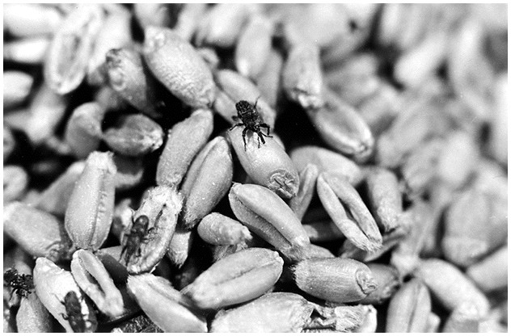
4. Examples of Competition with Real Species
a. Tansley’s plant study
b. A. C. Crombie did this with moths and beetles which compete for grain

Slide 27
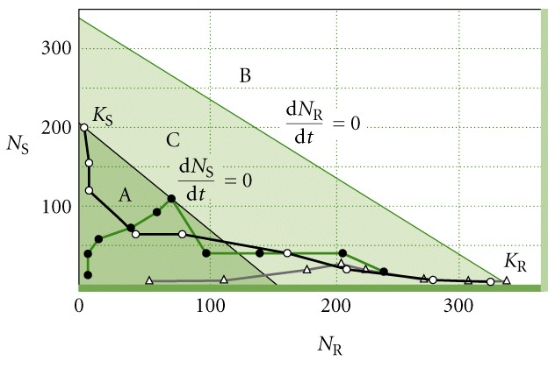
 | Rhizopertha | Sitotraga
K | 338 | 200
r | 0.05 | 0.10/day
α | α_{RS} = 1.0 | α_{SR} = 1.3
Crombie found:
The model correctly predicts that Rhizopertha wins in competition

Slide 28
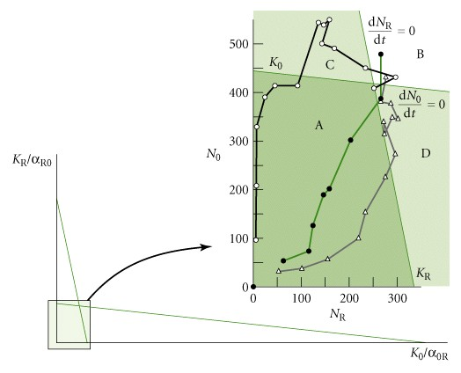
Other studies by Crombie with different species assemblages showed coexistence:

Slide 29
So, A. C. Crombie’s work with laboratory cultures of insects in competition for grain demonstrate that:
Competition occurs for limiting resources
Competition can lead to competitive exclusion or coexistence for different species combinations
The outcome of competition can be well described by Lotka-Volterra equations using simple experiments

Slide 30
4. Examples of Competition with Real Species
a. Tansley’s plant study
b. A. C. Crombie tested Lotka-Volterra with beetles and moths
Can we demonstrate that competition changes with environment, as Tansley apparently found?
c. Thomas Park worked on competition in flour beetles. These species generally exhibit resource competition, where each species tries to consume flour in vials in the lab as fast as possible. Some of the species are also predators/cannibals, eating the eggs and larvae of competitors along with the flour as they chug along feeding.
Park grew two species in a variety of conditions of different
temperatures and humidity.
Notes:
K is a function of the environment
and a species
and can be mainpulated.
Flour beetles tunnel and eat as they go, are canibals – dependent on temperature and humidity

Slide 31
4. Examples of Competition with Real Species
a. Tansley’s plant study
b. A. C. Crombie tested Lotka-Volterra with beetles and moths
c. Thomas Park worked on competition in flour beetles.
Under dry conditions, Tribolium confusum virtually always won. However, under moist conditions, temperature had an effect on the winner.
For example, under moist conditions, Park found:
Notes:
Different outcomes at different temperatures

Slide 32
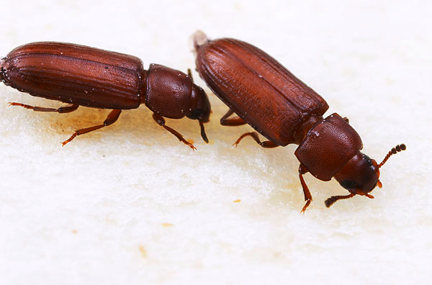
Park demonstrated that environmental conditions do affect the outcome of competition by varying the K’s and α’s of the component species.
Park worked on a number of different species of flour beetles under a variety of conditions. He was able to easily demonstrate all four of the predicted outcomes of competition (A wins, B wins, AB have stable coexistence, or winner depends on initial abundance)
Notes:
Can get all possible outcomes depending on the environment

Slide 33

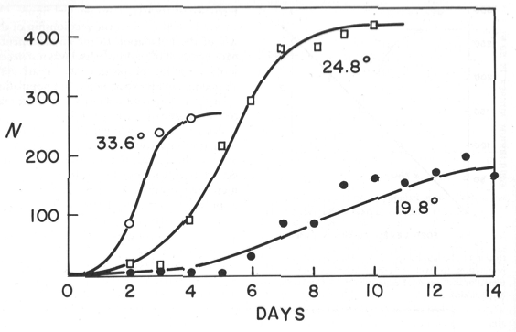
Growth of populations of Moina macrocopa at three temperatures (from Hutchinson). Does temperature affect r or K? Now, how does it affect the competitive ability of this species?
Notes:
We already knew it affected karying capacity
Think as a group- how does changing temp change competitivie ability

Slide 34
4. Examples of Competition in Real Populations
a. Tansley’s plant study
b. A. C. Crombie tested Lotka-Volterra with beetles and moths
c. Thomas Park worked on competition in flour beetles.
d. Finally, there have been studies that have looked at violating the assumptions of L-V. In reality, for example, α’s are not constant and so the isoclines are not actually straight but are somewhat curved.
Ayala demonstrated this with fruit flies, showing the competition was most intense when one or both species was rare, but was not intense when each is closer to its carrying capacity. This yields curved isoclines.
Notes:
Violating the assumptions of lotka volterra
-for example linear assuptions
-2 people and 100 hotdogs
-ayala catholic priest geneticist-80 yo –-brute force-

Slide 35
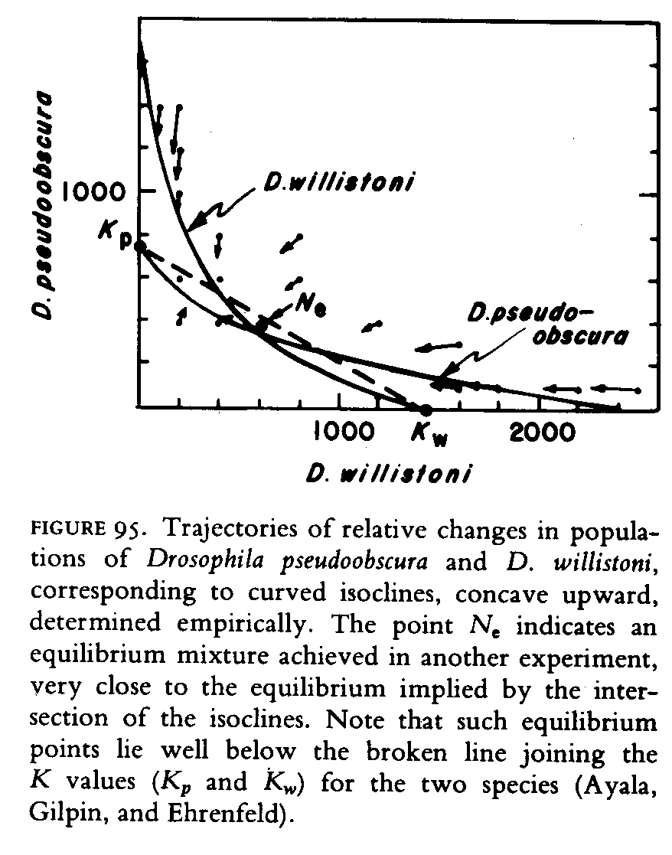
Notes:
but the curve does not change the competitive outcome
Assumptions are robust

Slide 36
4. Examples of Competition in Real Populations
a. Tansley’s plant study
b. A. C. Crombie tested Lotka-Volterra with beetles and moths
c. Thomas Park worked on competition in flour beetles.
d. Finally, there have been studies that have looked at violating the assumptions of L-V. In reality, for example, α’s are not constant and so the isoclines are not actually straight but are somewhat curved.
The important things here is that the assumptions of the L-V can be frequently violated. The specific predictions from L-V may then NOT work, but the qualitative predictions often still hold.

Slide 37
V. Populations and Biotic Influences
A. Migration
B. Types of Species Interactions
C. Competition
1. Definition:
2. Types of competition (resource vs. interference)
  3. Simple Models of Competition --
4. Examples of Competition in Real Populations
a. Tansley’s plant study
b. A. C. Crombie ( beetles and moths)
c. Thomas Park (flour beetles)
d. Violating the assumptions of L-V (Ayala’s Drosophila)
5. Evidence of competition:
What type of evidence is sufficient to demonstrate that competition is occurring in the wild?
  Operationally, Competition is an interaction between species, in which the population of one is lowered by the presence of the other.
Notes:
How can you tell whether they are competing
-make them makea list

Slide 38
5. Evidence of competition:
What type of evidence is sufficient to demonstrate that competition is occurring in the wild?
i) ?
ii) ?
iii) ?
iv) ?
Notes:
Correlation is not intuitive-ok but not sufficient
Exp- gold standard

Slide 39
5. Evidence of competition:
What type of evidence is sufficient to demonstrate that competition is occurring in the wild?
i) observation of interactions
ii) correlations in abundance
iii) experimental manipulations
iv) evolution of traits
Ultimately, all are associated with Gause’s competitive exclusion principle, “complete competitors cannot coexist.” Or, stated another way, species must differ in resource use in some way to allow coexistence.
Notes:
Correlation is not intuitive-ok but not sufficient
Exp- gold standard

Slide 40
5. Evidence of competition:
What type of evidence is sufficient to demonstrate that competition is occurring in the wild?
i) observation of interactions
ii) correlations in abundance
iii) experimental manipulations
iv) evolution of traits
i) observe active interference behavior between organisms (e.g., animals use the same food or fight for mates or flowers to pollinate). This provides necessary but not sufficient criteria. Consider all the animals that drink water at some permanent pool. Are they competing, even if water is always available? No, not unless water is limiting. That is, to show that two species interact and to show that they affect each others dN/dt are two different things.

Slide 41
5. Evidence of competition:
What type of evidence is sufficient to demonstrate that competition is occurring in the wild?
i) observation of interactions
Insufficient, because it doesn’t “prove” negative effects, and
competition may be hard to observe.
ii) correlations in abundance
iii) experimental manipulations
iv) evolution of traits

Slide 42


ii) correlations in abundance

Slide 43
ii) correlations in abundance

Slide 44
5. Evidence of competition:
What type of evidence is sufficient to demonstrate that competition is occurring in the wild?
i) observation of interactions (insufficient)
ii) correlations in abundance
If species are negatively correlated in where they occur, does this mean they are competitors? And, if they are positively correlated, are they not competitors?
iii) experimental manipulations
iv) evolution of traits

Slide 45
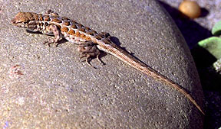
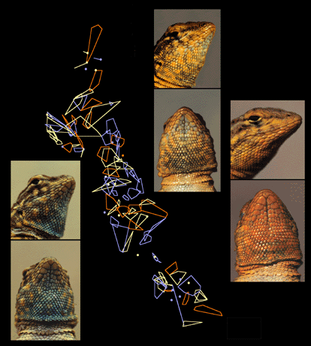
Common side-blotched lizards have territorial males. These males have three color morphs, blue, yellow, and orange, that compete for mates. The polygynous orange-throated males dominate the more monogamous mate-guarding blues; the oranges are in turn bested by the sneaker strategy of yellow-throated males, and the sneaker strategy of yellows is in turn bested by the mate guarding strategy of blue-throated males.
(figure from B. Sinervo)
Notes:
Obs-they don’t co-occur
Hard to intrepret the pattern without natural history

Slide 46
(sneek)
YELLOW
BLUE
(guard)
ORANGE
(harem)
These non-transitive relationships allow all three types to coexist. All types are competitors, yet will be positively correlated at some spatial scales, negatively at others.
Notes:
Negative or positive interactions
Correlation depends on scale

Slide 47
5. Evidence of competition:
What type of evidence is sufficient to demonstrate that competition is occurring in the wild?
i) observation of interactions (insufficient)
ii) correlations in abundance
At some scale, competitors are positively correlated with the abundance of their resource, which means that they will have positively correlations in abundance with one another. Other factors such as predation could cause negative correlation between possible competitors.
iii) experimental manipulations
iv) evolution of traits

Slide 48
5. Evidence of competition:
What type of evidence is sufficient to demonstrate that competition is occurring in the wild?
i) observation of interactions (insufficient)
ii) correlations in abundance (insufficient)
iii) experimental manipulations
YES! This is the most common and, perhaps,
satisfactory evidence of competition.
Remember Tansley and Connell! Both were Experiments.
iv) evolution of traits
Notes:
Read werner and hall!!!! -PROOF

Slide 49
Here is an example of a question from a past test.
We grow our red fish and blue fish in different starting combinations and follow the fish through time until equilibrium. We get the following results:
Initial abundances |  | Final abundances
blue | red | blue | red
2 | 0 | 80 | 0
0 | 2 | 0 | 120
2 | 100 | 0 | 120
65 | 5 | 80 | 0
Draw the appropriate isoclines. Label axes and points and use correct values, where possible.

Slide 50
Study Guide Items from Lecture 12
Terms:
Stable equilibrium
Unstable equilibrium
Concepts:
  Review of competition equations and isoclines
  Four outcomes of competition (A wins, B wins, stable and unstable coexistence)
  Predictions of Lotka-Volterra equations
  Coexistence requires K < K/α or α < 1.0 (intra- > interspecific competition)
  What is sufficient evidence for competition in the wild?
  Case Studies
  Crombie’s work with beetle and moth larvae, testing Lotka-Volterra
  Park’s work with flour beetles, showing that the outcome of competition depends on the environmental conditions
  Ayala’s work with competition in Drosophila
  Three colors of males of side-blotched lizards

