Slide 1
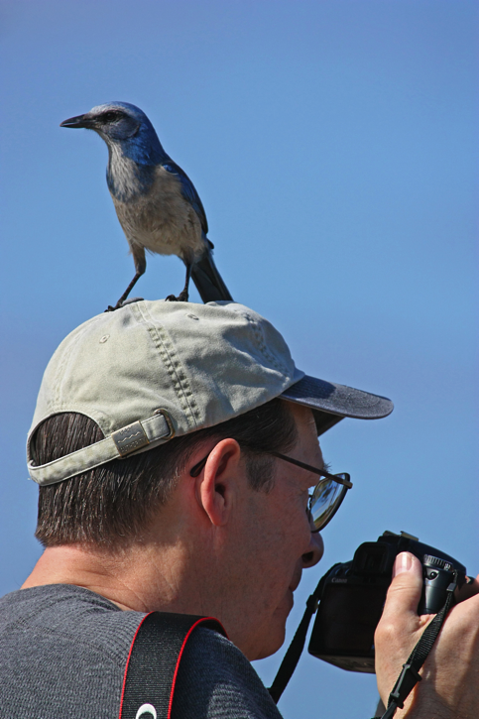
11th Lecture – Oct. 13, 2016
First Seminar Report Due Today by 5:00
Third Assignment is posted.
Friday, October 14, 4:00 pm, 1024 KIN—ECOLOGY AND EVOLUTION SEMINAR”
Encountering predators: the nature of the acute stress response and its effects on learned antipredator behavior in free-living birds,"
Dr. Blake C. Jones, Department of Biology, University of Memphis, TN.
Notes:
Remind the students that their first of two written assignments is due in mid-October.

Slide 2
Notes:
Remind the students that their first of two written assignments is due in mid-October.

Slide 3
We are going to delve into competition stuff for awhile. Remember:
BIOLOGY
MATH
GRAPHS

Slide 4
PHASE PLANE
Isocline where dN/dt = 0 for red fish
-
-
-
dN/dt < 0
-
-
-
-
-
-
+
-
-
+
Number of Blue fish (N_{B})
-
-
+
+
-
+
dN/dt > 0
+
+
+
+
+
-
+
Number of Red fish (N_{R})

Slide 5
PHASE PLANE
-
-
-
dN/dt < 0
-
-
-
-
-
-
+
-
-
Number of Blue fish (N_{B})
-
-
+
+
-
+
dN/dt > 0
+
+
+
+
+
+
+
Number of Red fish (N_{R})

Slide 6
PHASE PLANE
Remember that the growth rate of each species on its isocline is ZERO.
Number of Blue fish (N_{B})
Number of Red fish (N_{R})

Slide 7
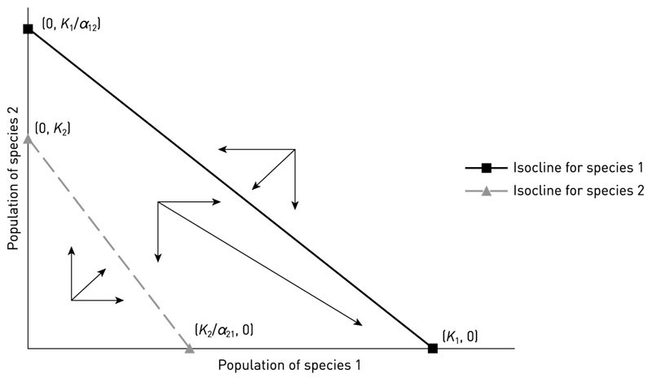
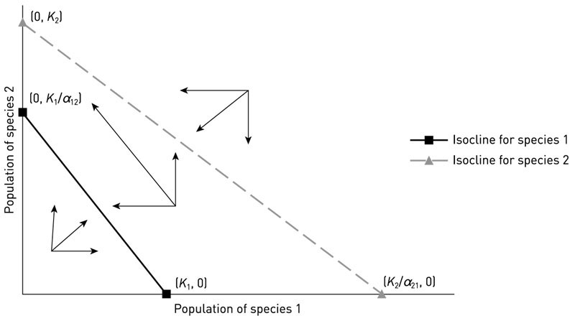
Species 1 wins
Species 2 wins

Slide 8
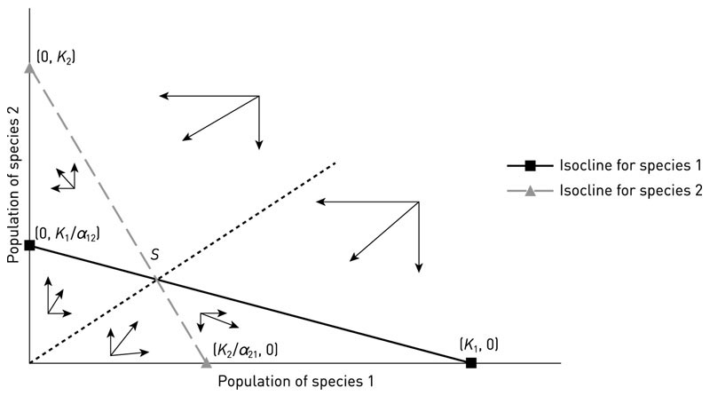
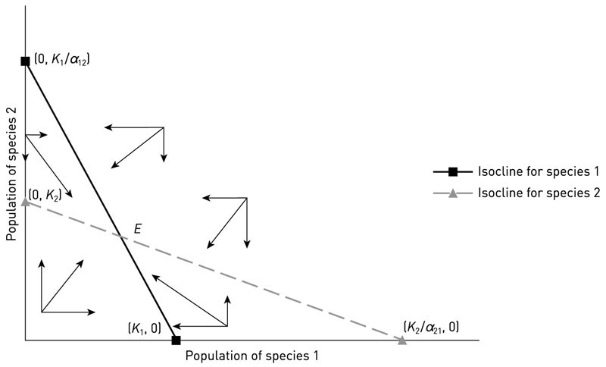
Unstable equilibrium
Stable equilibrium

Slide 9
We are going to delve into competition stuff for awhile. Remember:
BIOLOGY
MATH
GRAPHS

Slide 10
V. Populations and Biotic Influences
. . . . . . .
  3. Simple Models of Competition --
a. Lotka-Volterra equations and isoclines
i) extend logistic equation to two species
exponential
intraspecific
competition
Interspecific
(and intraspecific)
competition

Slide 11
V. Populations and Biotic Influences
. . . . . . .
  3. Simple Models of Competition --
a. Lotka-Volterra equations and isoclines
i) extend logistic equation to two species
But, these just tell us the growth rates of the two species, not who wins in competition or if they coexist. The outcome of competition involves looking at when dN/dt = 0.

Slide 12
V. Populations and Biotic Influences
. . . . . . .
  3. Simple Models of Competition --
a. Lotka-Volterra equations and isoclines
i) extend logistic equation to two species
ii) set equations to zero and derive isoclines
In both the previous two scenarios seen in the graphs, the growth rates of the two species go to zero. So we can set our growth equations to zero to figure out what happens at equilibrium, when the growth rate of the species is zero.

Slide 13
V. Populations and Biotic Influences
. . . . . . .
  3. Simple Models of Competition --
a. Lotka-Volterra equations and isoclines
i) extend logistic equation to two species
ii) set equations to zero and derive isoclines

Slide 14
V. Populations and Biotic Influences
. . . . . . .
  3. Simple Models of Competition --
a. Lotka-Volterra equations and isoclines
i) extend logistic equation to two species
ii) set equations to zero and derive isoclines
What does this mean? This is true when the growth rate of the species is zero.
It also describes a line on our graph of N₁ against N₂.

Slide 15
CRITERION FOR COEXISTENCE
K₁/α₁₂
K₂
NUMBER OF BLUE FISH
Better competitor will have the outside isocline, which requires a higher K or a lower alpha.
K₁
K₂/α₂₁
NUMBER OF RED FISH

Slide 16
b. Lotka-Volterra models.
Interaction | Make equations (b-d) | Equilibrium (dN/dt = 0) | Phase-space isoclines | Make predictions
competition |  |  |  | Who wins? Coexistence?
predation

Slide 17
V. Populations and Biotic Influences
. . . . . . . .
  3. Simple Models of Competition --
a. Lotka-Volterra equations and isoclines
b. Predictions: The model allows us to make predictions about what factors determine competitive outcomes.
i. Competition can lead to one of four outcomes (1 always wins, 2 always wins, 1&2 coexist or either 1 or 2 can win depending on initial abundances).
ii. Competitive outcome is dependent on K and α. Species with higher K and/or lower α₁₂ will be better competitors.

Slide 18
V. Populations and Biotic Influences
. . . . . . . .
  3. Simple Models of Competition --
a. Lotka-Volterra equations and isoclines
b. Predictions: The model allows us to make predictions about what factors determine competitive outcomes.
i. Competition can lead to one of four outcomes ii. Competitive outcome is dependent on K and α
iii. Competitive outcome is not dependent on r

Slide 19
Species 1 wins
Species 2 wins

Slide 20
Unstable equilibrium
Stable equilibrium

Slide 21
V. Populations and Biotic Influences
. . . . . . . .
  3. Simple Models of Competition --
a. Lotka-Volterra equations and isoclines
b. Predictions: The model allows us to make predictions about what factors determine competitive outcomes.
i. Competition can lead to one of four outcomes ii. Competitive outcome is dependent on K and α
iii. Competitive outcome is not dependent on r
iv. Coexistence requires that intraspecific competition
(=1) is greater than interspecific competition
(alpha’s) for both species.

Slide 22
CRITERION FOR COEXISTENCE
K₁/α₁₂
Stable coexistence of competitors requires that
K/α > K
so that, IF the K’s are relatively similar in size:
α < 1.0
K₂
NUMBER OF BLUE FISH
K₁
K₂/α₂₁
NUMBER OF RED FISH

Slide 23
CRITERION FOR COEXISTENCE
Coexistence of competitors requires that:
K/α > K
so that
< 1.0
Another way of stating this is that, for similar species (K’s are similar), coexistence requires that intraspecific competition (α₁₁ and α₂₂ = 1) be greater than interspecific competition (α₁₂ and α₂₁ < 1.0)
K₁/α₁₂
K₂
NUMBER OF BLUE FISH
K₁
K₂/α₂₁
NUMBER OF RED FISH

Slide 24
In Class Worksheet:

Slide 25
In Class Worksheet:

Slide 26
In Class Worksheet:

Slide 27
Study Guide Items from Lecture 11
Terms:
Isocline
phase plane
Concepts:
  How to get isoclines in phase planes from two-species growth equations
  Phase planes
  Lotka-Volterra competition equations.
  Four outcomes of competition (A wins, B wins, stable and unstable coexistence)
  Case Studies:
  none

