Slide 1
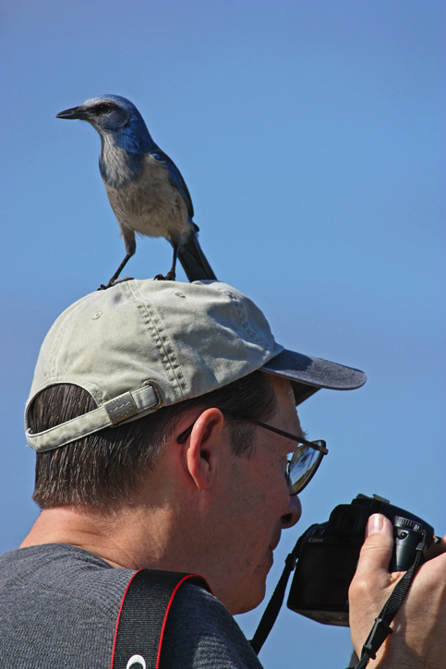
10th Lecture – Oct. 10, 2016
First Seminar Report Due Thursday
Third Assignment will be posted Thursday
Friday, October 14, 4:00 pm, 1024 KIN—ECOLOGY AND EVOLUTION SEMINAR”
Encountering predators: the nature of the acute stress response and its effects on learned antipredator behavior in free-living birds,"
Dr. Blake C. Jones, Department of Biology, University of Memphis, TN.
Notes:
Remind the students that their first of two written assignments is due in mid-October.

Slide 2
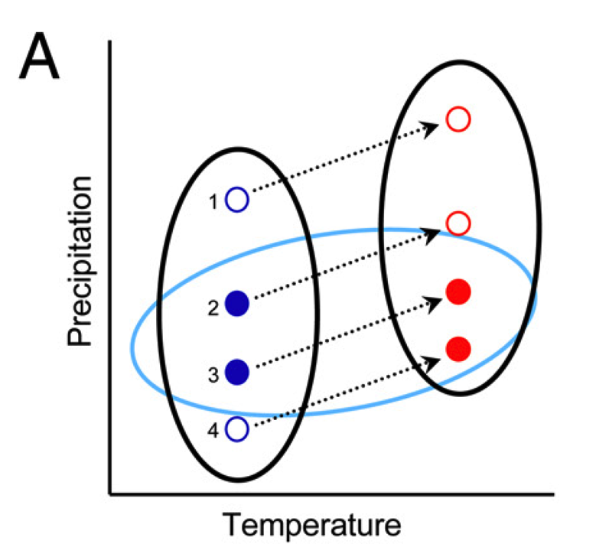
Grinnellian niche is the “needs” niche

Slide 3
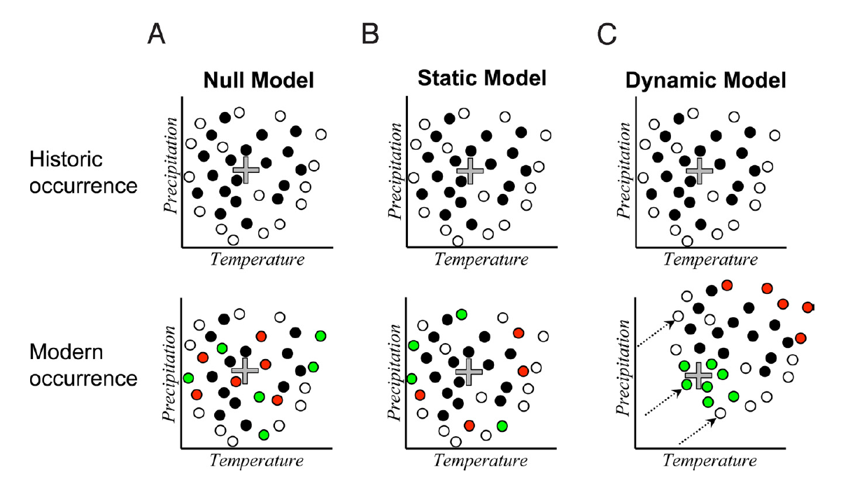

Slide 4
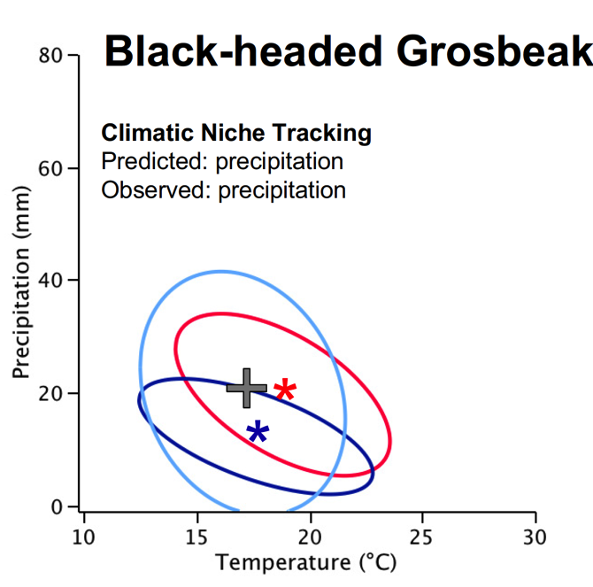
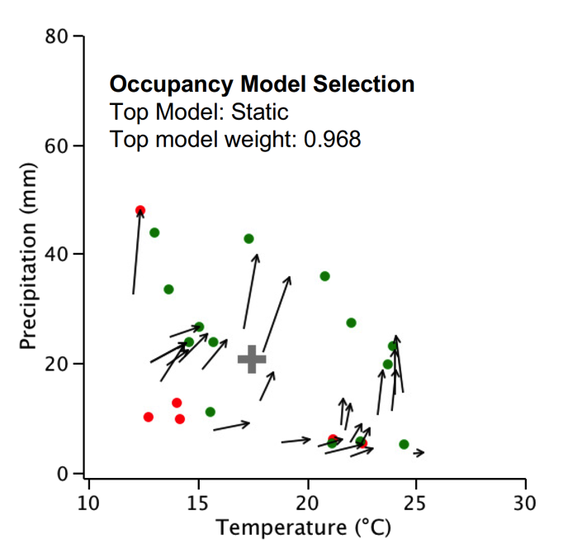
48 out of the 53 bird species investigated in California appear to be shifting their distribution to track their niche space as climate change occurs.

Slide 5
Where we are going. . . .
What is Ecology
Tools for Ecology (how to describe and compare populations)
Correlations of Life Histories
IV. The Niche and the environment
A. Niche theory
B. Basic Ingredients -- dominant abiotic niche factors
C. Biomes
V. Populations and Biotic Influences
A. types of species interactions
B. Competition
C. Predation
D. Mutualisms

Slide 6
The abiotic conditions, especially water, light, and temperature, are important at at least two different scales. First, large patterns in abiotic conditions define climate and biomes. Second, abiotic conditions in a given area help to determine the fundamental niche of species. We can describe the niche using the descriptors of populations already learned.
Finally, note that species both respond to and influence abiotic conditions, which in turn can help or hurt the species around them. For example, one plant takes up water, which leaves less water for surrounding plants.
These are species interactions – the next topic for the course.

Slide 7
On land, we can use the large-scale patterns of temperature and rainfall to define broad vegetation types, called “biomes.”

Slide 8
IV. The Niche and the environment
A. Niche theory
B. Basic Ingredients -- dominant abiotic niche factors
C. Biomes = large geographic areas that are characterized by
distinct types of plant species, maintained by
the climatic conditions of the region (mostly precipitation
and temperature.

Slide 9
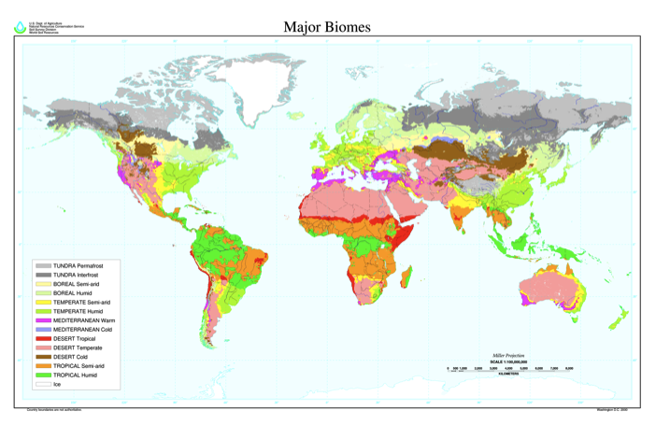

Slide 10
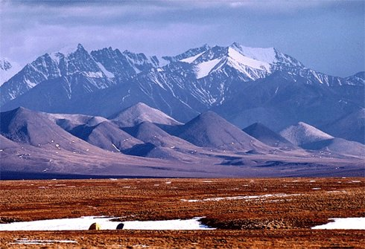
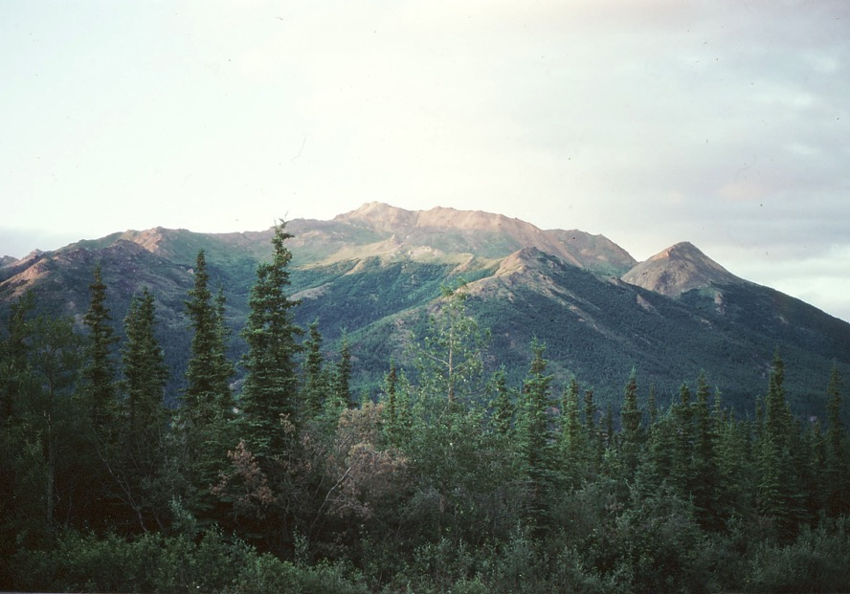
tundra
Taiga or boreal forest

Slide 11
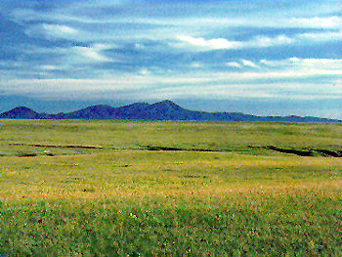
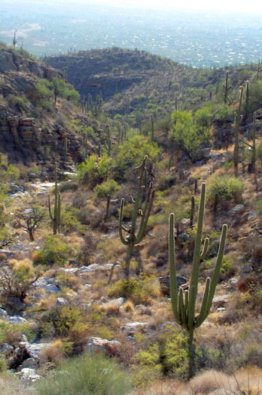
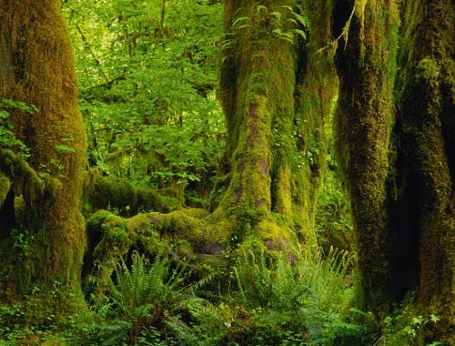
grassland
desert
temperate rain forest

Slide 12
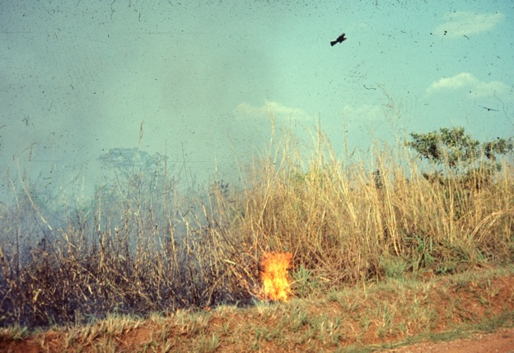
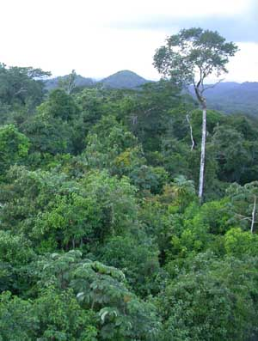
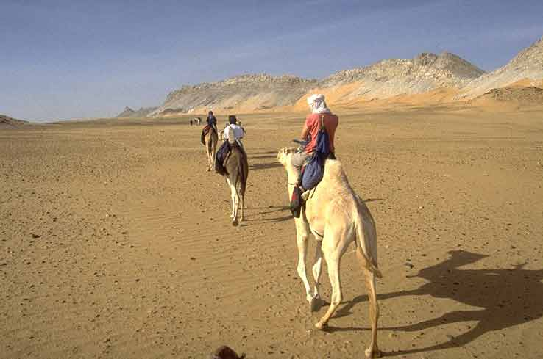
Tropical seasonal habitats (wet/dry seasons)
Tropical rainforests
desert

Slide 13
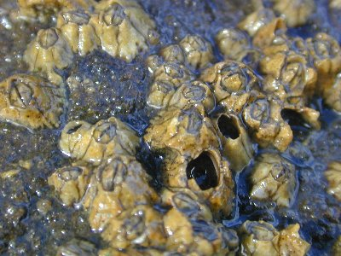
V. Populations and Biotic Influences
A. types of species interactions
B. Competition
C. Predation
D. Mutualisms
Joe Connell’s barnacle study (1961).

Slide 14
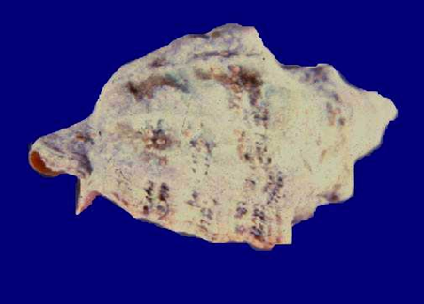
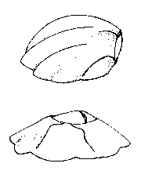
First, a little biology lesson. Barnacles are encrusting marine organisms that permanently attach to hard surfaces, such as rocks, docks, ships, or even whales. They are actually crustaceans, like lobsters or crabs. As larvae, they float around in the water, eventually settling out on hard substrates. They glue their head to the surface, leaving their legs to wave in the water, filter feeding anything in the water column. They surround themselves with a hard shell, usually constructed of six plates, with two more plates that can be used to cover the opening at the top. The top plates both prevent desiccation and deter predators.
Kurt Lively, at Indiana U., has studied predation by Acanthina (a snail) on barnacles. Acanthina have a “tooth” that they use to feed on barnacles. He found that where predation was heavy, a special shaped barnacle has evolved, with a bent-over top that reduces predation.

Slide 15
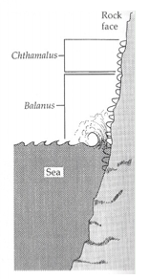
Joe Connell’s barnacle study.
Connell noted that two common barnacle species occurred at different locations in the intertidal.
Chthamalus usually occurred higher, while Balanus always occurred lower. He used experiments to determine which factors limited where the barnacles occurred (distribution) and their abundance where they did occur (density).
Remember this! It is much like Assignment 3.

Slide 16
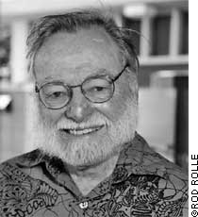
Joe Connell’s barnacle study.
In his experiments, Connell removed competitors (e.g., Balanus) or predators (e.g., Thaid snails) and then follow the Chthamalus populations through time.

Slide 17
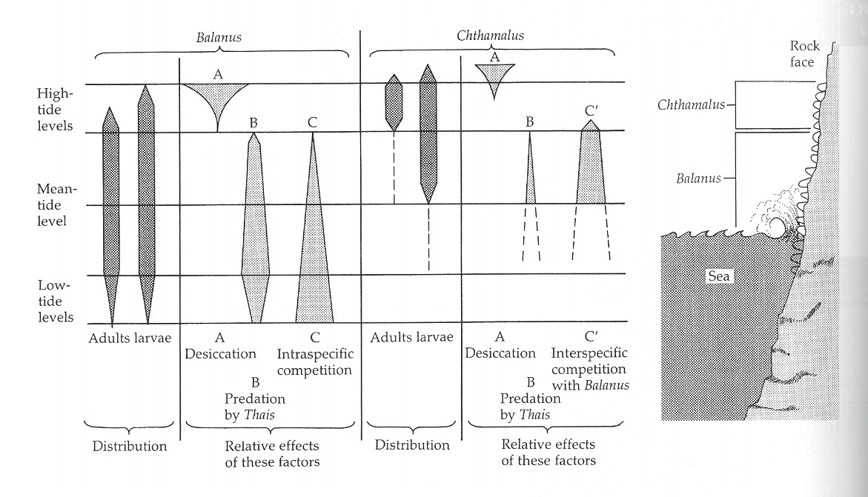
Joe Connell’s barnacle study.

Slide 18
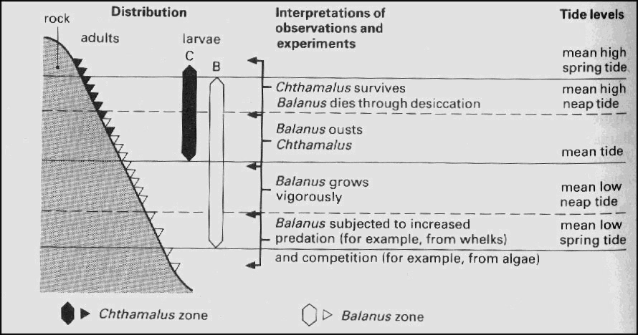
Chthamalus dies through desiccation
Better figure!

Slide 19
What you should understand from Joe Connell’s barnacle study:
Know the upper and lower limits to each species and what causes them.
Recognize that this is a study of both fundamental (abiotic) niche and realized (biotic) niche.
Shows that species do not necessarily occur in their ideal location, but can be displaced by a better competitor or predator (difference between fundamental and realized niche).
Has drought stress, competition, and predation.
Different parts of a species range can be controlled by different factors.

Slide 20
BIOSCOPES
Classification of species interactions
 | + | 0 | -
+ | mutualism | commensalism | predation parasitism herbivory
0 |  | no interaction | amensalism
- |  |  | competition
Symbiosis: close association between two species, often positive
Notes:
There are actually a lot of different types of species interactions that can affect population growth and can be both negative and positive. Since interactions occur between pairs of species, we can categorize these effects based on there they help or hurt either member of the pair. For example, competition, but definition hurts both members of a pair, whereas mutualisms help both members. If you think about it a bit, you will realize that predation hurts the prey, but helps the predator. Finally, two other types of interactions are sometimes discussed, commensalism and amensalism, in which one species is just not affected, while the other species is either helped or hurt, respectively.

Slide 21
BIOSCOPES
Classification of species interactions
 | + | 0 | -
+ | mutualism | commensalism | predation parasitism herbivory
0 |  | no interaction | amensalism
- |  |  | competition
Symbiosis: close association between two species, often positive
Notes:
There are actually a lot of different types of species interactions that can affect population growth and can be both negative and positive. Since interactions occur between pairs of species, we can categorize these effects based on there they help or hurt either member of the pair. For example, competition, but definition hurts both members of a pair, whereas mutualisms help both members. If you think about it a bit, you will realize that predation hurts the prey, but helps the predator. Finally, two other types of interactions are sometimes discussed, commensalism and amensalism, in which one species is just not affected, while the other species is either helped or hurt, respectively.

Slide 22
V. Populations and Biotic Influences
A. Types of Species Interactions
1. Joe Connell’s barnacle study (1961).
2. Classes of interactions
Type of interaction | effects | Connell?
Competition | -/- | limits Chthamalus
Predator-prey Herbivore-plant Parasite-host | +/- | limits Balanus
Commensalism | +/0
Mutualism | +/+

Slide 23
V. Populations and Biotic Influences
A. Migration
B. Types of Species Interactions
C. Competition
1. Definition: “a reduction in resource acquisition rate (feeding, foraging, parasitism, nutrient uptake) due to the action or presence of another individual that seeks to acquire the same resources” (after Nakayama & Fuiman 2010).
Some simple examples to think about:
-- green herons and little blue herons feeding on fish in a pond.
-- two male lions competing for a mate (but we will mostly discuss interspecific competition here).
-- plants compete for water? Only if water is limiting and one species affects the water availability of the second species.

Slide 24
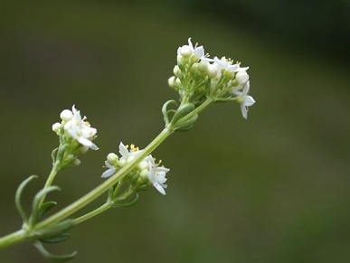
A couple of quick examples of competition:
The first person to test for the effects of competition between species was A. G. Tansley in 1917. He noted that closely related plants generally didn’t grow together in the same habitat. This wasn’t a new observation, but he wanted to see if the cause was competition (involving niche overlap) or if the species simply had completely different niches and couldn’t grow in the same habitat. He chose two species of a plant called bedstraw (Galium), each of which was generally found on a different soil type. He grew each plant alone and together on both its soil of origin and on the soil from the other species’ site.
A. G. Tansley (1917)

Slide 25
A. G. Tansley (1917)
There are two points to take from this. First, one must compare the growth with and without competitors to quantify competition. Second, the outcome of competition can vary with environment. Note that these were done within a single generation – just the growth period of a single plant, and so his measures don’t translate directly in dN/dt measures of population growth.

Slide 26
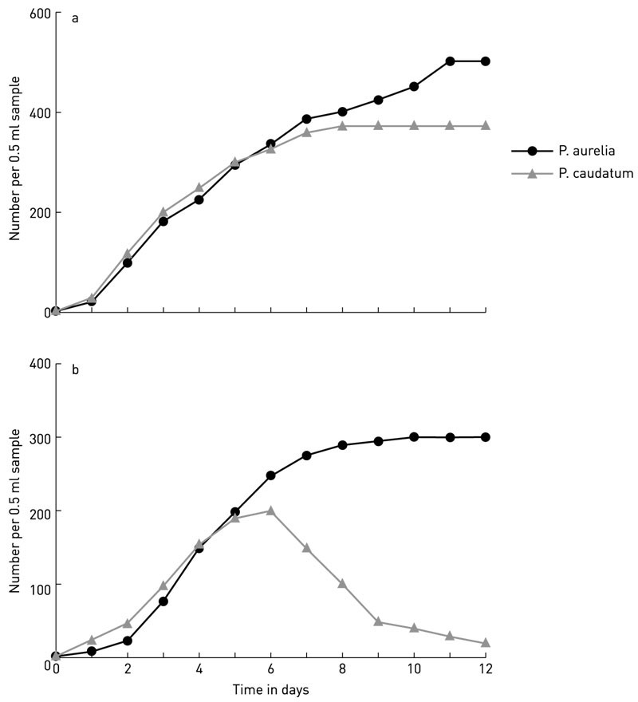
Gause studied competition between protozoa species feeding on yeast cells. Similar to Tansley, he compared the growth of populations in monoculture (alone) with growth in competition with another species.
This worked caused Gause to propose his theorem:
Two species cannot coexist unless they are doing things differently
or:
No two species can occupy the same ecological niche.

Slide 27
V. Populations and Biotic Influences
A. Migration
B. Types of Species Interactions
C. Competition
1. Definition:
2.. We can also classify two different types of competition
a. resource competition
b. interference competition, frequently for space.
c. everything in between. Not always clear, for example light competition in plants.

Slide 28
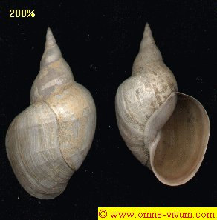
V. Populations and Biotic Influences
A. Migration
B. Types of Species Interactions
C. Competition
1. Definition:
2.. We can also classify two different types of competition
a. resource competition
b. interference competition, frequently for space.
c. everything in between. Not always clear, for example light competition in plants.
Eisenberg’s snails?
Hawaiian pheasants?

Slide 29
We are going to delve into competition stuff for awhile. It is going to be complicated. Just remember:
BIOLOGY
MATH
GRAPHS

Slide 30
V. Populations and Biotic Influences
A. Types of Species Interactions
B. Competition
1. Definition:
2. Types of competition (resource vs. interference)
3. Simple Models of Competition --
a. Lotka-Volterra equations and isoclines
i) extend logistic equation to two species
ii) set equations to zero and derive isoclines
iii) plot isoclines and understand zones
iv) make predictions based on zones and intercepts

Slide 31
We want equations that will predict various possible outcomes of competition that are observed in nature. Either species may go extinct or the two species may co-exist. Can we predict which species will win? Can we predict when the species will coexist?
Can we use this to better understand competition?

Slide 32
b. Lotka-Volterra models – a rubric
Interaction | Make equations (b-d) | Equilibrium (dN/dt = 0) | Phase-space isoclines | Make predictions
competition |  |  |  | Who wins? Coexistence?
predation

Slide 33
PHASE PLANE
Number of Blue fish (N_{B})
Number of Red fish (N_{R})

Slide 34
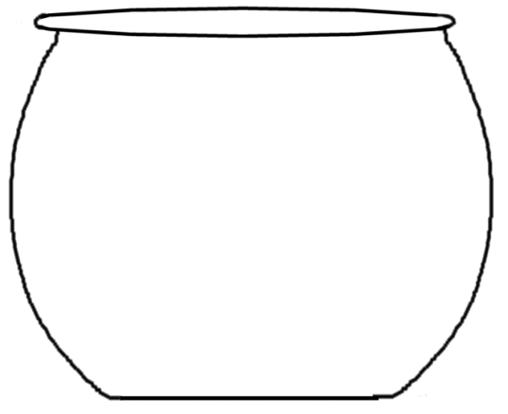
PHASE PLANE
Number of Blue fish (N_{B})
Number of Red fish (N_{R})

Slide 35
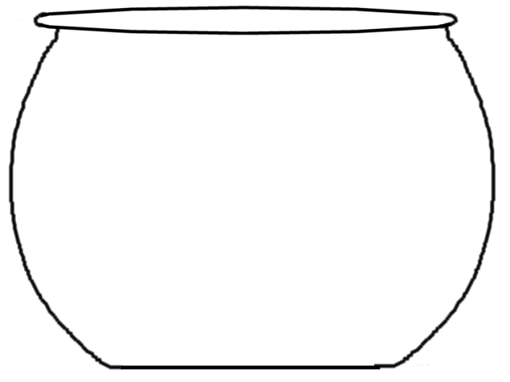
PHASE PLANE
Number of Blue fish (N_{B})
Number of Red fish (N_{R})

Slide 36
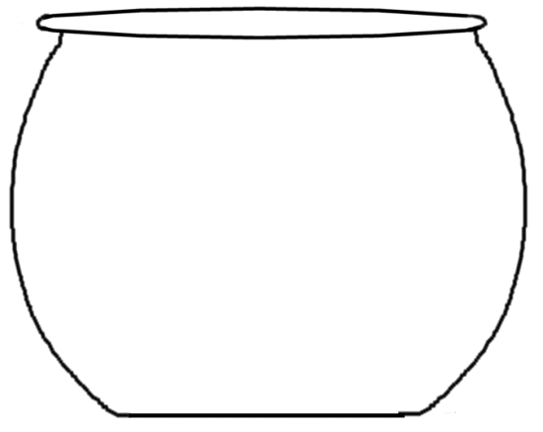
PHASE PLANE
Number of Blue fish (N_{B})
Number of Red fish (N_{R})

Slide 37
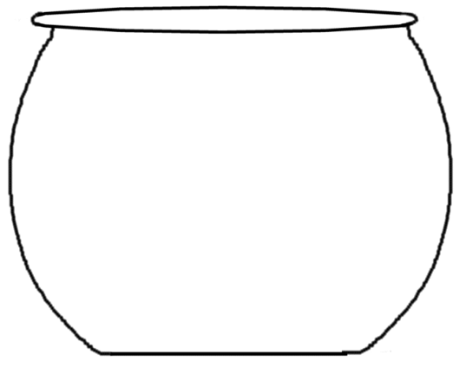
PHASE PLANE
Number of Blue fish (N_{B})
Number of Red fish (N_{R})

Slide 38
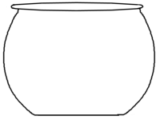
PHASE PLANE
Number of Blue fish (N_{B})
Number of Red fish (N_{R})

Slide 39
PHASE PLANE
Okay, now think about how the redfish population is doing in each of these circumstances? We have the tools to understand how populations are doing. Try thinking about this in terms of
dN/dt
Number of Blue fish (N_{B})
Number of Red fish (N_{R})

Slide 40
PHASE PLANE
Isocline where dN/dt = 0 for red fish
Number of Blue fish (N_{B})
Number of Red fish (N_{R})

Slide 41
PHASE PLANE
Negative growth?
Negative growth if interspecific competition is high?
Number of Blue fish (N_{B})
Positive growth?
Negative growth if intraspecific competition is high?
Number of Red fish (N_{R})

Slide 42
PHASE PLANE
-
-
-
dN/dt < 0
-
-
-
-
-
-
+
-
-
+
Number of Blue fish (N_{B})
-
-
+
+
-
+
dN/dt > 0
+
+
+
+
+
-
+
Number of Red fish (N_{R})

Slide 43
PHASE PLANE
Isocline where dN/dt = 0 for red fish
-
-
-
dN/dt < 0
-
-
-
-
-
-
+
-
-
+
Number of Blue fish (N_{B})
-
-
+
+
-
+
dN/dt > 0
+
+
+
+
+
-
+
Number of Red fish (N_{R})

Slide 44
PHASE PLANE
Now consider the blue fish’s growth →
Negative growth?
Negative growth if intraspecific competition is high?
Number of Blue fish (N_{B})
Positive growth?
Negative growth if interspecific competition is high?
Number of Red fish (N_{R})

Slide 45
PHASE PLANE
-
-
-
dN/dt < 0
-
-
-
-
-
-
+
-
-
Number of Blue fish (N_{B})
-
-
+
+
-
+
dN/dt > 0
+
+
+
+
+
+
+
Number of Red fish (N_{R})

Slide 46
PHASE PLANE
Isocline where dN/dt = 0 for blue fish
Number of Blue fish (N_{B})
Number of Red fish (N_{R})

Slide 47
PHASE PLANE
Number of Blue fish (N_{B})
Number of Red fish (N_{R})

Slide 48
PHASE PLANE
Isocline where dN/dt = 0 for red fish
-
-
-
dN/dt < 0
-
-
-
-
-
-
+
-
-
+
Number of Blue fish (N_{B})
-
-
+
+
-
+
dN/dt > 0
+
+
+
+
+
-
+
Number of Red fish (N_{R})

Slide 49
PHASE PLANE
Isocline where dN/dt = 0 for blue fish
-
-
-
dN/dt < 0
-
-
-
-
-
-
+
-
-
Number of Blue fish (N_{B})
-
-
+
+
-
+
dN/dt > 0
+
+
+
+
+
+
+
Number of Red fish (N_{R})

Slide 50
PHASE PLANE
Remember that the growth rate of each species on its isocline is ZERO.
Number of Blue fish (N_{B})
Number of Red fish (N_{R})

Slide 51
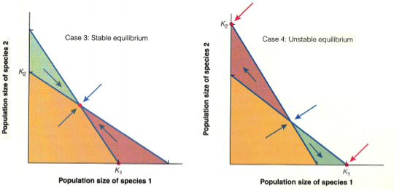
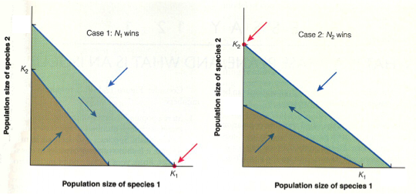
K₁/α₁₂
K₁/α₁₂
K₂/α₂₁
K₂/α₂₁
K₁/α₁₂
K₁/α₁₂
K₂/α₂₁
K₂/α₂₁

Slide 52
We are going to delve into competition stuff for awhile. Remember:
BIOLOGY
MATH
GRAPHS

Slide 53
Study Guide Items from Lecture 10
Terms:
Biomes • ammensalism
Competition • mutualism
Resource competition • interference competition
Symbiosis • isocline
Commensalism
Concepts:
Causes and names of major biomes
Types of species interactions
Isoclines and predicting the outcome of competition
Case Studies:
Climate change induced niche shifts in California birds
Connell’s barnacles
Tansley’s plants on soils
Gause’s protozoa and competitive exclusion

