Slide 1
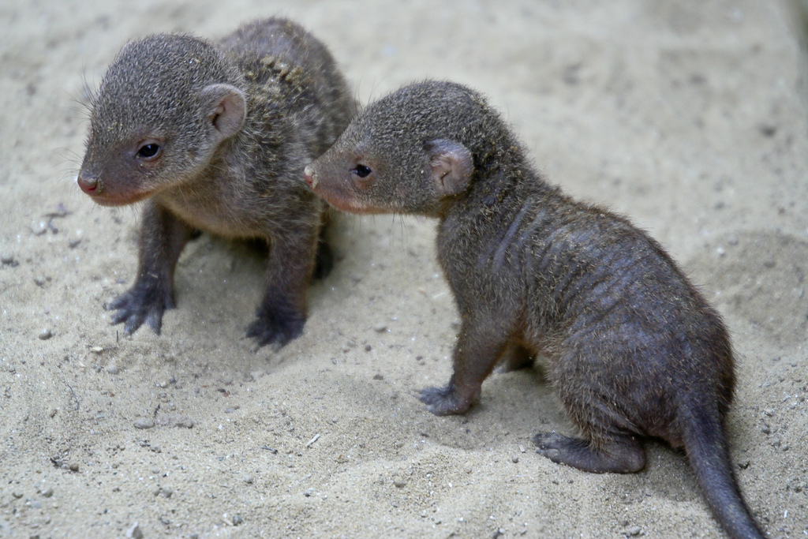
9th Lecture – October 6, 2016
-- exam average was ~ 72
Friday, October 7, 4:00 pm, 1024 KIN—ECOLOGY AND EVOLUTION SEMINAR:
"Parental care, filial cannibalism, and the evolution of social behavior,"
Dr. Hope Klug
Department of Biology, Geology and Environmental Science, University of Tennessee
In banded mongoose, females will sometimes eat all the young that are not their own litter.
Notes:
Omics aims at the collective characterization and quantification of pools of biological molecules that translate into the structure, function, and dynamics of an organism or organisms.

Slide 2
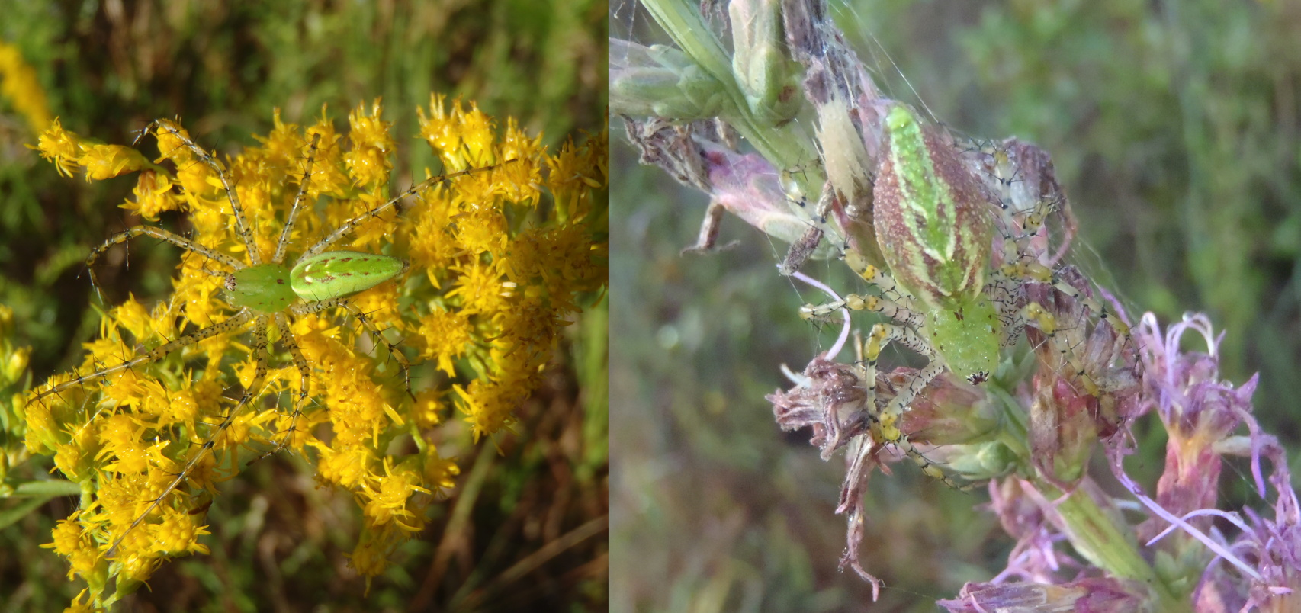

Slide 3
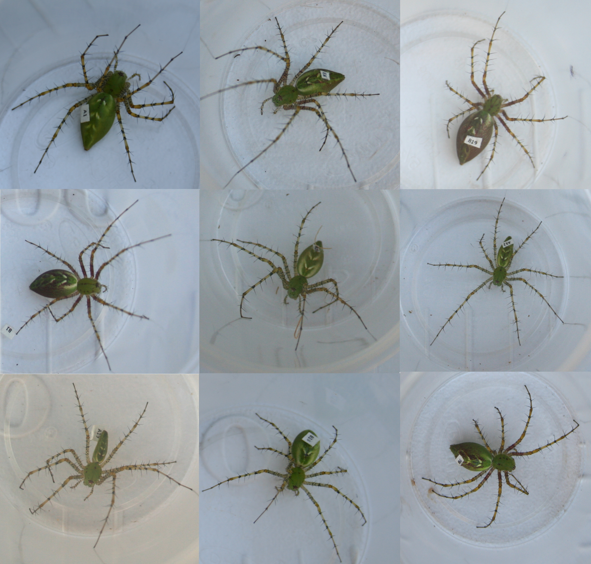

Slide 4
Grade Distribution for Exam 1
with estimates of grade breaks

Slide 5
Grade Distribution for Total points as of Oct 6 (170 pts.)
with estimates of grade breaks

Slide 6
What is Ecology?
  II. Tools for Ecology
III. Life History Strategies
IV. The Niche and the environment
The term “niche” has a checkered history in ecology:
“The niche concept remains one of the most confusing, yet important, topics in ecology.” R. B. Root (1967).
“I think it is a good practice to avoid the term niche whenever possible.” M. H. Williamson (1972).
“The niche concept is a very useful addition to the ecologist’s tool kit because it combines the best properties of both bailing wire and putty; it holds ill-fitting pieces together that would otherwise fall apart and at the same time fills the gaps between them so that the poor workmanship may go undetected. D. Reilloc (cited in Hurlbert 1981).

Slide 7
What is Ecology?
  Tools for Ecology
  The Niche and the environment
Two meanings of been used historically:
The first is the role of a species in the environment. The idea was originally discussed with the analogy of a village as a community. Each person in that village, such as the local vicar has a job or relationships in the village, must like a badger in the forest.
The second is the requirements of a species in an environment. Niche now becomes the resources or factors necessary for the existence of a species in a given habitat.

Slide 8
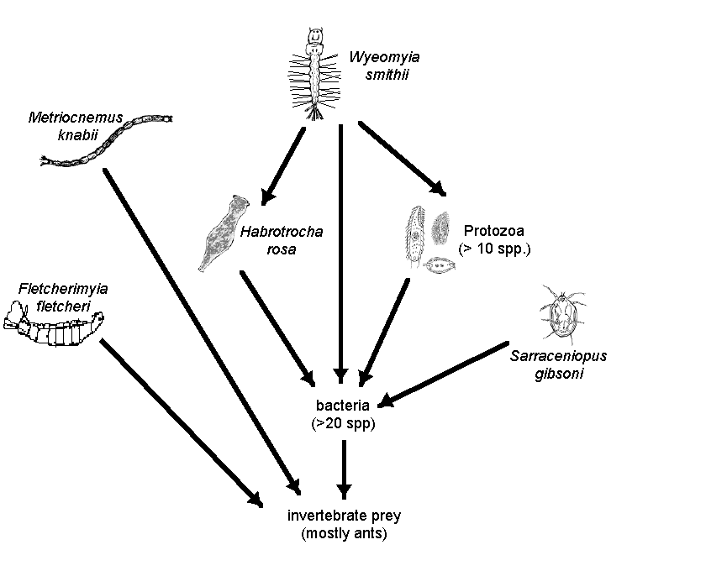
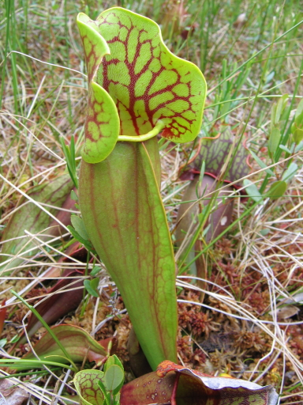
What do protozoa eat? What nutrients do they consume? What eats them? What do they provide to their community

Slide 9
What is Ecology?
  II. Tools for Ecology
III. Life History Strategies
IV. The Niche and the environment
Two meanings of been used historically:
The first is the role of a species in the environment. The idea was originally discussed with the analogy of a village as a community. Each person in that village, such as the local vicar has a job or relationships in the village, must like a badger in the forest.
The second is the requirements of a species in an environment. Niche now becomes the resources or factors necessary for the existence of a species in a given habitat.

Slide 10
What do protozoa need to survive? What food do they require? Temperature? Nutrients? What must the community provide for them?

Slide 11
r_{m}
        Resource level
Notes:
Now go to temperature and beer for undergrads to show 2-dimensions

Slide 12
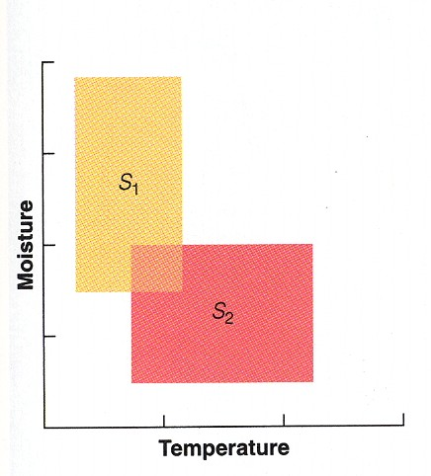

Slide 13
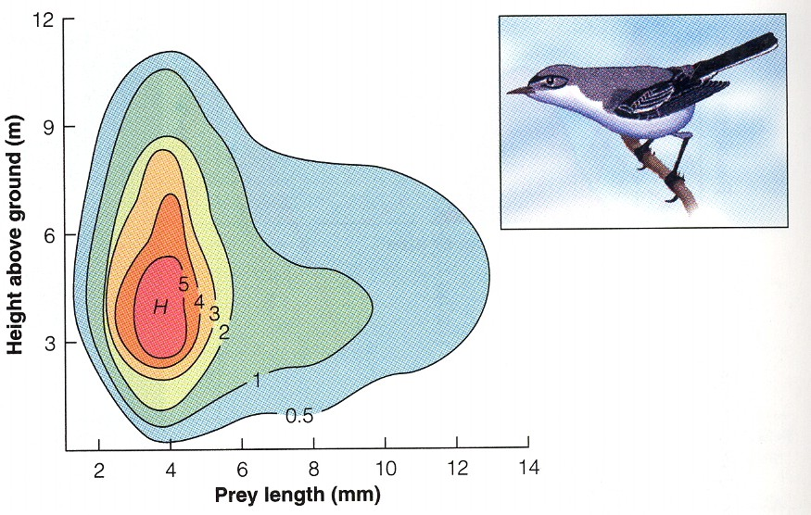

Slide 14
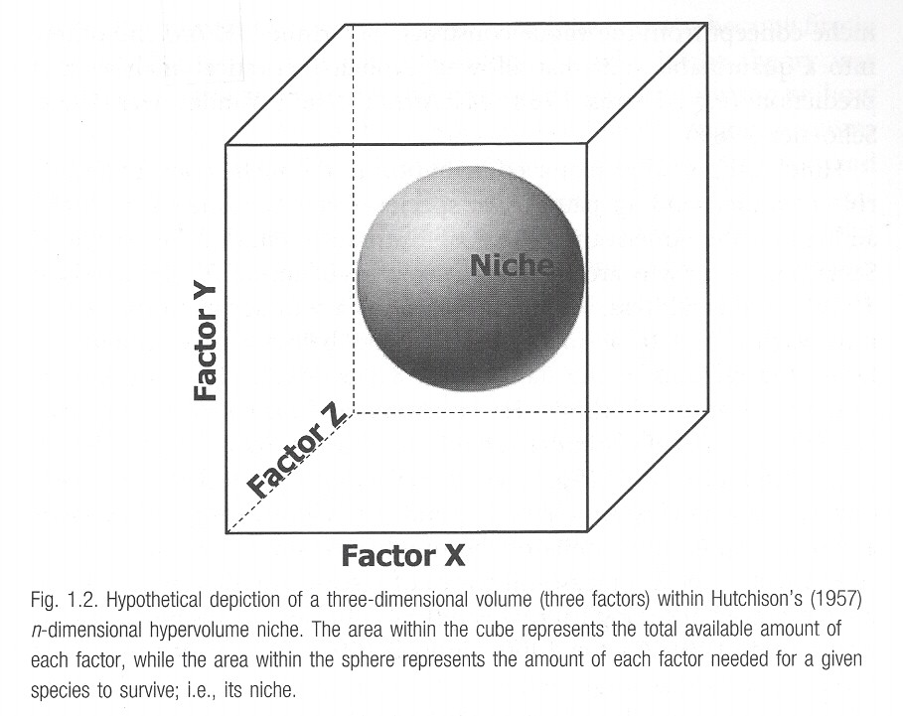
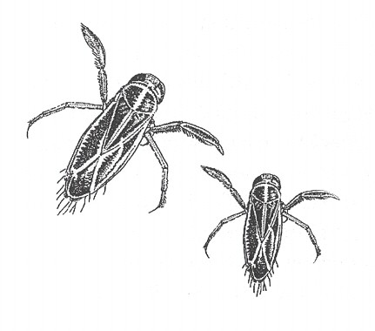
Hutchinson’s n-dimensional hypervolume concept

Slide 16
What is Ecology?
  II. Tools for Ecology
Life History Strategies
The Niche and the environment
    Role of a species in an environment
    Requirements of a species in an environment
Our definition combines the two definitions:
“The joint description of the environmental conditions that allow a species to persist in a given environment along with the per-capita effects of that species on the environmental conditions.”

Slide 17
IV. The Niche and the environment
A. Niche theory
  Role of a species in an environment
  Requirements of a species in an environment
“The joint description of the environmental conditions that allow a species to persist in a given environment along with the per-capita effects of that species on the environmental conditions.”
Two terms that refer to the requirements part of the niche definition:
Fundamental niche = a species’ niche in the absence of competition, predation, and other interactions
Realized niche = a species’ actual usage of resources with competition and other biotic interactions

Slide 18
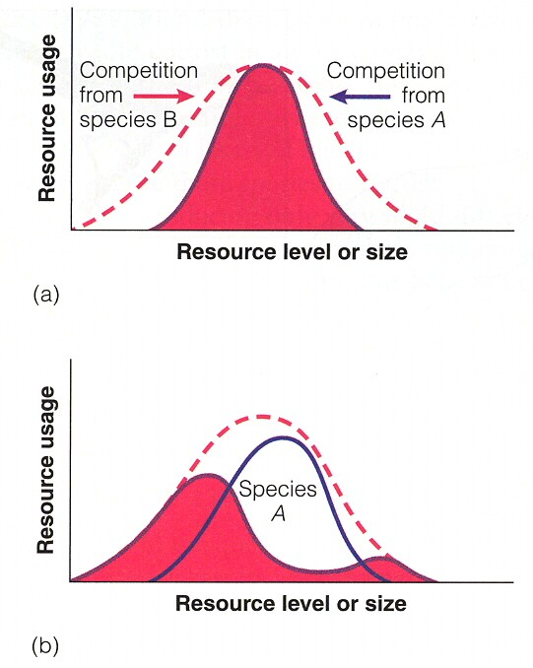
Fundamental niche describes where species could occur, if there was no competition and predation. This is often limited to abiotic factors.
The Realized niche describes where a species does occur, and includes biotic interaction with other species (e.g., competition and predation).

Slide 19
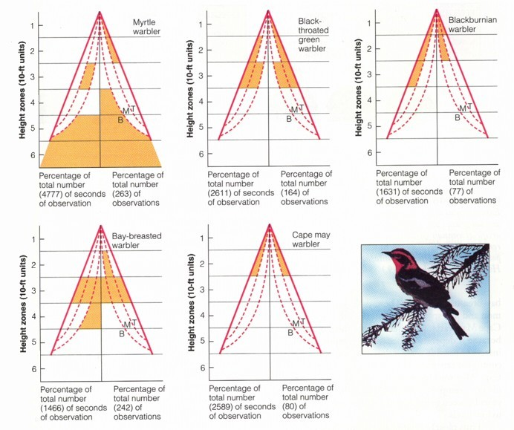
MacArthur’s study of warblers:

Slide 20
MacArthur’s study of warblers:
-- five warbler species coexist in boreal forest of New England
-- all eat insects and are about the same size
-- how can they coexist if they utilize the same trees and compete for food?
-- MacArthur showed that each species occupies a different portion of the tree
-- There are also some slight differences in nesting dates
-- he suggested that these differences allow the species to coexist
This is one of the first studies illustrating that different niches may allow a group of competing species to coexist.
-- Which niche definition was MacArthur using?
-- Was he quantifying the realized or fundamental niche?

Slide 21
IV. The Niche and the environment
A. Niche theory
We can described organisms by their niche. The fundamental niche describes where they could occur, if there was no competition and predation. Thus, since biotic interactions aren’t important, the fundamental niche describes abiotic factors that determine where a species can occur.
The realized niche is where species do occur, when both biotic and abiotic factors regulate the species. We tend to emphasize the biotic factors that limit species for their realized niche.

Slide 22
How could we determine if what we see is the fundamental or realized niche? Why would we want to do this?
Niche factor 2
Niche factor 1

Slide 23
How could we determine if what we see is the fundamental or realized niche? Why would we want to do this?
Fundamental niches?
Niche factor 2
Niche factor 1

Slide 24
How could we determine if what we see is the fundamental or realized niche? Why would we want to do this?
Realized niches?
Niche factor 2
Niche factor 1

Slide 25
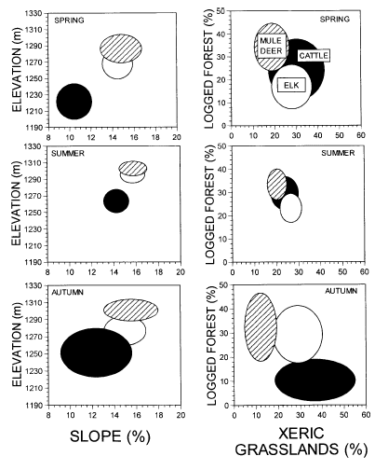
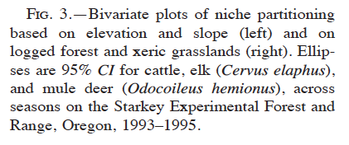
How could we determine if what we see is the fundamental or realized niche? Why would we want to do this?
Stewart et al. 2002
Notes:
Deer and elk have coexisted for a while, with more deer in forests and more elk in grasslands. But, will cattle cause problems?
Maybe during the spring and summer, but not in the autumn.

Slide 26
Stewart et al. quantified the niches of elk, mule deer, and cattle.
-- They proposed that elk and deer have persisted for a long time in the same area because the partition the habit in some way. However, cattle are new to the area and may compete (and thus have high niche overlap) with elk and mule deer.
-- Elk and mule deer generally to partition the habit, with elk spending more time in the grasslands and deer more time in the forest.
-- Cattle may compete strongly with both species during the spring and summer, but not in the fall when they move down to lower elevation grasslands.

Slide 27
Where we are going. . . .
What is Ecology
Tools for Ecology (how to describe and compare populations)
Correlations of Life Histories
IV. The Niche and the environment
A. Niche theory
B. Basic Ingredients -- dominant abiotic niche factors
C. Climate
V. Populations and Biotic Influences
A. migration
B. types of species interactions
C. Competition
D. Predation
E. Mutualisms

Slide 28
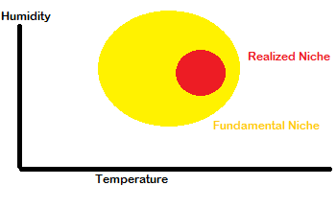
Temperature, water, light

Slide 29
So, lets talk for a bit about the abiotic factors that determine the niche, such as temperature, water and light. Each has some important properties that influence how they contribute to species niches.
IV. The Niche and the environment
A. Niche theory
B. Basic Ingredients -- dominant abiotic niche factors
Temperature.
-- life processes only occur at the liquid temperature range for water (0° to 100° C). Mostly, about 2.3° to 45° C
-- heat increases kinetic energy of molecules and accelerates chemical reactions 4X for every 10°C rise in temperature (so metabolic rates increase!)
-- enzymes and other proteins become less stable at high temperatures (approx. >50-60° C).
Temperature can determine the distribution (3 D’s!) for a species. Each species can also have different optima. The optima can be determined by the growth parameters we have already studied.

Slide 30
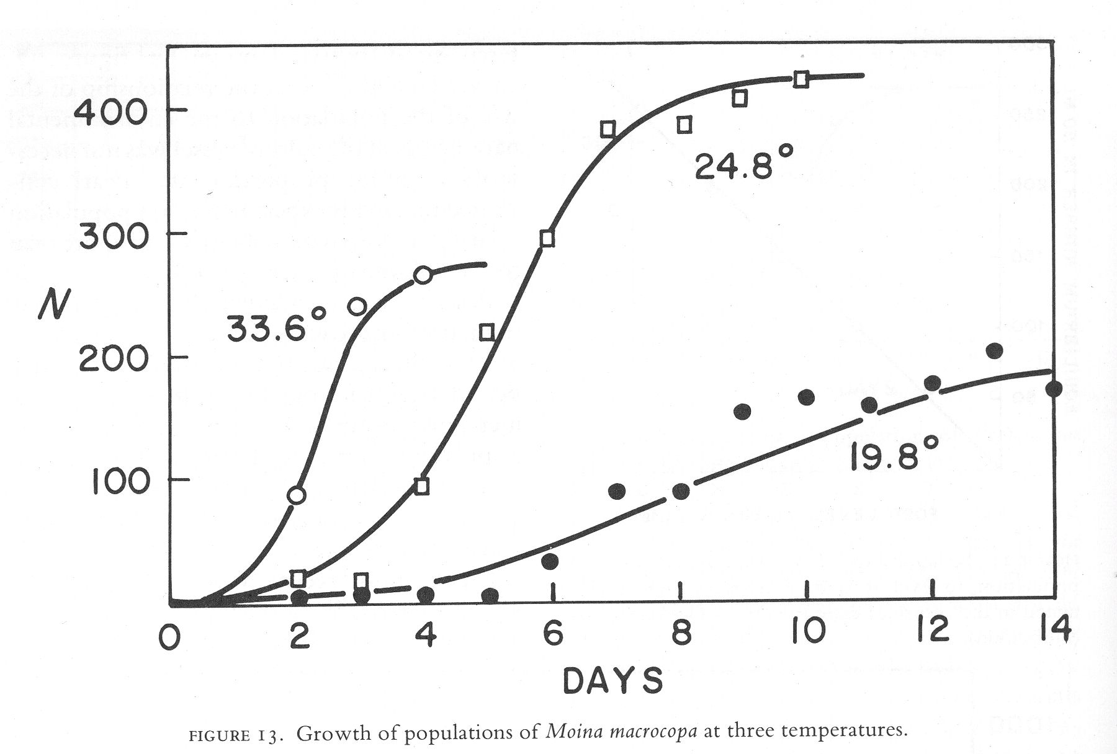

Slide 31
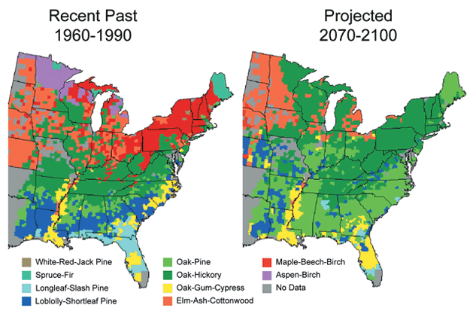

Slide 32
IV. The Niche and the environment
A. Niche theory
B. Basic Ingredients -- dominant abiotic niche factors
1. Temperature.
2. Water -- many strange but important properties
-- generally a liquid on earth, requires lots of energy to
cool off or heat up (adds to homeostasis)
-- expands on freezing, resulting in floating and providing
a refuge for life under ice.
-- universal solvent because of strong chemical bond
attractions for other molecules.

Slide 33
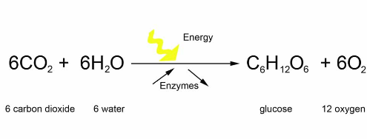
IV. The Niche and the environment
A. Niche theory
B. Basic Ingredients -- dominant abiotic niche factors
1. Temperature.
2. Water -- many strange but important properties
-- Obviously, water is very important for metabolism. For
plants, it is both important in photosynthesis (6 CO₂ +
6 H₂0 . . ), but is important for transporting nutrients in
plants. Most plant water is lost through stomata, not
used in photosynthesis.

Slide 34
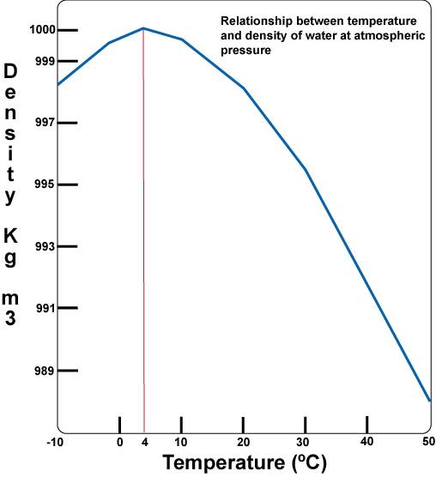
IV. The Niche and the environment
A. Niche theory
B. Basic Ingredients -- dominant abiotic niche factors
1. Temperature.
2. Water -- many strange but important properties (cont.)
-- is most dense 4° C, allowing turnover in lakes.
In the fall, air temperatures cool, causing the surface water in a lake to cool and become more dense. This water sinks, forcing lighter, less dense water to the surface. This continues until the whole lake is about 4 degrees -- eventually the top water gets colder than 4 degrees, now floats, and freezes. A similar process occurs in the spring. The sinking action and mixing of the water results in the exchange of bottom and surface water, moving important nutrients in the water column. This process is turnover.

Slide 35
III. The Niche and the environment
A. Niche theory
B. Basic Ingredients -- dominant abiotic niche factors
1. Temperature.
2. Water -- many strange but important properties (cont.)
-- is most dense 4° C, allowing turnover in lakes.
-- air holds moisture, but how much depends on temp.
and pressure.
adiabatic cooling: heating or cooling that comes from within. Air moving up loses pressure (at higher altitude) and hence loses heat (cools) and vice-versa. Adiabatic lapse rate is 10° C/km.
-- Water vapor affects the rate of adiabatic cooling due to
condensation. Warm air can hold a greater
concentration of water.
dew point = temperature at which condensation begins.

Slide 36
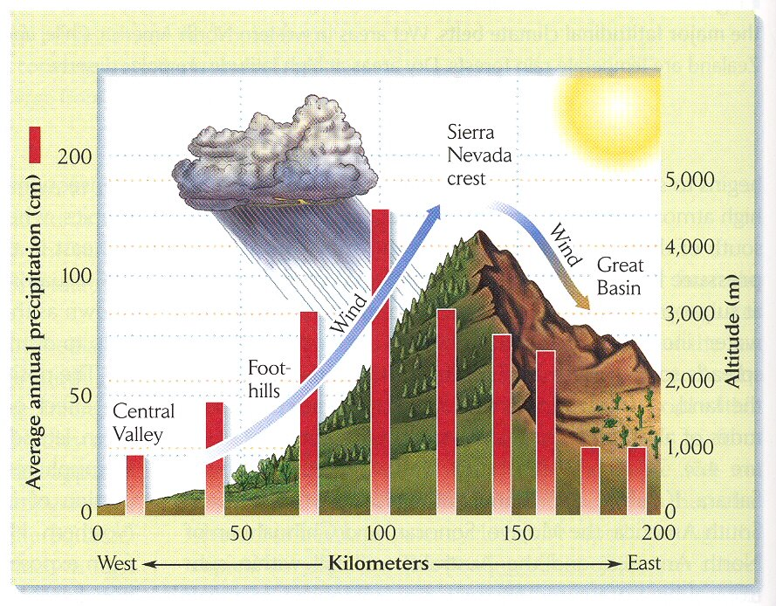
This process produces rain shadows, where winds push air over a mountain. As the air rises, it cools (adiabatic cooling) and loses its ability to hold water, causing rain. The air that reaches the other side is now dry, causing a dry “shadow” on the far side.

Slide 37
III. The Niche and the environment
A. Niche theory
B. Basic Ingredients -- dominant abiotic niche factors
1. Temperature
2. Water -- many strange but important properties (cont.)
3. Light
-- primary source of energy
-- photosynthesis, of course
-- heat, of course, can influence coloration and behavior
-- different wavelengths have different amounts of energy. Ultraviolet is high energy and is giving us all skin cancer, we are protected by Ozone (O₃).
-- vision and photosynthesis occur at wavelengths that, at the earth’s surface, contain the greatest amount of energy. Pigments in the plants absorb the energy, but saturation point is quite low (10% of full sunlight).

Slide 38

Graduate School in Biology (or other Sciences)
-- What is graduate school?
-- How do you find a program
appropriate for your record
and goals?
-- How can you help your record?
-- How do you apply?
-- How do we evaluate
applicants?
-- What then?

Slide 39
Graduate School in Biology (or other Sciences)
-- What is graduate school?
In the sciences, graduate school is more like an internship; it is not like continuing on as an undergrad.
It can take 5-7 years for a Ph.D.; 2-3 years for a masters.
You spend this time taking specialized courses and conducting your own research.

Slide 40
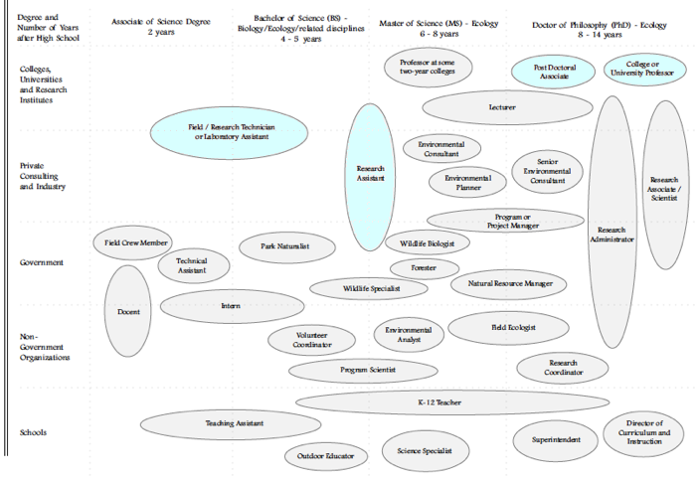

Slide 41
Graduate School in Biology (or other Sciences)
-- What is graduate school?
-- How do you find a program
appropriate for your record
and goals?
-- How can you help your record?
-- How do you apply?
-- How do we evaluate
applicants?
-- What then?

Slide 42
Graduate School in Biology (or other Sciences)
-- What is graduate school?
-- How do you find a program
appropriate for your record
and goals?
-- How can you help your record?
-- How do you apply?
-- How do we evaluate
applicants?
-- What then?

Slide 43
What you can do as an undergraduate:
-- Learn from professional societies and discussion what careers are possible with a graduate degree.
-- Interact with professors and graduate students
-- Find out what research is done at FSU (webpages!)
-- Get involved in research, either volunteer or paid
-- Join reading groups or other lab activities
-- Work on something, even if not your thesis topic or even if not publishable
-- There are a significant number of research fellowships available for undergrads, such as REUs.
-- practical goals are (1) research experience, (2) letters of recommendation, (3) most importantly, meeting faculty and grad students to see if academia is really what you want.

Slide 44
Graduate School in Biology (or other Sciences)
-- What is graduate school?
-- How do you find a program
appropriate for your record
and goals?
-- How can you help your record?
-- How do you apply?
-- How do we evaluate
applicants?
-- What then?

Slide 45
Graduate School in Biology (or other Sciences)
How do we evaluate applicants?
-- Applications now often due by December for Fall 2014!
-- We look at three aspects of your record
-- paper scores (GPA, GRE, grades in specific classes
-- life experiences (research, jobs, background)
-- letters of recommendation (get to know faculty!)
-- We match students backgrounds and interests with strengths and availability in our program.

Slide 46
Study Guide for Lecture 9
Terms:
Niche
fundamental niche
realized niche
“roles” niche
“needs” niche
Turnover in lakes
Rainshadows
Adiabatic cooling
Dew point
Concepts:
  Testing for fundamental vs. realized niche space
  Understanding the two definitions of niche and their combined meaning
  Needs niche as an n-dimensional hypervolume
  Fundamental niche determined by abiotic factors like light, temperature, and water.
  Basic properties of light, water, and temperature
  Case Studies:
  Deer, elk, and cattle niche parameters.
  MacArthur’s warblers

