Slide 1
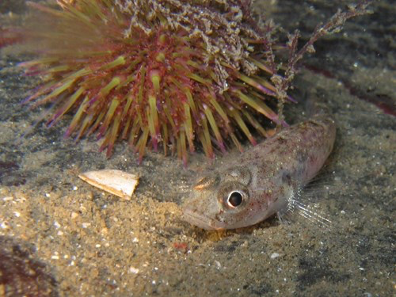
8th Lecture – October 4, 2016
-- exam back on Thursday
-- average was ~ 72
Friday, October 7, 4:00 pm, 1024 KIN—ECOLOGY AND EVOLUTION SEMINAR:
"Parental care, filial cannibalism, and the evolution of social behavior,"
Dr. Hope Klug
Department of Biology, Geology and Environmental Science, University of Tennessee
“Why would an animal parent kill and sometimes eat the kids? That's a question that inspires the research of evolutionary biologist Hope Klug.”
Notes:
Omics aims at the collective characterization and quantification of pools of biological molecules that translate into the structure, function, and dynamics of an organism or organisms.

Slide 2
II. Tools for Ecology
A. Population demography: describing populations.
1. Definitions
2. Demography
B. Demography in the real world
1. Experiments testing density dependence
a. Eisenberg’s snails
b. Forester’s fish
2. Human Population Dynamics

Slide 3
II. Tools for Ecology
A. Population demography: describing populations.
1. Definitions
2. Demography
B. Demography in the real world
1. Experiments testing density dependence
a. Eisenberg’s snails
b. Forester’s fish
2. Human Population Dynamics
Metapopulations
Consider squirrels that live in different woodlots in Tallahassee. Is this all one population? They may be one population if there is significant migration among the woodlots. One easy way to handle such patchy populations is as a metapopulation.

Slide 4
II. Tools for Ecology
A. Population demography: describing populations.
1. Definitions
2. Demography
B. Demography in the real world
C. Metapopulation
births
deaths
immigration
emigration
dN/dt = bN – dN + imm - emi

Slide 5
II. Tools for Ecology
A. Population demography: describing populations.
1. Definitions
2. Demography
B. Demography in the real world
C. Metapopulations
If we had to keep track of the bN and dN, as well as migration, in each of the local habitats and then somehow add them all up, it could get really difficult.
So, instead, we are going to consider two different population scales, local and regional, and “count” populations in a new way.

Slide 6
II. Tools for Ecology
A. Population demography: describing populations.
B. Demography in the real world
C. Metapopulations
1. Definitions
metapopulation is a group of several local populations
that are linked by immigration and extinction.
shift from considering size of local population to persistence of populations -- 0's and 1's
shift to very different spatial scale, or really having to work at both scales.
Only really appropriate if migration rates are intermediate. Too little migration and it isn’t important. Too much migration makes it all one population.

Slide 7
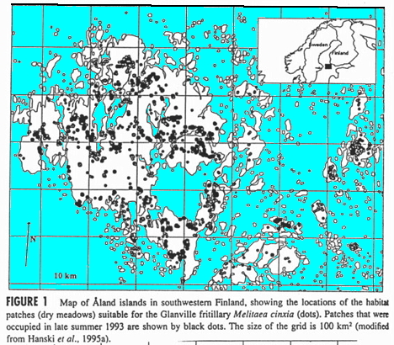
This scenario is a common occurrence.
Species often occur in discrete patches, with patches being different in size and degree of isolation.
This is a map of Hanski’s dry meadows where butterfly populations are found.

Slide 8
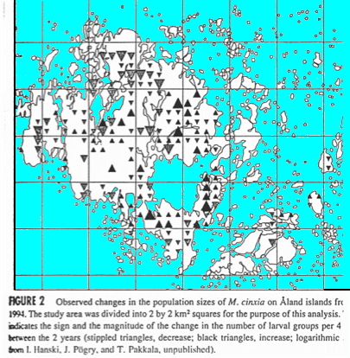
Populations in these patches aren’t static or unchanging. Instead, some populations may increase in size, while others decline. Some may go extinct, while others are being colonized. It is a dynamic process that is best investigated using probabilities.

Slide 9
II. Tools for Ecology
…..
C. Metapopulations
1. Definitions
2. Quantifying extinction and immigration — using
probabilities
-- probability of patch extinction (ε)
-- rate of propagule production for colonization (c)
-- proportion of patches occupied (P)
dP/dt = cP(1-P) - εP
I will not expect you to know or solve these equations – just understand the principles for metapopulations. This equation is really just saying that the growth rate of the number of occupied local populations can be determined as the colonization of new patches (birth) minus the extinction of populations on established patches (death).

Slide 10
Assumptions of simple metapopulation model:
-- all patches are the same
-- no spatial structure (all patches are equidistant
from each other, which is impossible!)
-- no time lags
-- constant probabilities of patch extinction (ε) and
colonization (c)
-- sufficient migration that it affects c and ε
-- a large number of patches

Slide 11
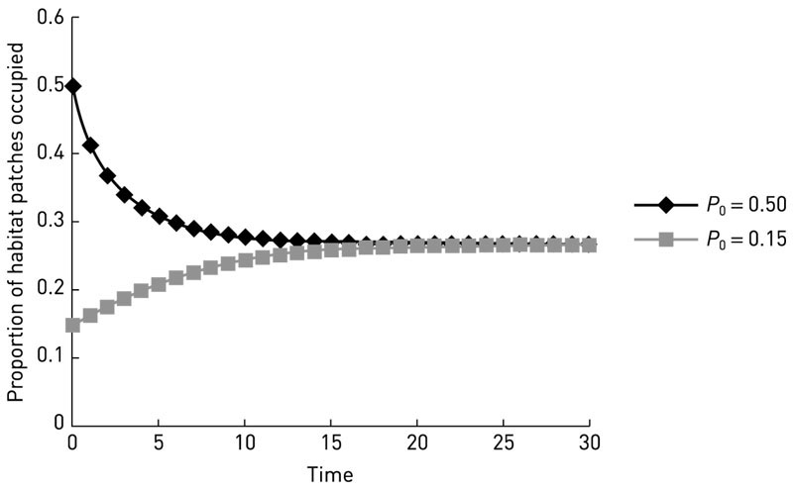
We can determine the equilibrium number of patches that we might expect “on average” by understanding the balance between colonization and extinction.
What is important for you to remember is that, given enough time and constant rates of patch colonization and extinction, the number of occupied patches at any given time will stabilize.

Slide 12
II. Tools for Ecology
…..
C. Metapopulations
1. Definitions
2. Quantifying extinction and immigration — using
probabilities
-- probability of patch extinction (ε)
-- rate of propagule production for colonization (c)
-- proportion of patches occupied (P)
dP/dt = cP(1-P) - εP
I will not expect you to know or solve these equations – just understand the principles for metapopulations. This equation is really just saying that the growth rate of the number of occupied local populations can be determined as the colonization of new patches (birth) minus the extinction of populations on established patches (death).

Slide 13
Now, let’s consider the effect of the number of patches on regional extinction. Does more than 1 patch help that much to prevent extinction?
probability that a population won't go extinct is just = 1- ε
probability that a population won't go extinct for two time periods is = (1-ε) (1-ε)
So the probability that a local population will persist for n years is:
Persistence for n years = (1-ε)^{n}

Slide 14
That is just one patch. Now, what if we consider the
simultaneous extinction of two patches?
The probability of regional persistence for one year is (1 - the probability that both patches go extinct during the year):
Persistence of 2 patches = 1 - (ε) (ε) = 1 - (ε)²
This can be generalized to give the probability of regional persistence in a set of x patches:
Persistence of x patches = 1 – (ε)^{x}
Note that this is different than the probability of a single patch not going extinct through time. It is the probability that at least one patch will survive from a group of x.

Slide 15
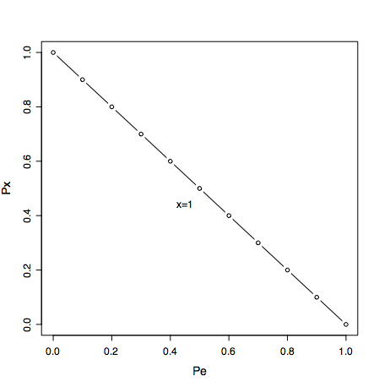
Persistence of x patches = 1 – (ε)^{x}
Regional Persistence of at least one Patch
Individual Patch Extinction (ε)

Slide 16
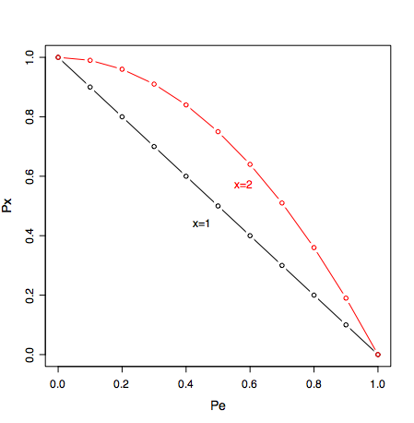
Persistence of x patches = 1 – (ε)^{x}
Regional Persistence of at least one Patch
Individual Patch Extinction (ε)

Slide 17
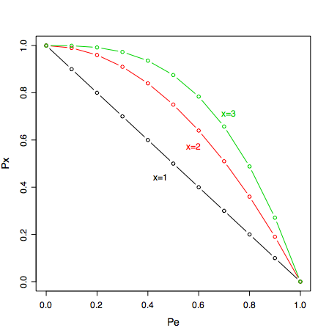
Persistence of x patches = 1 – (ε)^{x}
Regional Persistence of at least one Patch
Individual Patch Extinction (ε)

Slide 18
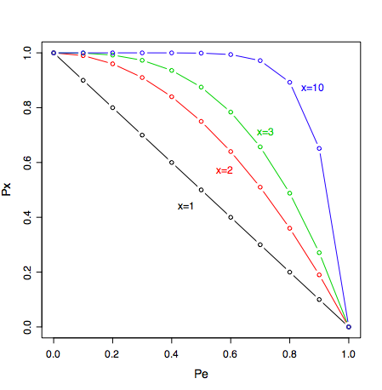
Persistence of x patches = 1 – (ε)^{x}
Regional Persistence of at least one Patch
Individual Patch Extinction (ε)

Slide 19
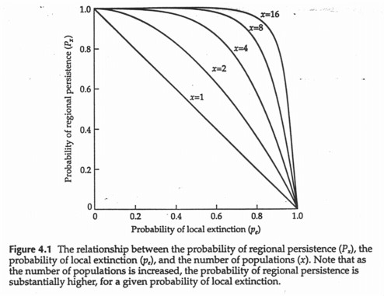
This is quite important for conservation, because it suggests one way to avoid extinctions. You don’t necessarily have to save all local populations (patches), if you have lots of patches and some amount of migration between patches.

Slide 20
Remember the assumptions we already noted:
3. Assumptions of simple metapopulation model:
-- all patches are the same
-- no spatial structure -- all patches are
equidistant from each other (impossible!)
-- no time lags
-- constant p_{e} and p_{i}
-- sufficient migration that it affects p_{e} and p_{i}
-- a large number of patches, otherwise
stochasticity or random extinctions
becomes overwhelmingly important.

Slide 21
3. Assumptions of simple metapopulation model:
Violations lead to some interesting known phenomenon:
-- source/sink model
In many metacommunities, some populations are doing much better than others. This can lead to some populations having a net export of individuals (emigration > immigration = “source”), while others have a net import of individuals (immigration > emigration = “sink”)
-- Rescue effects
The populations in some patches are maintained only through continuous migration, otherwise the population would go extinct. In effect, the population is being continuously “rescued” from extinction.

Slide 22
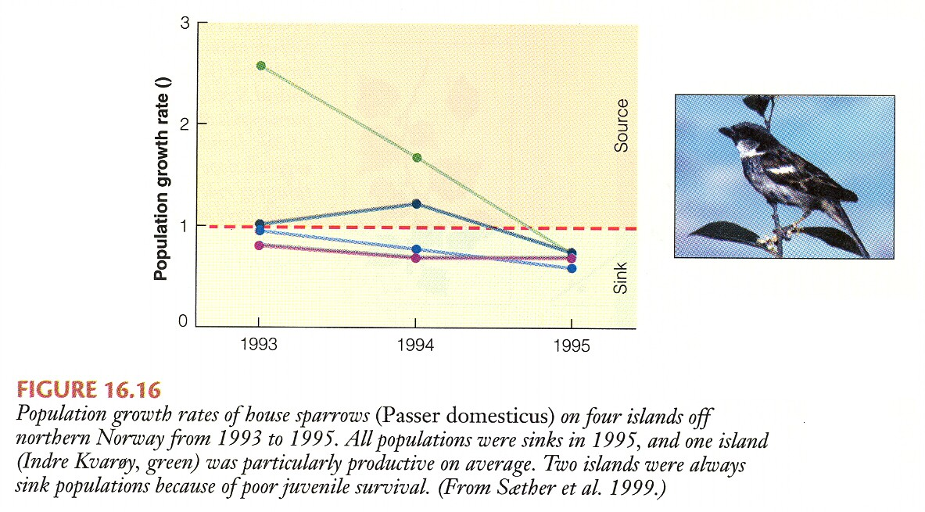
House sparrows on islands as a source-sink population

Slide 23
House sparrows on islands as a source-sink population
Simple example of sparrow populations on four islands off the coast of Norway. All islands maintained relatively constant number across the three years of this study, with migration from source populations “rescuing” sinks. The graph shows that some islands are more productive that others, acting as sources in good years. But, in severe years, all populations are sinks.

Slide 24
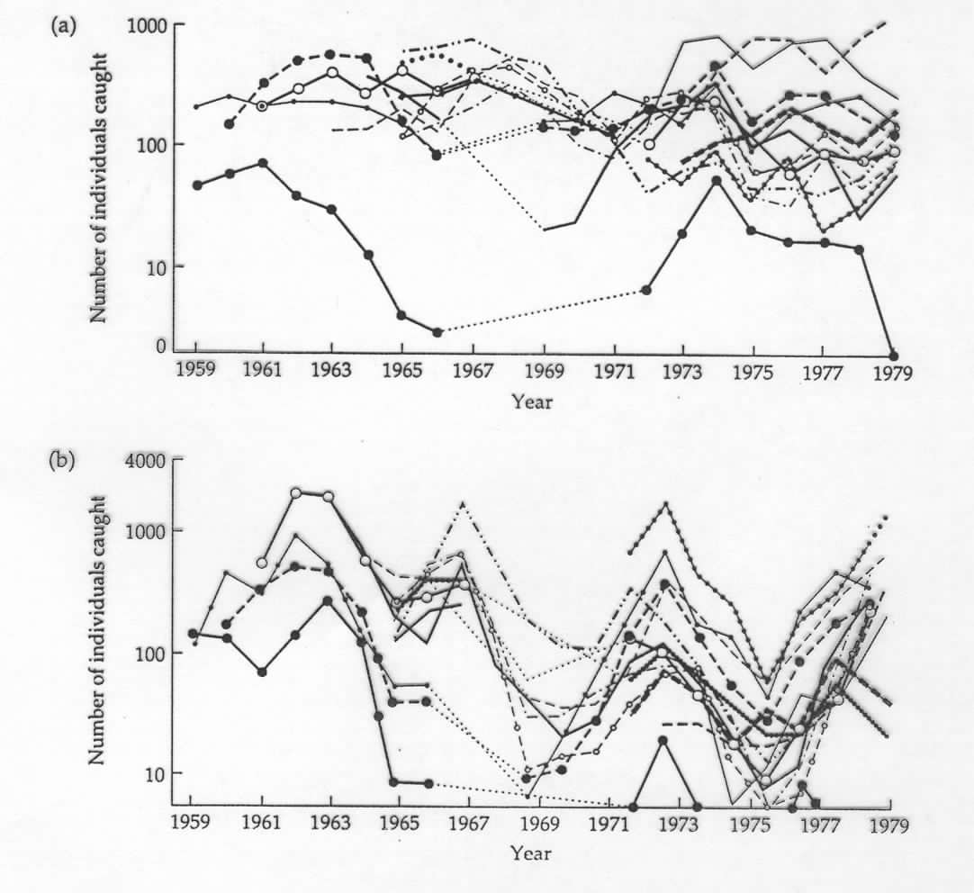
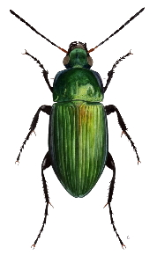
Carrabid beetles from two sites in the Netherlands
Pterostichus versicolor had no extinctions over 21 years.
Calathus melanocephalus has occasional extinctions of many local populations.
Why do these two beetle metapopulations differ?

Slide 25
Carabid ground beetles from two sites in the Netherlands
Both graphs show the number of beetles found in local populations using pit-fall traps (den Boer, 1981, Oecologia 50:39-53).
For the beetle Pterostichus versicolor, the abundances vary asynchronously and there were no extinctions over the 21 years.
For the beetle, Calathus melanocephalus, populations varied somewhat synchronously, leading to occasional local extinctions.

Slide 26
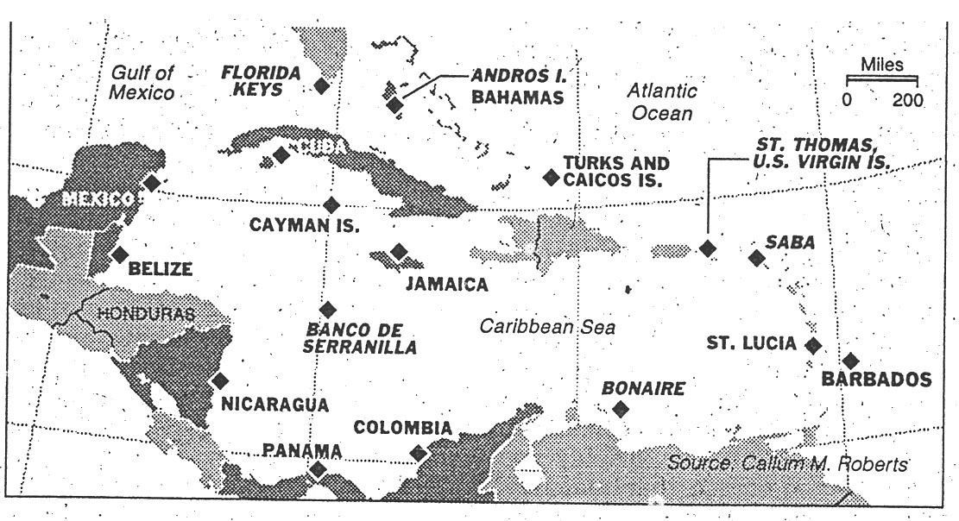
Robert’s study of coral reef invertebrates in the Caribbean

Slide 27
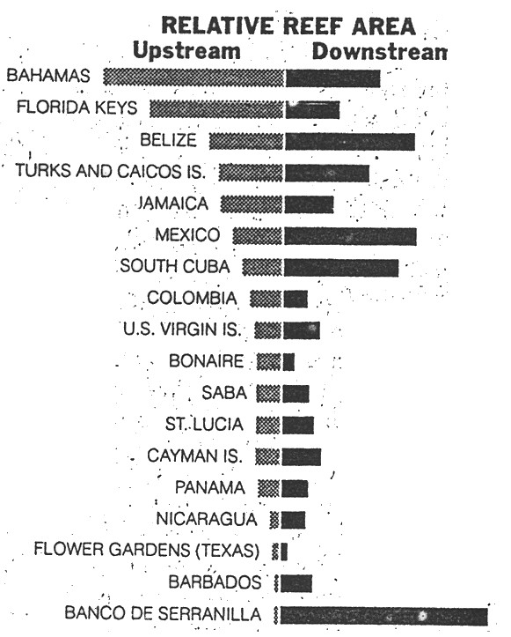
Robert’s study of coral reef invertebrates in the Caribbean
Roberts work is a special case of a metapopulation, in which populations are arranged along a circular current, so each has an upstream side providing migrants and a downstream side to which they provide migrants. Note (1) island with large upstream sides should be more stable in the short term, but (2) circular nature will link all populations so that the extinction of any one would lead to problems in all.

Slide 28
Summary of some metapopulation ideas
-- metapopulations provide another spatial scale to study populations, where regional and local effects are considered.
-- local habitats are either filled or empty (1 or 0) and we apply probability theory to understand how 1’s may turn to 0’s and 0’s may turn to 1’s. (kind of like switching to digital technology).
-- everything else we have considered are really local effects in closed systems – metapopulations incorporate migration in local open systems
-- Metapopulation stuff is very popular in conservation biology. Sometimes, the models are far too simplistic to be used with real systems – and some conservation biologists don’t understand their limitations.

Slide 29
For example, what if you can buy 10,000 acres to help preserve some endangered species of squirrels. Should you buy one preserve of 10,000 acres OR perhaps 10 preserves of 1,000 acres, which you can link with corridors.
A simple metapopulation answer might be to get the 10 preserves because, if the squirrels in any one of the smaller preserves went extinct, then they could be “rescued” or re-established from one of the other preserves.
However, it depends on the relationship between ε and preserve size. If smaller preserves are much more likely to go extinct, then perhaps the single large reserve is better.
This is related to SLOSS, which we will discuss later in the course.

Slide 30
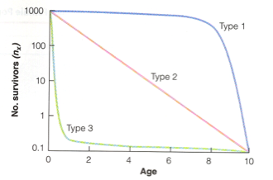
We now have these tools and measures of population growth and structure. Are there necessary or expected relationships among them that might help to tell us how nature is structured?
For example, is there a necessary relationship between:
r and G?
K and r?
l_{x} and m_{x}?

Slide 31
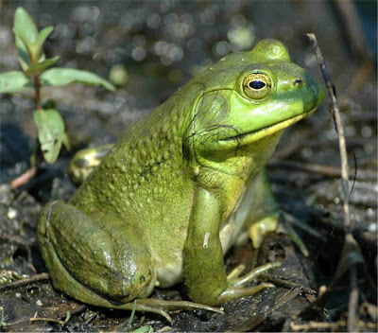
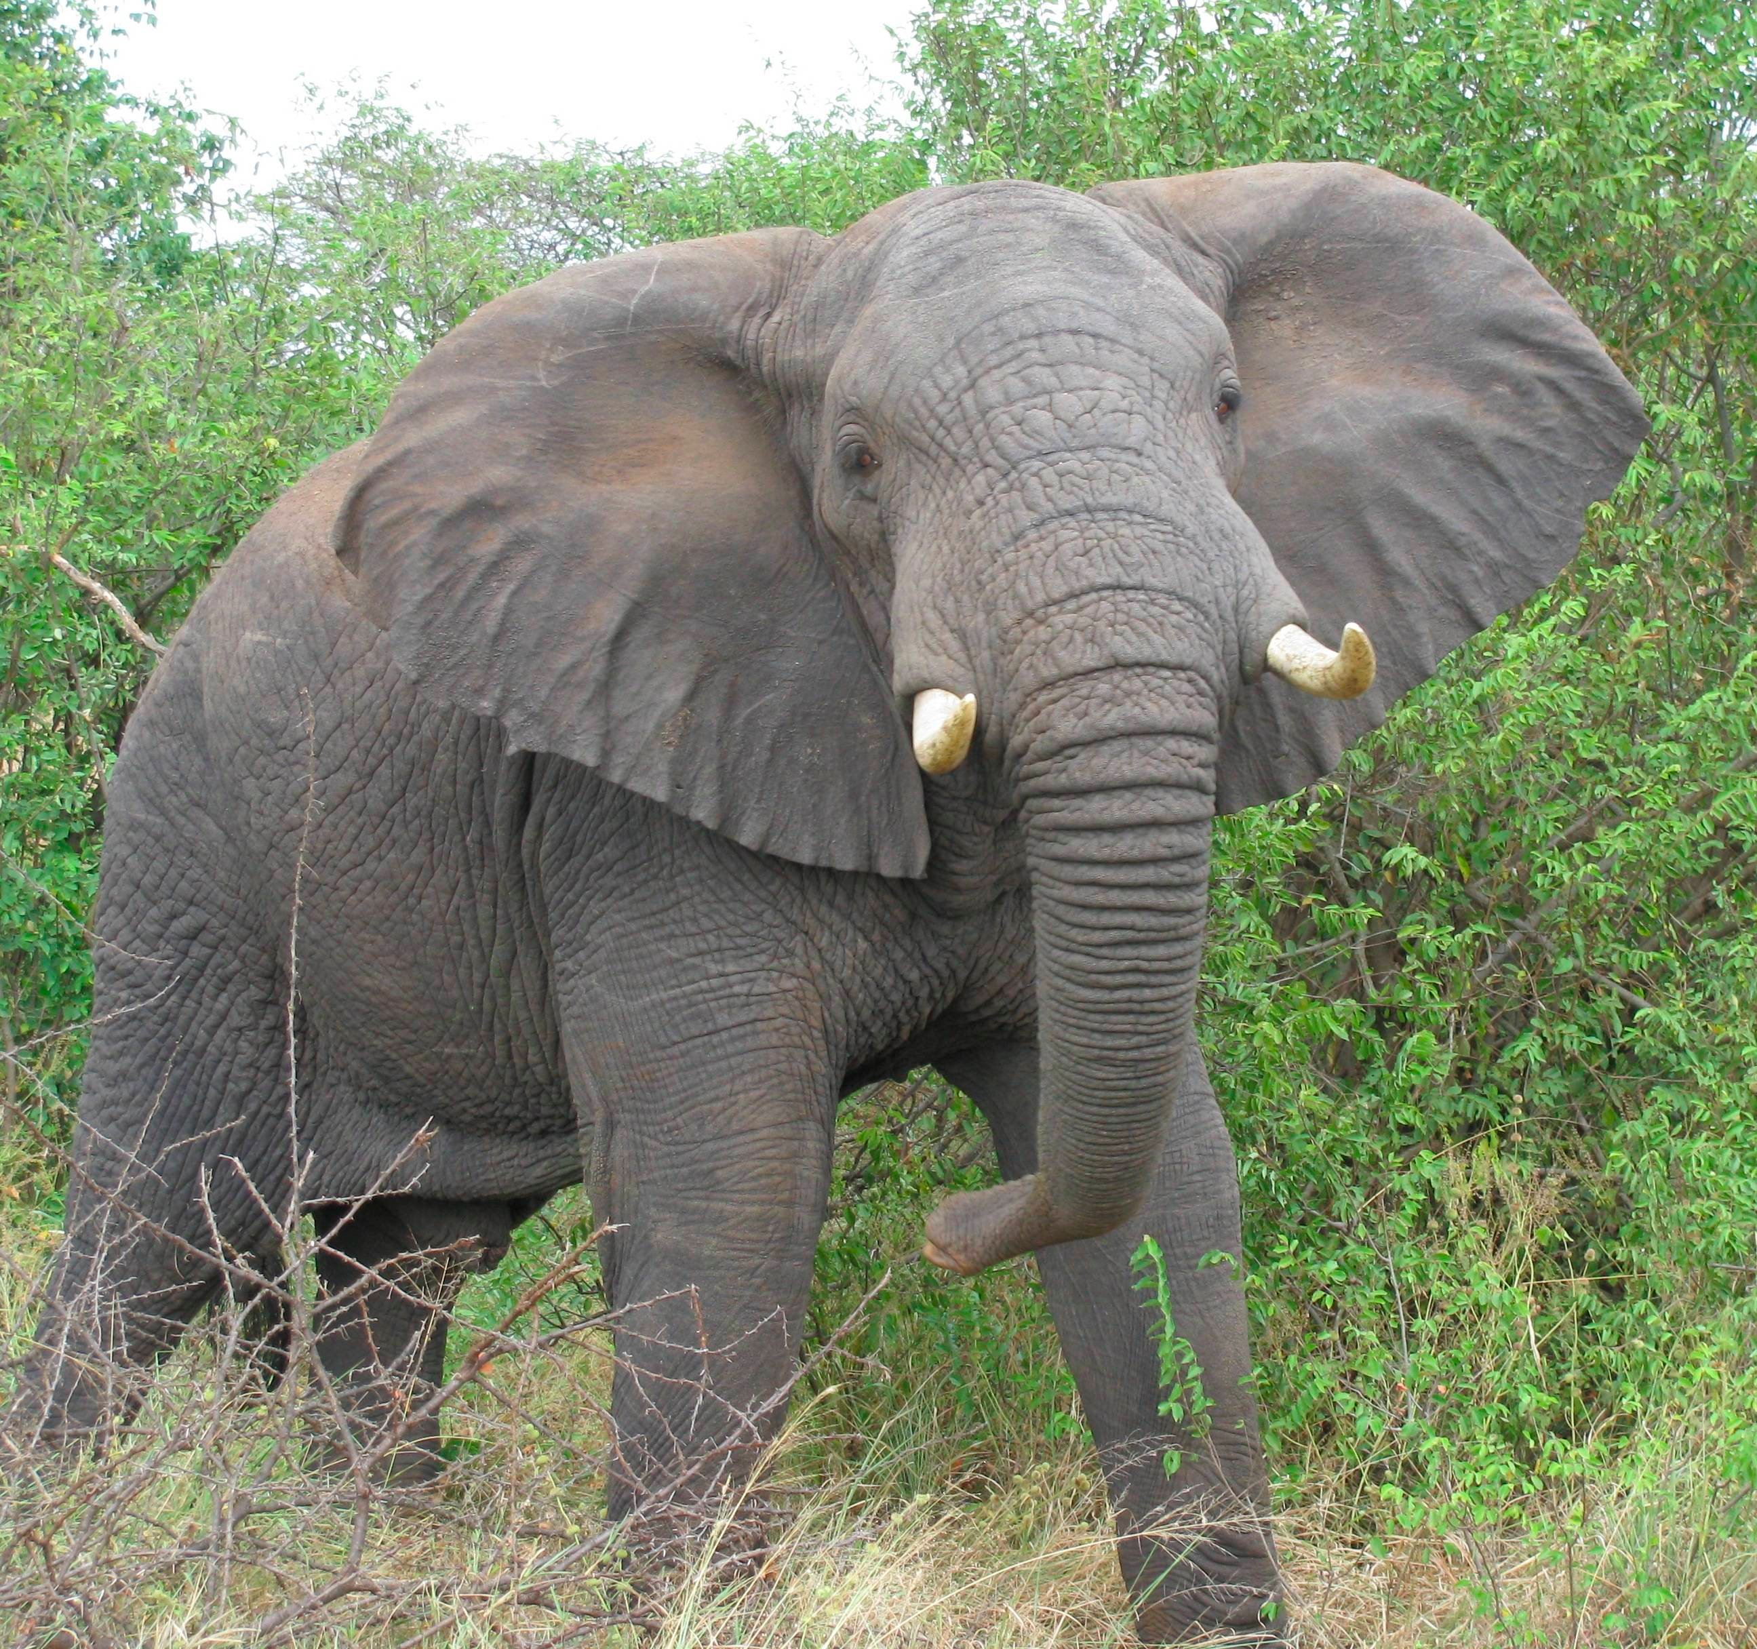
Let’s consider just the basic biology of a couple of species. Consider frogs and elephants:
Life span: ~7 yrs
Clutch size: 20,000 eggs
Life span: ~55 yrs
Clutch size: 1 every 2-4 years from age 25- 45
Offspring per year
Length of reproductive life (years)

Slide 32
Can you have anything with a long life, but also many offspring per year? Or a short life, but few offspring?
?
Life span: ~7 yrs
Clutch size: 20,000 eggs
Life span: ~55 yrs
Clutch size: 1 every 2-4 years from age 25- 45
Offspring per year
?
Length of reproductive life (years)

Slide 33
Well, now let’s consider the math. We know that the population growth rate can be modeled as:
R_{o} = Σ l_{x}m_{x}
Reproductive rate
(multiplication rate)
Birthrate
Survivorship
If most species have approximately stable populations, then we can assume that R₀ is around 1.0, no matter whether we are discussing elephants or bullfrogs. If so, then increasing l_{x} must lead to a compensating decrease in m_{x}. And, a decrease in l_{x} must result in an increase in m_{x}.

Slide 34
Can you have anything with a long life, but also many offspring per year? Or a short life, but few offspring?
?
Life span: ~7 yrs
Clutch size: 20,000 eggs
Life span: ~55 yrs
Clutch size: 1 every 2-4 years from age 25- 45
Offspring per year
?
Length of reproductive life (years)

Slide 35
We can represent this trade-off between lx and mx as a line.
R_{o} = Σ l_{x}m_{x}
For a given Ro, l_{x} and m_{x} have an inverse relationship
Offspring per year
R_{o} Isocline
Length of reproductive life (years)

Slide 36
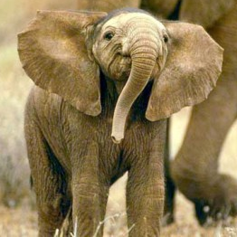
So, why can’t we have species not on the line? Bullfrogs that live forever AND have many offspring? Or Elephants that have short lifespans AND few offspring?
Offspring per year
R_{o} Isocline
Length of reproductive life (years)

Slide 37
It is easy to see that species with short life-spans, but also low reproduction are more likely to go extinct. R₀ < 0.
Offspring per year
Decreasing Ro
EXTINCTION
R_{o} Isocline
Length of reproductive life (years)

Slide 38
But why not be a “super species” that has a long life AND lots of offspring? Here the problem is insufficient energy. You can either make babies OR put energy into living longer.
INSUFFICIENT ENERGY
Increasing Ro
Offspring per year
R_{o} Isocline
Length of reproductive life (years)

Slide 39
Similar logic can be used to explain why r and G are constrained, such that increasing r must decrease G.
R₀ = e ^{r G}
For a given Ro, r and G have an inverse relationship
Offspring per year
R_{o} Isocline
Length of reproductive life (years)

Slide 40
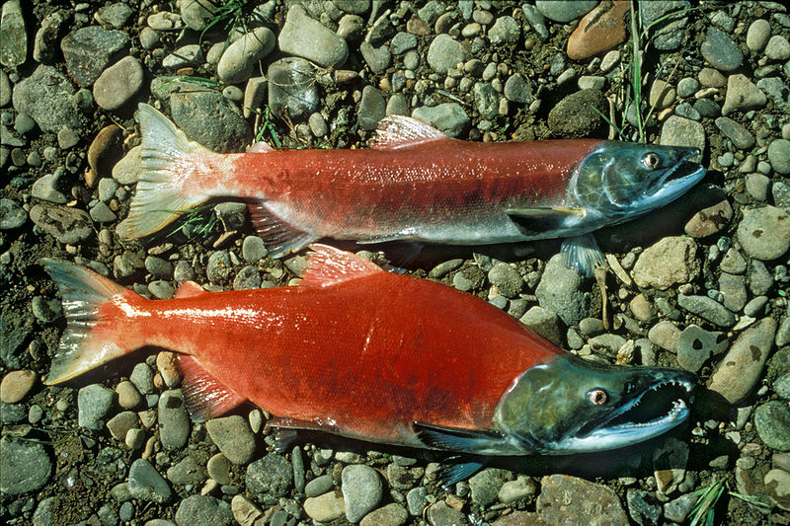
Many tradeoffs are known for “life-history” traits
Surveys of patterns in real organisms have shown that:
-- r is inversely related to G.
-- generation time (G) is positively related to size
-- r is inversely related to body size
-- life span and growth rate are negatively associated
-- high individual growth rate is positively correlated with r
-- individual growth rate is inversely correlated with size
Ultimately, evolution is favoring species that have highest survival and birth rates, but at the best times

Slide 41
These constraints are due to energy limits -- should you invest in yourself (somatic tissue) or your children (reproductive tissue)?
________________________________________________________
Two energetic truths underlie a basic problem that must be solved by all organisms:
Staying alive requires a lot of (expensive) maintenance. This requires maintaining the body tissue that is not reproductive (soma).
Generally, the more energy invested in offspring, the more likely you are to pass them into the next generation.

Slide 42
Species solve this energetic limitation in different ways. The two extremes are exhibited by comparing two modes of reproduction.
Semelparous:
(e.g. many salmon, annual plants)
Lower somatic maintenance, more energy to reproduction
Not as reliant on survivorship
Risk of losing all in poor environment
Iteroparous:
(e.g., humans, perennial plants)
Requires somatic maintenance
Risk of dying before producing all offspring
Hedges against environmental fluctuation
Pacific salmon
Homo sapien
Notes:
Semele was a priestess at a temple for Zeus. He saw her bathing, washing the blood of a bull sacrificed on his altar, and fell in love. Zeus started an affair with Semele and she became pregnant. Eventually Hera, Zeus’ wife found out. She came down in disguise and suggested to Semele that Zeus was lying and not really a god. So, Semele insisted that Zeus show himself to her as a god. He did, but mere mortals can’t look at gods – she was immediately consumed by flames and died. Zeus saved the baby, however, and sewed it into his thigh. This half-god, half-mortal was born a few months later and is Dionysus, the god of wine and ritual madness.

Slide 43
We can integrate all of these trade-offs in life-history traits into a single framework.
Remember the equation for logistic growth:
dN/dt = rN (K-N)/K
K: carrying capacity
Pop. Size (N)
r: slope
Time
This equation shows that there are two ways to increase the per-capita growth rate, at least in the short term (before reaching K). Increase r or increase K. These represent alternate strategies for different species.

Slide 44
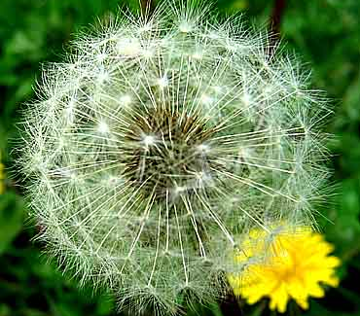
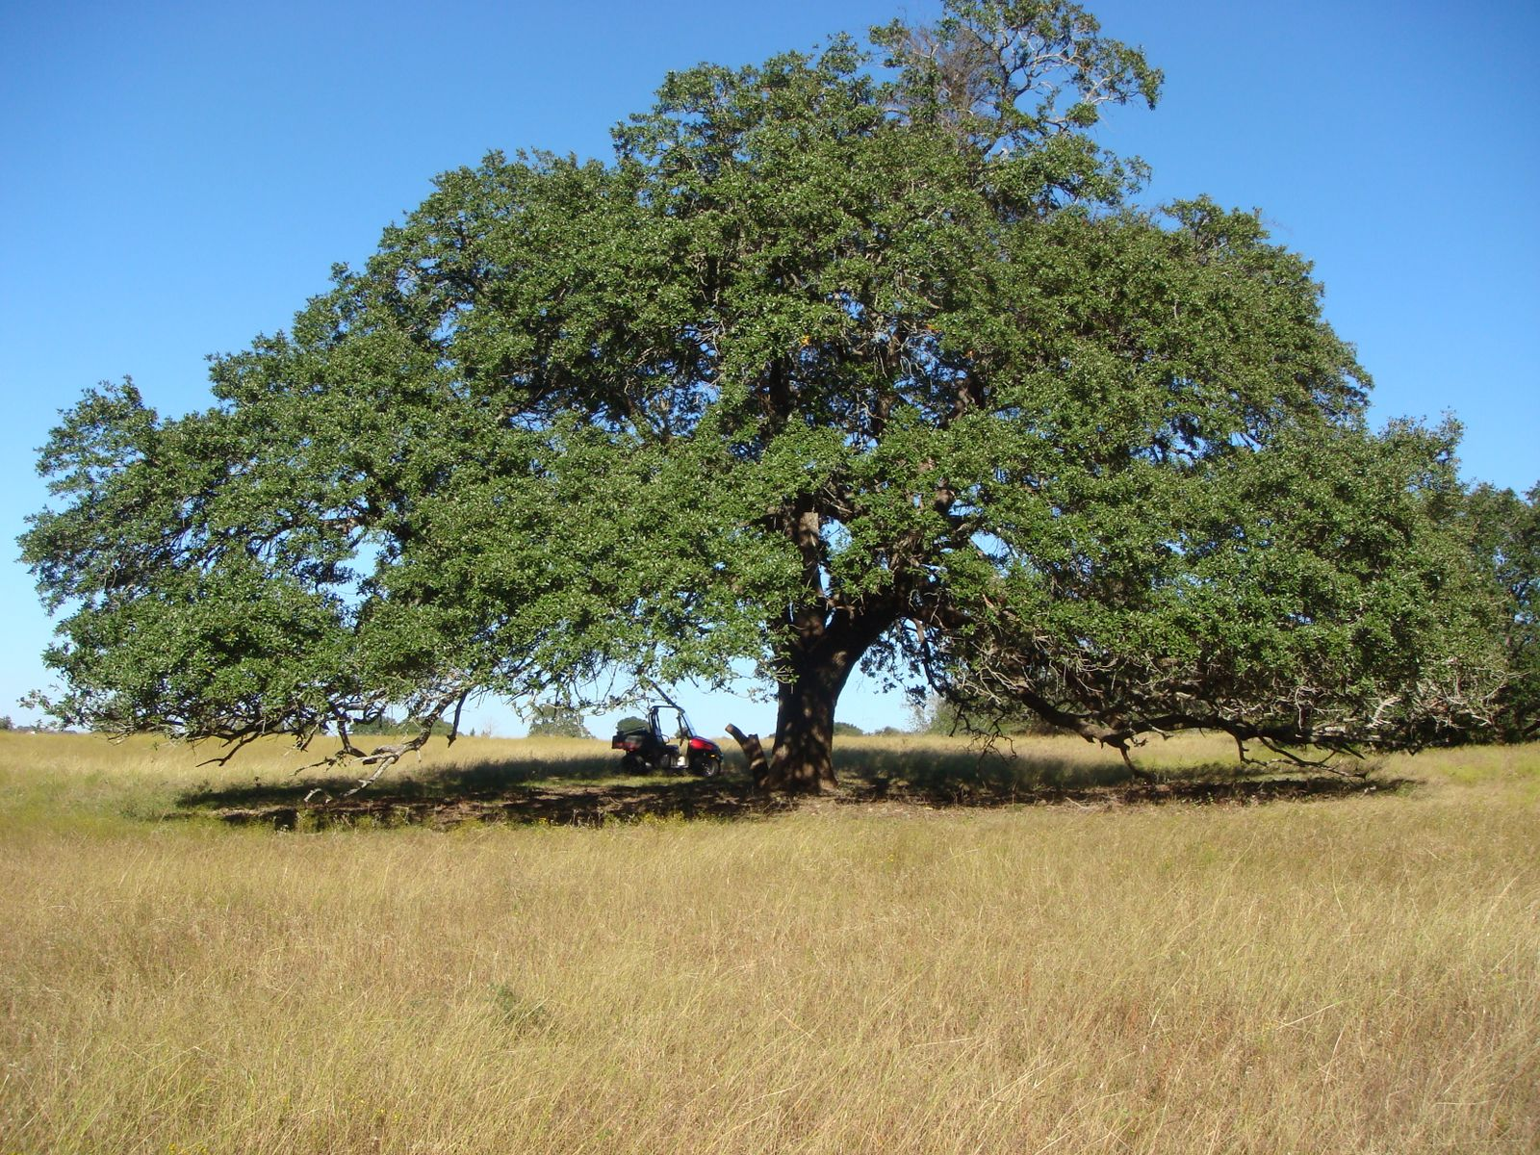
“r” and “K” Life history strategies
MacArthur and Wilson (1967)
Suggested that species fall on a gradient from:
r-selected species:
High initial growth rates
High dispersal rates
Good colonizers or invasives
K-selected species:
Use resources efficiently
Good competitors
Survive when it is more crowded
This theory should only be used as a rule of thumb as there are many exceptions!

Slide 45
Trait | r-selected | K-selected
climate | variable | predictable
mortality | DI | DD
Survivorship | Type III | Type I or II
Pop. size | Variable, <K | Constant, Near K
Competitive ability | poor | high
Predation defense | poor | high
Parental care | minimal | high
Life span | short | long
development | fast | slow
rmax | high | low
Time to reproduction | short | long
Body size | small | large
Offspring number | Many | Few
Offspring size | Small | Large
Dispersal ability | High | low
Traits commonly associated with “r” and “K” life history strategies.
I don’t expect you to memorize this table. However, on an exam I could give a trait and ask if it was r- or K- selected. Or I could ask for you to list 2-3 traits of r- or K- selected species.

Slide 46
Study Guide Items from Lecture 8
Terms:
Metapopulation
Iteroparous
Semelparous
local population
regional population
Source population
Sink population
Concepts:
Metapopulations, colonization and extinction, local and regional persistence
Correlations pr trade-offs among r, K, G, and other traits
Energetic constraints on life history
r and K species and their traits
Case Studies:
Hanski’s Glanville Fritillary butterflies on islands as a metapopulation.
Sparrows on four island.
Beetles in the Netherlands showing metapopulation effects.
Robert’s ideas about circular migration among reefs in Caribbean.

