Slide 1
7th Lecture -- September 27, 2016
-- Exam 1 from 2014 and 2015 is posted.
-- Key to Assignment 2 will be posted later today
Thursday, September 29, 4:00 pm, 1024 KIN—BIOLOGICAL SCIENCE COLLOQUIUM, "Tree rings and natural disturbances: using dendroecological techniques to reconstruct the past frequency and seasonality of fire," Dr. Monica Rother, Tall Timbers Research Station and Land Conservancy
Thursday, September 29, 7:00 pm, 1024 KIN—TRIBETA NATIONAL HONOR SOCIETY COLLOQUIUM, " Endangered sawfish and deep-sea sixgill sharks: Using modern telemetry to study the ecology of very large elasmobranch fishes," Dr. R. Dean Grubbs, Florida State Suniversity Coastal and Marine Laboratory,
Friday, September 30, 4:00 pm, 1024 KIN—ECOLOGY AND EVOLUTION SEMINAR, "Comparative trophic ecology and mercury contamination in demersal deep sea sharks,” Johanna Imhoff, FSU Coastal and Marine Laboratory, and Department of Biological Science, Florida State University.

Slide 2
II. Tools for Ecology
A. Population demography: describing populations.
1. Definitions
2. Demography
a. distribution, dispersion, and density
b. gender and age
c. population growth
d. life tables (birth and death of age classes)
1) age groups - x
2) survivorship (opposite of death rate)
3) m_{x}, average births per individual age x.
4) l_{x}m_{x}
5) R₀ and G
e. projecting population growth from life tables

Slide 3
Month | X | p_{x} | l_{x} | m_{x} | l_{x}m_{x}
March | 0 | 0.8 | 1 | 0 | 0
Apr | 1 | 0.25 | 0.8 | 0 | 0
May | 2 | 1.0 | 0.2 | 0 | 0
June | 3 | 1.0 | 0.2 | 0 | 0
July | 4 | 1.0 | 0.2 | 1 | 0.2
Aug | 5 | 1.0 | 0.2 | 1 | 0.2
Population projection from a life table
Time/age | First month | Second month | Third month | Fourth month | Fifth month | Six month
Aug. | 100 | 100 | 0 | 0 | 0 | 0
Sept. | 0 | 80 | 25 | 0 | 0 | 0
Oct | 0 | 0 | 20 | 25 | 0 | 0
Nov. | 0 | 0 | 0 | 20 | 25 | 0
Dec. | 25 | 0 | 0 | 0 | 20 | 25
Right now, we are taking columns of m’s and L’s from the life-table and multiplying them by rows of N’s in projection matrix, yes? We are just multiplying vectors.

Slide 4
II. Tools for Ecology
There is an “easier” (well, mathematically simpler) way to do population projections is using matrices.
The rows and columns are just vectors. A vector is just a 1 x n arrangement of values. For example, we can construct a population vector:
NOT ON FIRST EXAM
. . . that can be used to represent the current abundances for a population by age class. This is just like the first row of a projection matrix.

Slide 5
II. Tools for Ecology
f. Age (Leslie) and Stage Transition Matrices
A matrix is an n x m arrangement. For our use, we will use square matrices (n x n) that contain the probabilities of going from one age class to the next. This is called a “Leslie” matrix, after P. H. Leslie, or an “age-based transition matrix.”
NOT ON FIRST EXAM
where:
P_{x} = probability that an individual of age x will survive to enter the next age group x+1.
F_{x} = number of female offspring born in one time interval per female age x

Slide 6
F₃
F₂
F₀
F₁
0
1
2
3
P₁
P₂
P₃
NOT ON FIRST EXAM
where:
P_{x} = probability that an individual of age x will survive to enter the next age group x+1.
F_{x} = number of female offspring born in one time interval per female age (x = m_{x}P_{x})

Slide 7
II. Tools for Ecology
f. Age (Leslie) and Stage Transition Matrices
We can use a the vector and the transition matrix to predict how the population is going to change through time, very similar to life tables and projections.
We aren’t going to require you to do any complicated matrix math. However, you have to understand how matrices and vectors are multiplied. If an n x n matrix is multiplied by a vector, then it produces a vector by taking each row of the matrix times the vector.
NOT ON FIRST EXAM

Slide 8
II. Tools for Ecology
f. Age (Leslie) and Stage Transition Matrices
Now things get a little more complicated. But, it is really the same thing as what we were doing before, but with matrix math. We aren’t going to askyou to do any complicated matrix math. However, you have to understand how matrices and vectors are multiplied. If an n x n matrix is multiplied by a vector, then it produces a vector by taking each row of the matrix times the vector. (wave your arms here!)
NOT ON FIRST EXAM

Slide 9
II. Tools for Ecology
f. Age (Leslie) and Stage Transition Matrices
Remember that we could use life tables to estimate population growth by calculating R₀. Similarly, we can estimate population growth from the stage matrix by determining the eigenvalue of the matrix. The concept of eigenvalues is confusing to almost everyone, including me.
One way is to think about eigenvalues is as a vector on an x-y graph.
NOT ON FIRST EXAM
A doubling of the vector is the same as doubling the eigenvalue. If the vector is in multidimensional space as determined by the N_{x} values, then the eigenvalue represents the growth rate of the population.
N₁
time 2
time 1
N₀

Slide 10
II. Tools for Ecology
f. Age (Leslie) and Stage Transition Matrices
Just remember that the eigenvalue is a single number that can be determined from any transition matrix that tells you how rapidly the matrix will change the N vector – which gives a growth rate called lambda (= λ).
By the way, AND YOU DON’T HAVE TO KNOW THIS, but the right eigenvector gives the stable age distribution and the left eigenvector gives the reproductive values of each age class. So, transition matrices are like magic and can provide all sorts of information.
NOT ON FIRST EXAM

Slide 11
NOT ON FIRST EXAM
e^{r} = λ
r = ln(λ)
r = ln(R₀)/G or R₀ = e^{rG}

Slide 12
Life table for frogs
stage | x | l_{x} | P_{x} | m_{x} | l_{x}m_{x}
eggs | 0 | 1.0 | 0.2 | 0 | 0
tadpoles | 1 | 0.2 | 0.2 | 0 | 0
Adults | 2 | 0.04 | 0.0 | 50 | 2.0
Dead! | 3 | 0 | -- | -- | 0
NOT ON FIRST EXAM
Age Transition Matrix for frogs
The P_{x}’s are related to the l_{x}’s, while the F_{x}’s are the m_{x}’s weighted by mortality to the beginning of the age class (p_{x}m_{x})

Slide 13
II. Tools for Ecology
f. Age (Leslie) and Stage Transition Matrices
The matrix approach of using transition probabilities also works when the life-cycle of the species is more appropriately divided up into stages, rather than ages. This is called a stage-based matrix (rather than the age-based Leslie Matrix), as age is now replaced by stage. More importantly, there are more possible transitions -- an individual can stay at a particular stage for longer than one time interval, as well as advancing more than one stage per interval.
This is best exemplified by plants, where individuals may stay as seeds, seedlings, juveniles or adults for very different amounts of times. But, other species that have very different life forms for different periods of time may also be more usefully studied with stage-based matrices.
Fortunately, all the analyses stay the same, so that the lambda value and population growth dynamics are done just as with a Leslie matrix.
NOT ON FIRST EXAM

Slide 14
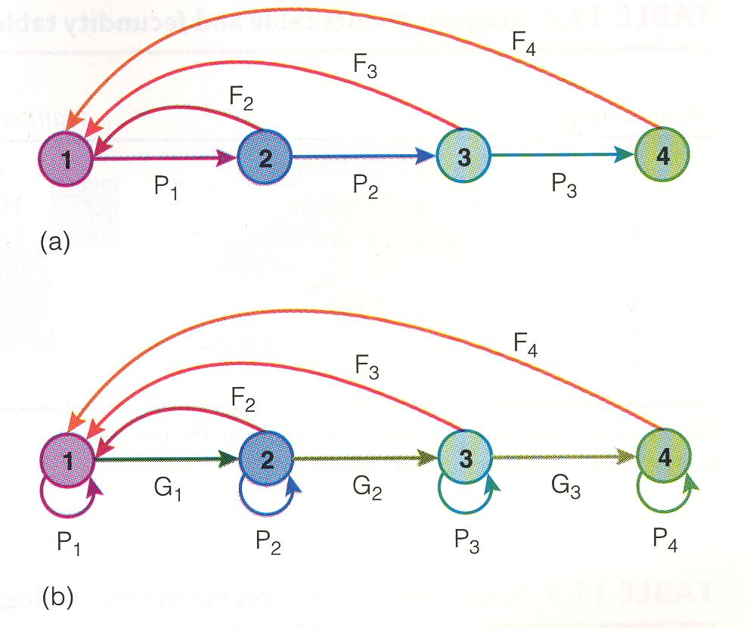
Age-based
transitions
NOT ON FIRST EXAM
Stage-based
transitions

Slide 15
II. Tools for Ecology
f. Stage-based Matrices
With a stage-based matrix (also called Lefkovitch matrix), you have more non-zero values across the matrix. The P values now represent the probability of staying in a stage class, while “G” values represent the probability of advancing to the next stage.
NOT ON FIRST EXAM

Slide 16
II. Tools for Ecology
A. Population demography: describing populations.
1. Definitions
2. Demography
a. distribution, dispersion, and density
b. gender and age
c. population growth
d. life tables (birth and death of age classes)
e. projecting population growth from life tables
f. Age and stage transition matrices
Age (Leslie) and stage based matrices are really powerful tools for ecologists and conservation biologists to use. One really cool thing we can do with these matrices is sensitivity analysis. This is used to see which part of the matrix most affect lambda (λ), the overall population growth rate. Basically, the analysis allows each value in the matrix to go up or down a little bit, then re-measure lambda.
NOT ON FIRST EXAM

Slide 17
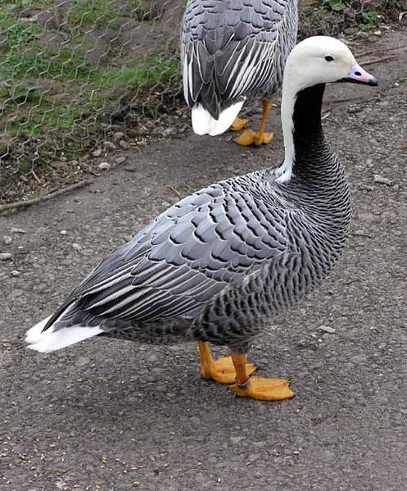
Sensitivity analysis is best explained using an example from Schmutz and pals on Emperor Geese. This bird breeds around the Bering Sea, including in Alaska and Kamchatka. It eats shoreline grasses and and other coastal plants. It showed severed declines in abundance in the 1960’s and is listed as “near threatened” by the International Union for the Conservation of Nature and Natural Resources (IUCN). This is the type of species that may be especially affected by global climate change.
NOT ON FIRST EXAM
The survival of hatchlings is low (0.136), but the survival from then on is relatively high (0.893). The fertility of 2-year birds is OK (0.639), but gets a little better for older birds (0.894).
What can we do with these 4 numbers?
Schmutz, J., R. Rockwell, and M. Petersen. 1997. Relative Effects of Survival and Reproduction on the Population Dynamics of Emperor Geese. Journal of Wildlife Management 61: 191-201.

Slide 18
Yep, let’s make a matrix.
-- Age or stage?
-- size of matrix?
-- Px values?
-- Fx values?
-- lambda?
NOT ON FIRST EXAM

Slide 19
The survival of hatchlings is low (0.136), but the survival from then on is relatively high (0.893). The fertility of 2-year birds is OK (0.639), but gets a little better for older birds (0.894).
Here is the Lefkovitch (stage-based) matrix.
NOT ON FIRST EXAM
 | 0 | 1 | 2 | 3
0 | 0 | 0 | 0.571 (0.64 x 0.89) | 0.798 (0.89 x 0.89)
1 | 0.136 | 0 | 0 | 0
2 | 0 | 0.893 | 0 | 0
3 | 0 | 0 | 0.893 | 0.893
And, if we take the eigenvalue, lambda = 0.989.
Is our population growing or declining?

Slide 20
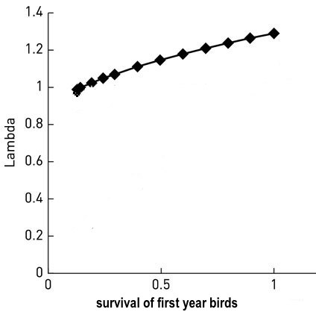
 | 0 | 1 | 2 | 3
0 | 0 | 0 | 0.571 | 0.798
1 | 0.136 | 0 | 0 | 0
2 | 0 | 0.893 | 0 | 0
3 | 0 | 0 | 0.893 | 0.893
NOT ON FIRST EXAM
Now, if we just take the survival of first year birds, what would be the effect of increasing this number on lambda, the population growth rate?
Well, the population growth rate increases . . . some.

Slide 21
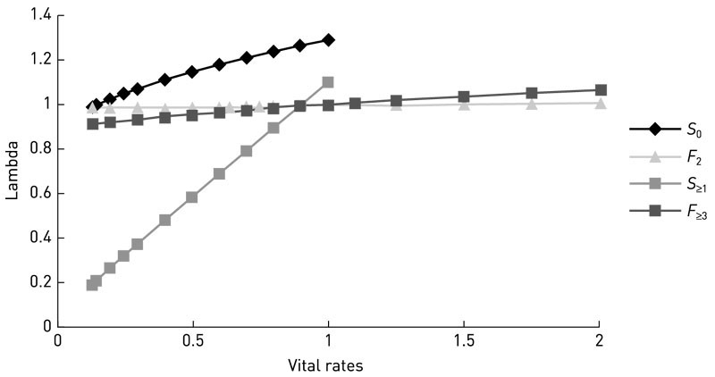
 | 0 | 1 | 2 | 3
0 | 0 | 0 | 0.571 | 0.798
1 | 0.136 | 0 | 0 | 0
2 | 0 | 0.893 | 0 | 0
3 | 0 | 0 | 0.893 | 0.893
NOT ON FIRST EXAM
juvenile survival
Here we have varied all the values in the table and then refigured λ.
Survival of the adults produces the greatest change, by far.
adult fertility
early fertility
adult survival

Slide 22
 | 0 | 1 | 2 | 3
0 | 0 | 0 | 0.571 | 0.798
1 | 0.136 | 0 | 0 | 0
2 | 0 | 0.893 | 0 | 0
3 | 0 | 0 | 0.893 | 0.893
NOT ON FIRST EXAM
This is one way to do a sensitivity analysis, which in this case uses the slopes of these lines as a measure of the sensitivity of the matrix values to any change. These can be very useful for managers or conservation biologists to make decisions about how to deal with either helping rare species or, perhaps, eliminating invasive species. They are also useful to ecologists for understanding where species occur and for evolutionary biologists to understand why different traits have evolved.

Slide 23
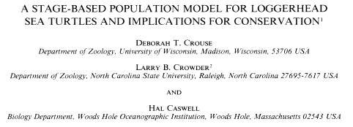
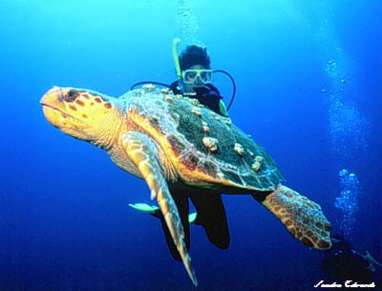
NOT ON FIRST EXAM
Crouse, Crowder, and Caswell, used Lefkovitch (stage-based matrices) to understand the population patterns in loggerhead sea turtles. In particular, they used the matrices to inform management decisions about this endangered species.

Slide 24
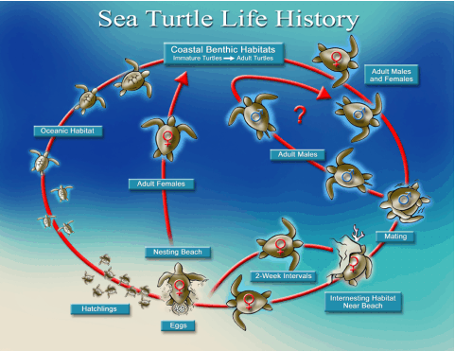
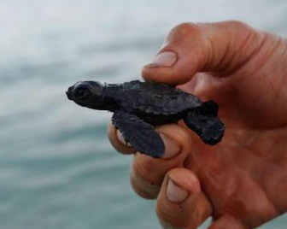
Loggerheads have a complex life cycle. The females nest on beaches in the U.S. Atlantic and Gulf of Mexico beaches. Young turtles crawl out of these nests at hatching and head for the water. They spend many years hiding out and growing. Loggerheads reach maturity at approximately 30 to 35 years of age. Adults do not nest every year. The average remigration interval (number of years between successive nesting years) is 2½ to 3 years. During a nesting season, loggerheads in the southeast United States lay between 1 and 7 clutches, but the average is approximately 4.
NOT ON FIRST EXAM

Slide 25
Crouse, et al., divided the life cycle of turtles up into seven stages. They searched the literature to get estimates of survival and reproduction in each stage.
NOT ON FIRST EXAM
They then used this information to create the standard stage-based matrix with F’s across the top and P’s representing transitions in appropriate places within the matrix.

Slide 26
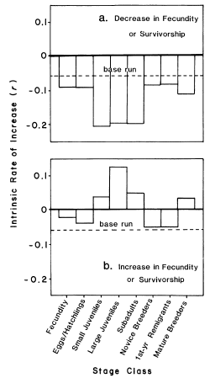
Figure 1, Crouse, et al. This uses a different way of doing a sensitivity analysis.
The top graph shows the effects of a 50% decrease in each of the seven stages, either survival or reproduction.
The bottom graph shows a 50% increase in reproduction or an increase in survival to 100% for each stage.
Both show that juveniles and sub-adults have the strongest responses to these simulated changes.
NOT ON FIRST EXAM

Slide 27
II. Tools for Ecology
A. Population demography: describing populations.
1. Definitions
2. Demography
B. Demography in the real world
1. Experiments testing density dependence
a. Eisenberg’s snails
b. Forester’s fish
2. Human Population Dynamics

Slide 28
II. Tools for Ecology
A. Population demography: describing populations.
1. Definitions
2. Demography
B. Demography in the real world
1. Experiments testing density dependence
a. Eisenberg’s snails
b. Forester’s fish
2. Human Population Dynamics
-- Is human population growth DD?
-- Is there a carrying capacity for the earth?
-- Are we nearing the K?
-- Do we expect environmental or demographic stochasticity?
-- Might we overshoot K because of time-lags? (demographic stochasticity)
-- What is likely to happen with the current trends?
-- What can be done?

Slide 29
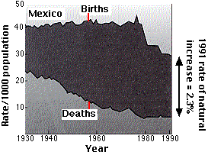
Remember my mantra -- everything can be reduced to births - deaths.
Consider the birth and death rates in Mexico over the past 70 years. This is a very typical pattern for a country shifting from third world to a country with a developing economy. Better nutrition, better health care, improved sanitation and widespread immunization have led to a rapid decline in death rates, but birth rates held constant or increase until1975. The growth rate in Mexico in 2015 is = 1.22 (% yearly change), which is quite high.

Slide 30
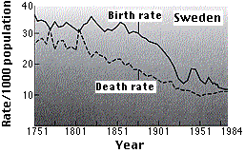
Compare this to a country like Sweden (note change in x scale), where the growth rate is now 0.63 and entirely due to migrants. Some European countries now have zero, or even negative population growth.
The shift from high birth and death rates to low birth as well as death rates is called a demographic transition, and is known to occur as countries develop more stable economies, which allows for better health care and education.
Many island countries also have negative growth rates, such as Cuba and Japan, for obvious reasons.

Slide 32
-- undeveloped countries have more recent changes, where birth rates often stay high or even increase, while death rates decline. This causes even higher population growth rates (i.e., r = b-d).
-- More developed countries had birth and death rates decline at the same time and over a longer time period., resulting in less effect on growth. Now, b are fairly close to d, such at r ~ 0.

Slide 34
Theoretically, when each pair of parents just replaces itself with 2 children (b = d, so r = 0.0 or R₀ = 1.0), the population should be stable. However, because some children will die before they grow up, the number is around 2.1 or 2.2 offspring. This number is called the replacement rate.
But, a replacement rate of 2.0 - 2.1 does not mean that a population will not grow, at least in the short term! You have to take into account the age structure of the population.

Slide 35
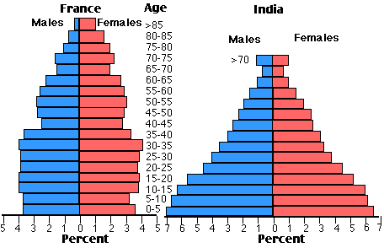
A comparison of a fairly typical developed country such as France, with a developing country such as India shows that the proportion of pre-reproductive individuals is much higher in India. In France, the percent of the population that is reproducing will stay constant, so that a replacement rate of 2.1 will result in zero population growth (ZPG). But, in India, that bolus of younger individuals still has yet to reproduce, meaning that the population will continue to grow for some time, even if the the replacement rate is near 2.0.

Slide 36
II. Tools for Ecology
A. Population demography: describing populations.
B. Population Regulation
1. Density dependence vs. independence
2. What is “regulated”?
3. Experiments in the real world
a. Forester’s fish
b. Eisenberg’s snails
4. Human Population Dynamics
-- Is human population growth DD? (yes)
-- Is there a carrying capacity for the earth?
-- Are we nearing the K?
-- Do we expect environmental or demographic stochasticity?
-- Might we overshoot K because of time-lags? (demographic stochasticity)
-- What is likely to happen with the current trends?
-- What can be done?

Slide 37
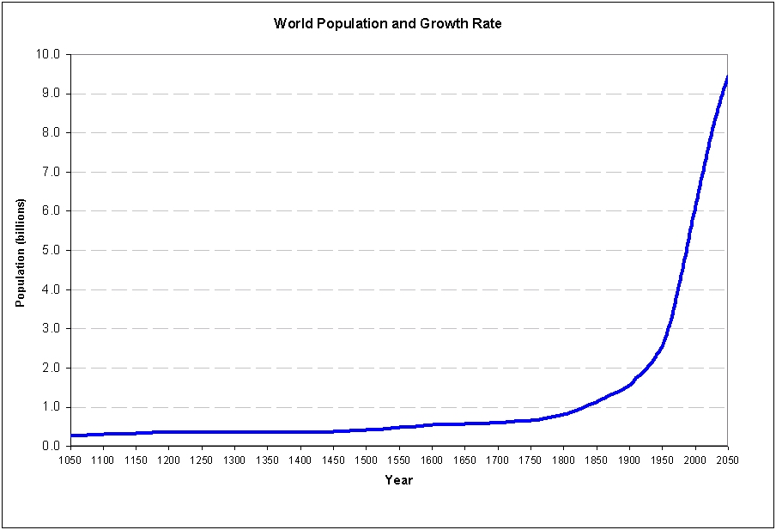
So, are we nearing K? Where is K?

Slide 38
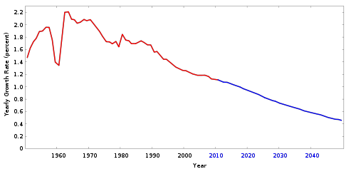
In the last 20 years, there has been a reduction in the global population growth rate. While the population is still increasing at a good clip, the rate at which it is increasing is declining.
From Wikipedia

Slide 39
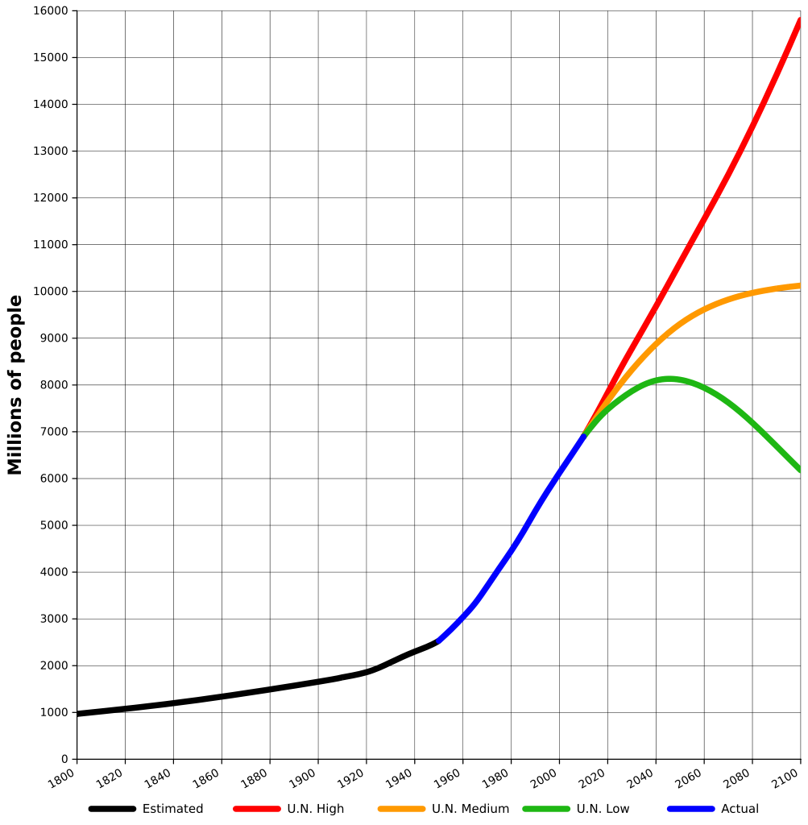
So, given that we are clearly not at K, is there at K?
Seems like there must be. But, it is moving as a function of food availability and resources and we can’t predict where it is.
From Wikipedia

Slide 40
An ecologist in the 1960’s, Paul Erlich, used reasonable assumptions to predict that human populations would very soon outstrip resources. The original edition of The Population Bomb (1968) began with this statement:
The battle to feed all of humanity is over. In the 1970s hundreds of millions of people will starve to death in spite of any crash programs embarked upon now. At this late date nothing can prevent a substantial increase in the world death rate ...
This was a well-accepted prediction in the 60’s. But, obviously, it did not occur.

Slide 41
It may be that Erlich was just a poor scientist, as has been suggested by several critics. Others argue that a large increase in global food production since the 1960s has prevented the famines and catastrophes foretold by Ehrlich. This is called the green revolution and was, in part, caused by the use use of modern methods and fertilizers in tropical agricultural.
Erlich argues that he was actually right. Millions have died of starvation and perhaps he even underestimated the effects of the “population bomb”.
But, most people feel that he failed and that he failed so dramatically that scientists are now reluctant to make strong statements from their data. They are reluctant to now make dire predictions about population growth, disease, and climate change.
The Green Revolution refers to a series of research, development, and technology initiatives, occurring between the 1930s and the late 1960s, that increased agricultural production worldwide, particularly in the developing world, beginning most markedly in the late 1960s. (from Wikipedia).

Slide 42
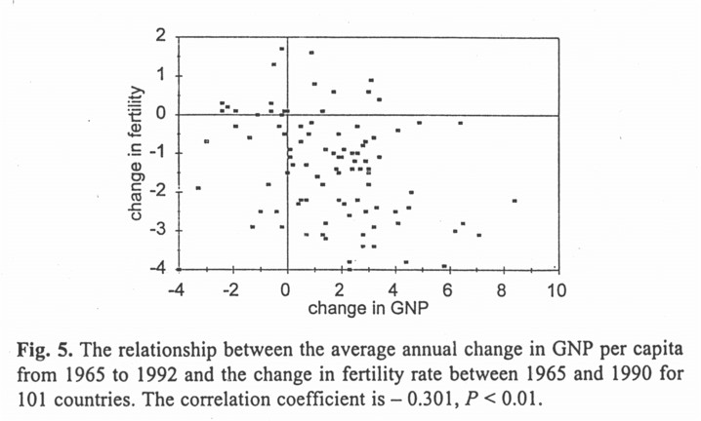
What affects human growth rate?
-- better economics? Give poor countries
money or technology?

Slide 43
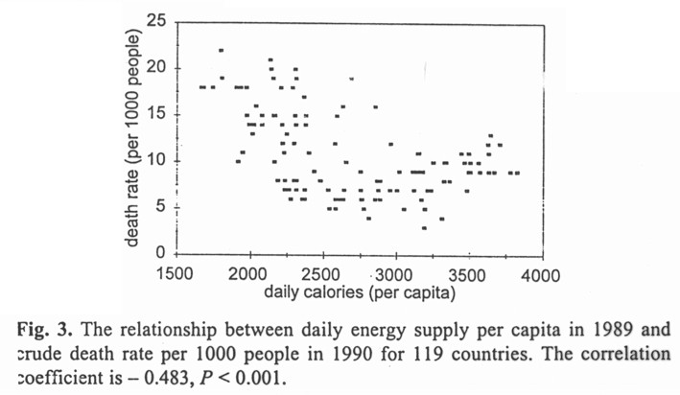
What affects human growth rate?
-- reduce hunger? Send food overseas?

Slide 44
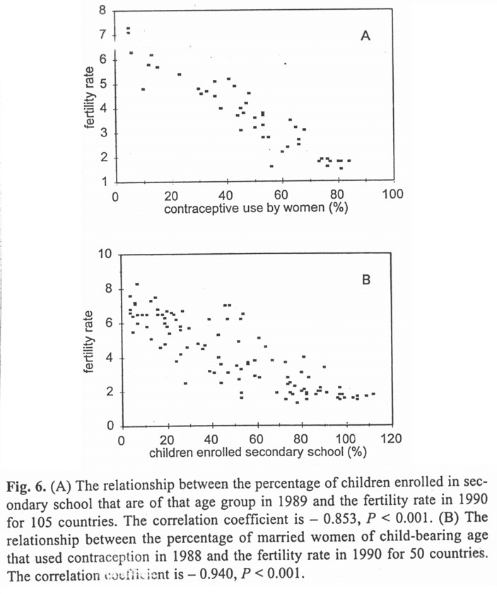
What affects human
growth rate?
-- contraception?
-- education?

Slide 45
II. Tools for Ecology
A. Population demography: describing populations.
B. Population Regulation
1. Density dependence vs. independence
2. What is “regulated”?
3. Tests in the real world
a. density experiments
b. human population growth
-- Is human population growth DD?
-- Is there a carrying capacity for the earth?
-- Are we nearing the K?
-- Do we expect environmental or demographic stochasticity?
-- Might we overshoot K because of time-lags? (demographic stochasticity)
-- What is likely to happen with the current trends?
-- What can be done?
Maybe recently
Must be!
Growth rate is slowing. . . so, maybe
Yes

Slide 46
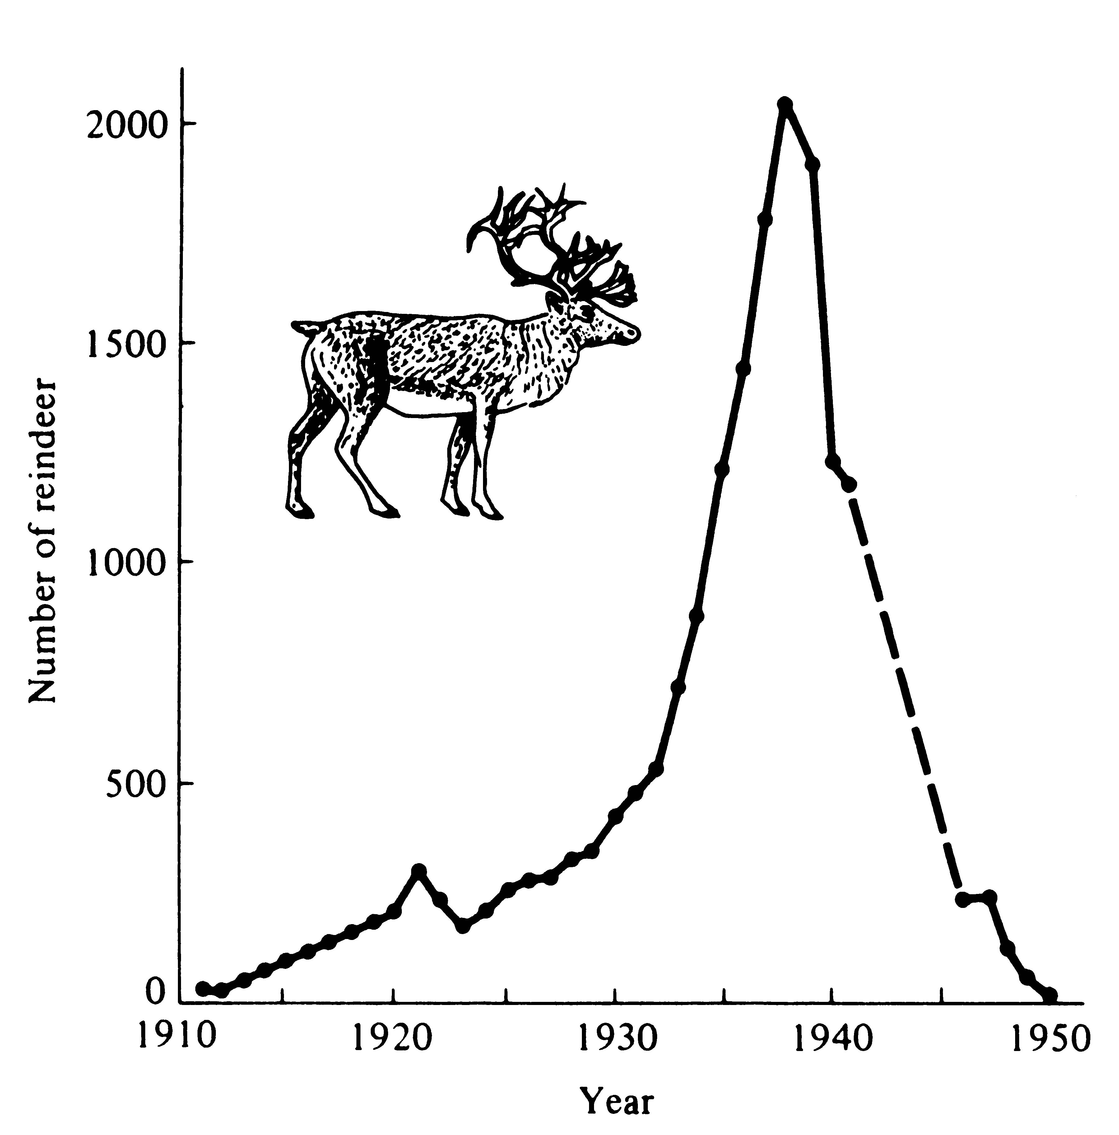
In 1911, 25 reindeer were introduced on Saint Paul Island off Alaska. The population grew rapidly and nearly exponentially until about 1938, when there were over 2000 animals on the 41-square-mile island. The reindeer badly overgrazed their food supply (primarily lichens) and the population “crashed.” Only eight animals could be found in 1950.

Slide 47
II. Tools for Ecology
A. Population demography: describing populations.
B. Population Regulation
1. Density dependence vs. independence
2. What is “regulated”?
3. Tests in the real world
a. density experiments
b. human population growth
-- Is human population growth DD?
-- Is there a carrying capacity for the earth?
-- Are we nearing the K?
-- Do we expect environmental or demographic stochasticity?
-- Might we overshoot K because of time-lags? (demographic stochasticity)
-- What is likely to happen with the current trends?
-- What can be done?
Maybe recently
Must be!
Growth rate is slowing. . . so, maybe
Yes
Maybe

Slide 48
-- What can be done?
Some economists (Sowell, Williams) argue that poverty and famine not directly caused by overpopulation, but are instead caused by bad government and bad economic policies. They note if you rank countries by population density, the poorest countries with the worst standards of living are not the most dense.
Economist Julian Simon similarly argues that higher population density leads to more specialization and technological innovation, which in turn leads to a higher standard of living.
Simon also claims that, when considering a list of countries ranked in order by population density, there is no correlation between population density and poverty and starvation. Instead, if a list of countries is considered according to corruption within their respective governments, there is a significant correlation between government corruption, poverty and famine.
From Wikipedia

Slide 49
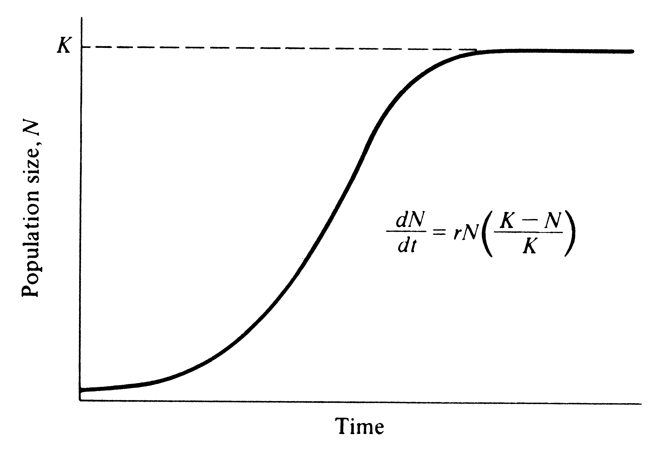
Where do you want to be on this curve?

Slide 50
Study Guide Items from Lecture 7
Terms:
Concepts:
Age vs. stage –based transition matrices
Lamda (the third growth rate) as the eigenvalue
Lambda vs. Ro vs. r
Sensitivity analysis
Past and predicted patterns in human population growth
Case Studies:
Schmuck’s sensitivity analysis with Emperor Geese
Crouse, Crowder and Caswell’s study of sea turtle conservation
Human population growth patterns
RED STUFF IS NOT ON FIRST EXAM
Population vector Lamda (λ, from eigenvalue) F_{x}, p_{x} Demographic transition Replacement rate | Age-based transition matrix Stage-based transition matrix Sensitivity analysis Zero population growth Green revolution
Notes:
50

