Slide 1
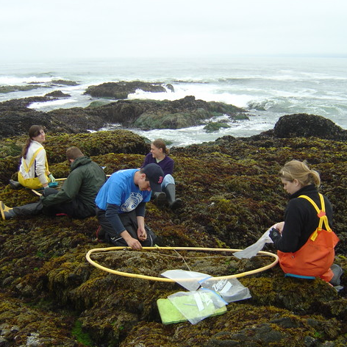
5th Lecture – September 20, 2016
-- Quiz maybe Thursday??
-- Read Forrester 1995 available on blackboard. This is a great example of applying the tools we have studied so far.
-- Assignment #2 is now posted. Because of Hermine, we haven’t covered all the information necessary to complete this assignment. So, the due date is moved back to Sept. 27.
-- The exam was Sept 27th! So, let’s move that back to Sept. 29th. First exam delayed one class!
Two talks by Dr. John J. Stachowicz, Professor of Evolution and Ecology, University of California.
Thursday, September 22, 4:00 pm, 1024 KIN—BIOLOGICAL SCIENCE COLLOQUIUM, "From species and genotypes to traits: the evolution of the diversity - ecosystem functioning paradigm?,”
Friday, September 23, 4:00 pm, 1024 KIN—ECOLOGY AND EVOLUTION SEMINAR, "‘Ecological fitting’: lessons for and from the invasion of marine invertebrate communities,”

Slide 2
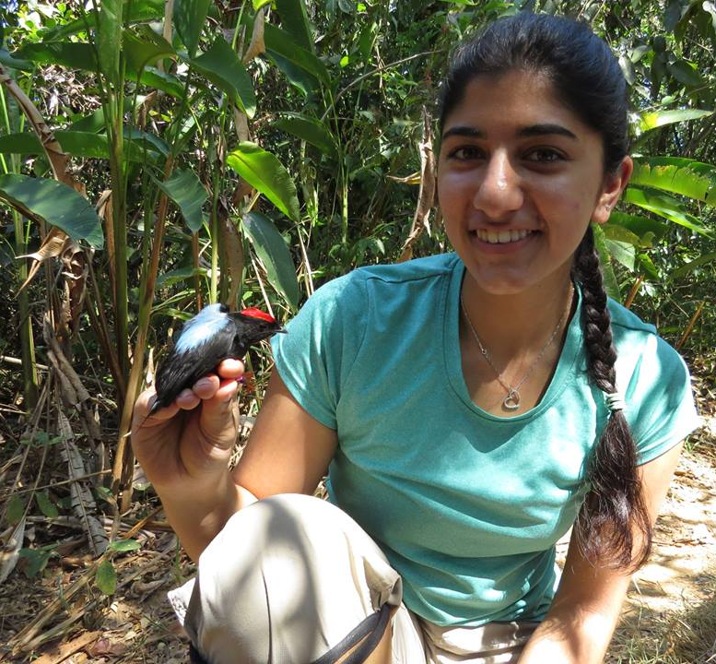
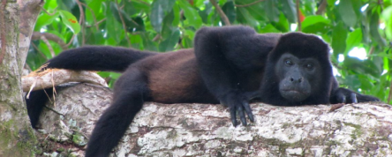
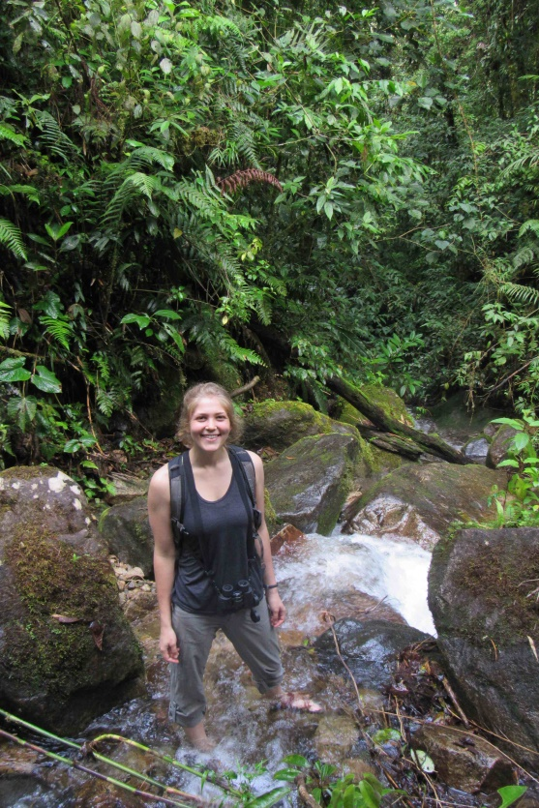
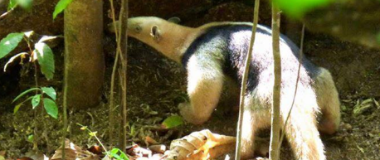
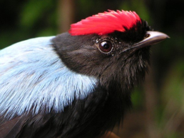

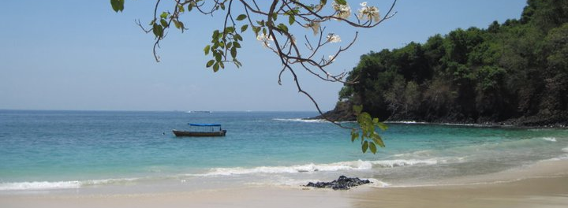
Tropical Behavioral Ecology Field Program in Panama
May 11 – June 7, 2017 Scholarships available!
Information Session: Thursday September 22, 3-4 PM, KIN 2057
Questions?
Emily DuVal (ehduval@bio.fsu.edu) or Kevin Dixon (dixon@bio.fsu.edu)

Slide 3
National Public Lands Day will be celebrated from 9am-12pm at Alfred B. Maclay Gardens State Park next Saturday, September 24th.
If you have not pre-registered, we would highly encourage you do so to make sure there is enough food for everyone. You may RSVP with the ranger station at 850-487-4556. If you’ve already signed up then thank you so much! Were excited and looking forward to the event.
Make sure to bring closed toe shoes, long pants, a water bottle, and a great attitude! Again, we appreciate your help and will see you next Saturday.

Slide 4
II. Tools for Ecology
A. Population demography: describing populations.
1. Definitions
2. Demography
a. distribution, dispersion, and density
b. gender and age
c. population growth and regulation
i) density independent growth (exponential)
ii) density dependent growth (logistic)
d. life tables (birth and death of age classes)
i) age groups - x
ii) survivorship (opposite of death rate)
iii) m_{x}, average births per individual age x.
iv) l_{x}m_{x},

Slide 5
II. Tools for Ecology
A. Population demography: describing populations.
1. Definitions
2. Demography
a. distribution, dispersion, and density
b. gender and age
c. population growth
i) density independent growth (exponential)
ii) density dependent growth (logistic)
d. life tables (birth and death of age classes)
i) age groups - x
ii) survivorship (opposite of death rate)
iii) m_{x}, average births per individual age x.
iv) l_{x}m_{x},

Slide 6
Simple life table example. Imagine cockroaches in your house that live 4 weeks, maximum. Due to various causes, 80% die each week. A few reproduce in their 3rd week of life, but most reproduce in their 4th week, when each pair of cockroaches produces 200 offspring.
Time (weeks) | x (age) | p_{x} | l_{x} | m_{x} | l_{x}m_{x}
1st | 0 | 0.2 | 1.0 | 0 | 0
2nd | 1 | 0.2 | 0.2 | 0 | 0
3rd | 2 | 0.2 | 0.04 | 5 | 0.2
4th | 3 | 0.0 | 0.008 | 100 | 0.8
5th | 4 | 0 | 0 | --
Notes:
We are going to spend a fair amount of time on life-tables, and so it is important that you understand them. You will be required to work with life tables on at least 2 of the 3 exams. They are a very powerful way of describing populations.

Slide 7
II. Tools for Ecology
A. Population demography: describing populations.
1. Definitions
2. Demography
a. distribution, dispersion, and density
b. gender and age
c. population growth
d. life tables (birth and death of age classes)
i) age groups - x
ii) survivorship (opposite of death rate or mortality)
iii) m_{x}, average births per individual age x.
iv) l_{x}m_{x},
p_{x} is the probability of surviving from x to x+1. In other words, it is the probability that an individual will survive during time interval x.

Slide 8
Simple life table example. Imagine cockroaches in your house that live 4 weeks, maximum. Due to various causes, 80% die each week. A few reproduce in their 3rd week of life, but most reproduce in their 4th week, when each pair of cockroaches produces 200 offspring.
Time (weeks) | x | p_{x} | l_{x} | m_{x} | l_{x}m_{x}
1st | 0 | 0.2 | 1.0 | 0 | 0
2nd | 1 | 0.2 | 0.2 | 0 | 0
3rd | 2 | 0.2 | 0.04 | 5 | 0.2
4th | 3 | 0.0 | 0.008 | 100 | 0.8
5th | 4 | 0 | 0 | --
Notes:
We are going to spend a fair amount of time on life-tables, and so it is important that you understand them. You will be required to work with life tables on at least 2 of the 3 exams. They are a very powerful way of describing populations.

Slide 9
II. Tools for Ecology
A. Population demography: describing populations.
1. Definitions
2. Demography
a. distribution, dispersion, and density
b. gender and age
c. population growth
d. life tables (birth and death of age classes)
i) age groups - x
ii) survivorship (opposite of death rate)
iii) m_{x}, average births per individual age x.
iv) l_{x}m_{x},
We also keep track of cumulative survival, which is a different measure. For survivorship, we use the term l_{x} which is the probability of surviving from birth to the beginning of age class x.

Slide 10
Simple life table example. Imagine cockroaches in your house that live 4 weeks, maximum. Due to various causes, 80% die each week. A few reproduce in their 3rd week of life, but most reproduce in their 4th week, when each pair of cockroaches produces 200 offspring.
Time (weeks) | x | p_{x} | l_{x} | m_{x} | l_{x}m_{x}
1st | 0 | 0.2 | 1.0 | 0 | 0
2nd | 1 | 0.2 | 0.2 | 0 | 0
3rd | 2 | 0.2 | 0.04 | 5 | 0.2
4th | 3 | 0.0 | 0.008 | 100 | 0.8
5th | 4 | 0 | 0 | --
Notes:
We are going to spend a fair amount of time on life-tables, and so it is important that you understand them. You will be required to work with life tables on at least 2 of the 3 exams. They are a very powerful way of describing populations.

Slide 11
Time (weeks) | x | p_{x} | l_{x} | m_{x} | l_{x}m_{x}
1st | 0 | 0.2 | 1.0 | 0 | 0
2nd | 1 | 0.2 | 0.2 | 0 | 0
3rd | 2 | 0.2 | 0.04 | 5 | 0.2
4th | 3 | 0.0 | 0.008 | 100 | 0.8
5th | 4 | 0 | 0 | --
Notes:
Note that I dropped the age 4 = 0 group because the log of 0 is not defined.

Slide 12
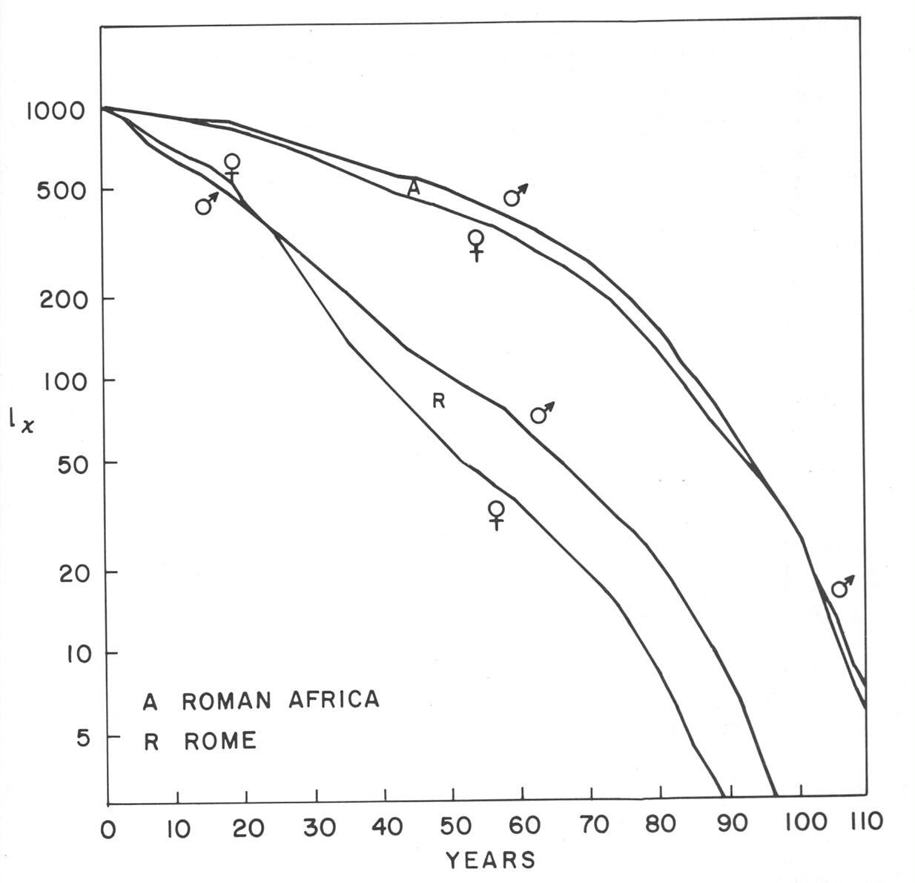
Survivorship curves for the city of Rome and the Roman province of Africa, mostly from about the 4th century.
The great age of individuals from the provinces may be due to the use of a very different calendar.
Note two cross-over points. Females tend to have higher mortality during childbirth years. However, females tend to live longer.

Slide 13
Survivorship curves can be confusing because the y axis may be plotted in several different ways. For example, the y axis may be actual numbers of individuals or proportions (this won’t affect the shape of the curve). Or, even more confusing, the y axis may be either log transformed or on a log scale -- this does change the shape!

Slide 14
II. Tools for Ecology
A. Population demography: describing populations.
1. Definitions
2. Demography
a. distribution, dispersion, and density
b. gender and age
c. population growth
d. life tables (birth and death of age classes)
1) age groups - x
2) survivorship (opposite of death rate)
3) m_{x}, average births per individual age x.
4) l_{x}m_{x}
5) R₀ and G
e. projecting population growth from life tables

Slide 15
Survivorship curves for the city of Rome and the Roman province of Africa, mostly from about the 4th century.
The great age of individuals from the provinces may be due to the use of a very different calendar.
Note two cross-over points. Females tend to have higher mortality during childbirth years. However, females tend to live longer.

Slide 16
We noted that survivorship curves can be drawn in different ways, depending on the scale of the y-axis. Be careful when you look at survivorship curves.
One reason for using log-scales is that they easily separate species into Type I, II, and III survivorship curves. Type II is constant probability of death (or survival) across age classes.

Slide 17
When survivorship curves are plotted on a log-scale, they can roughly be divided into three groups based on the shape of the curve.
Type 1 curves exhibit high juvenile survival and are common for mammals.
Type 2 curves have a constant probability of death and are common for birds.
Type 3 curves show low juvenile survival and are common for insects and fish.
Notes:
Discuss how these are correlated with parental care, number of offspring, offspring size, etc.

Slide 18
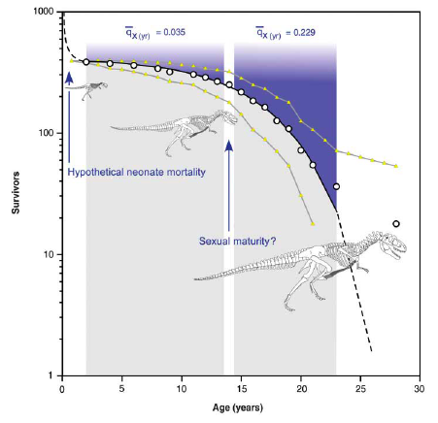
II. Tools for Ecology
Remember that we are emphasizing methods that allow us to describe and compare different populations.
Survivorship curves can tell us a lot about different populations.
North American tyrannosaur survivorship curve from Erickson et al. 2006. Science 213:313

Slide 19
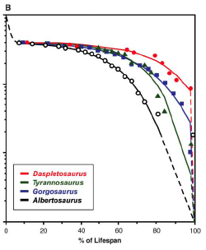
II. Tools for Ecology
Remember that we are emphasizing methods that allow us to describe and compare different populations.
North American tyrannosaur survivorship curve from Erickson et al. 2006. Science 213:313
Notes:
We can also compare different dinosaurs and begin to ask if this type of a survival curve is common, at least for all these larger meat-eating types.

Slide 20
There are two ways to get the data for life tables.
Cohort life tables are constructed by following an even age group (such as all the eggs in nests from one year) throughout their entire life. At any point in time, they are all the same age.
Static life tables are constructed by following all individuals a sample of a population, presumably representing all the different possible ages, for a short period of time.
Notes:
We can also compare different dinosaurs and begin to ask if this type of a survival curve is common, at least for all these larger meat-eating types.

Slide 21
Dr. Erickson used fossil teeth to decide the age of the dinosaurs, then make a survivorship curve (cohort or static?). You get to directly determine age of death from headstones for the assignment. How do you get a survivorship curve from this data?
name | born | died | age
Albert Camus | 1913 | 1960 | 47
Paul Auster | 1947 | 2014 | 67
J. G. Ballard | 1930 | 2009 | 69
Thomas Pynchon | 1937 | 2014 | 77
Juan Rulfo | 1917 | 1986 | 69
Franz Kafka | 1883 | 1924 | 41
Fyodor Dostoyevsky | 1821 | 1881 | 60
Julio Cortázar | 1914 | 1984 | 70
William Faulkner | 1897 | 1962 | 65
Jorge Luis Borges | 1899 | 1986 | 87
Notes:
Modern 20th century writers. Camus, algerian aburdist; Auster is american absurdist, not dead yet!; Ballard, british, Crash, new wave author, sexually aroused by staging and participating in real car-crashes; Pynchon, American horrible writer, “Gravity’s Rainbow”, not dead; Rulfo, “El llano de llamas”, Mexican; Kafka, Austrian, “The metamorphosis”; Dostoyevsky, Russian, pacifist, “Crime and Punishment”; Cortazar, Argentinian, mostly short stories, such as “Las Babas del Diablo” (the devil’s drool); Faulkner, southern US writer, “The sound and the fury”; Borges, start of magical realism, Argentinian.

Slide 22
Let’s consider an example of great 20th century authors.
So, here are our ages at death: 41,47,60,67,65,69,69,70,77,87
Age class (x) | #die | #alive | l_{x}
0 to 10
10 to 20
20 to 30
30 to 40
40 to 50
50 to 60
60 to 70
70 to 80
80 to 90
Lets do the l_{x}
for the life table:

Slide 23
Let’s consider an example of great 20th century authors.
So, here are our ages at death: 41,47,60,67,65,69,69,70,77,87
Age class (x) | #die | #alive | l_{x}
0 to 10 | 0
10 to 20 | 0
20 to 30 | 0
30 to 40 | 0
40 to 50 | 2
50 to 60 | 0
60 to 70 | 5
70 to 80 | 2
80 to 90 | 1
Lets do the l_{x}
for the life table:

Slide 24
Let’s consider an example of great 20th century authors.
So, here are our ages at death: 41,47,60,67,65,69,69,70,77,87
Age class (x) | #die | #alive | l_{x}
0 to 10 | 0 | 10
10 to 20 | 0 | 10
20 to 30 | 0 | 10
30 to 40 | 0 | 10
40 to 50 | 2 | 10
50 to 60 | 0 | 8
60 to 70 | 5 | 8
70 to 80 | 2 | 3
80 to 90 | 1 | 1
Lets do the l_{x}
for the life table:

Slide 25
Let’s consider an example of great 20th century authors.
So, here are our ages at death: 41,47,60,67,65,69,69,70,77,87
Age class (x) | #die | #alive | l_{x}
0 to 10 | 0 | 10 | 1.0
10 to 20 | 0 | 10 | 1.0
20 to 30 | 0 | 10 | 1.0
30 to 40 | 0 | 10 | 1.0
40 to 50 | 2 | 10 | 1.0
50 to 60 | 0 | 8 | 0.8
60 to 70 | 5 | 8 | 0.8
70 to 80 | 2 | 3 | 0.3
80 to 90 | 1 | 1 | 0.1
Lets do the l_{x}
for the life table:

Slide 26
This should be some help for completing the first assignment. Here are survivorship curves for our “famous” authors.

Slide 27
And, here are the same curves, except that the curve on the right is now log (lx * 1000), which is a common way to put curves for many species.

Slide 28
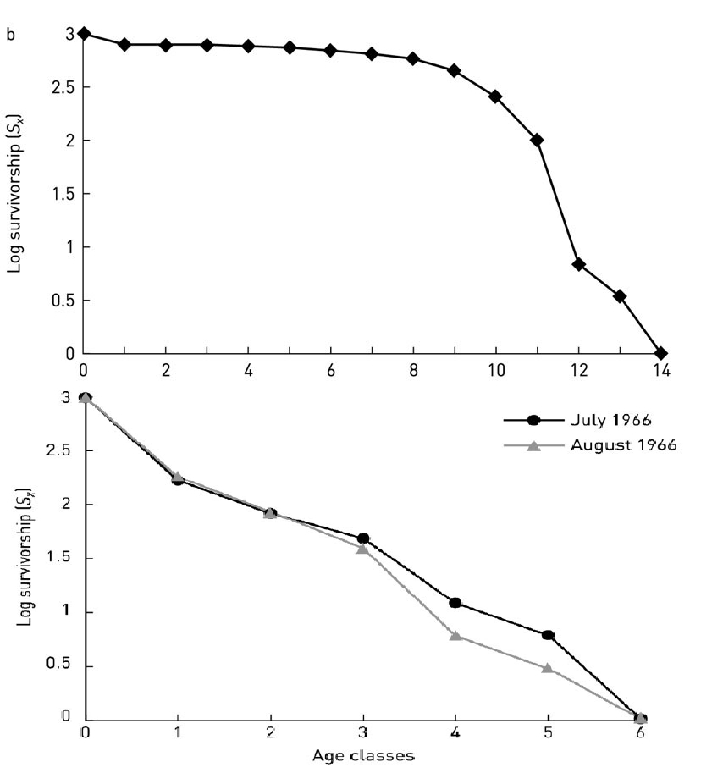
Do type I, II, and III survivorship curves really occur in nature? Yes, but they represent a gradient and there are many exceptions.
Here is a classic type I survivorship curve for Dall sheep (top) and type II curves for two cohorts of white-crowned sparrows (bottom).

Slide 29
Watch the axes carefully! I found an example of gray squirrels described as a type III survivorship curve. The graph on the left was given by the authors and shows the right shape for a Type III curve – but it isn’t on the correct scale! When graphed on a log scale, we do see kind of the correct shape, but it is weak – looks more like type II to me.

Slide 30
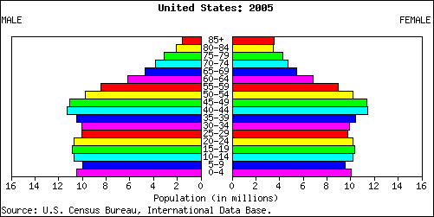
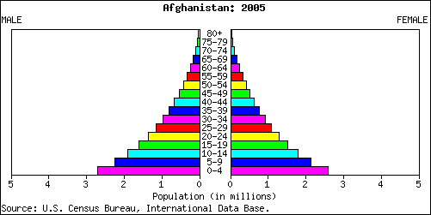
Hey, remember these? Now we can understand these bars and how they are created by different age-specific patterns of survival. Each bar is determined by the number of individuals that survive from the previous cohort.
What about the bottom bar? This shows the reproduction from the other bars.

Slide 31
Note that we are essentially using methods common to the insurance industry. Looking at age-specific death rates is the basis for life-insurance, where you are betting an insurance company that you are going to die soon (weird logic!).
So, now we want to look at age specific reproduction, as well as survival.
I have a textbook with an example of an island breaking off California with several thousand people surviving. They could be there either for a concert by some boy pop star (lots of teenage girls) or an AARP convention. Obviously, there would be effects be on the growth of any surviving population.
This is why it is important to take into account the age and sex structure of populations.

Slide 32
II. Tools for Ecology
A. Population demography: describing populations.
1. Definitions
2. Demography
a. distribution, dispersion, and density
b. gender and age
c. population growth
d. life tables (birth and death of age classes)
1) age groups - x
2) l_{x}, survivorship (opposite of death rate)
3) m_{x}, average births per individual age x.
4) l_{x}m_{x}

Slide 33
For example, here is the survivorship (l_{x}) and birth rates (m_{x})of women in the United States over the last 40 years
 | lx (survivorship) |  |  |  | mx (birth rates)
age class | 1973 | 1989 | 1996 | 2006 | 1973 | 1989 | 1996 | 2006
0-9 | 0.982 | 0.99 | 0.993 | 0.996 | 0.000 | 0.000 | 0.000 | 0.000
10-14 | 0.98 | 0.988 | 0.992 | 0.993 | 0.003 | 0.002 | 0.003 | 0.002
15-19 | 0.977 | 0.986 | 0.991 | 0.992 | 0.140 | 0.123 | 0.137 | 0.109
20-24 | 0.974 | 0.983 | 0.988 | 0.990 | 0.286 | 0.264 | 0.280 | 0.260
25-29 | 0.97 | 0.98 | 0.986 | 0.987 | 0.269 | 0.277 | 0.285 | 0.286
30-34 | 0.966 | 0.977 | 0.983 | 0.985 | 0.133 | 0.181 | 0.211 | 0.234
35-39 | 0.959 | 0.971 | 0.979 | 0.981 | 0.052 | 0.065 | 0.089 | 0.107
40-44 | 0.949 | 0.964 | 0.973 | 0.976 | 0.013 | 0.013 | 0.017 | 0.021
45-49 | 0.934 | 0.953 | 0.964 | 0.968 | 0.001 | 0.005 | 0.001 | 0.001
50+ | -- | -- | -- | -- | 0.000 | 0.000 | 0.000 | 0.000
Note that l₀ is not 1.0! In this case, they lumped together the 0-4 and 5-9 age classes, and so averaged the first two l_{x} values.

Slide 34
Simple life table example. Imagine cockroaches in your house that live 4 weeks, maximum. Due to various causes, 80% die each week. A few pair off and reproduce (averaging 5 babies per couple) in their 3rd week of life, but most reproduce in their 4th week, when each pair of cockroaches produces 200 offspring.
Time (weeks) | x | p_{x} | l_{x} | m_{x} | l_{x}m_{x}
1st | 0 | 0.2 | 1.0 | 0 | 0
2nd | 1 | 0.2 | 0.2 | 0 | 0
3rd | 2 | 0.2 | 0.04 | 2.5 | 0.1
4th | 3 | 0.0 | 0.008 | 100 | 0.8
5th | 4 | 0 | 0 | --
Notes:
We are going to spend a fair amount of time on life-tables, and so it is important that you understand them. You will be required to work with life tables on at least 2 of the 3 exams. They are a very powerful way of describing populations.

Slide 35
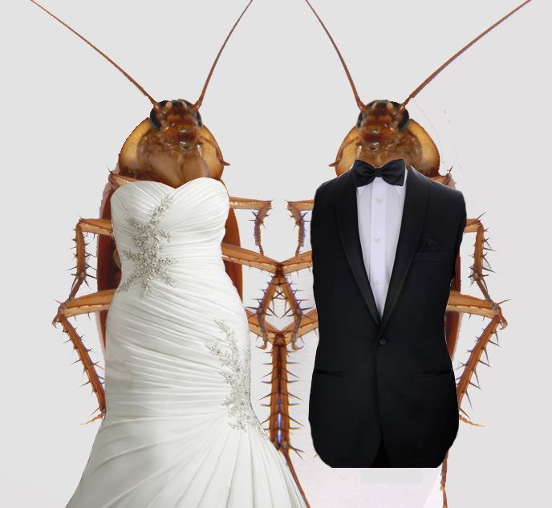
Cockroaches pairing off . . . . legally
Notes:
We are going to spend a fair amount of time on life-tables, and so it is important that you understand them. You will be required to work with life tables on at least 2 of the 3 exams. They are a very powerful way of describing populations.

Slide 36
Simple life table example. Imagine cockroaches in your house that live 4 weeks, maximum. Due to various causes, 80% die each week. A few pair off and reproduce (averaging 5 babies per couple) in their 3rd week of life, but most reproduce in their 4th week, when each pair of cockroaches produces 200 offspring.
Time (weeks) | x | p_{x} | l_{x} | m_{x} | l_{x}m_{x}
1st | 0 | 0.2 | 1.0 | 0 | 0
2nd | 1 | 0.2 | 0.2 | 0 | 0
3rd | 2 | 0.2 | 0.04 | 2.5 | 0.1
4th | 3 | 0.0 | 0.008 | 100 | 0.8
5th | 4 | 0 | 0 | --
Notes:
We are going to spend a fair amount of time on life-tables, and so it is important that you understand them. You will be required to work with life tables on at least 2 of the 3 exams. They are a very powerful way of describing populations.

Slide 37
Note that we now have birth rates and death rates for our population, but as age-specific numbers. Can we use this to figure out if our population is growing or declining?
Of course we can! The birth rate is a function of individuals surviving to reproduce X how much they reproduce if they survive.
Time (weeks) | x | p_{x} | l_{x} | m_{x} | l_{x}m_{x}
1st | 0 | 0.2 | 1.0 | 0 | 0
2nd | 1 | 0.2 | 0.2 | 0 | 0
3rd | 2 | 0.2 | 0.04 | 2.5 | 0.1
4th | 3 | 0.0 | 0.008 | 100 | 0.8
5th | 4 | 0 | 0 | --
Notes:
We are going to spend a fair amount of time on life-tables, and so it is important that you understand them. You will be required to work with life tables on at least 2 of the 3 exams. They are a very powerful way of describing populations.

Slide 38
II. Tools for Ecology
A. Population demography: describing populations.
1. Definitions
2. Demography
a. distribution, dispersion, and density
b. gender and age
c. population growth
d. life tables (birth and death of age classes)
1) age groups - x
2) l_{x}, survivorship (opposite of death rate)
3) m_{x}, average births per individual age x.
4) l_{x}m_{x}

Slide 39
We can actually get the population growth rate directly from a life table. The l_{x}m_{x} for each age group tells us the reproductive contribution of each age group, weighted by the probably of surviving to reproduce. If we add up all these, it tell us the population growth rate. In fact, it gives us our old friend R₀:
R₀ = sum of l_{x}m_{x}

Slide 40
Simple life table example. Imagine cockroaches in your house that live for 4 weeks, maximum. Due to various causes, 80% die each week (20% survive). A few reproduce in their 3rd week of life averaging 5 babies per pair, but most reproduce in their 4th week, when each pair of cockroaches produces 200 offspring.
Time (weeks) | x | l_{x} | m_{x} | l_{x}m_{x}
1st | 0 | 1.0 | 0 | 0
2nd | 1 | 0.2 | 0 | 0
3rd | 2 | 0.04 | 2.5 | 0.1
4th | 3 | 0.008 | 100 | 0.8
5th | 4 | 0 | --
Sum of the l_{x}m_{x} = 0.9
Notes:
We are going to spend a fair amount of time on life-tables, and so it is important that you understand them. You will be required to work with life tables on at least 2 of the 3 exams. They are a very powerful way of describing populations.

Slide 41
We can use l_{x} and m_{x} to estimate the population growth rate for humans in 2006 by getting R₀
age class | lx | mx | lxmx
0-9 | 0.996 | 0.000 | 0.000
10-14 | 0.993 | 0.002 | 0.002
15-19 | 0.992 | 0.109 | 0.108
20-24 | 0.990 | 0.260 | 0.257
25-29 | 0.987 | 0.286 | 0.283
30-34 | 0.985 | 0.234 | 0.230
35-39 | 0.981 | 0.107 | 0.105
40-44 | 0.976 | 0.021 | 0.021
45-49 | 0.968 | 0.001 | 0.001
50+ | -- | 0.000 | 0.000
The sum of l_{x}m_{x} = R₀
In this case,
R₀ = 1.007
Note that this is a per-generation growth rate! So, unless you know how long a generation is, you don’t really know how fast the population is growing in real time.

Slide 42
Here is R₀ for the period of 1973 to 2006.
 | lx (survivorship) |  |  |  | mx (birth rates)
age class | 1973 | 1989 | 1996 | 2006 | 1973 | 1989 | 1996 | 2006
0-9 | 0.982 | 0.99 | 0.993 | 0.996 | 0.000 | 0.000 | 0.000 | 0.000
10-14 | 0.98 | 0.988 | 0.992 | 0.993 | 0.003 | 0.002 | 0.003 | 0.002
15-19 | 0.977 | 0.986 | 0.991 | 0.992 | 0.140 | 0.123 | 0.137 | 0.109
20-24 | 0.974 | 0.983 | 0.988 | 0.990 | 0.286 | 0.264 | 0.280 | 0.260
25-29 | 0.97 | 0.98 | 0.986 | 0.987 | 0.269 | 0.277 | 0.285 | 0.286
30-34 | 0.966 | 0.977 | 0.983 | 0.985 | 0.133 | 0.181 | 0.211 | 0.234
35-39 | 0.959 | 0.971 | 0.979 | 0.981 | 0.052 | 0.065 | 0.089 | 0.107
40-44 | 0.949 | 0.964 | 0.973 | 0.976 | 0.013 | 0.013 | 0.017 | 0.021
45-49 | 0.934 | 0.953 | 0.964 | 0.968 | 0.001 | 0.005 | 0.001 | 0.001
50+ | -- | -- | -- | -- | 0.000 | 0.000 | 0.000 | 0.000
 |  |  |  | R0 = | 0.871 | 0.911 | 1.008 | 1.007

Slide 43
II. Tools for Ecology
A. Population demography: describing populations.
1. Definitions
2. Demography
a. distribution, dispersion, and density
b. gender and age
c. population growth
d. life tables (birth and death of age classes)
1) age groups - x
2) survivorship (opposite of death rate)
3) m_{x}, average births per individual age x.
4) l_{x}m_{x}
Life tables allow us to take age or sex structure into account when studying population growth. It also allows us to see what ages or genders are more important for population growth, which can obviously be important for population management or conservation.

Slide 44
II. Tools for Ecology
A. Population demography: describing populations.
1. Definitions
2. Demography
a. distribution, dispersion, and density
b. gender and age
c. population growth
d. life tables (birth and death of age classes)
1) age groups - x
2) survivorship (opposite of death rate)
3) m_{x}, average births per individual age x.
4) l_{x}m_{x}
5) R₀ and G

Slide 45
We have already used R: N_{t+1} = N_{t} x R₀
R₀ = the net reproductive rate (it is the same multiplicative growth rate we have already discussed.)
= mean number of female offspring produced per female per generation
= Σ l_{x}m_{x}
As before, it is multiplicative – if it is 1, the population size is stable.
G = generation time
= mean age of mothers at the time of their mean daughter’s birth
= Σ xl_{x}m_{x} / R₀

Slide 46
Simple life table example. Imagine cockroaches in your house that live for 4 weeks, maximum. Due to various causes, 80% die each week. A few reproduce in their 3rd week of life averaging 10 babies per pair, but most reproduce in their 4th week, when each pair of cockroaches produces 200 offspring.
Time (weeks) | x | l_{x} | m_{x} | l_{x}m_{x} | xl_{x}m_{x}
1st | 0 | 1.0 | 0 | 0 | 0
2nd | 1 | 0.2 | 0 | 0 | 0
3rd | 2 | 0.04 | 2.5 | 0.1 | 0.2
4th | 3 | 0.008 | 100 | 0.8 | 2.4
5th | 4 | 0 | --
R₀ = 0.9
Σxl_{x}m_{x} = 2.6
so, G = 2.89
Notes:
We are going to spend a fair amount of time on life-tables, and so it is important that you understand them. You will be required to work with life tables on at least 2 of the 3 exams. They are a very powerful way of describing populations.

Slide 47
Here is R₀ for the period of 1973 to 2006.
 | lx (survivorship) |  |  |  | mx (birth rates)
age class | 1973 | 1989 | 1996 | 2006 | 1973 | 1989 | 1996 | 2006
0-9 | 0.982 | 0.99 | 0.993 | 0.996 | 0.000 | 0.000 | 0.000 | 0.000
10-14 | 0.98 | 0.988 | 0.992 | 0.993 | 0.003 | 0.002 | 0.003 | 0.002
15-19 | 0.977 | 0.986 | 0.991 | 0.992 | 0.140 | 0.123 | 0.137 | 0.109
20-24 | 0.974 | 0.983 | 0.988 | 0.990 | 0.286 | 0.264 | 0.280 | 0.260
25-29 | 0.97 | 0.98 | 0.986 | 0.987 | 0.269 | 0.277 | 0.285 | 0.286
30-34 | 0.966 | 0.977 | 0.983 | 0.985 | 0.133 | 0.181 | 0.211 | 0.234
35-39 | 0.959 | 0.971 | 0.979 | 0.981 | 0.052 | 0.065 | 0.089 | 0.107
40-44 | 0.949 | 0.964 | 0.973 | 0.976 | 0.013 | 0.013 | 0.017 | 0.021
45-49 | 0.934 | 0.953 | 0.964 | 0.968 | 0.001 | 0.005 | 0.001 | 0.001
50+ | -- | -- | -- | -- | 0.000 | 0.000 | 0.000 | 0.000
 |  |  |  | R0 = | 0.871 | 0.911 | 1.008 | 1.007
 |  |  |  | G = | 25.8 | 26.7 | 26.9 | 27.6
Get away from the equations and think about what the generation time really means. Does these numbers seem appropriate?

Slide 48
Remember we are using these to more accurately describe populations. So, here is a new life table. What can we discern about this population?
-- What type of survivorship curve is this?
-- When does the species reproduce?
-- Is the population growing? How fast?
-- What is the generation time?
(seems to be II)
(mostly at Age 1)
(yes, 1.22)
(= 1.5/1.22 = 1.24)
Age, x | p_{x} | l_{x} | m_{x} | l_{x}m_{x} | xl_{x}m_{x}
0 | 0.4 | 1.00 | 0 | 0 | 0
1 | 0.4 | 0.40 | 2.5 | 1 | 1
2 | 0.4 | 0.16 | 1 | 0.16 | 0.32
3 | 0 | 0.064 | 1 | 0.06 | 0.18
4 |  | 0 | 0 | 0 | 0
sums |  |  |  | R₀= 1.22 | 1.5

Slide 49
Here is a typical life table question. We follow 500 new frog eggs. Of these 500, 450 get eaten in the first month, with the survivors turning into tadpoles. None of the tadpoles die, and after a month they turn into adult frogs. They live for two months as adults with none dying, then all die. As adults, they pair up and produce 5 eggs for each pair of frogs each month.
-- What type of survivorship curve is this?
-- When does the species reproduce?
-- Is the population growing? How fast?
-- What is the generation time?
Stage | Age, x | l_{x} | m_{x} | l_{x}m_{x} | xl_{x}m_{x}
egg
tadpole
adult
adult
dead
 | sums

Slide 50
Here is a typical life table question. We follow 500 newly frog eggs. Of these 500, 450 get eaten in the first month, with the survivors turning into tadpoles. None of the tadpoles die, and after a month they turn into adult frogs. They live for two months as adults with none dying, then all die. As adults, the pair up and produce 5 eggs for each pair of frogs per month.
-- What type of survivorship curve is this?
-- When does the species reproduce?
-- Is the population growing? How fast?
-- What is the generation time?
Stage | Age, x | l_{x} | m_{x} | l_{x}m_{x} | xl_{x}m_{x}
egg | 0 | 1.00 | 0 | 0 | 0
tadpole | 1 | 0.1 | 0 | 0 | 0
adult | 2 | 0.1 | 2.5 | 0.25 | 0.5
adult | 3 | 0.1 | 2.5 | 0.25 | 0.75
dead | 4 | 0 | 0 | 0 | 0
 | sums |  |  | R₀= 0.5 | 1.25

Slide 51
Here is a typical life table question. We follow 500 newly frog eggs. Of these 500, 450 get eaten in the first month, with the survivors turning into tadpoles. None of the tadpoles die, and after a month they turn into adult frogs. They live for two months as adults with none dying, then all die. As adults, the pair up and produce 5 eggs for each pair of frogs each month.
-- What type of survivorship curve is this?
-- When does the species reproduce?
-- Is the population growing? How fast?
-- What is the generation time?
. . . Seems to be a type III
. . . In their 3rd and 4th months of life
. . . Pop. is declining by 50%/gen.
. . . 2.5 months
Stage | Age, x | l_{x} | m_{x} | l_{x}m_{x} | xl_{x}m_{x}
egg | 0 | 1.00 | 0 | 0 | 0
tadpole | 1 | 0.1 | 0 | 0 | 0
adult | 2 | 0.1 | 2.5 | 0.25 | 0.5
adult | 3 | 0.1 | 2.5 | 0.25 | 0.75
dead | 4 | 0 | 0 | 0 | 0
 | sums |  |  | R₀= 0.5 | 1.25

Slide 52
Study Guide Items from Lecture 5
Terms:
Concepts:
  Type I, II, and III survivorship curve and examples from real populations
  Age-specific reproduction, m_{x}
  l_{x}m_{x} as a way of determining the reproductive contribution of each age class
  Another way of determining R₀ as the sum of l_{x}m_{x}
  G or generation time as the sum of xl_{x}m_{x}/R₀
  What is a Life table
  Type I, II, and III survivorship curves (understand log scale!)
Case Studies:
  Erickson’s dinosaurs show type I survivorship curve
m_{x} Lx Cohort life table | Generation time (G) Static life table px
Notes:
52

